Slide 1


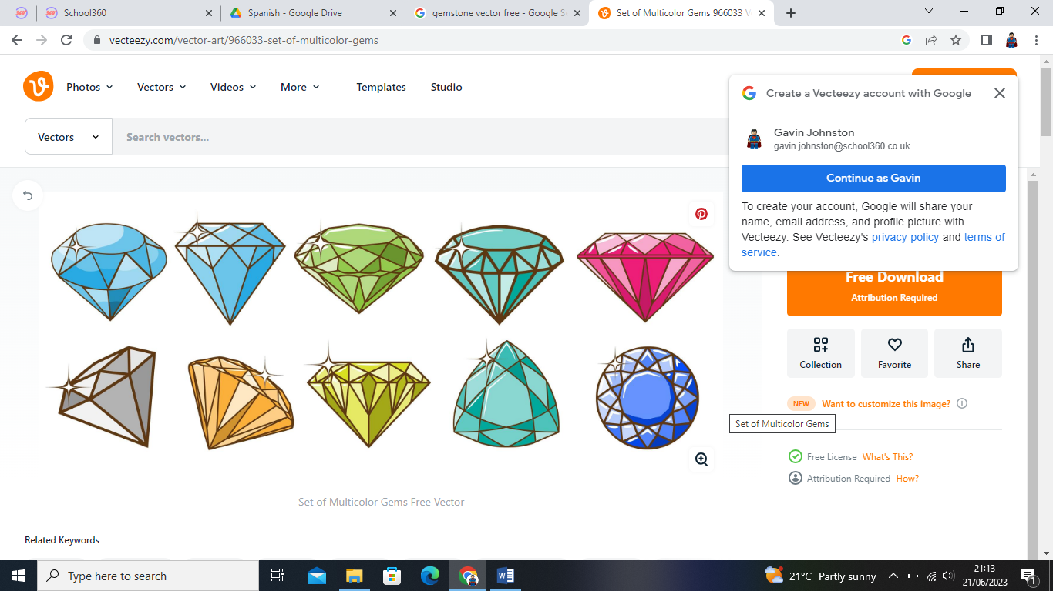
Welcome to the amber Class

Slide 2
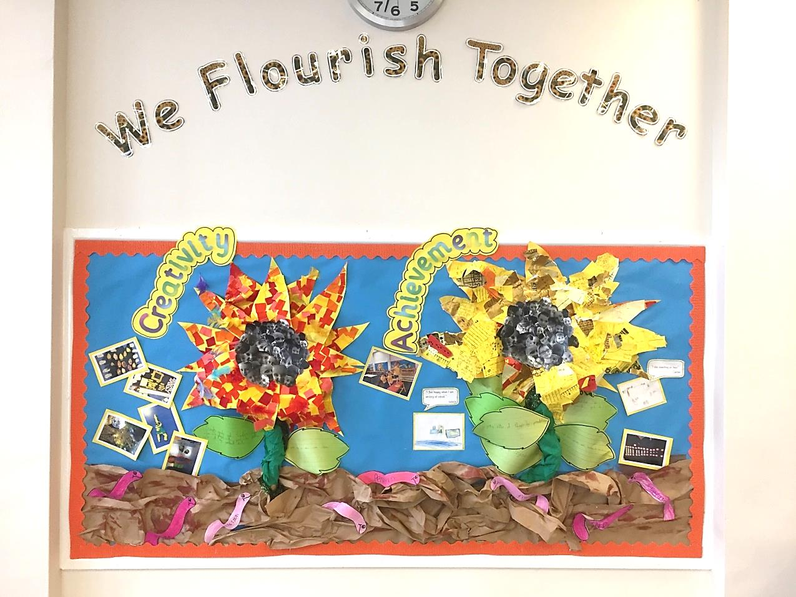
Our vision:
Achieving and growing together

Slide 3
Respect
Perseverance
Achievement
Notes:
A curriculum equation

Slide 4
School rules
Keep hands, feet and objects to ourselves
Use quiet, calm voices (no bad language)
Always follow teacher instructions
Care for the school environment

Slide 5
Attendance and punctuality
School begins at 8.45am for all children
Breakfast clubs runs from 7.30am if needed
Children should be at school every day and on time
Good attendance and punctuality sets good habits for the future.

Slide 6
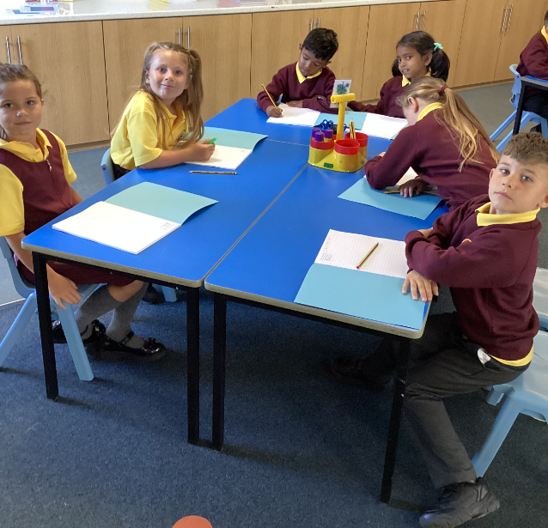
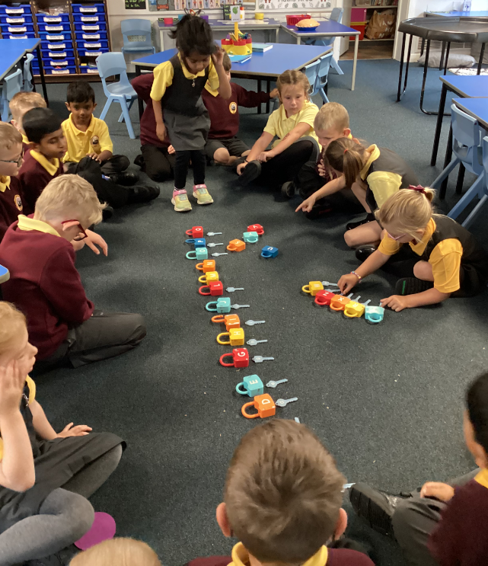
NEW Uniform
Smart school uniform sets the tone for a day of learning.

Slide 7
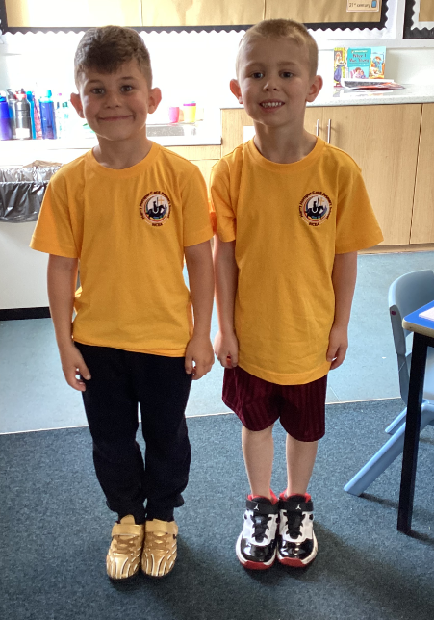
PE – Physical education
PE is part of the National Curriculum.
Our PE days are Wednesday (inside) and Friday (outside).
We are lucky to have coaches from Trident Soccer and Northumberland Cricket
Children are to come in their PE tops or school T-shirt for the day.
Children can wear black tracksuit bottoms and jumpers if it is cold. Usually shorts.
Other clothing is not allowed.
(Swimming kit and days / costs)

Slide 8


We are a reading School!
Our ambition is for every child to read by 7 using a synthetic phonics approach and to develop a love of reading for fluency and comprehension in order to access a broad and balanced curriculum. We do everything to make this happen.

Slide 9
RWInc – our method to teach phonics
Reading
When using RWI to read the children will:
Learn 44 sounds and the corresponding letter/letter groups using simple prompts
Learn to read words using sound blending (Fred talk)
Read lively stories featuring words they have learnt to sound out
Show that they comprehend the stories by answering 'Find It' and 'Prove It’
Mrs Redpath is our phonics leader.
Children will read every day in school and we expect them to read every day at home.

Slide 10
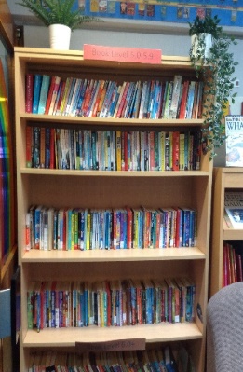
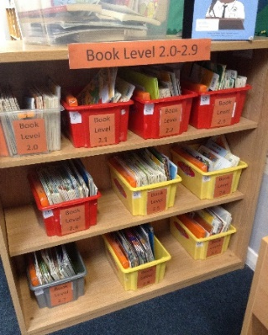
Accelerated reader – a love of reading
What is Accelerated Reader?
Accelerated Reader is a computer program that helps teachers and librarians manage and monitor children’s independent reading practice. Your child picks a book at their own level and reads it at their own pace. When finished, your child takes a short quiz on the computer. (Passing the quiz is an indication that your child understood what was read.) Accelerated Reader gives children and teachers feedback based on the quiz results, which the teacher then uses to help your child set goals and direct ongoing reading practice

Slide 11
Spellings – earn 200 points from the menu!
50 point spelling activities:
Rainbow words: copy your spellings at least three times in different colours
Draw your words: draw and label each of your spellings
ABC words: write your words in alphabetical order
Silly sentences: write a ‘silly’ sentence for each of your words
Poem spellings: write a poem with at least 5 of your words
Colourful words: write your spellings with one colour for vowels and another for consonants
Backwards words: write your spellings backwards
Highlight: write your spellings out and use a highlighter for the trickiest part of each word
CAPITALS: write your spellings in capital letters

Slide 12


homework
Homework is KS1 and 2 consists of 3 parts:
  Daily reading
  Spelling
  Maths – Numbots or TTRockstars
  It is set on a Monday and ‘collected’ on a Friday.
  This sets good habits for moving on in education and the world of work.
  It is tightly focused on core learning – it helps to build perseverance.
  Teachers will keep a record of children who complete homework.

Slide 13
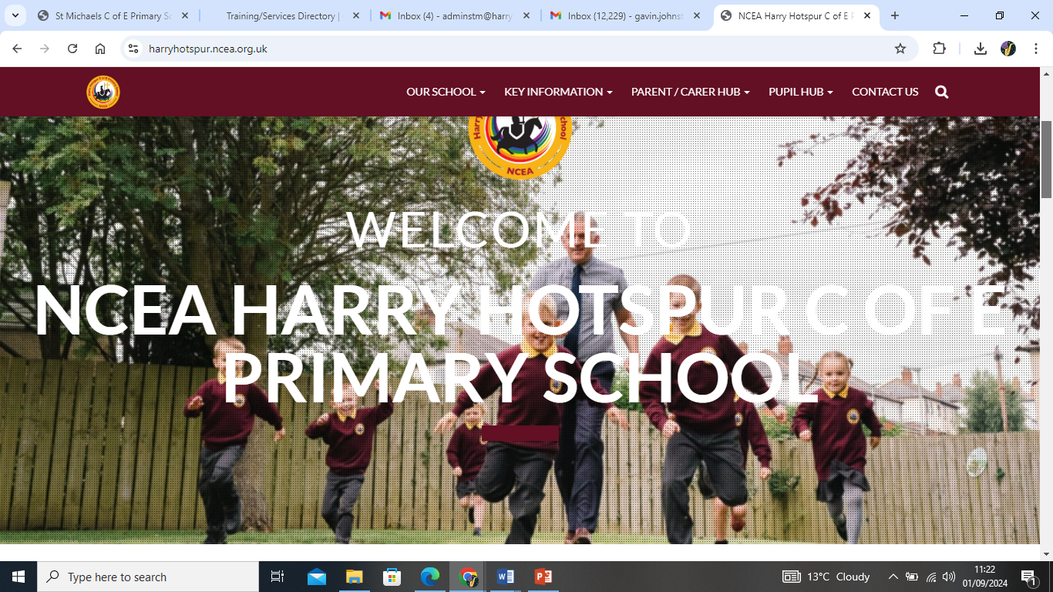
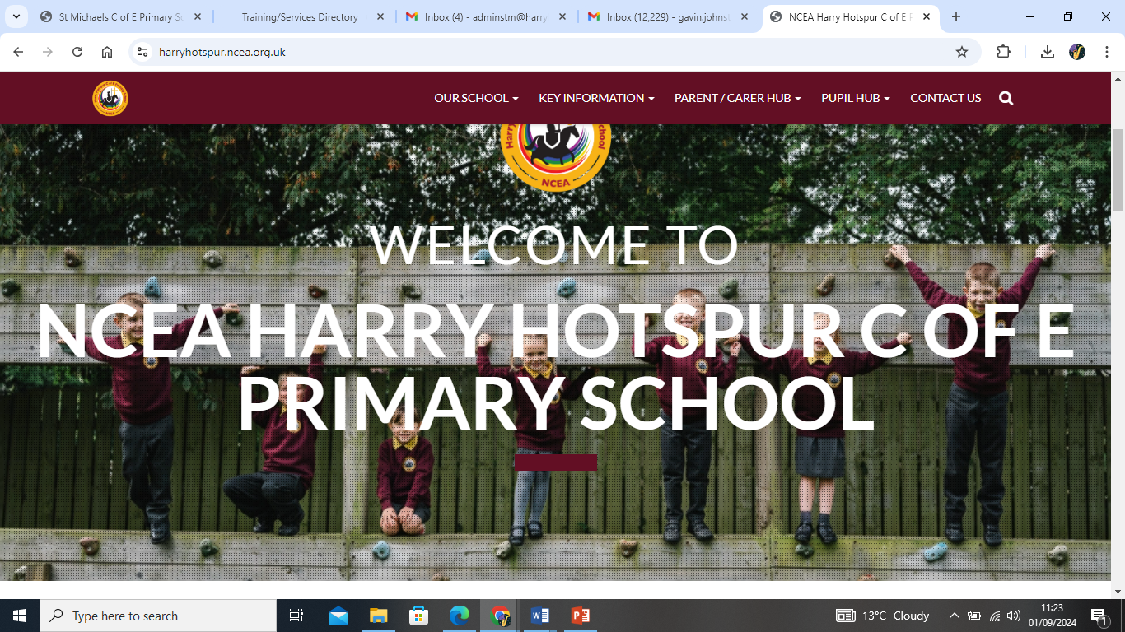
How to find out more
Our school website: https://harryhotspur.ncea.org.uk/

Slide 14

If you need to talk to us…
We can pass on small pieces of information at the beginning of the day.
If you would like to talk more in-depth, please make an appointment with the office. We’re here to listen and address things as soon as possible.

