Slide 1



Welcome to the RUBY Class

Slide 2
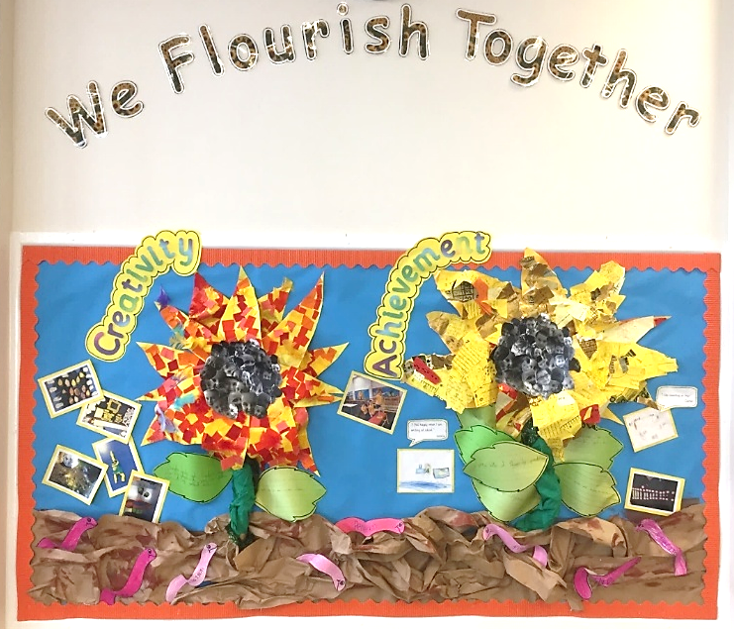
Our vision:
Achieving and growing together

Slide 3
Respect
Perseverance
Achievement
Notes:
A curriculum equation

Slide 4

School rules
Keep hands, feet and objects to ourselves
Use quiet, calm voices (no bad language)
Always follow teacher instructions
Care for the school environment
We adapt this to ensure it is EY’s appropriate using
Mr Potato Head.

Slide 5
Attendance and punctuality
School begins at 8.45am for all children
Breakfast clubs runs from 7.30am/after school club until 5.30pm. R to Y6
Children should be at school every day and on time
Good attendance and punctuality sets good habits for the future.

Slide 6
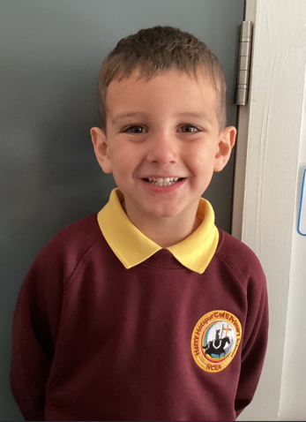
Uniform
Smart school uniform and black school shoes.

Slide 7
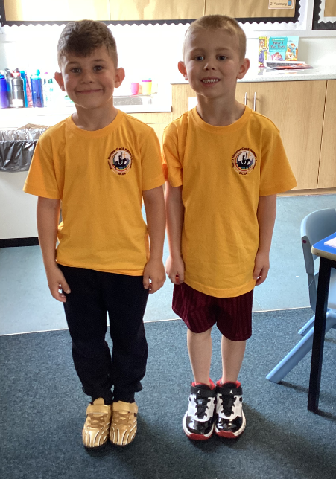
PE – Physical education
PE is part of the National Curriculum.
Our PE day in Thursday. PE is in the afternoon.
Children are to come in their PE tops and school jumper and either black or burgundy shorts or tracksuit bottoms and trainers.
Other clothing is not allowed.
Swimming

Slide 8

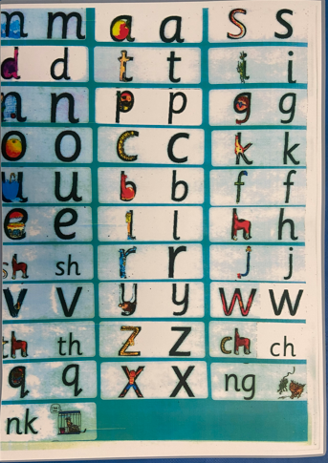
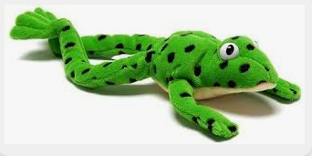
We are a reading School!
Our ambition is for every child to read by 7 using a synthetic phonics approach and to develop a love of reading for fluency and comprehension in order to access a broad and balanced curriculum. We do everything to make this happen.

Slide 9
RWInc – our method to teach phonics
Reading
When using RWI to read the children will:
Learn 44 sounds and the corresponding letter/letter groups using simple prompts
Learn to read words using sound blending (Fred talk)
Read lively stories featuring words they have learnt to sound out
Show that they comprehend the stories by answering 'Find It' and 'Prove It’
Mrs Redpath is our phonics leader.
More information will follow to allow you to support your child on this important journey.

Slide 10
homework
Homework is EYFS:
  It is set on a Monday and will be added to Tapestry to begin with.
  Homework in EYFS allows us to share the learning from school with home. It is a practical task to begin with aimed at supporting learning in school e.g. homework this week is to share a family photo that we can display in the home corner.
  As we move through the year the focus turns to reading. Supporting the children to read daily at home has a HUGE impact on their learning in every area. We work hard to get this right at the very beginning. We use reading incentives to get the children excited.
  Homework in the summer term may involve recording in a book.

Slide 11
Newsletter Information
Uniform Hub – Clean, good quality second hand items for a suggested donation of 50p, available from school.
Mobile Phones – Please remind children that phones should be turned off when on the school site (including playground)
Arbor App – Update your child’s details, check attendance, pay for trips, clubs and school meals.
Facebook – Keep up to date with what’s happening in school.
Water + Snacks
Please encourage your child to bring water to school. Fruit is provided for snack time.

Slide 12
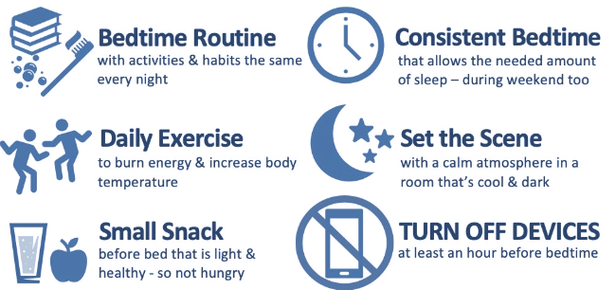
Bed Time

Slide 13
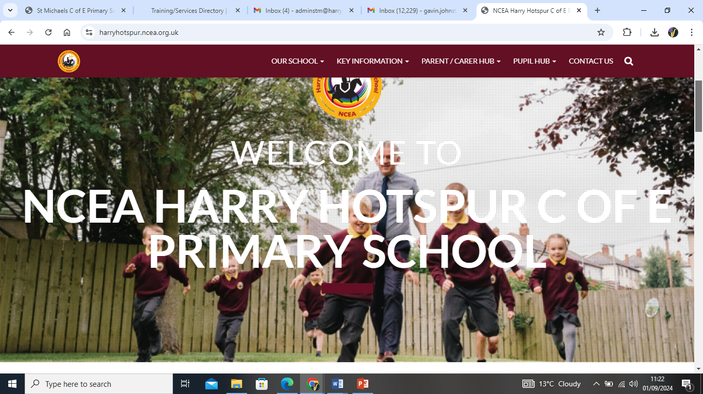
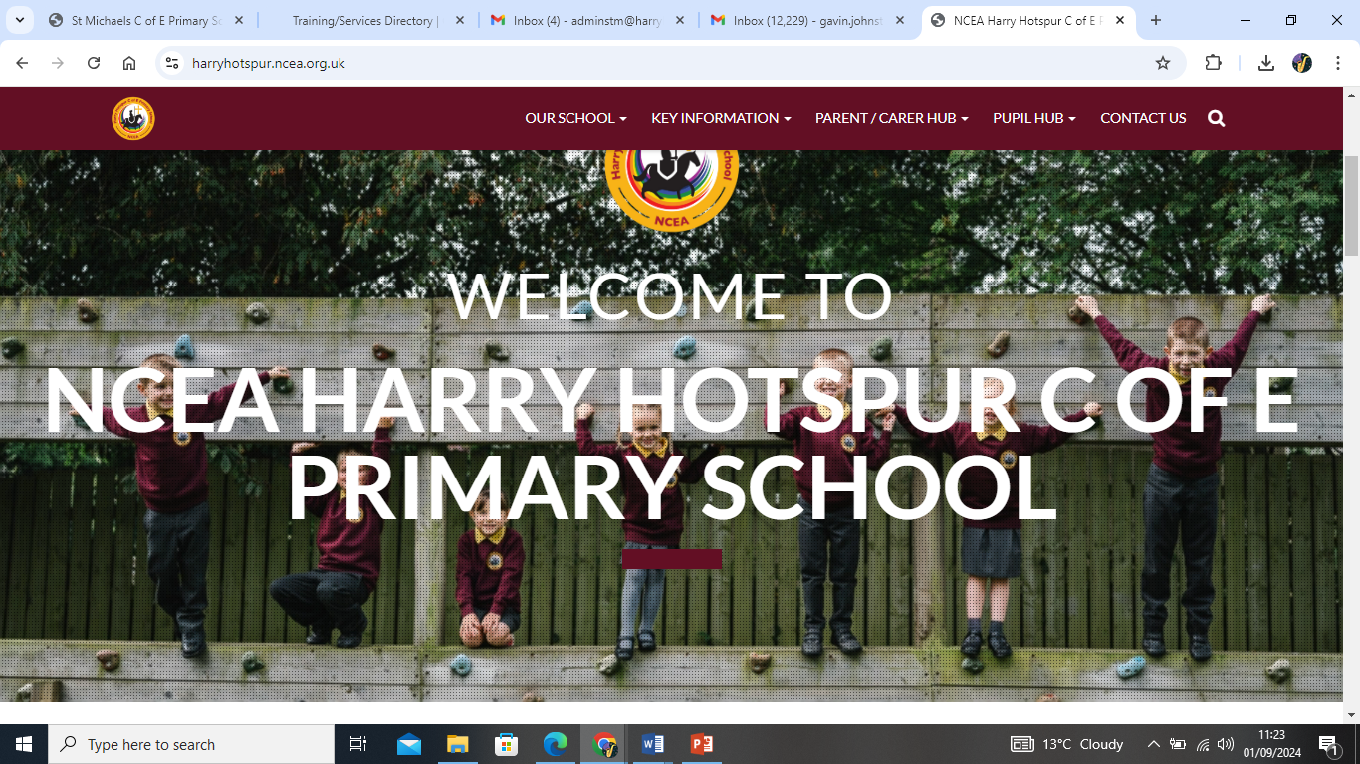
How to find out more
Our school website: https://harryhotspur.ncea.org.uk/

Slide 14

If you need to talk to us…
We can pass on small pieces of information at the beginning of the day.
If you would like to talk more in-depth, please make an appointment with the office. We’re here to listen and address things as soon as possible.

