Slide 1



Welcome to the EMERALD Class

Slide 2
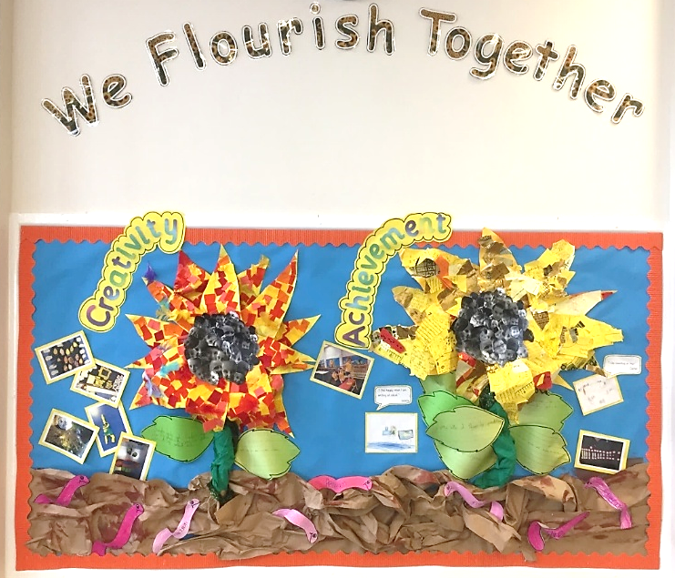
Our vision:
Achieving and growing together

Slide 3
Respect
Perseverance
Achievement
Notes:
A curriculum equation

Slide 4
School rules
Keep hands, feet and objects to ourselves
Use quiet, calm voices (no bad language)
Always follow teacher instructions
Care for the school environment

Slide 5
Attendance and punctuality
School begins at 8.45am for all children
Breakfast clubs runs from 7.30am/after school club until 5.30pm
Children should be at school every day and on time
Good attendance and punctuality sets good habits for the future.

Slide 6
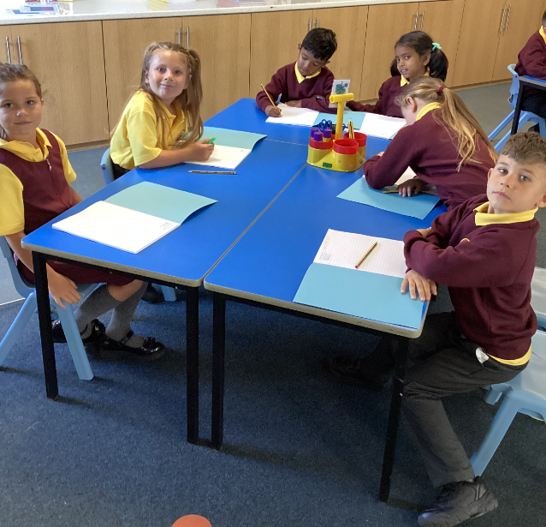
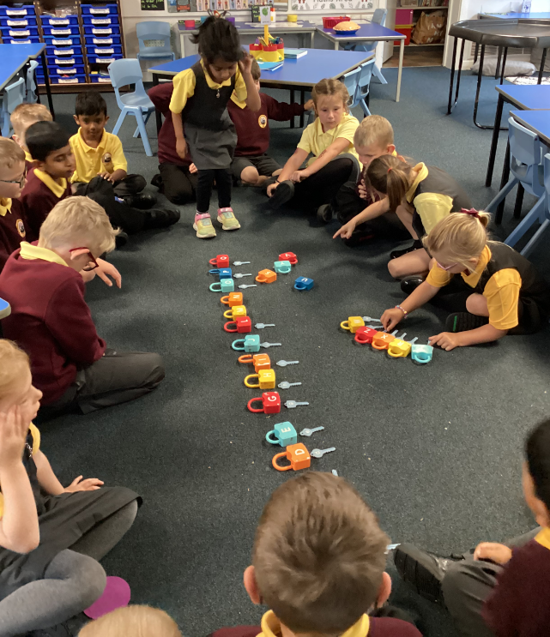
Uniform
Smart school uniform and black school shoes.

Slide 7
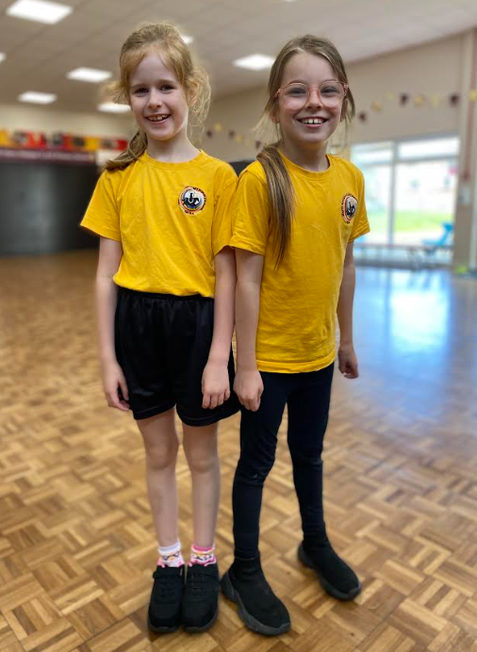
PE – Physical education
PE is part of the National Curriculum.
Our PE days are Thursday and Friday.
Children are to come in their PE tops. School T-shirt and either black or burgundy shorts or tracksuit bottoms and trainers.
Other clothing is not allowed.
Swimming

Slide 8


We are a reading School!
Our ambition is for every child to read by 7 using a synthetic phonics approach and to develop a love of reading for fluency and comprehension in order to access a broad and balanced curriculum. We do everything to make this happen.

Slide 9
RWInc – our method to teach phonics
Reading
When using RWI to read the children will:
Learn 44 sounds and the corresponding letter/letter groups using simple prompts
Learn to read words using sound blending (Fred talk)
Read lively stories featuring words they have learnt to sound out
Show that they comprehend the stories by answering 'Find It' and 'Prove It’
Mrs Redpath is our phonics leader.
Children will read every day in school and we expect them to read every day at home.

Slide 10
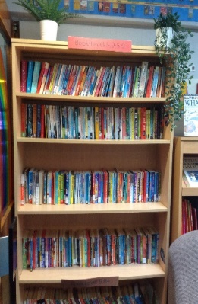
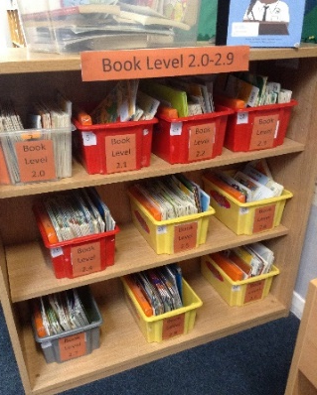
Accelerated reader – a love of reading
What is Accelerated Reader?
Accelerated Reader is a computer program that helps teachers and librarians manage and monitor children’s independent reading practice. Your child picks a book at their own level and reads it at their own pace. When finished, your child takes a short quiz on the computer. (Passing the quiz is an indication that your child understood what was read.) Accelerated Reader gives children and teachers feedback based on the quiz results, which the teacher then uses to help your child set goals and direct ongoing reading practice

Slide 11


homework
Homework is KS1 and 2 consists of 3 parts:
  Daily reading at home
  Spellings
  Maths – Numbots or TTRockstars
  It is set on a Monday and collected on a Friday.
  This sets good habits for moving on in education and the world of work.
  It is tightly focused on core learning – it helps to build perseverance.
  Teachers will keep a record of children who complete homework.

Slide 12
Newsletter Information
Uniform Hub – Clean, good quality second hand items for a suggested donation of 50p, available from school.
Mobile Phones – Please remind children that phones should be turned off when on the school site (including playground)
Arbor App – Update your child’s details, check attendance, pay for trips, clubs and school meals.
Facebook – Keep up to date with what’s happening in school.
Water + Snacks
Please encourage your child to bring water to school and any snacks should be less than 100 calories.

Slide 13
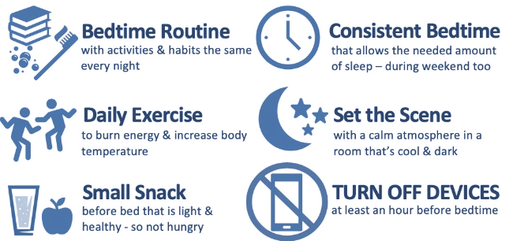
Bed Time

Slide 14
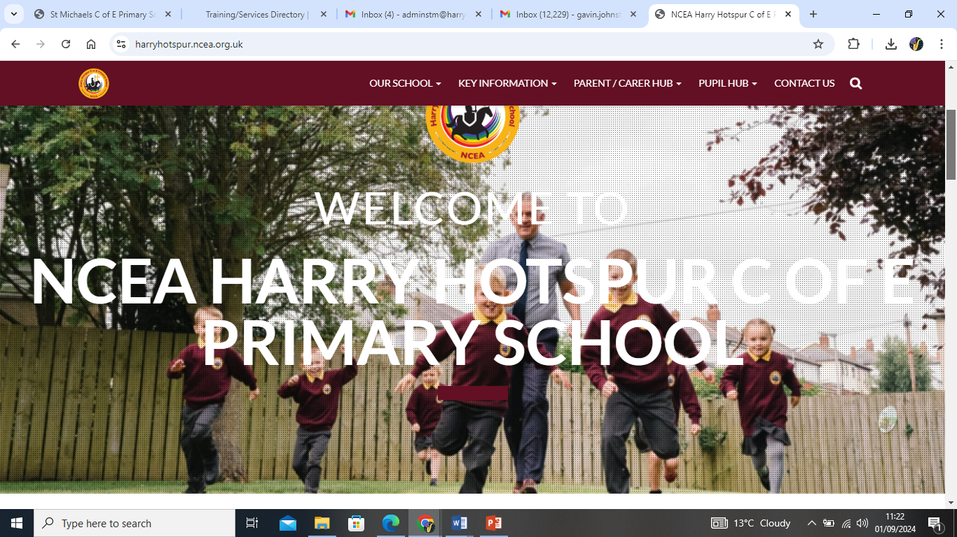
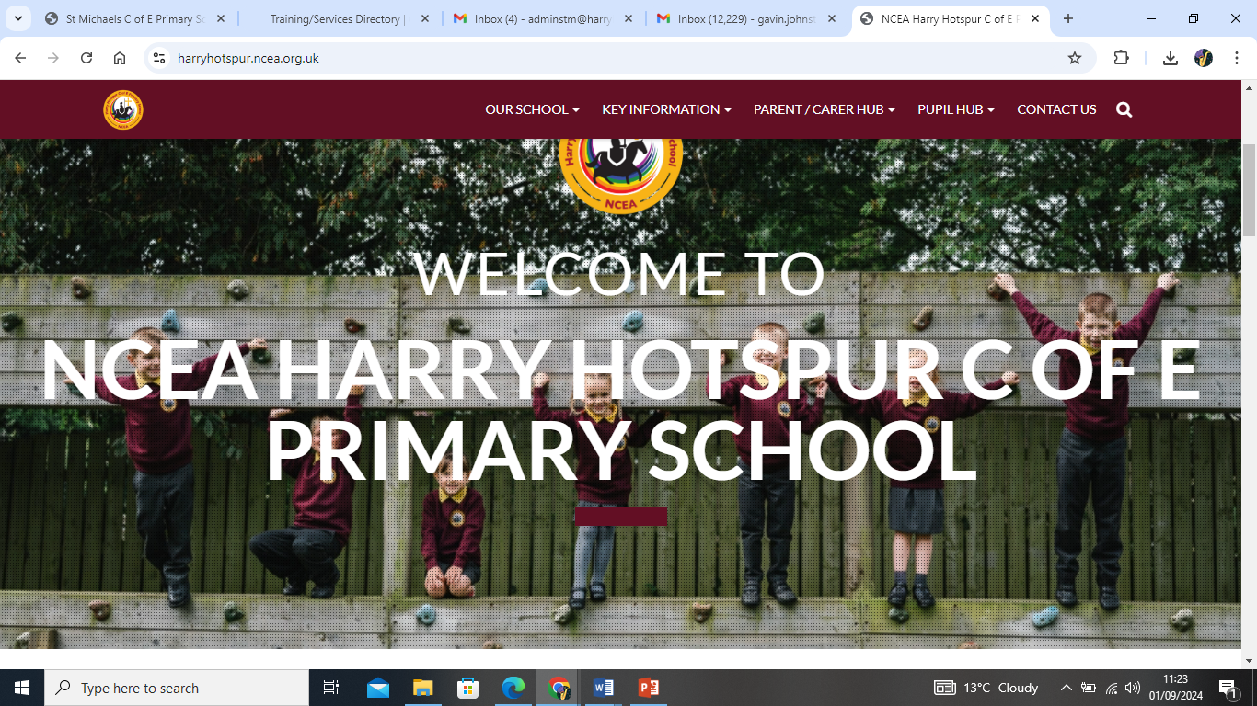
How to find out more
Our school website: https://harryhotspur.ncea.org.uk/

Slide 15

If you need to talk to us…
We can pass on small pieces of information at the beginning of the day.
If you would like to talk more in-depth, please make an appointment with the office. We’re here to listen and address things as soon as possible.

