Slide 1

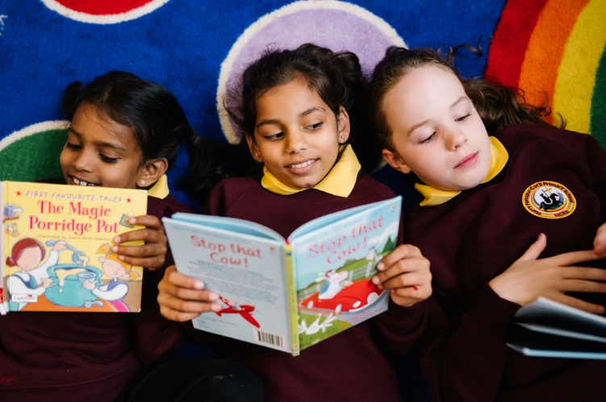
Reading at school and at home
Teach a child to read and keep that child reading and we will change everything.
And I mean everything.

Slide 2








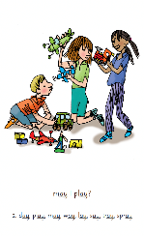
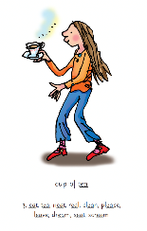

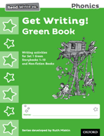
Who is RWI for and how is it taught?

Slide 3
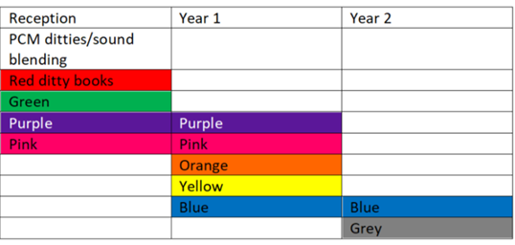
Progress groups
Group children by phonic stages.
Teach to the group’s challenge level.
Re-assess all children every half term.

Slide 4
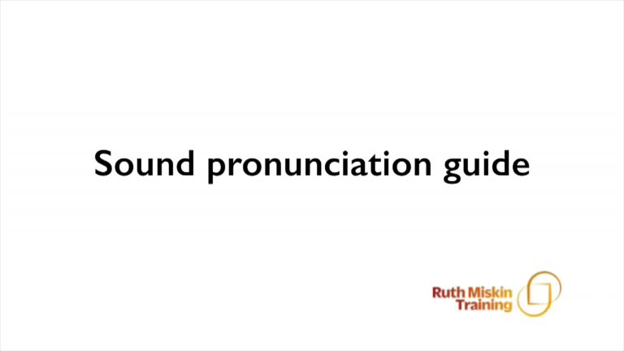
Pure Sounds
Notes:
Children need to know sounds – not letter names – to read words.
We say the sounds in a way to make them easy to blend into a word.
We aim to eliminate the ‘uh’ at the end of the sound. This is called a ‘schwa’ sound.
We say ‘c’ ‘a’ ‘t’ rather than cuh a tuh.
Use MTYT to teach each of the Set 1 sounds to parents.
You can watch this film of little Sylvie on the Ruth Miskin website to practise using pure sounds. Play a little bit of the video.

Slide 5
Set 2 and Set 3
Set 2 |  | Set 3
Sound | Mnemonic | Sound | Mnemonic
ay | May I play? | ea | Cup of tea
ee | What can you see? | oi | Spoil the boy
igh | Fly high | a-e | Make a cake
ow | Blow the snow | i-e | Nice smile
oo | Poo at the zoo | o-e | Phone home
oo | Look at a book | u-e | Huge brute
ar | Start the car | aw | Yawn at dawn
or | Shut the door | are | Care and share
air | That’s not fair | ur | Nurse with a purse
ir | Whirl and twirl | er | A better letter
ou | Shout it out | ow | Brown cow
oy | Toy for a boy | ai | Snail in the rain
 |  | oa | Goat in a boat
 |  | ew | Chew the stew
 |  | ire | Fire, fire!
 |  | ear | Hear with your ear
 |  | ure | Sure it’s pure

Slide 6
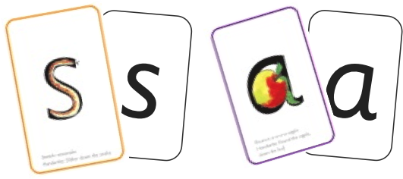
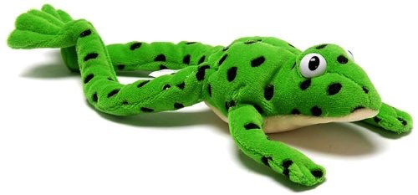

Sounds + Blending = Word reading
+
=

Slide 7


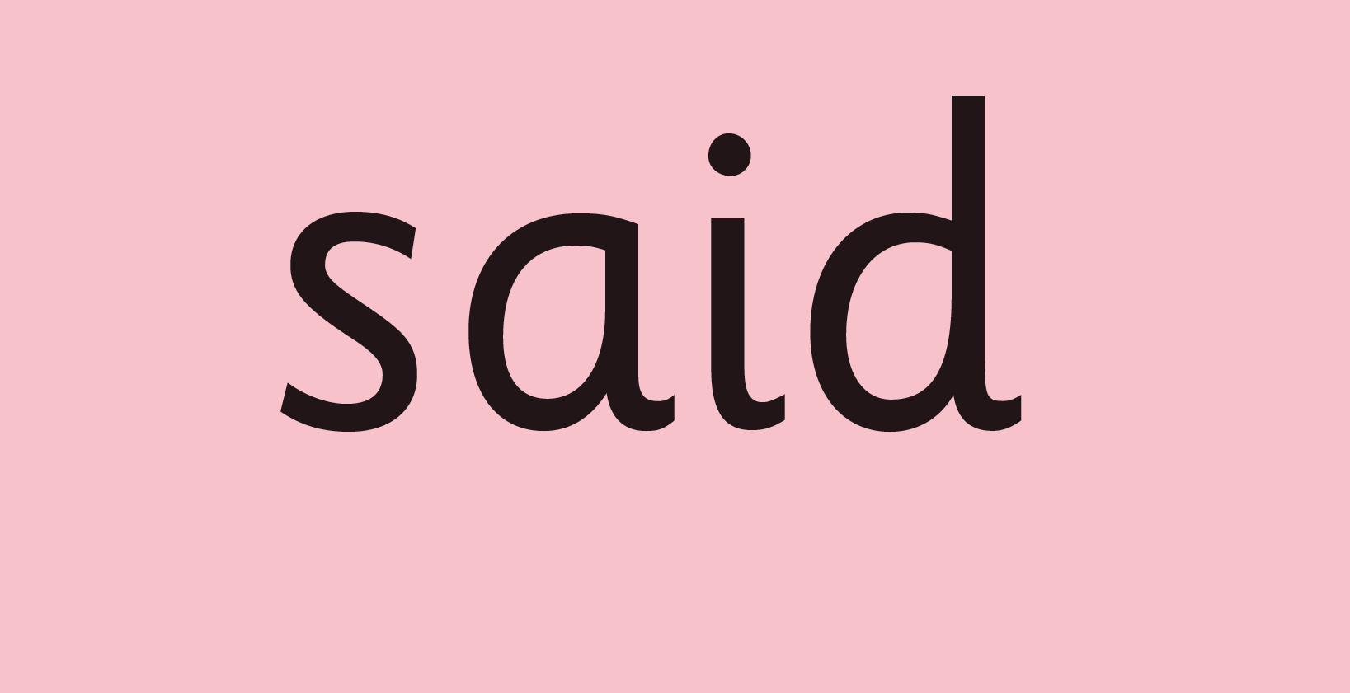
Green words and Red words

Slide 8
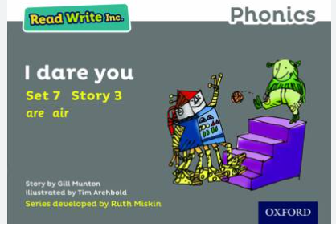
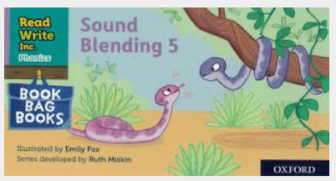
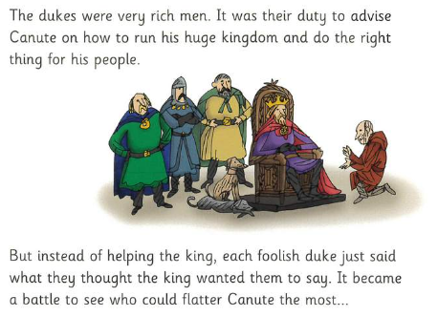
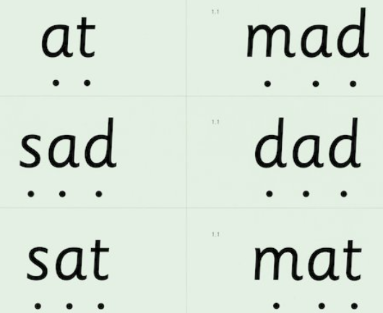
Progression

Slide 9
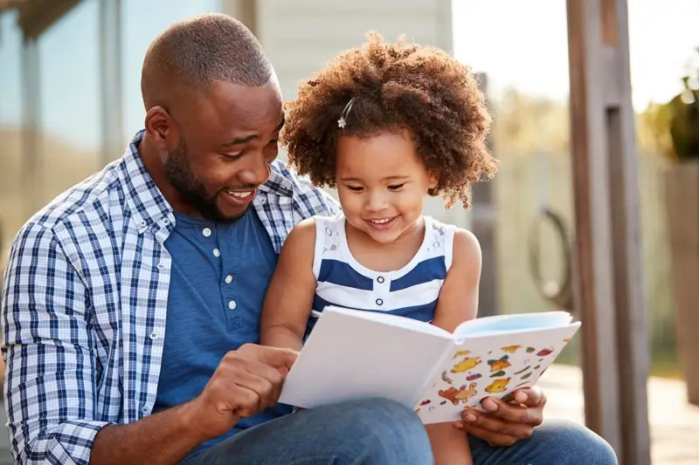
What can you do at home?
Listen to your child read their reading book
Ask your child to read the sounds and words before they read the story. They will enjoy teaching you to read these words too.
When your child reads the story, encourage them to read the word in Fred Talk if they hesitate or read it incorrectly. Praise them when they succeed.
Read back each sentence or page to keep the plot moving - your child’s energy is going into reading the words not the story.

Slide 10
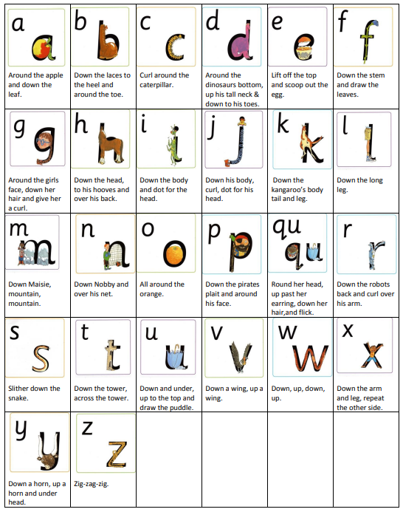
Set 2 |  | Set 3
Sound | Mnemonic | Sound | Mnemonic
ay | May I play? | ea | Cup of tea
ee | What can you see? | oi | Spoil the boy
igh | Fly high | a-e | Make a cake
ow | Blow the snow | i-e | Nice smile
oo | Poo at the zoo | o-e | Phone home
oo | Look at a book | u-e | Huge brute
ar | Start the car | aw | Yawn at dawn
or | Shut the door | are | Care and share
air | That’s not fair | ur | Nurse with a purse
ir | Whirl and twirl | er | A better letter
ou | Shout it out | ow | Brown cow
oy | Toy for a boy | ai | Snail in the rain
 |  | oa | Goat in a boat
 |  | ew | Chew the stew
 |  | ire | Fire, fire!
 |  | ear | Hear with your ear
 |  | ure | Sure it’s pure

Slide 11
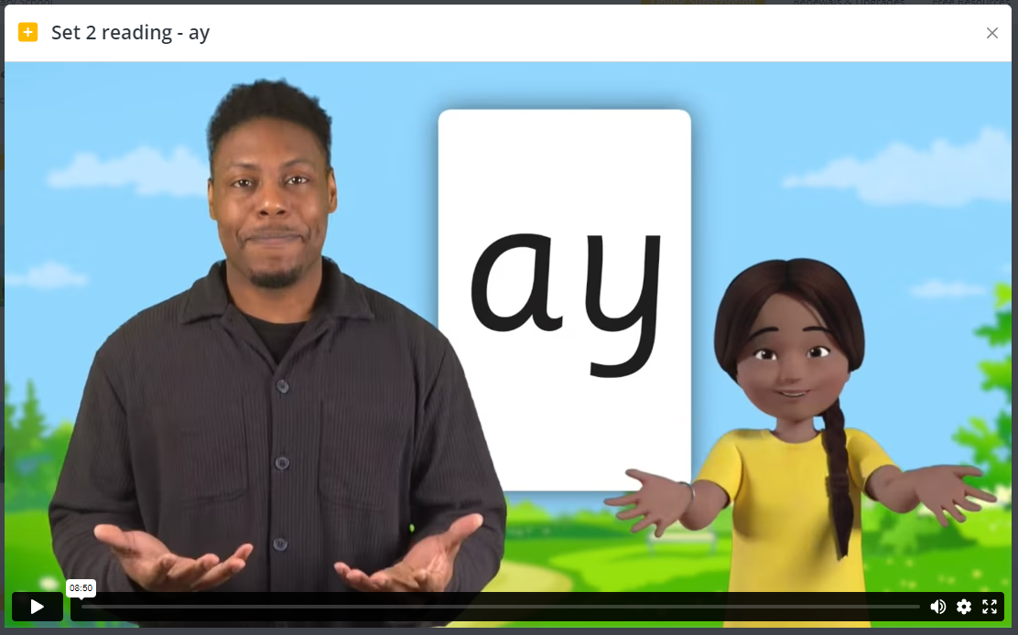
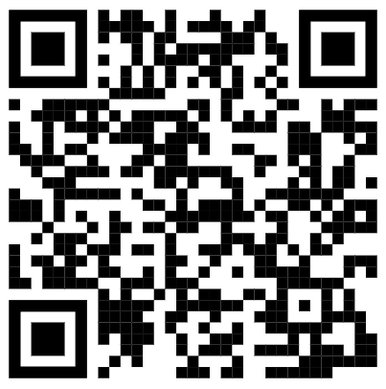
What can you do at home?
Use the QR codes to watch videos
Set aside 10 minutes to watch a film with your child.
Find a quiet space for your child to watch the film on a laptop or tablet.
Praise your child as they join in with the lesson – make it fun!
The more they practise using these films, the quicker they’ll learn to read.

Slide 12
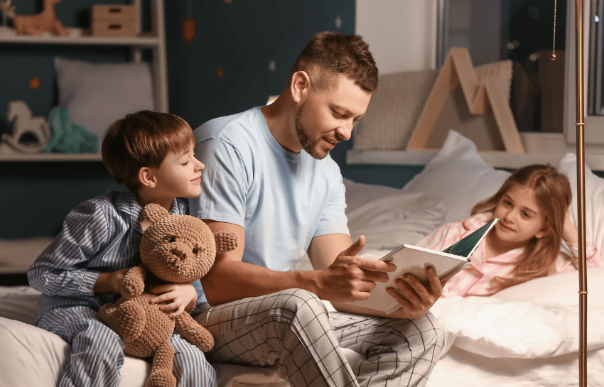
What can you do at home?
Read stories to your child
Read the same stories aloud again and again.
2. Read with enthusiasm – love each story.
3. Talk with your child as much as possible.

Slide 13


Slide 14
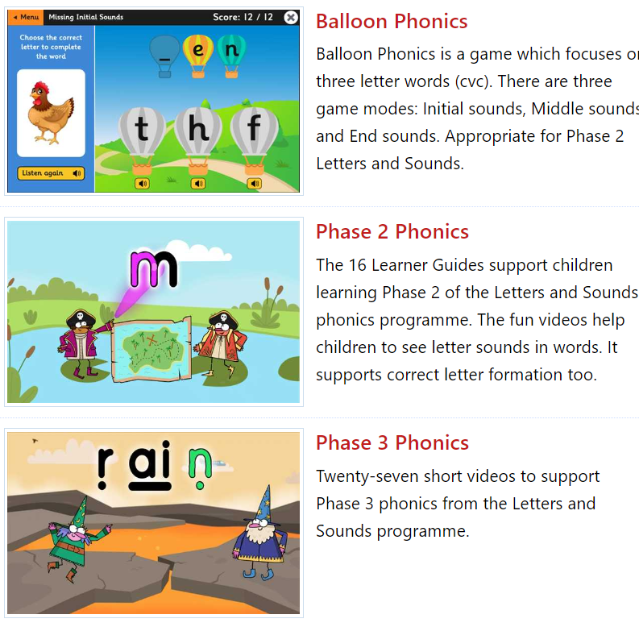
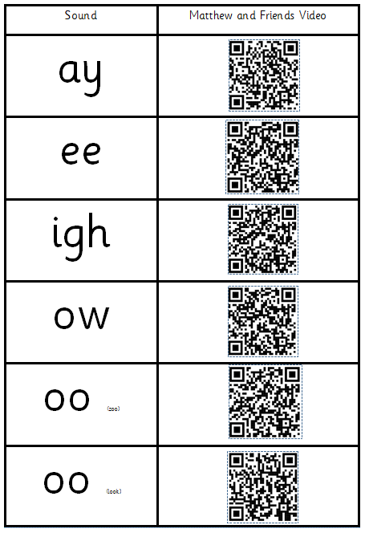
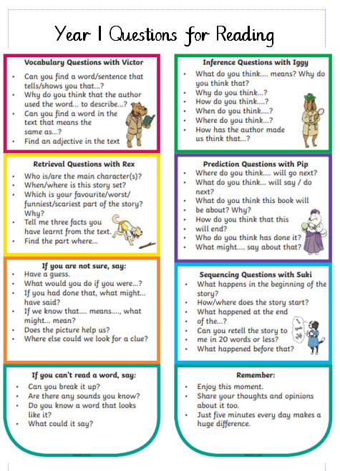
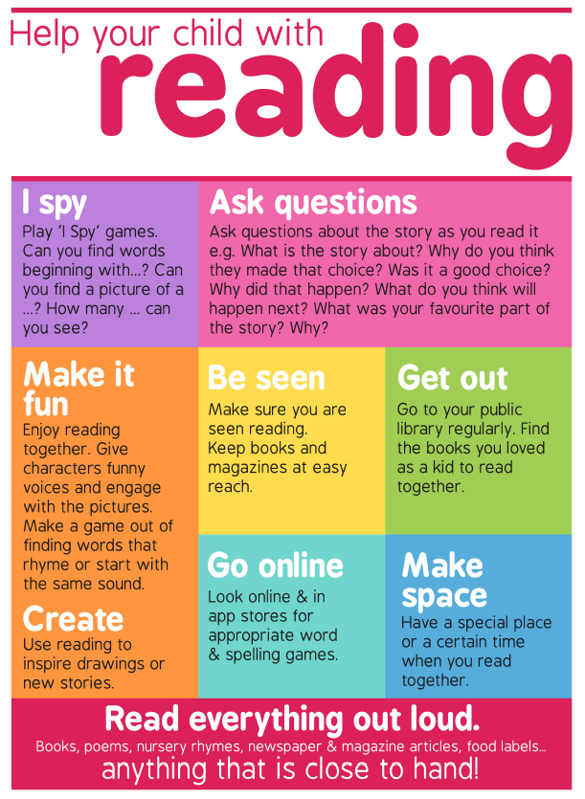
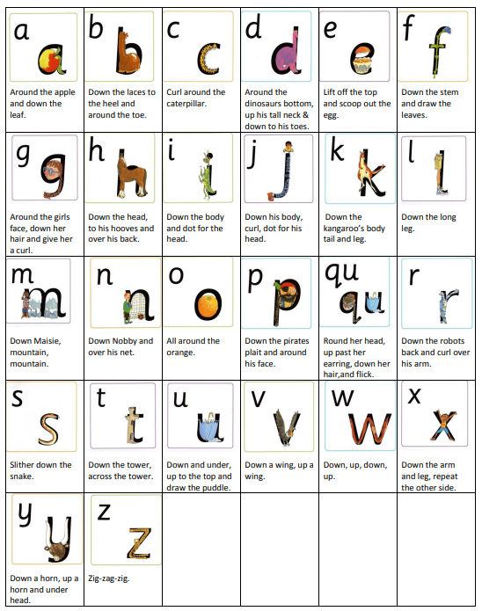
In your pack -

