Slide 1
Welcome to our Act of Worship
Castle School
Monday ^{15th} March 2021

Slide 2
In Secondary
Monday – Act of Worship
This is when we learn about the Bible
and we worship God
Friday – Let Your Light Shine
This is when we find out what fantastic things
you have been learning during the week
and when we give certificates for ‘Learner of the Week’

Slide 3
After you have had your class Act of Worship on Monday’s we would like you to put your Castle worship badge next to the ‘Thought of the Week’ display in the corridor.
Worship Badge
Worship Badge
Worship Badge
Worship Badge
Berwick Class
Norham Class
Aydon Class
Langley Class
Worship Badge
Etal Class

Slide 4
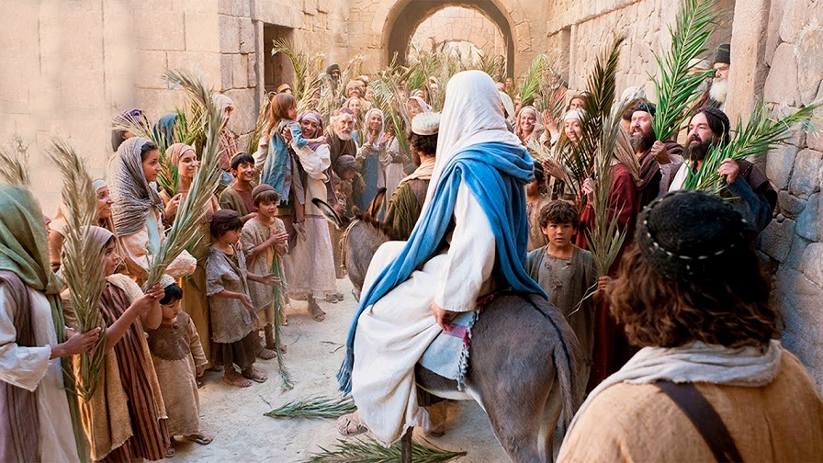
Our Act of Worship today is about Palm Sunday

Slide 5
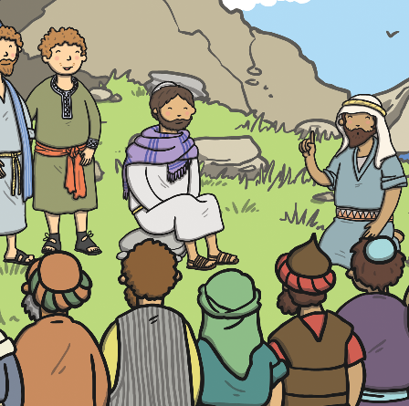
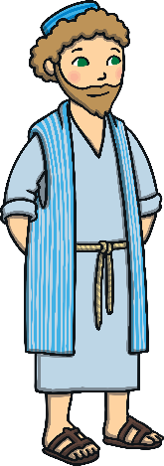
Jesus was famous for telling people to love one another and healing people who had been unwell. Lots of people loved him and believed he was the Son of God.
There were also people who didn’t believe in him and tried to find ways to get rid of him.

Slide 6
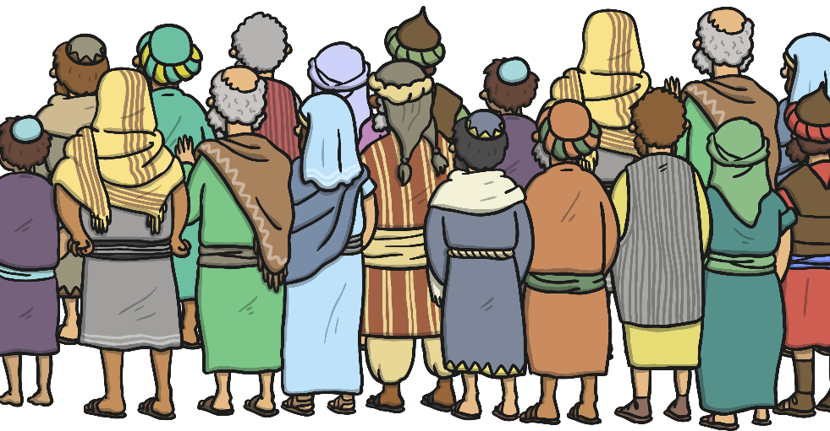
Jesus had come to Jerusalem with his loyal followers, called disciples, to celebrate Passover.
Crowds had gathered because they had heard Jesus was coming.

Slide 7
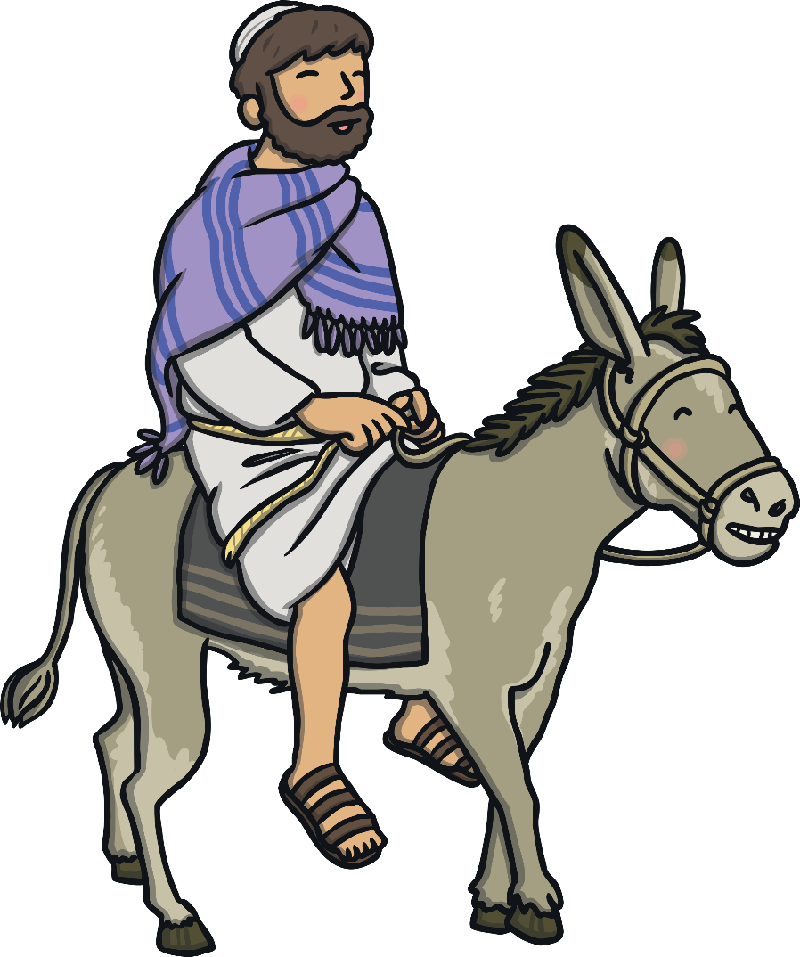
Jesus rode into Jerusalem on the back of a donkey.

Slide 8
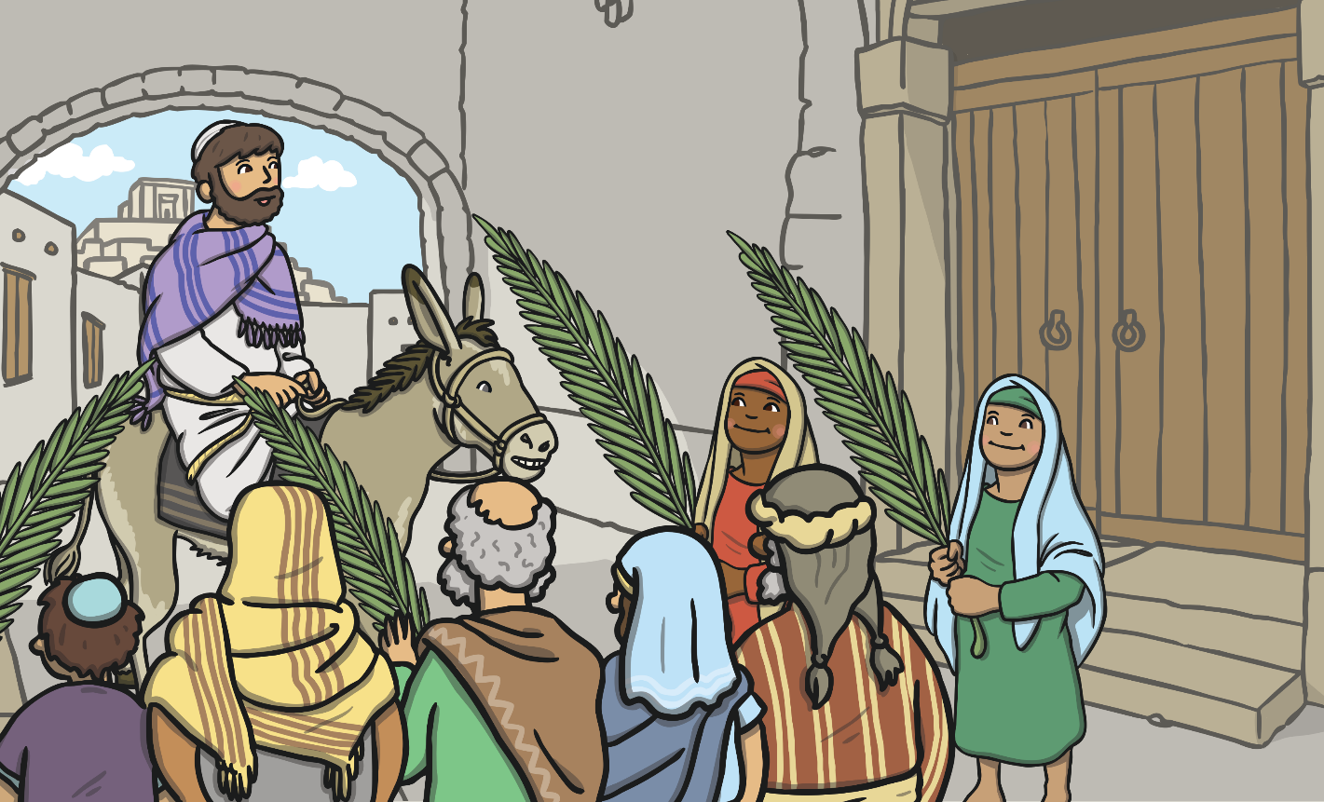
The people waved palm leaves and lay them in his path. They shouted, “Hosanna! Hosanna! Blessed is the King of Israel!”

Slide 9
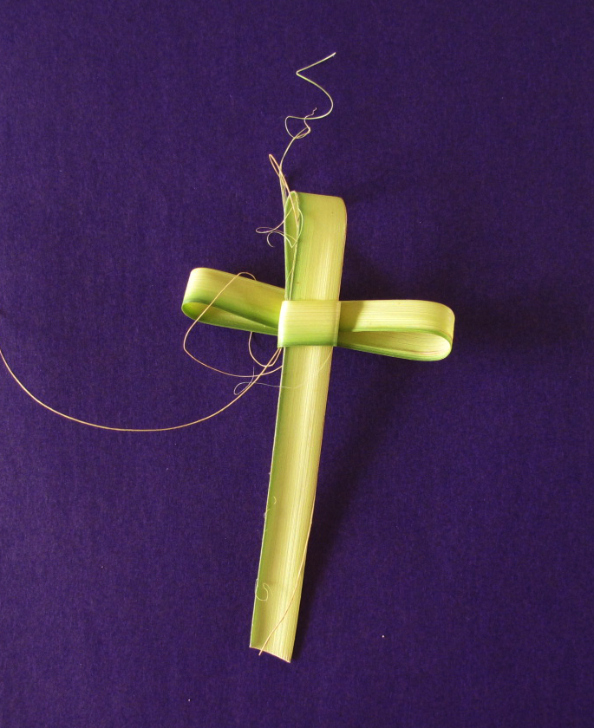
The day when Jesus arrived in Jerusalem is known as ‘Palm Sunday
On Palm Sunday, churches give people a cross made from a palm leaf.
Many churches have a procession around the church while people sing songs of praise and wave palm leaves.
This helps them to imagine what it was like for Jesus and the people in Jerusalem.
https://www.youtube.com/watch?v=MnOJN_0hBJk

Slide 10
Secondary Palm Sunday Procession
We are going to go into the corridor one class at a time with our palm leaves and have a procession – you can sing, dance, shout Hosanna!
You can watch at the window while each class passes by
When you get back into class we are going to have a Passover feast with your friends
Take some photos so we can share them with everyone

Slide 12
Dear God
Thank you that you sent your son Jesus
Thank you that we can celebrate
And have fun together
Amen

Slide 13
Thought of the Week

Slide 14
https://www.youtube.com/watch?v=96pcmyyHaZk

