Slide 1
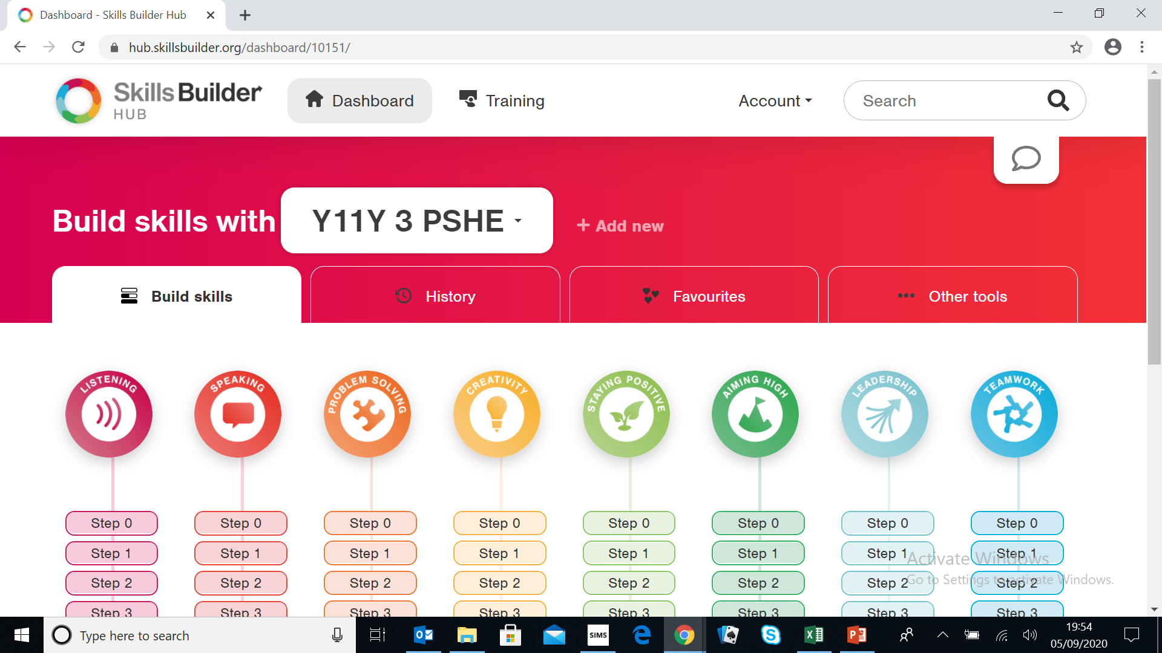
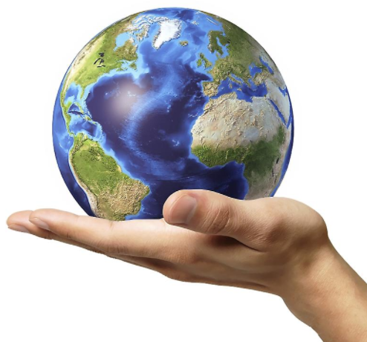


Y9 Employability Learning Journey
NAME |  | CLASS
Go to university to enhance your studies and get a degree
Start a degree level apprenticeship
Start a job
College, 6th Form or Apprenticeship
Continue your lifelong love of learning and personal development
Years 12 and 13
Apprenticeship Application Workshop
How to revise sessions
Individual and group Careers Interviews
Derbyshire Skills Festival
Raising Aspirations University Visits
NCS opportunities
Post 16 Evening
Derby College Visits
Enrichment Day
YEAR
Apply to become a Prefect and develop your leadership
skills
Stay at home or move away?
LMI and Hot and Cold Jobs
Interview Preparation
Applications and Back Up Plans
Qualifications Post 16
Options Post 16
Continuation of work on the 8 Skills Builder Employability Skills
11
CV Workshop
Work place Health and Safety
Derbyshire Skills Festival
Work Experience
Toyota Production Apprentice Days
Toyota Cadets
Health Care Insight Day
Mock Interviews
World of Work Days
Derby Public Speaking Competition
6th Form Visits
Work Experience Evening
CV Workshop
Enrichment Day
Continuation of work on the 8 Skills Builder Employability Skills
What is a CV and why do I need one?
What do I need to know about interviews?
Ways of working and LMI?
Finding a work experience placement
Coping with stress in the workplace
YEAR
Sign up for the Duke of Edinburgh award
10
Derby Scholars
Toyota Visits
IRail Day
Options Evening
Options talks
Industry Day and Progressions Pathway
Enrichment Day
What job / career might I be good at?
What subjects should I choose?
What qualifications can I take?
What am I good at?
What do I like?
Continuation of work on the 8 Skills Builder Employability Skills
Take part in activities outside school
YEAR
9
Represent school
Enrichment Day
Toyota / Learn By Design STEAM Club
Formula One Challenge
The Big Bang
YEAR
Continuation of work on the 8 Skills Builder Employability Skills
LMI (Labour Market Information) and Hidden Jobs
Employability – Company Presentation Challenge
Introduction to Career Pilot
Take part in Extra-Curricular activities
8
Enrichment Day
Toyota / Learn By Design STEAM Day
Derby University visit
YEAR
7
Buzz Quiz
What kind of animal am I?
Employability – Enterprise Challenge Competition
Introduction to the 8 Skills Builder Employability Skills
Introduction to the
CIEAG (Careers information, education advice and guidance at Murray Park
Develop a lifelong love of learning
PROUD TO BE HERE

