Slide 1
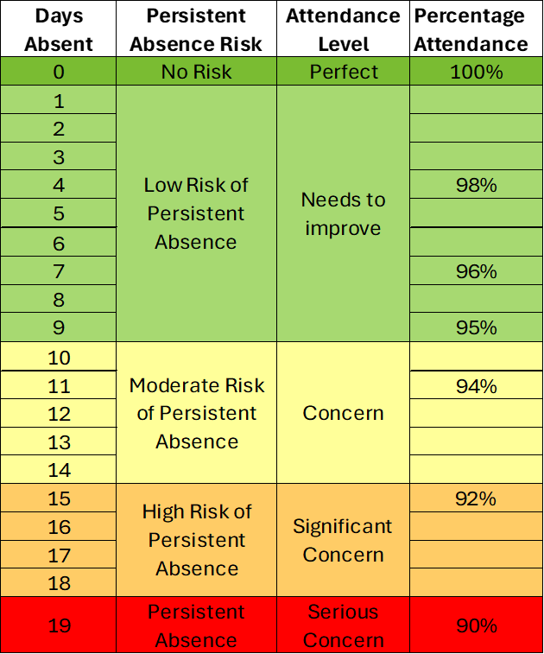
Attendance Levels
Level 1 1 – 9 days absence
Level 2 10 - 18 days absence
Level 3 19 days + absence
Universal
Targeted
Specialist

