Slide 1
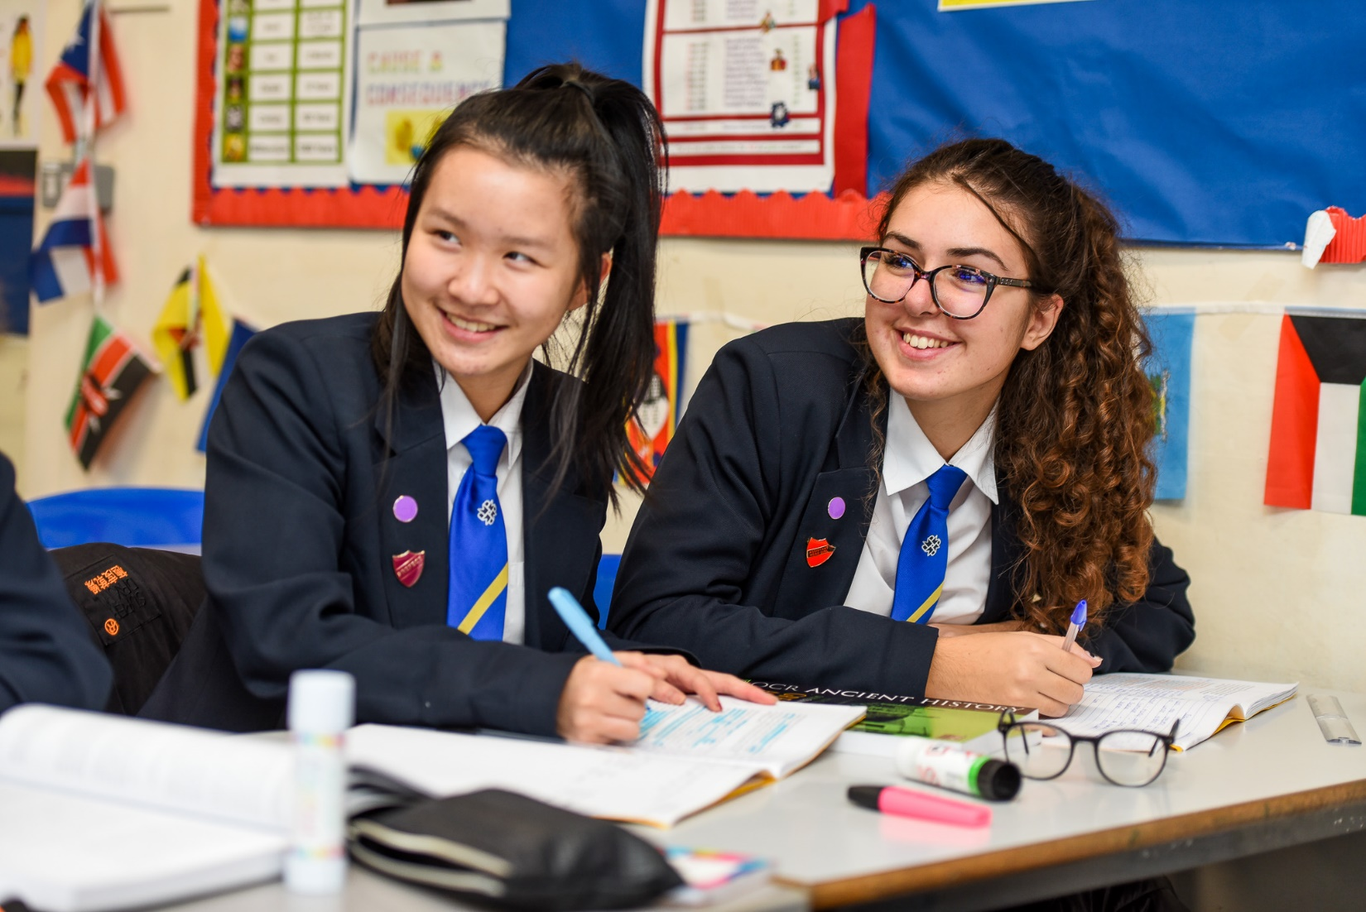
Murray Park School
Applicant Information Pack
Part Time Cleaner
Application deadline: | Monday 25th November 2024 at 9am
Interview Date: | W/C 2nd December 2024
Start Date: | 4th January 2025 (subject to satisfactory enhanced DBS clearance & references)
Murray Park School is committed to safeguarding and promoting the welfare of children and appointment to this post is subject to a criminal record and background check and references
Head Teacher: Mrs N. Caley
Address: Murray Road, Mickleover, Derby, DE3 9LL
Telephone: 01332 515921
Web: www.murraypark.derby.sch.uk
Recruitment Email: recruitment@murraypark.derby.sch.uk

Slide 2
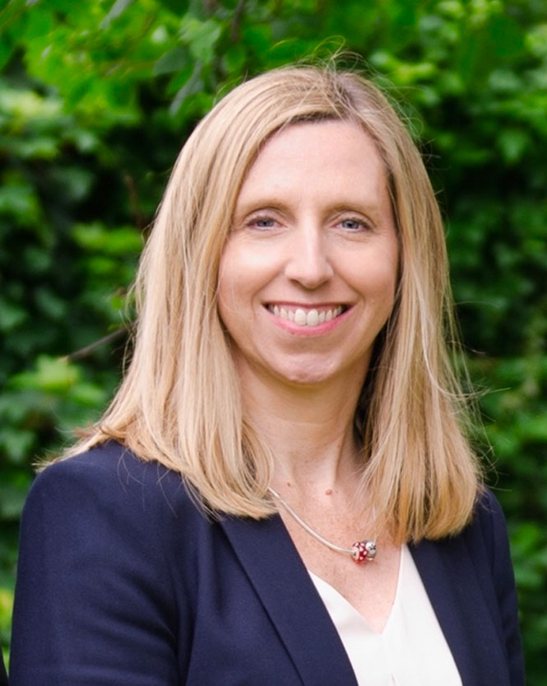
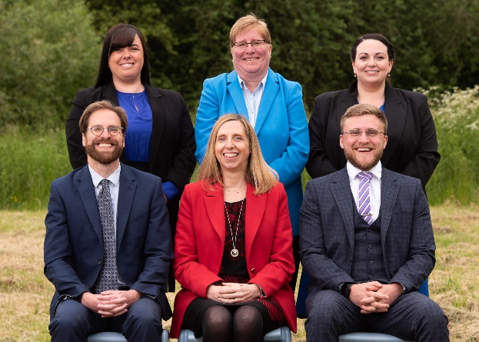
Our Headteacher
I am delighted to introduce you to our wonderful school. Since my arrival in 2018, I have sought to create a thriving working environment which enables our wonderful students to succeed in all aspects of life at Murray Park and beyond. It was great for this to be recognised by Ofsted in September 2022 when we achieved our Good judgement.
We pride ourselves on giving teachers the conditions in which to teach without distraction and ensure that all staff are supported quickly with any concerns both in and outside the classroom.
We are fully committed to offering a top-class education – on-line or in school – which keeps abreast of national and international trends. We welcome applications from high-quality candidates who are looking to make a real difference to our students' lives.
We support all new staff with a supportive induction package. ECTs follow the Derby City new teacher
programme as well as our in-house training. We endeavour to ensure your skills are developed so you can perform at your optimum.
Please take your time to consider the information in this pack and do not hesitate to make contact with us should you require any further information.
I wish you the best of luck with your application to our school.
Mrs N. Caley
Senior Leadership Team
Nicola Caley – Headteacher
Rebecca Somes – Deputy Headteacher
George Hagen – Deputy Headteacher
Theresa Lucas – Assistant Headteacher
Nick Lynn – Assistant Headteacher
Leanne Dodd – Assistant Headteacher
“Being a teacher at Murray Park is a privilege, providing me with the opportunity to be part of a community with shared values…”
Flavia Kupferberg – Teacher of English

Slide 3
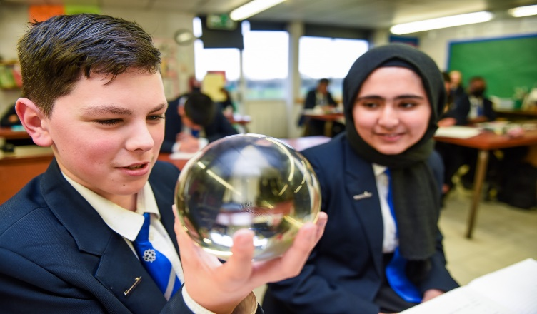
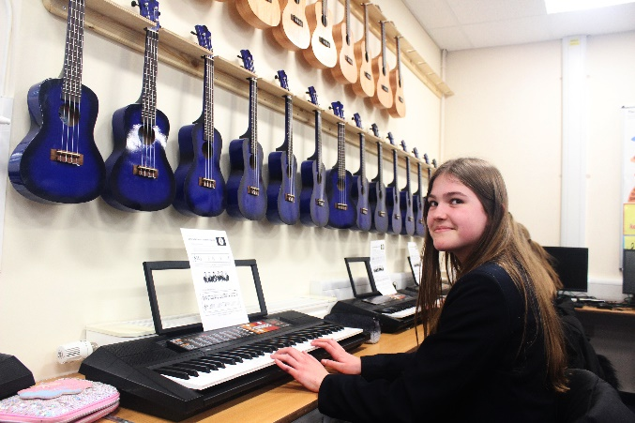
Ambition Statement
At Murray Park School, our curriculum vision is to provide an ambitious and inspirational education for all of our pupils. Our strong set of values: Perseverance; Respect; Independence; Dreams and Excellence (PRIDE) underpins our ethos. Through our curriculum, our pupils develop the confidence to embrace the responsibilities that life has to offer and to become valued members of the local community, both now and in the future.
In all lessons the pupils are challenged and engaged in an education that prepares them for their futures. Our Learning Motto, OASIS, enables all of our pupils to develop life skills, such as, creativity, empathy and collaboration, resulting in resilient individuals with high aspirations.
Our health and wellbeing provision ensures that our pupils lead healthy and fulfilling lives and that every pupil has the knowledge and confidence to take care of their own physical and mental wellbeing.
As a result of our outstanding careers programme, all of our pupils are prepared for the next stage of their education, training and employment through our extensive network of business partners and dedicated careers’ centre. Our wide range of extra-curricular activities include residential opportunities and international travel. These opportunities enrich the formal curriculum and deepen the pupils’ knowledge and skills.
Every child at Murray Park School is equipped to become a well-qualified and successful young person.
“ The supportive atmosphere created by amazing, dedicated colleagues and students that genuinely appreciate what you do for them , gives me a reason to smile every day.” (Miss Dodd – Assistant Headteacher)

Slide 4
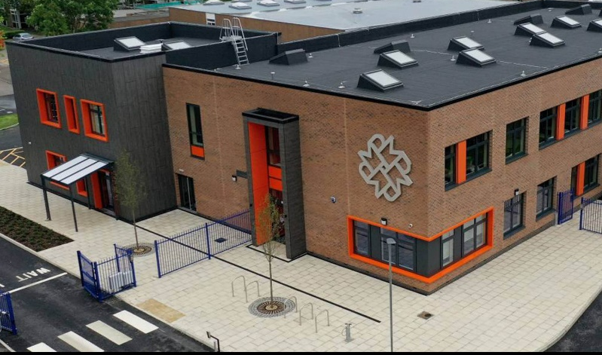
School Information
Murray Park is a dynamic and forward-looking 11-16 mixed comprehensive school on the western fringes of the city of Derby. It is a Foundation Status school but has a close working relationship with the local authority.
We cater for approximately 1200 students, situated on a spacious site surrounded by greenery. We serve students from the Derby City area, within reach of the Derbyshire countryside and our cohort sizes are growing each year.
Our students reflect the full academic ability range and there is a breadth to the socio-economic status of our families.
Application Process
recruitment@murraypark.derby.sch.uk
Informal visits to the school are available but not essential. You must complete the application form fully and give details of all employment, training and gaps in employment since leaving secondary school to the present day. Any additional information, which you wish to bring to the notice of the selection panel should be included in your letter of application.
Your letter of application should make reference to the job description and in particular how you meet the person specification. At least one of your references should be a current employer and you should indicate if you are happy for us to contact each reference.
Please provide an email address for your referees so that we can contact them.
Please email your completed application form and letter of application to:
Murray Park School is committed to safeguarding and promoting the welfare of children and appointment to this post is subject to a criminal record and background check and references
“Murray Park is a fantastic school to work for, I've felt extremely welcome and supported by the school, first as a trainee and then as a new starter.”
James Murton – Teacher of English

Slide 5
Ofsted
Our School was inspected in September 2022 and gained a Good judgment from Ofsted. Here are just a few quotes from their highly positive report. To access our full report please use our website link:
Ofsted Reports | Murray Park
Quality of Education | “Leaders have designed an ambitious curriculum that allows pupils to learn a broad range of knowledge.” “Leaders have planned assessments to check pupils' understanding.”
Behaviour and Attitudes | “Pupils are happy and safe at Murray Park. They know teachers care about them.” “Leaders have ensured that classrooms are places where pupils can learn.”
Personal Development | “The 'Charter for Success' encourages pupils to engage in activities such as theatre trips and cookery.” “Leaders ensure that all pupils have opportunities to gain different cultural experiences.”
Leadership and Management | “Leaders have prioritised reading.” “Leaders have created a culture of safeguarding.”
SAFEGUARDING INFORMATION
Murray Park School shares a commitment to safeguard and promote the welfare of children and young people. Our commitment is underpinned by robust processes and procedures that seek to maximise opportunity, minimise risk and continuously promote a culture that embraces the ethos of safeguarding amongst our workforce.
This post is Exempt from the Rehabilitation of Offenders Act 1974 and the amendments to the Exceptions Order 1975, 2013 and 2020 and is subject to an enhanced DBS Disclosure check.
Recruitment Information
The application form must be completed in line with our Important Recruitment Information section on the school website. It is an offence to apply for the role if you are barred from engaging in regulated activity relevant to children.
Child Protection and Safeguarding Policy
Recruitment of Ex Offenders
The Equality and Diversity Form
GDPR Privacy Notice
Recruitment Policy
These documents can be found using following the link: https://www.murraypark.derby.sch.uk/key-information/vacancies/
“Since starting at Murray Park there has been no time for nerves, just excitement. I am delighted to continue my journey here, whilst inspiring others on my way.”
Charlotte Bunting – Teacher of Science

Slide 6
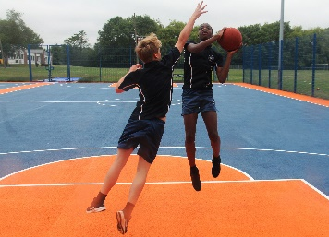
Staff Well-being
Murray Park considers the well-being of staff to be important. When we make strategic or operational decisions, we always consider the well-being and workload of staff. See below for some of the ways we support staff wellbeing and workload for all our team:
 | Opportunity for flexible working for all staff
 | A robust and centralised behaviour system, including an internal Alternative Provision.
 | A designated, trained, mental health leader.
 | A Leadership Team who fully consider staff workload and wellbeing when considering any changes to practice or systems.
 | Paid lunch duties, including a free meal.
 | CPD for all staff, in all roles, including whole-school and opportunities for any bespoke courses.
 | Latest technology, including new laptops for teachers.
 | A measured approach to data management, including meeting free weeks during data points.
 | An approach to pedagogy that ensures we deliver high-quality teaching in each and every lesson, whilst giving staff professional autonomy.
 | Staff social and sports events.
“Murray Park School is at the centre of the community. For our students this is their OASIS.”
Katy Drew – Alternative Provision Lead

Slide 7
Job Advert
Cleaner
Salary: £11.59 per hour (pay award pending)
Responsible to: Site/Facilities Manager
Contract: 15 hours per week, Mon-Fri 3.00pm – 6.00pm daily, 39 weeks term time plus 2 weeks to be worked over the summer holiday period (hours to be arranged with line manager).
Framework: To work within the NJC Green Book Terms and Conditions, current legislation and the policies of the school.
Murray Park School is a rewarding and professionally stimulating place to work. Over the last 3 years we have undergone a journey of rapid improvement; moving from a Requires Improvement Ofsted grading to Good in September 2022, along with a much improved Progress 8 score, as well as now being over-subscribed. Never complacent, we are now on our next stage of development and seek high-quality staff to enable this.
Other considerations:
The postholder will be expected to observe safe working practices in carrying out the required duties and ensure that instructions specified by the Site Manager are adhered to. Previous experience preferred but not essential as training will be given. Must be able to work on their own and as part of a team. Flexibility is required to cover sickness/absence.
For all positions:
Previous experience preferred but not essential
Must be able to work on their own and as part of a team
Flexibility is required to cover sickness/absence
Application packs can be found on the School's website
How to Apply
An application pack can be downloaded from the school website at http://murraypark.derby.sch.uk/key-information/vacancies
Murray Park School is committed to safeguarding and promoting the welfare of children and appointment to this post is subject to a criminal record and background check and references
“Murray Park is an extremely engaging place to work, but more than that it feels like a family and really integrates the ‘community’ aspect of the school’s name.”
Joe Potts – Teacher of Geography

Slide 8
Roles and Responsibilities
Key purpose:
To provide a high standard of hygiene and cleanliness throughout the school daily.
Key Tasks:
Cleaners are required to undertake the following duties as directed by the Supervisor using the prescribed methods and frequencies in line with the requirements of the cleaning specification. Emptying waste bins or similar receptacles, transporting waste materials to designated collection points. Sweeping floors with brushes or dust control mops Mopping floors with wet or damp mops Suction cleaning carpeted areas and spot cleaning carpets. Using electronic powered cleaning/scrubbing/polishing to burnish, scrub, polish and spray clean floors (after receiving proper instruction and training) Using electrically powered pick-up machines To dust, damp wipe, wash and polish furniture, ledges, window sills, external surfaces of cupboards, radiators, shelves and fitments. To replenish consumable items (soap, toilet rolls, paper towels) as required To clean toilets, urinals, hand basins, sinks, baths, showers. To use such chemical agents as required in the discharge of cleaning operations or maintenance procedures (after receiving proper instruction and training) in particular toilet floors are to be swept and mopped with a germicidal agent daily. Cleaners working in Specialist teaching areas (ie Art, Design & Technology, Food Tech, Science etc) are required to sweep or wipe benches, clean cookers and work surface areas etc. To clean the inside of window panes and the glass in interior doors and partitions when necessary within the limitations of safe working practices. Washing walls, cleaning of furniture and deep cleaning during the school holiday period. Cleaning of external foyer/entrance areas including glass in exterior doors and partitions when necessary with the limitations of safe working practices. Use of various products when needed for preventative infection control in touch point areas. To carry out any other reasonable duties within the overall function of the job.
The post-holder will be expected to carry out other tasks/duties as directed by the Headteacher that are commensurate with the responsibilities of the position
Murray Park School is committed to safeguarding and promoting the welfare of children and appointment to this post is subject to a criminal record and background check and references

Slide 9
Person Specification
 | Essential/ Desirable
Experience Working or having worked in a school environment Supervising staff (Cleaning Team) | D D
Qualifications Evidence of relevant professional development or training Driving Licence | D D
Knowledge/Skills Awareness of Health and Safety procedures/legislation Basic computer literacy A willingness to learn new skills Good all round general maintenance and repair skills Ability to prioritise Environmental awareness | D E E E D D
Personal Qualities Good attendance and punctuality record Enthusiasm and energy Commitment to supporting the full life of the school Professional appearance and manner Enhanced Disclosure and Barring Service Check (on appointment) To work well with colleagues and function as a “team” Well developed inter-personal & communication skills To be able to work flexible hours To use own initiative and work without supervision Be approachable, trustworthy and reliable | E E E E E E E E E E
About You:
Murray Park site team are committed to delivering a safe and supportive environment to support school with their vision of realising the full potential of every student here. We can only achieve this by having the right kind of people, so if you are enthusiastic, self-motivated, reliable and flexible with a positive outlook, we want to hear from you.
You will be willing, flexible and presentable, able to demonstrate excellent customer care and have good clear communication skills. An ability to get on with people of all ages and backgrounds is essential. You must be physically fit as the role often requires lifting and manual tasks. Duties will be varied so a wide range of practical maintenance skills and experience would be an advantage. You must be willing to undertake an enhanced Disclosure and Barring Service check and having an existing enhanced DBS is preferable.

Slide 10
Murray Park Community School
@murrayparkderby
Head Teacher: Mrs N. Caley
Address: Murray Road, Mickleover, Derby, DE3 9LL
Telephone: 01332 515921
Web: www.murraypark.derby.sch.uk
Recruitment Email: recruitment@murraypark.derby.sch.uk
Head Teacher: Mrs N. Caley
Address: Murray Road, Mickleover, Derby, DE3 9LL
Telephone: 01332 515921
Web: www.murraypark.derby.sch.uk
Email: info@murraypark.derby.sch.uk

