Slide 1



Murray Park School
Applicant Information Pack
Primary first aider and administrator
30 hours per week – 39 weeks per year (term time only)
Application deadline: | Monday 9th January 9am
Interview Date: | W/C 16th January
Start Date: | Asap subject to safer recruitment checks
Murray Park School is committed to safeguarding and promoting the welfare of children and appointment to this post is subject to a criminal record and background check and references.
Head Teacher: Mrs N. Caley
Address: Murray Road, Mickleover, Derby, DE3 9LL
Telephone: 01332 515921
Web: www.murraypark.derby.sch.uk
Recruitment Email: recruitment@murraypark.derby.sch.uk

Slide 2
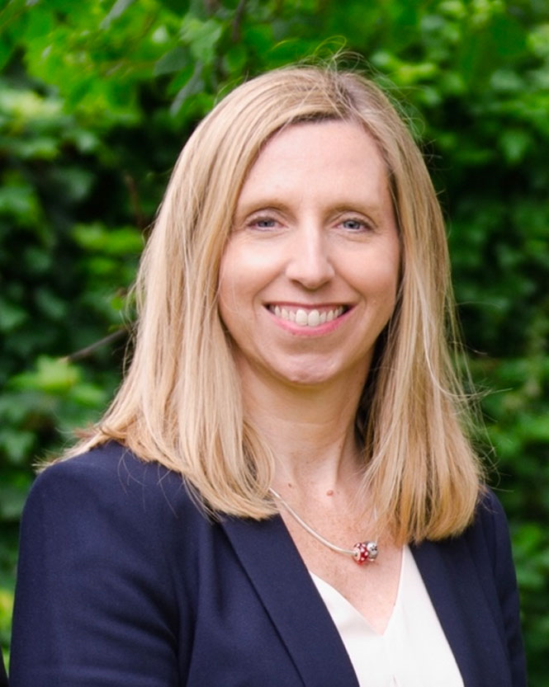

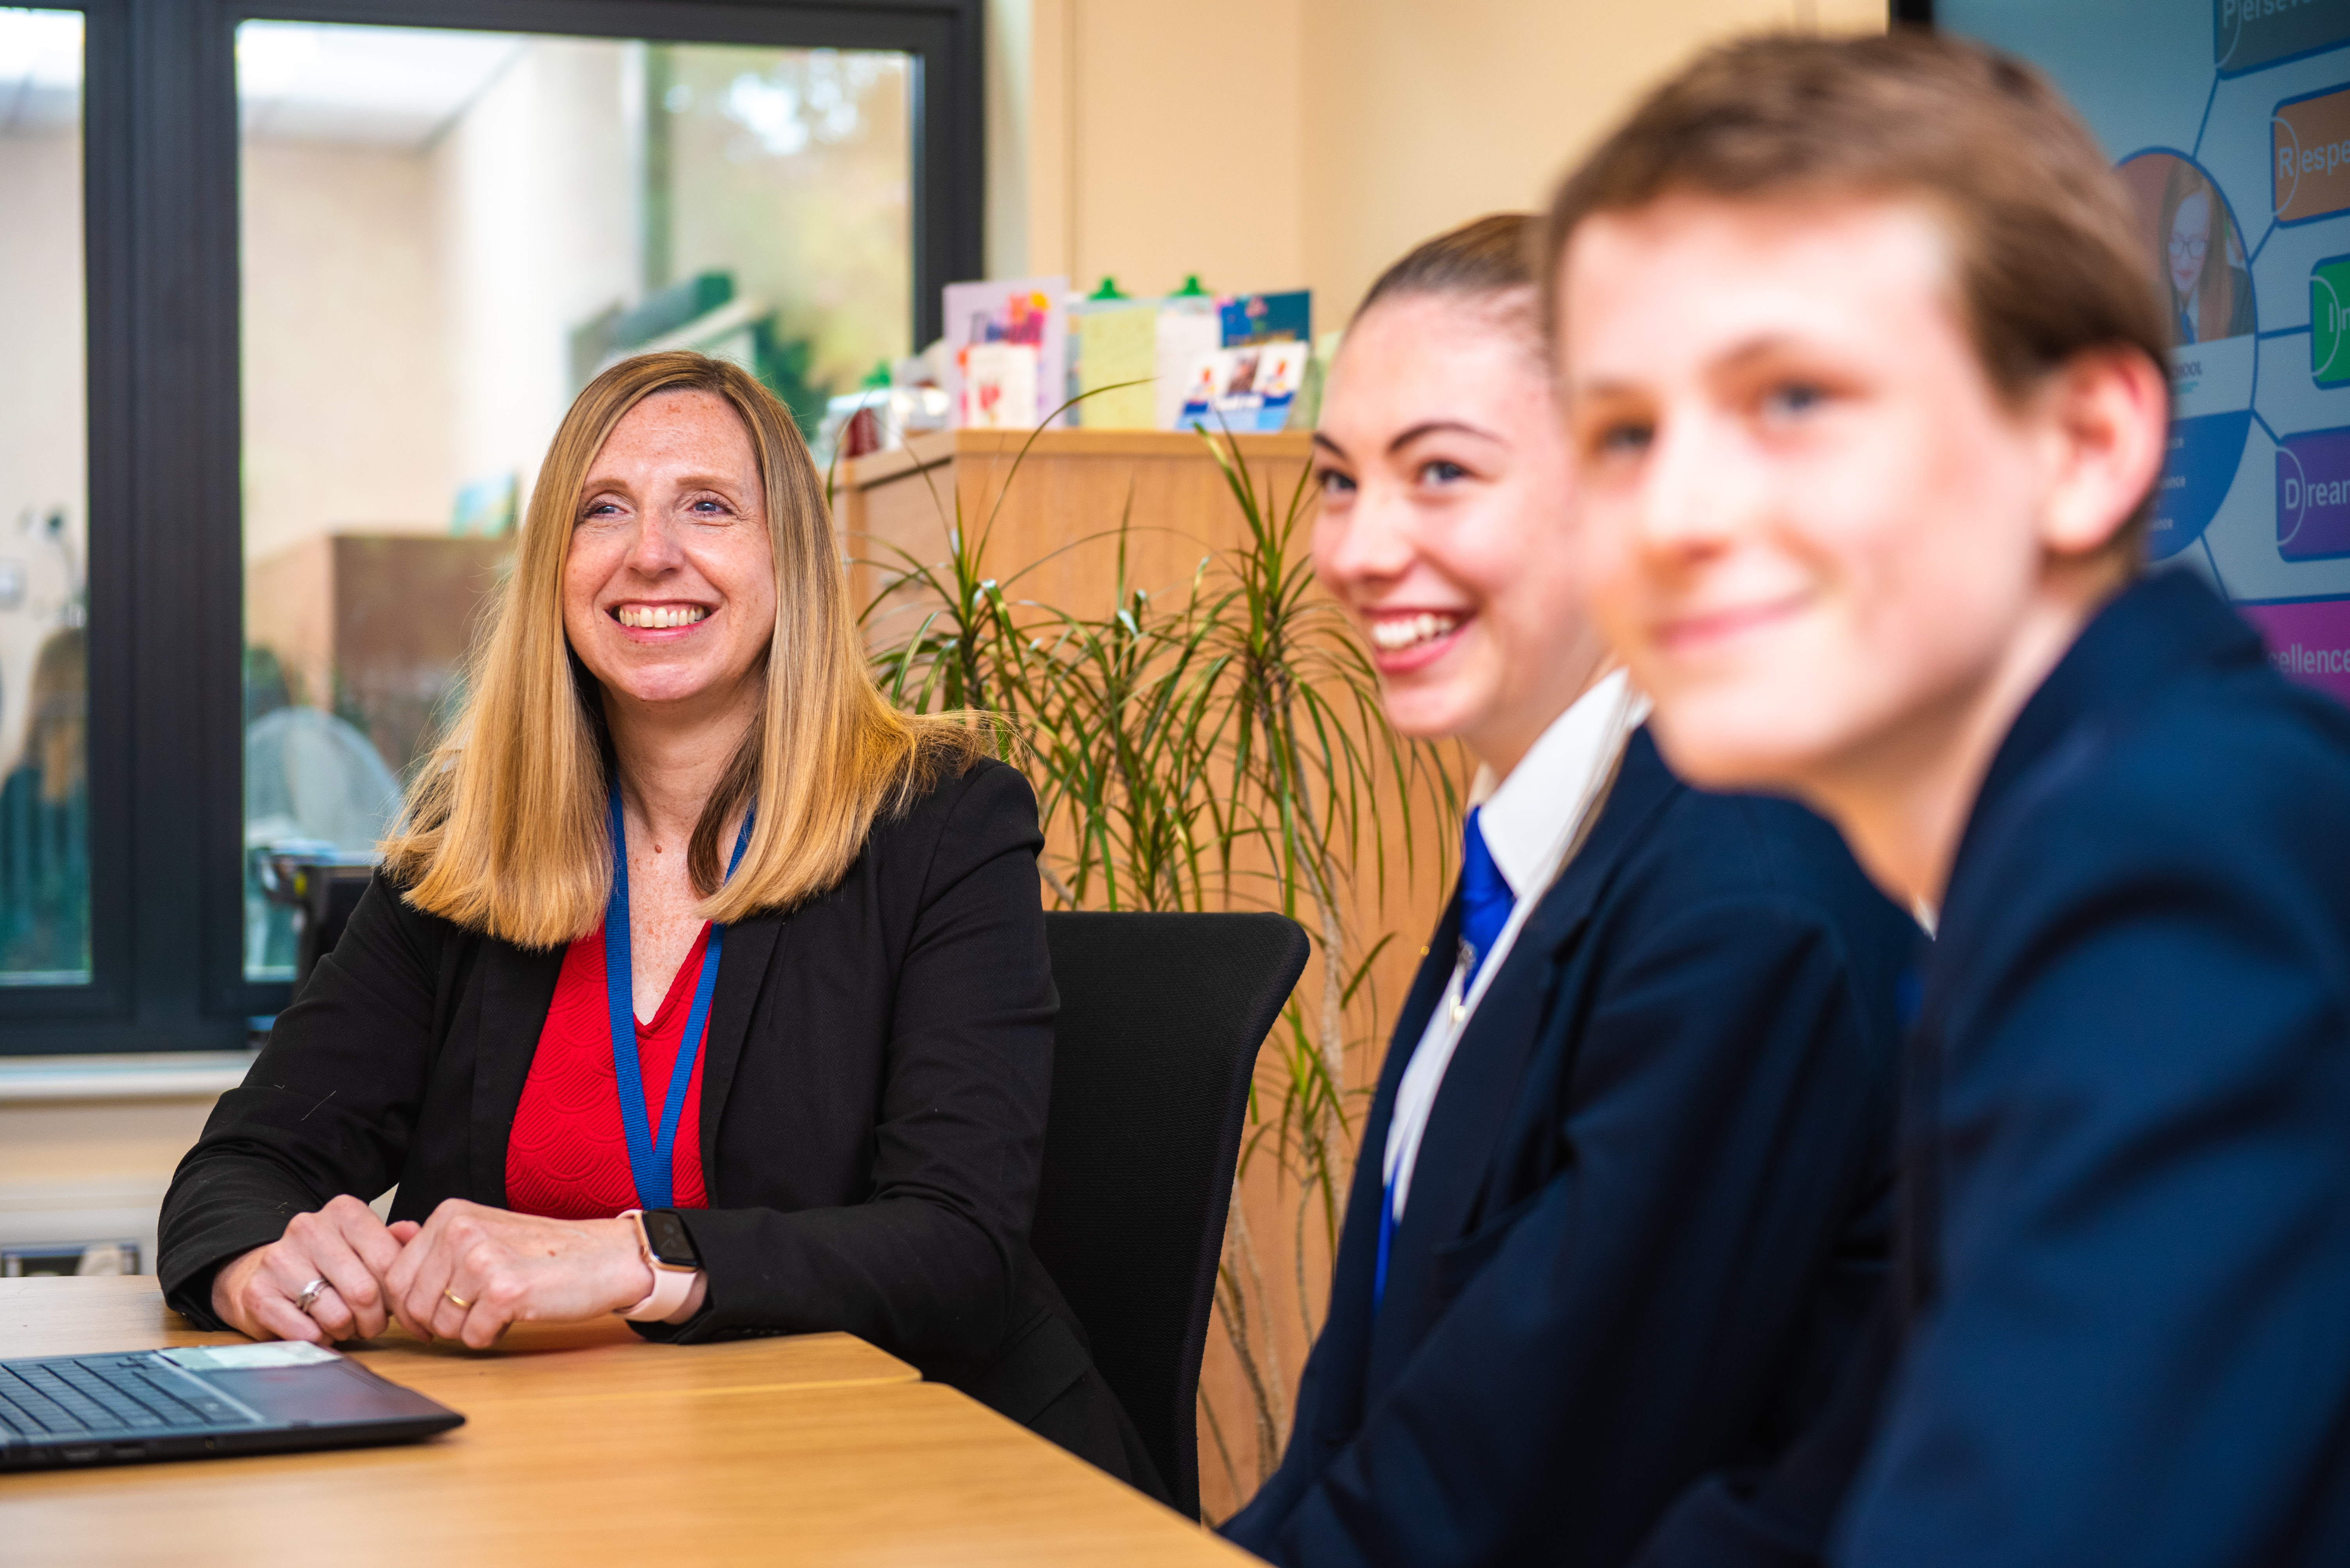
Our Head teacher
We are fully committed to offering a top-class education – on-line or in school – which keeps abreast of national and international trends. We welcome applications from high-quality candidates who are looking to make a real difference to our students' lives.
We support all new staff with a supportive induction package. We endeavour to ensure your skills are developed so you can perform at your optimum.
Please take your time to consider the information in this pack and do not hesitate to make contact with us should you require any further information.
Mrs N. Caley
I am delighted to introduce you to our wonderful school. Since my arrival in 2018, I have sought to create a thriving working environment which enables our wonderful students to succeed in all aspects of life at Murray Park and beyond. It was great for this to be recognised by Ofsted in September 2022 when we achieved our Good judgement.
We pride ourselves on giving teachers the conditions in which to teach without distraction and ensure that all staff are supported quickly with any concerns both in and outside the classroom.
“Being a teacher at Murray Park is a privilege, providing me with the opportunity to be part of a community with shared values and a common goal of not only celebrating our students’ diversity but championing them to achieve their dreams.” (Flavia Kupferberg – Teacher)

Slide 3
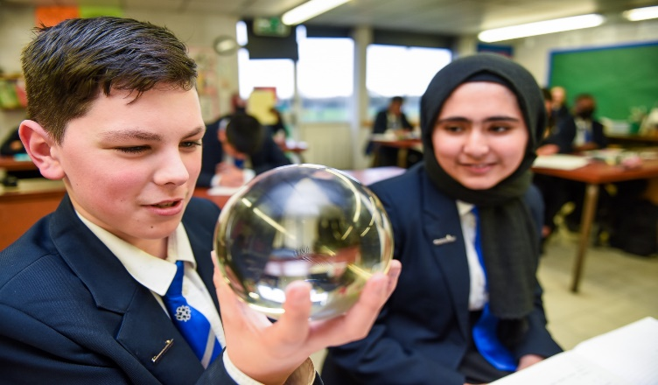
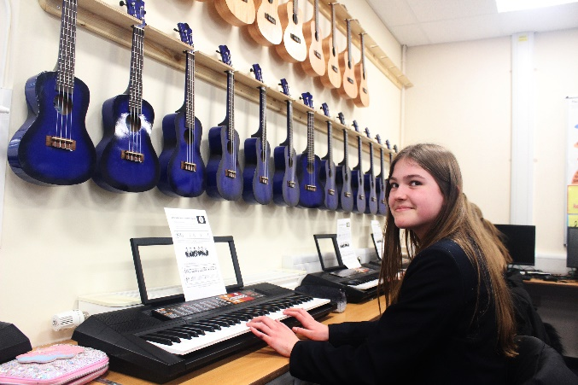
Ambition Statement
At Murray Park School, our curriculum vision is to provide an ambitious and inspirational education for all of our pupils. Our strong set of values: Perseverance; Respect; Independence; Dreams and Excellence (PRIDE) underpins our ethos. Through our curriculum, our pupils develop the confidence to embrace the responsibilities that life has to offer and to become valued members of the local community, both now and in the future.
In all lessons the pupils are challenged and engaged in an education that prepares them for their futures. Our curriculum enables all of our pupils to develop life skills, such as, creativity, empathy and collaboration, resulting in resilient individuals with high aspirations.
Our health and wellbeing provision ensures that our pupils lead healthy and fulfilling lives and that every pupil has the knowledge and confidence to take care of their own physical and mental wellbeing.
As a result of our outstanding careers programme, all of our pupils are prepared for the next stage of their education, training and employment through our extensive network of business partners and dedicated careers’ centre. Our wide range of extra-curricular activities include residential opportunities and international travel. These opportunities enrich the formal curriculum and deepen the pupils’ knowledge and skills.
Every child at Murray Park School is equipped to become a well-qualified and successful young person.
“ The supportive atmosphere created by amazing, dedicated colleagues and students that genuinely appreciate what you do for them , gives me a reason to smile every day.” (Miss Dodd – Head of Mathematics)

Slide 4
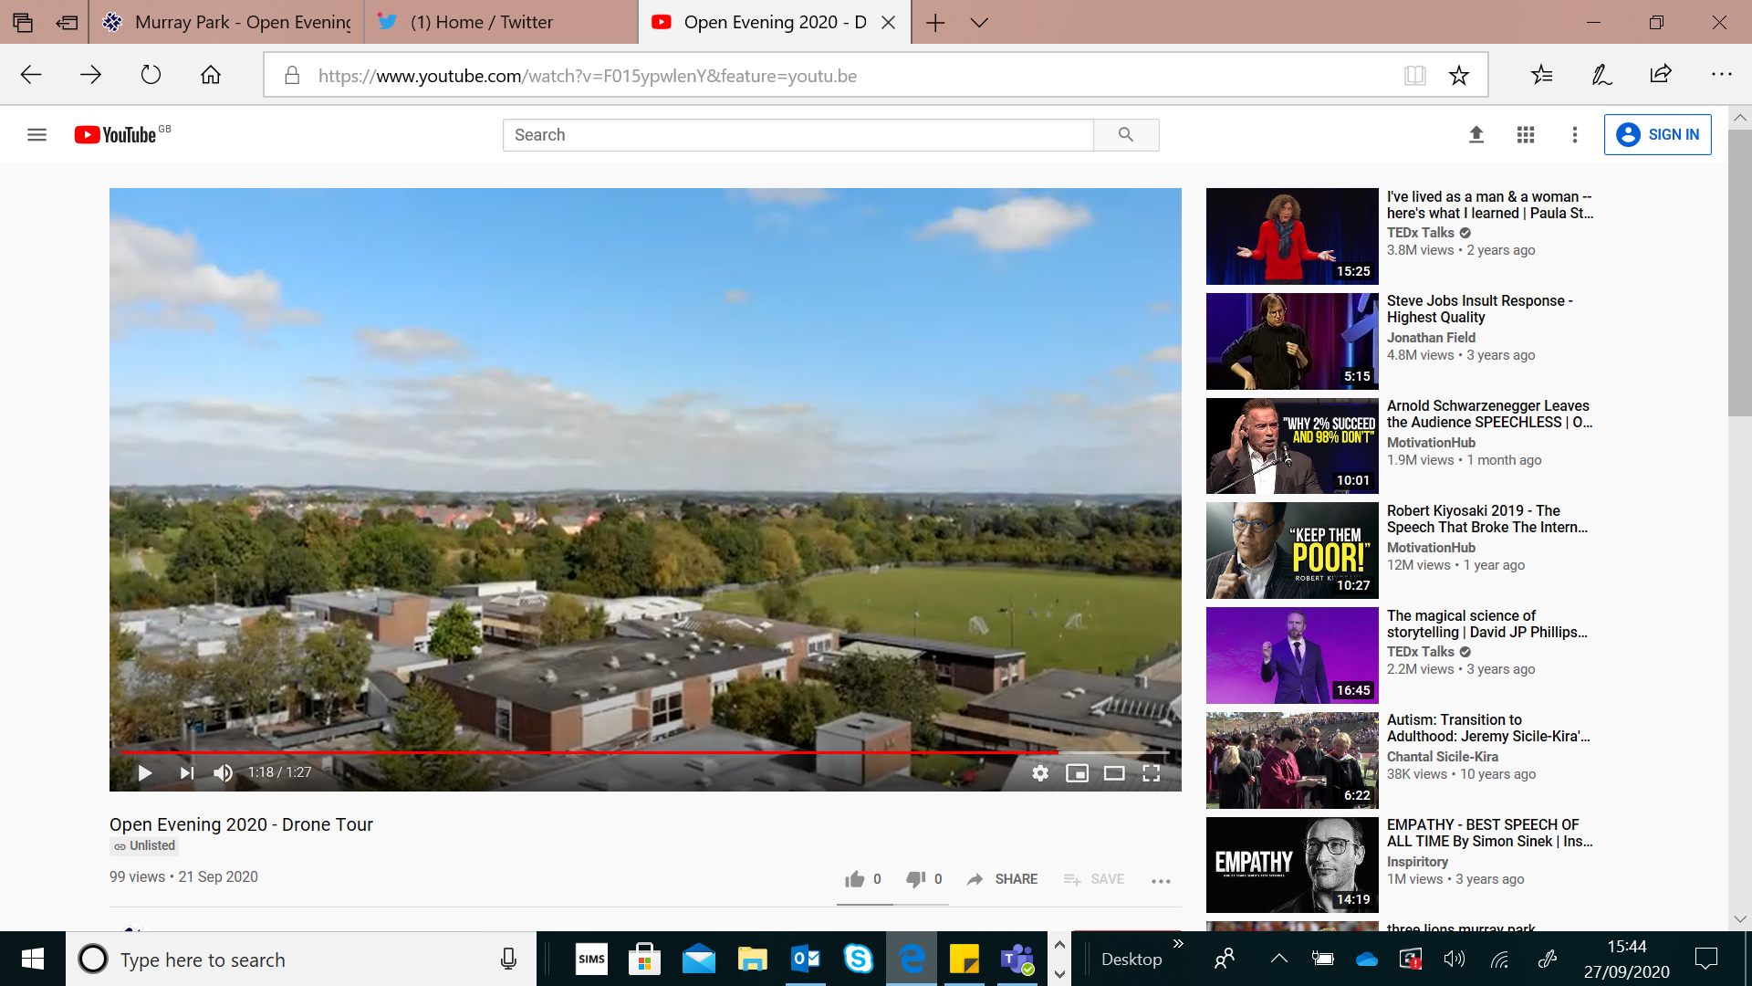
School Information
Murray Park is a dynamic and forward-looking 11-16 mixed comprehensive school on the western fringes of the city of Derby. It is a Foundation Status school, but has a close working relationship with the local authority.
We cater for approximately 1111 students, situated on a spacious site surrounded by greenery. We serve students from the Derby City area, within reach of the Derbyshire countryside and our cohort sizes are growing each year.
Our students reflect the full academic ability range and there is a huge breadth to the socio-economic status of our families.
Application Process
Informal visits to the school are available but not essential. You must complete the application form fully and give details of all employment, training and gaps in employment since leaving secondary school to the present day. Any additional information, which you wish to bring to the notice of the selection panel should be included in your letter of application.
Your letter of application should make reference to the job description and in particular how you meet the person specification. At least one of your references should be a current employer and you should indicate if you are happy for us to contact each reference.
Please provide an email address for your referees so that we can contact them.
Please email your completed application form and letter of application to recruitment@murraypark.derby.sch.uk. The application letter should be no longer than 2 sides of A4, Arial font size 11.
“The School has continuously supported me with my career development. If you wish to challenge yourself to develop as a leader then Murray Park School is the place for you.” (Mr Gregory – AHT KS4 Achievement)

Slide 5
Ofsted 2022
Our school was inspected in September 2022 and gained a Good judgment from Ofsted. Here are just a few quotes from their highly positive report. To access our full report please use our website link: Ofsted Reports | Murray Park
Quality of Education | “Leaders have designed an ambitious curriculum that allows pupils to learn a broad range of knowledge.” “Leaders have planned assessments to check pupils' understanding.”
Behaviour and Attitudes | “Pupils are happy and safe at Murray Park. They know teachers acre about them.” “Leaders have ensured that classrooms are places where pupils can learn.”
Personal Development | “The 'Charter for Success' encourages pupils to engage in activities such as theatre trips and cookery.” “Leaders ensure that all pupils have opportunities to gain different cultural experiences.”
Leadership and Management | “Leaders have prioritised reading.” “Leaders have created a culture of safeguarding.”
SAFEGUARDING INFORMATION
Murray Park School shares a commitment to safeguard and promote the welfare of children and young people. Our commitment is underpinned by robust processes and procedures that seek to maximise opportunity, minimise risk and continuously promote a culture that embraces the ethos of safeguarding amongst our workforce.
This post is Exempt from the Rehabilitation of Offenders Act 1974 and the amendments to the Exceptions Order 1975, 2013 and 2020 and is subject to an enhanced DBS Disclosure check.
Recruitment Information
The application form must be completed in line with our Important Recruitment Information section on the school website. It is an offence to apply for the role if you are barred from engaging in regulated activity relevant to children.
Child Protection and Safeguarding Policy
Recruitment of Ex Offenders
The Equality and Diversity Form
GDPR Privacy Notice
Recruitment Policy
These documents can be found using following the link: https://www.murraypark.derby.sch.uk/key-information/vacancies/
“Since starting at Murray Park there has been no time for nerves, just excitement. I am delighted to continue my journey here, whilst inspiring others on my way” (Miss Bunting – Science)

Slide 6










Staff Well-being
Murray Park considers the well-being of staff to be important. Decisions in terms of staff support make well-being a priority. Anything that can be done to support staff in their role will be considered. See below for 10 things we do for staff-wellbeing:
 | Opportunity for flexible working for all staff.
 | A robust and centralised behaviour system, including an internal Alternative Provision.
 | A designated, trained, mental health leader.
 | A Leadership Team who fully consider staff workload and wellbeing when considering any changes to practice or systems.
 | Paid lunch duties, including a free meal.
 | CPD for all staff, in all roles, including whole-school and opportunities for any bespoke courses.
 | Latest technology, including new laptops for teachers.
 | A measured approach to data management, including meeting free weeks during data points.
 | An approach to pedagogy that ensures we deliver high-quality teaching in each and every lesson, whilst giving staff professional autonomy.
 | Staff social and sports events.
“ Murray Park School is at the centre of the community and our students and this is their OASIS.” (Mrs Drew – AP Lead)

Slide 7
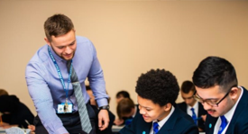
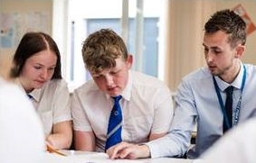
Department Information
The administrative team is a large team that provides efficient and effective support across all aspects of the school supporting both students and staff.
There are a number of administrative bases within school with the Student Services office being the busiest in terms of supporting students.
Student Services currently consists of two full time-time and four part-time members of staff that cover administration, reprographics and the medical room. Due to the growth of the school, we are looking to expand the team by adding a Primary First Aider and Administrator post.
This position will be based at the medical room overseeing the first aid provision in school.
The ideal person will have experience of carrying out first aid and develop processes to support all students with medical conditions.
We are looking for someone to join the team that shares our excellent working ethos whilst supporting other members of the team personally, enjoys friendly working relationships and is willing to embrace and develop new working practices within this busy and sometimes challenging environment.
“Murray Park School is a great place to work. If you are passionate about making a difference to the lives of young people, this is the place to be”
(Mr Holland – PE)

Slide 8
Job Advert
Primary First Aider and Administrator – Term Time only (39 weeks per year)
Hours: 30 hours per week (39 weeks/term time only). Hours are normally worked Monday-Friday 8.30am-3.00pm (excluding 30 minutes unpaid lunch)
Salary: NJC Points 6-7 : Actual Salary £15,324 - £15,593
plus generous contributions into the LGPS scheme currently approx. 21.5%
Responsible to: Office Manager
Framework: to work within the framework of the NJC pay and conditions (30 hours per week 39 weeks per year (term time only), current legislation and policies of the school.
Murray Park School is a rewarding and professionally stimulating place to work. Over the last 3 years we have undergone a journey of rapid improvement; moving from a Requires Improvement Ofsted grading to Good in September 2022, along with a Progress 8 improvement from -0.64 in 2019 to 0 in 2022, as well as now being over-subscribed.
The post is suitable for an experienced first aider and administrator to join a hardworking, forward thinking and supportive Student Services team. All staff receive a comprehensive induction programme.
The person appointed will have:
  Experience of providing an effective first aid service.
  Excellent organisation and administrative skills and be highly motivated, enthusiastic and dynamic.
  Relentlessly high standards.
  A commitment to continuous improvement of their own practice, irrelevant of job role, career stage or position.
Staff at Murray Park School benefit from:
  A friendly and supportive working environment.
  A positive approach to flexible working for all staff.
  A Senior Leadership Team who prioritise staff well-being and consider this when launching any new systems or pedagogical approaches.
  A whole-school CPD package which includes professional development opportunities
How to Apply
Employed staff at Murray Park do not need to complete an application form but should send a letter of application of no more than 2 sides of A4. All other candidates can download a support staff (non teaching) application pack from the school website https://www.murraypark.derby.sch.uk/key-information/vacancies/.
Murray Park School is committed to safeguarding and promoting the welfare of children and appointment to this post is subject to a criminal record and background check and references

Slide 9
Roles and Responsibilities
Duties as a Primary First Aider and Administrator:
Key Purpose: To have a highly organised individual to join our team to provide effective and efficient first aid /administrative service to the school. The successful candidate will work well under pressure, be able to work to strict deadlines and be highly motivated.
Key Tasks:
To be responsible to the Office Manager. To be the lead first aider within the school and to administer emergency first aid to students, staff and visitors as required. To maintain a full First Aid at Work qualification and ensure this is renewed as necessary. To regularly undertake Diabetic and Epi pen training. To correspond with parents/carers and staff including SENDCo & Heads of Year over students with medical conditions and first aid issues. To ensure Risk Assessments and Individual Care Plans for students with serious medical conditions such as diabetes are regularly updated and medical information is current and communicated to staff including for trips and school activities. Update the MIS system with medical conditions and health information. To deal with parents respectfully and promptly in the case of emergencies. To record first aid administered and accidents on our system and by use of the accident book. To liaise with the school health Team and school over visits to the school. To work closely with the school immunisation team to co-ordinate the immunisation process including communicating information to parents and the administration process within the school on the day. To be responsible for the medical room and first aid boxes around school and regularly check stock levels and placing orders for first aid supplies. To be responsible for medicine that students need to take in school ensuring appropriate parental consent has been given (including keeping a log of medicine consent forms) and ensure medicine is stored away securely. To ensure students with asthma, allergies or diabetes have a spare inhaler, epi pen and diabetic supplies in Student Services/medical room and ensure they are stocked up an are in date. To monitor and correspond with parents of student requiring an inhaler or epi pen and gain written consent for using emergency in school inhaler and epi pens if they don’t have one of their own in school. To arrange for the return/disposal of out of date student medication/epi pens/inhalers etc and return left over medication when students leave school. To ensure all record keeping is up to date. Work closely with the Student Services team who will provide first aid support to ensure the smooth running of the first aid provision. Use internal systems such as SIMS/Go 4 schools to input and view information. Deal with enquires from parents, students and outside agencies via email, telephone and in person and respond promptly. To assist with other administration duties with the Student Services Team as and when required.
The post-holder will be expected to carry out other tasks/duties as directed by their Line Manager that are commensurate with the responsibilities of a Primary Fist Aider and Administrator. to work within the framework of the NJC pay and conditions (30 hours per week for 39 weeks per year term –time only) current legislation and policies of the school.
Murray Park School is committed to safeguarding and promoting the welfare of children and appointment to this post is subject to a criminal record and background check and references

Slide 10
Person Specification
 | Essential | Desirable
Experience Experience of carrying out first aid Diabetic, epi pen and defibrillator training Experience in operation of administrative systems Experience of working in a school environment | ✓ | ✓ ✓ ✓
Qualifications GCSE or equivalent at grade C or above in English and Maths Recognised IT qualification Valid First Aid Certificate | ✓ | ✓ ✓
Knowledge Awareness of policies/codes of practice and legislation applicable to the position Knowledge of SIMS or similar management system. |  | ✓ ✓
Skills/Abilities Good numeracy/literacy skills Good ICT skills including Microsoft packages Ability to work constructively as part of a team, understanding the school’s roles and responsibilities, and your own position within these Ability to relate well to children and to adults Excellent communication and interpersonal skills Good organisation skills Ability to prioritise effectively Ability to work to tight deadlines | ✓ ✓ ✓ ✓ ✓ ✓ ✓ | ✓
Personal Qualities Accepts, supports and quickly implements change Proactively seeks opportunities to increase job knowledge and understanding Works with others to resolve differences of opinion Requires minimum supervision Takes responsibility for own actions Identifies and overcomes barriers Takes quick and effective action Demonstrates focused implementation of role and responsibilities Contributes to a team ethos where everyone feels valued Is accountable for own development Is of smart appearance and manner Enhanced Criminal Record check (school will apply for this on behalf of the successful candidate) | ✓ ✓ ✓ ✓ ✓ ✓ ✓ ✓ | ✓ ✓ ✓ ✓
Murray Park School is committed to safeguarding and promoting the
welfare of children and appointment to this post is subject to a criminal
record and background check and references

Slide 11



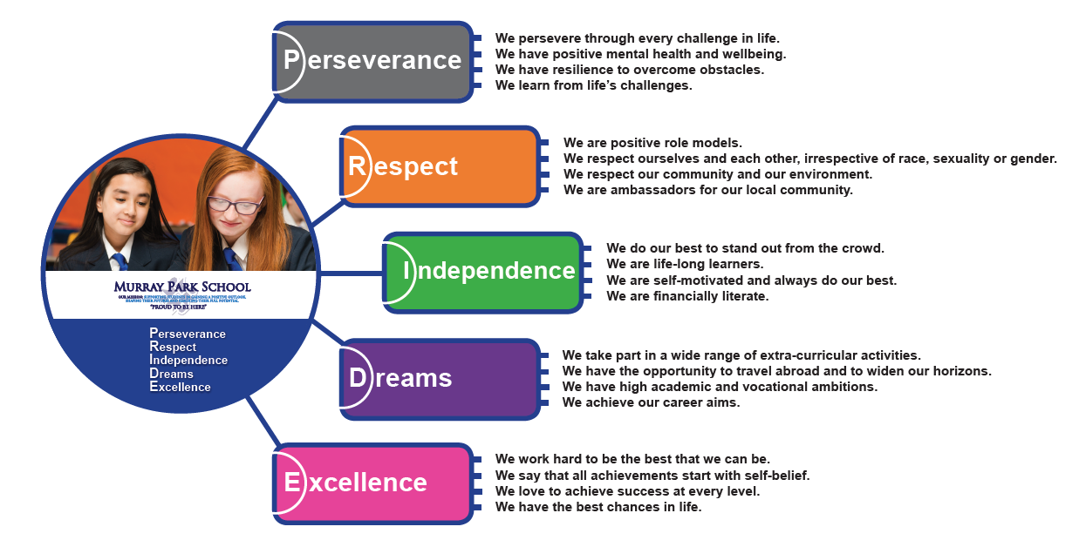








Murray Park Community School
@murrayparkderby
Head Teacher: Mrs N. Caley
Address: Murray Road, Mickleover, Derby, DE3 9LL
Telephone: 01332 515921
Web: www.murraypark.derby.sch.uk
Recruitment Email: recruitment@murraypark.derby.sch.uk
Head Teacher: Mrs N. Caley
Address: Murray Road, Mickleover, Derby, DE3 9LL
Telephone: 01332 515921
Web: www.murraypark.derby.sch.uk
Email: info@murraypark.derby.sch.uk

