Slide 1
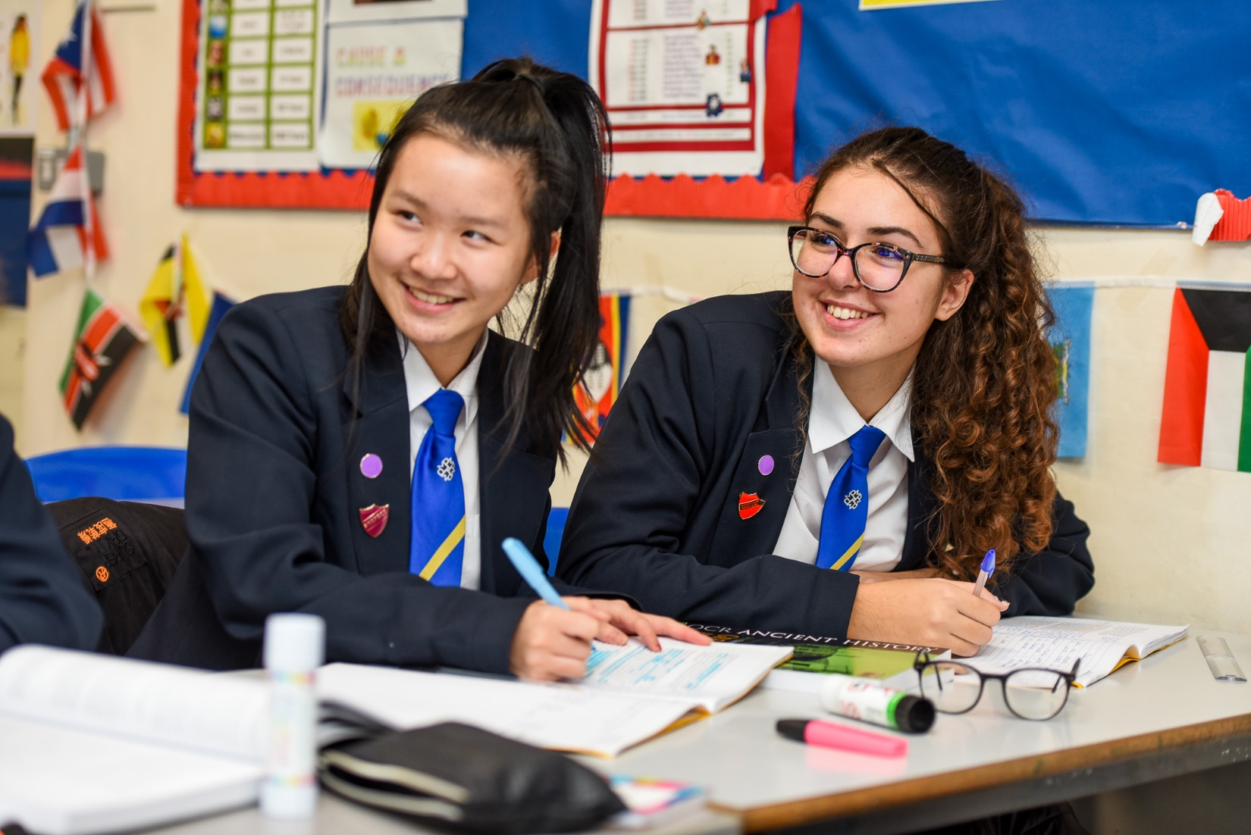


Murray Park School
Applicant Information Pack
Teacher of Computer Science/ICT
Application deadline: | Monday 14th November @ 9.00am
Interview Date: | Friday 18th November
Start Date: | January 2022
Murray Park School is committed to safeguarding and promoting the welfare of children and appointment to this post is subject to a criminal record and background check and references
Head Teacher: Mrs N. Caley
Address: Murray Road, Mickleover, Derby, DE3 9LL
Telephone: 01332 515921
Web: www.murraypark.derby.sch.uk
Recruitment Email: recruitment@murraypark.derby.sch.uk

Slide 2
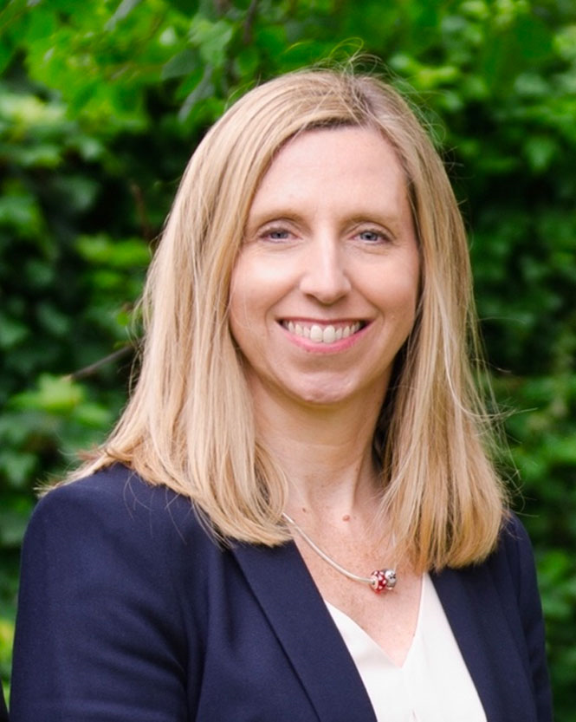

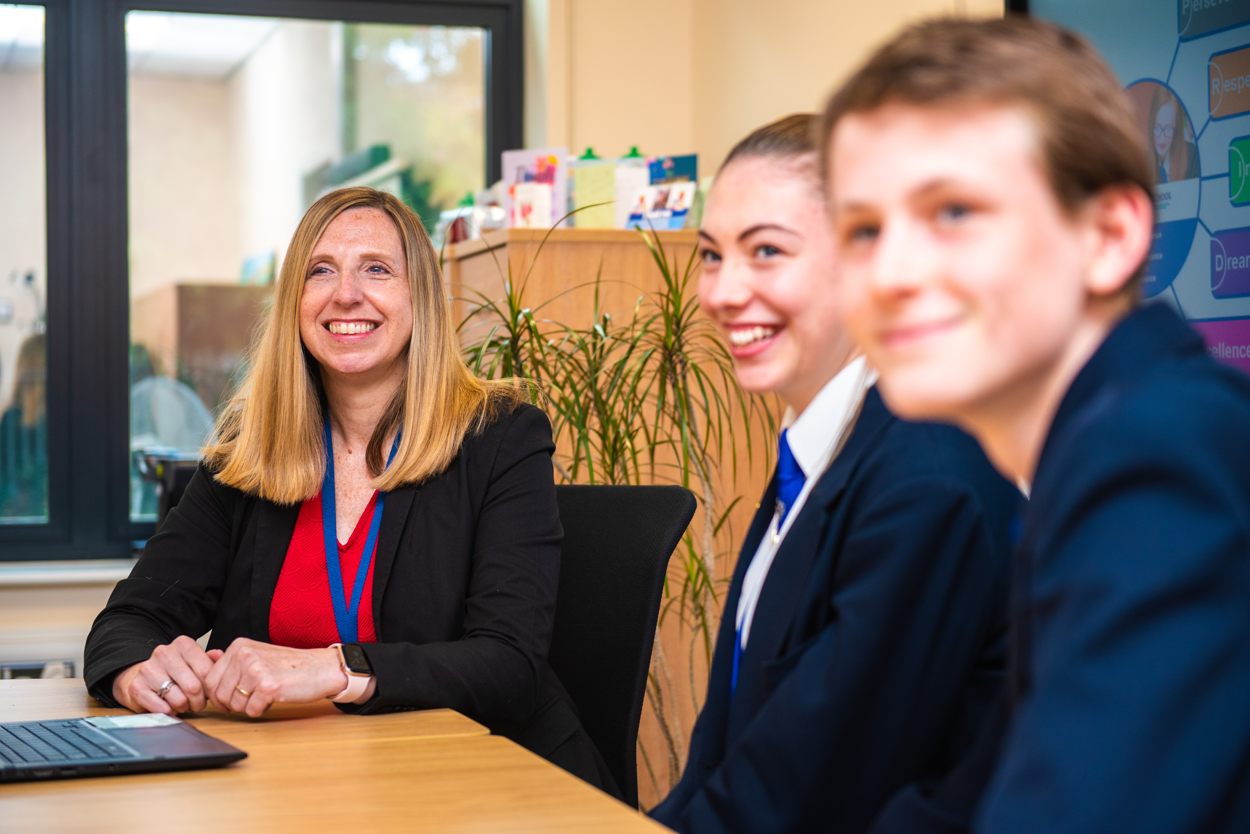
Our Head teacher
We are fully committed to offering a top-class education – on-line or in school – which keeps abreast of national and international trends. We welcome applications from high-quality candidates who are looking to make a real difference to our students' lives.
We support all new staff with a supportive induction package. NQTs follow the Derby City new teacher programme as well as our in-house training. We endeavour to ensure your skills are developed so you can perform at your optimum.
Please take your time to consider the information in this pack and do not hesitate to make contact with us should you require any further information.
Mrs N. Caley
I am delighted to introduce you to our wonderful school. Since my arrival in 2018, I have sought to create a thriving working environment which enables our wonderful students to succeed in all aspects of life at Murray Park and beyond.
We pride ourselves on giving teachers the conditions in which to teach without distraction and ensure that all staff are supported quickly with any concerns both in and outside the classroom.
“As a new member of the Murray Park team I was warmly welcomed by the entire school community, students, colleagues and parents alike. We really are proud to be here”. (Mr Hagen – AHT KS3 Achievement)

Slide 3
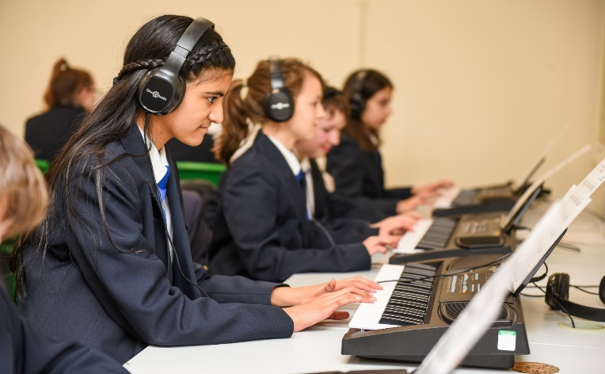
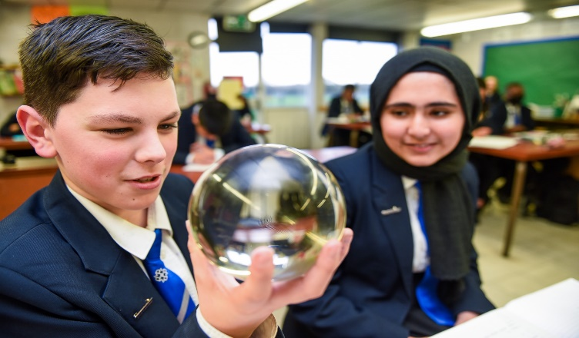
Ambition Statement
At Murray Park School, our curriculum vision is to provide an ambitious and inspirational education for all of our pupils. Our strong set of values: Perseverance; Respect; Independence; Dreams and Excellence (PRIDE) underpins our ethos. Through our curriculum, our pupils develop the confidence to embrace the responsibilities that life has to offer and to become valued members of the local community, both now and in the future.
In all lessons the pupils are challenged and engaged in an education that prepares them for their futures. Our curriculum enables all of our pupils to develop life skills, such as, creativity, empathy and collaboration, resulting in resilient individuals with high aspirations.
Our health and wellbeing provision ensures that our pupils lead healthy and fulfilling lives and that every pupil has the knowledge and confidence to take care of their own health and wellbeing.
As a result of our outstanding careers programme, all of our pupils are prepared for the next stage of their education, training and employment through our extensive network of business partners and dedicated careers’ centre. Our wide range of extra-curricular activities include residential opportunities and international travel. These opportunities enrich the formal curriculum and deepen the pupils’ knowledge and skills.
Every child at Murray Park School is equipped to become a well-qualified and successful young person.
“ The supportive atmosphere created by amazing, dedicated colleagues and students that genuinely appreciate what you do for them , gives me a reason to smile every day.” (Miss Dodd – Head of Mathematics)

Slide 4
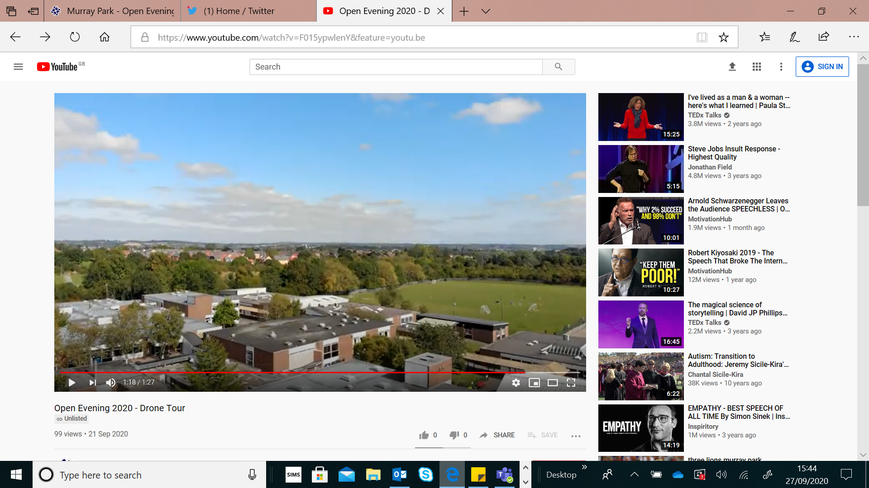
School Information
Murray Park is a dynamic and forward-looking 11-16 mixed comprehensive school on the western fringes of the city of Derby. It is a Foundation Status school, but has a close working relationship with the local authority.
We cater for approximately 1030 students, situated on a spacious site surrounded by greenery. We serve students from the Derby City area, within reach of the Derbyshire countryside and our cohort sizes are growing each year.
Our students reflect the full academic ability range and there is a huge breadth to the socio-economic status of our families.
Application Process
Informal visits to the school are available but not essential. You must complete the application form fully and give details of all employment, training and gaps in employment since leaving secondary school to the present day. Any additional information, which you wish to bring to the notice of the selection panel should be included in your letter of application.
Your letter of application should make reference to the job description and in particular how you meet the person specification. At least one of your references should be a current employer and you should indicate if you are happy for us to contact each reference.
Please provide an email address for your referees so that we can contact them.
Please email your completed application form and letter of application to recruitment@murraypark.derby.sch.uk or upload using the TES platform. The application letter should be no longer than 2 sides of A4, Arial font size 11.
“The School has continuously supported me with my career development. If you wish to challenge yourself to develop as a leader then Murray Park School is the place for you.” (Mr Gregory – AHT KS4 Achievement)

Slide 5
Ofsted 2022
Our School was inspected in September 2022 and here are just a few quotes from their highly positive report. To access our full report please use our website link:
Ofsted Reports | Murray Park
Quality of Education | “Leaders have designed an ambitious curriculum that allows pupils to learn a broad range of knowledge.” “Leaders have planned assessments to check pupils' understanding.”
Behaviour and Attitudes | “Pupils are happy and safe at Murray Park. They know teachers acre about them.” “Leaders have ensured that classrooms are places where pupils can learn.”
Personal Development | “The 'Charter for Success' encourages pupils to engage in activities such as theatre trips and cookery.” “Leaders ensure that all pupils have opportunities to gain different cultural experiences.”
Leadership and Management | “Leaders have prioritised reading.” “Leaders have created a culture of safeguarding.”
SAFEGUARDING INFORMATION
Murray Park School shares a commitment to safeguard and promote the welfare of children and young people. Our commitment is underpinned by robust processes and procedures that seek to maximise opportunity, minimise risk and continuously promote a culture that embraces the ethos of safeguarding amongst our workforce.
This post is Exempt from the Rehabilitation of Offenders Act 1974 and the amendments to the Exceptions Order 1975, 2013 and 2020 and is subject to an enhanced DBS Disclosure check.
Recruitment Information
The application form must be completed in line with our Important Recruitment Information section on the school website. It is an offence to apply for the role if you are barred from engaging in regulated activity relevant to children.
Child Protection and Safeguarding Policy
Recruitment of Ex Offenders
The Equality and Diversity Form
GDPR Privacy Notice
Recruitment Policy
These documents can be found using following the link: https://www.murraypark.derby.sch.uk/key-information/vacancies/
“Since starting at Murray Park there has been no time for nerves, just excitement. I am delighted to continue my journey here, whilst inspiring others on my way” (Miss Bunting – Science)

Slide 6










Staff Well-being
Murray Park considers the well-being of staff to be important. Decisions in terms of staff support make well-being a priority. Anything that can be done to support staff in their role will be considered. See below for 10 things we do for staff-wellbeing:
 | Opportunity for flexible working for all staff
 | A robust and centralised behaviour system, including an internal Alternative Provision.
 | A designated, trained, mental health leader.
 | A Leadership Team who fully consider staff workload and wellbeing when considering any changes to practice or systems.
 | Paid lunch duties, including a free meal.
 | CPD for all staff, in all roles, including whole-school and opportunities for any bespoke courses.
 | Latest technology, including new laptops for teachers.
 | A measured approach to data management, including meeting free weeks during data points.
 | An approach to pedagogy that ensures we deliver high-quality teaching in each and every lesson, whilst giving staff professional autonomy.
 | Staff social and sports events.
“ Murray Park School is at the centre of the community and our students and this is their oasis” (Mrs Drew – AP Lead)

Slide 7
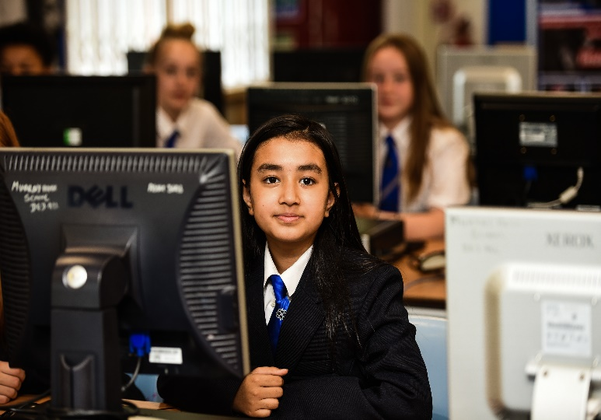
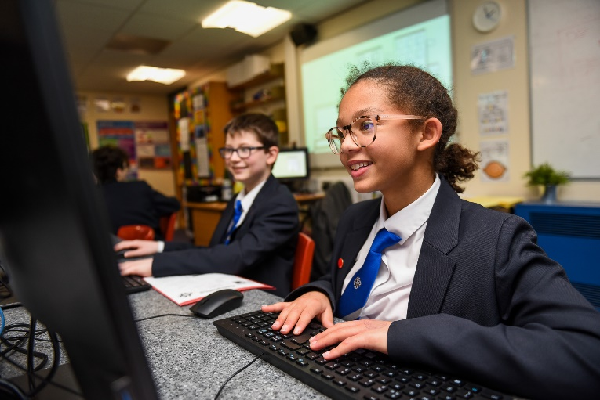
Department Information
The Computing and Business department at Murray Park consists of three full time subject specialist and two experienced second subject teachers, delivering Computing lessons at KS3, and as options subjects at KS4. Computing and Business subjects are continually popular with our students and we are very proud of the outcomes we support our students in achieving. Our staff boast a wealth of specific skills and experience, which we use to enthuse our students and develop inspirational schemes of work.
The department is very well resourced, with four fully equipped air conditioned Computing rooms featuring a recently upgraded suite of computers as well as four smartboards with speakers. In addition to this we have two theory based classrooms again equipped with smart boards and speakers. The department has its own dedicated full colour laser printer and staff each have their own school provided work laptop. There is a dedicated staff room with separate workstation space for staff to work on in their own time if they so wish.
Students have access to extra-curricular provisions run through the Computing and Business department such as after school clubs and competitions run by staff, and the department hosts regular homework club sessions for students to catch up with their work after school if they do not have a computing provision at home.
Our Key Stage Three provision aims to give students a balanced insight into the ‘Big Picture’ of computing through working with a range of hardware and software, ensuring engaging creative and practical tasks are blended supportively with challenging technical knowhow to ensure students make excellent progress throughout. Moving into Key Stage Four we offer a variety of courses to suit students’ interest and aspirations, following both GCSE and vocational courses. At all stages we tailor our teaching to ensure students continue to develop transferrable skills.
“ Murray Park School is a great place to work. If you are passionate about making a difference to the lives of young people, this is the place to be”
(Mr Holland – PE)

Slide 8
JOB Advert
Teacher of Computer Science/ICT
Full-time or Part-time and Temporary in the first instance:
Salary: Main Pay Scale/UPS
Responsible to: The Head of Computing and Business
Framework: To work within the framework of teachers’ pay and conditions, current legislation and the policies of the school.
Murray Park School is seeking to appoint a teacher of Computer Science/ICT to join our thriving department. The post will be temporary until July 2022 in the first instance, with the potential to become permanent. Murray Park School is a rewarding and professionally stimulating place to work. Over the last 3 years we have undergone a journey of rapid improvement; moving from a Requires Improvement Ofsted grading to Good in September 2022, along with a Progress 8 improvement of 0.64 to 0 from the 2019 figure, as well as now being over-subscribed. Never complacent, we are now on our next stage of development and seek high-quality staff to enable this.
The post is 0.6 working Wednesday to Friday; however, applications from candidates who would like working hours above this are welcome. Please state your preferred working arrangements on your letter of application.
The person appointed will have:
  A passion for ensuring the best outcomes for all students, including those who are part of disadvantaged and vulnerable groups.
  Excellent subject and pedagogical knowledge.
  Relentlessly high standards and expectations of all students.
  A commitment to continuous improvement of their own practice, irrelevant of job role, career stage or position.
Staff at Murray Park School benefit from:
  A positive approach to flexible working for all staff.
  A Senior Leadership Team who prioritise staff well-being and consider this when launching any new systems or pedagogical approaches.
  A robust and centralised behaviour system, including an internal Alternative Provision, to ensure learning in our classrooms is disruption free.
  A whole-school CPD package which includes the sharing of recent research and best-practice.
  An approach to pedagogy which ensures teachers teach the highest-quality lessons possible, whilst still allowing teachers the freedom to maintain professional autonomy.
How to Apply
An application pack can be downloaded from the school website at http://murraypark.derby.sch.uk/key-information/vacancies or apply via TES Online.
Murray Park School is committed to safeguarding and promoting the welfare of children and appointment to this post is subject to a criminal record and background check and references

Slide 9
Roles and Responsibilities
Duties as a Classroom Teacher:
Teaching in an agreed curriculum area Planning structured lessons that meet the needs of individual students Sharing plans and teaching resources with colleagues Maintaining records, marking and assessment of pupils’ work according to school and departmental policies, external examination and national curriculum requirements Reporting on pupils as required by the school policy and national curriculum requirements Using school procedures to maintain your teaching area/s to a standard that motivates pupils and meets health and safety requirements Following safe working practices in all your teaching and duty situations Supporting the tutorial system as required.
Key Tasks:
To be responsible to the Head of Computing and Business for teaching duties. To work in accordance with the school’s Curriculum Policy Statement and the aims and objectives of the Computing and Business department. To teach Computing throughout Key Stage 3 in addition to BTEC Digital IT throughout Key stage 4 To liaise with other members of the department in the delivery of Computing and Business, undertaking a fair and equitable share of the work by helping to develop and prepare teaching materials for use within the department and cross-curricular themes as required. To enhance pupils Computing and Business experience through extra-curricular activities. To maintain records, marking and assessment of pupils’ work according to the departmental assessment policy, and Key Stage Four course requirements. To monitor progress of students and report to parents in line with school procedures for recording and reporting. To set and mark homework as indicated by the department and school homework timetable in accordance with the departmental homework policy. To contribute to the organisation of displays of work within the school, and in particular to be responsible for provision of a motivating learning environment in an identified area of the department. To attend departmental meetings, general school meetings and parents’ meetings as appropriate. To be responsible for and follow adopted safe working practice in accordance with the latest Health and Safety regulations. To fulfil a role within the tutor system and actively support the work of Heads of Year To participate in relevant INSET to enhance teaching effectiveness.
The post-holder will be expected to carry out other tasks/duties as directed by the Headteacher that are commensurate with the responsibilities of a teacher.
Murray Park School is committed to safeguarding and promoting the welfare of children and appointment to this post is subject to a criminal record and background check and references

Slide 10
Person Specification
 | Essential | Desirable
Qualifications
Relevant Degree and Qualified Teacher Status | ✓
Knowledge
Full working knowledge of the national curriculum for Computing at KS3 Knowledge and experience of teaching GCSE Computer Science/ICT/Business Experience and knowledge of ICT opportunities in within the classroom. | ✓ ✓ ✓
Skills and abilities
To motivate students To work as part of a team To use own initiative The ability to work under pressure The willingness to promote your own subject Competence with a variety of Computing/ICT software Strong ICT skills for teaching and learning The ability to strategically intervene when students are underperforming A keen interest in learning new technologies for use within the classroom. | ✓ ✓ ✓ ✓ ✓ ✓ ✓ ✓ | ✓
Personal Qualities
A positive outlook, well motivated, enthusiastic & energetic. Commitment to improvement/staff development. The desire to succeed. Good attendance and punctuality record. Commitment to supporting the full life of the school. Professional appearance and manner. Enhanced Criminal Record check. (School will apply for this on behalf of the successful candidate) | ✓ ✓ ✓ ✓ ✓ ✓ ✓
Murray Park School is committed to safeguarding and promoting the welfare of children and appointment to this post is subject to a criminal record and background check and references

Slide 11



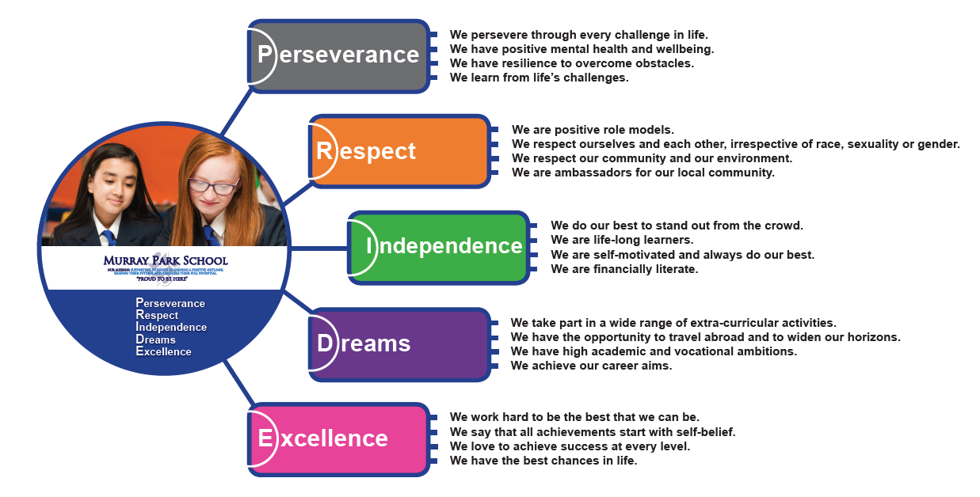






Murray Park Community School
@murrayparkderby
Head Teacher: Mrs N. Caley
Address: Murray Road, Mickleover, Derby, DE3 9LL
Telephone: 01332 515921
Web: www.murraypark.derby.sch.uk
Recruitment Email: recruitment@murraypark.derby.sch.uk
Head Teacher: Mrs N. Caley
Address: Murray Road, Mickleover, Derby, DE3 9LL
Telephone: 01332 515921
Web: www.murraypark.derby.sch.uk
Email: info@murraypark.derby.sch.uk

