Slide 1



Year 6 SAT Meeting
English
15th October 2025

Slide 2

Reading, Spelling, Punctuation and Grammar SAT
Writing scaffolding
Mrs Marshall – Deputy Headteacher Mr White – Year 6 Teacher
Mr Barron – Year 6 Teacher

Slide 3

Held every May, the 2025 Key Stage 2 SATs run from Monday, May 11th – Thursday, May 14th
The purpose of Key Stage 2 SATs is to measure your child's academic progress and the school's performance. SATs results are passed on to your child's secondary school to help their new school set a baseline for progress measurement and often place them into suitable sets or streams in Year 7.
SATs English Subjects
English Grammar, Punctuation, and Spelling (GPS): This assesses grammar rules, punctuation, and spelling knowledge.
There are two GPS papers, 70 marks, 60 minutes.
English Reading: Tests comprehension skills through questions based on various texts.
There is one English Reading Paper, 50 marks, 60 minutes.

Slide 4
SATs Test Schedule
Monday, 11th May 2025: English Grammar, Punctuation, and Spelling (Papers 1 and 2).
Tuesday, 12th May 2025: English Reading.

Slide 5

READING SAT
The reading test will be a single paper with questions based on three passages of text. Your child will have one hour, including reading time, to complete the test.
Year 6 SATs Papers | Teachers To Your Home

Slide 6
There will be a selection of question types, including:
• Ranking/ordering, e.g. ‘Number the events below to show the order in which they happen in the story’
• Labelling, e.g. ‘Label the text to show the title of the story’ • Find and copy, e.g. ‘Find and copy one word that suggests what the weather is like in the story’
• Short constructed response, e.g. ‘What does the bear eat?’
• Open-ended response, e.g. ‘Look at the sentence that begins Once upon a time. How does the writer increase the tension throughout this paragraph? Explain fully, referring to the text in your answer.’

Slide 7
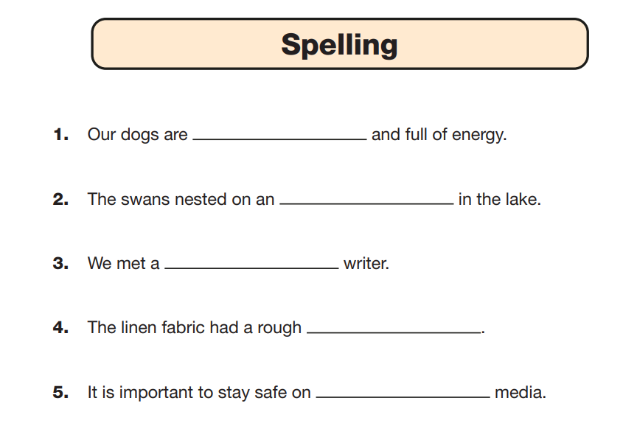
Spelling
This test involves your child's teacher reading 20 sentences from a script. Your child then fills in a blank on their answer sheet by correctly spelling the missing word.

Slide 8
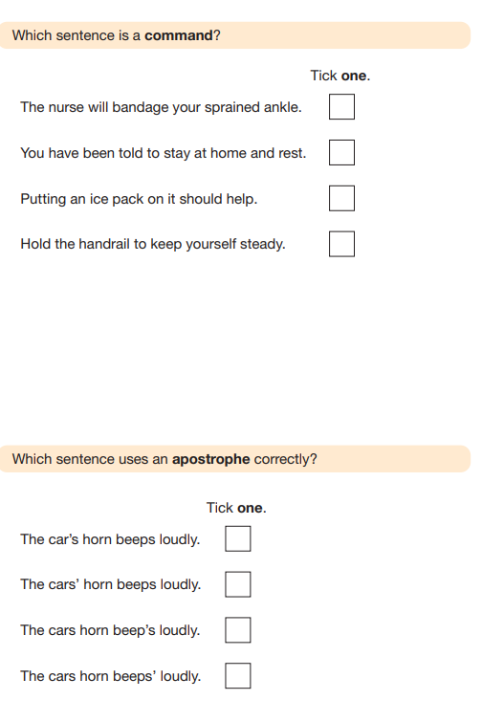
Grammar and Punctuation
This test involves 50 questions relating to Grammar and Punctuation
Your child will have 45 minutes to complete the test.

Slide 9
Writing scaffolds
Pupil’s writing will be teacher assessed. Alongside quality first teaching, the writing process is modelled and guided through the use of:
Worked examples (visualiser used)
Paired and collaborative learning
Word banks
Sentence stems
Writing frames
This is to foster and support a love of writing and encourage our pupils to become skilful, independent writers.

