Slide 1

Oh for the love of reading! by Helen Austin and Lyndsey Pearce Context
We both work in Laygate Community School a small, maintained primary school, which is situated in the Laygate ward of South Shields, South Tyneside. It is in an area of high deprivation with large numbers of disadvantaged and EAL pupils. In 2018, Ofsted recognised the progress pupils make, often from very poor starting points ‘In 2017, pupils made outstanding progress in writing and mathematics at the end of key stage 2. Pupils’ progress in reading was also positive but less significantly so’ whilst also recommending that we ‘embed new approaches to reading, so that the sustained and substantial progress pupils have made in writing and mathematics is replicated in their reading’.
Recently we have invested in phonics training and the John Murray Guided Reading CPD. This has strengthened some aspects of our provision but we know that we are still on a journey to improve our reading provision so that it is sustained and consistent across the school. The OU RfP project appealed to us because it would support our community to read more widely for enjoyment. Also this seemed

Slide 2

OU Research inspiration and rationale
In January 2021, after facing the 2nd lockdown and with most pupils accessing remote learning, we attended an introduction session of the South Tyneside TRG. Already well aware of the impact COVID had on the children’s reading, the research by Teresa Cremin gave us an insight into the importance of reading for pleasure and the research which underpins this.
We already use book-led units in our English lessons and have embedded a literacy spine. However, the session impressed upon us the need for a much wider range of reading opportunities and for there to be much more talk about books and reading. We were already aware that some of the staff and children had limited knowledge of children’s literature so wanted to explore this further. We hoped that the project would give a boost to the reading environments too. Some of the pupils seem to be less talkative around books and book choices so we wanted to find activities to tackle this.

Slide 3
Aims
To explore and widen the knowledge of children’s books and authors amongst the staff
To understand our reading community by exploring the reading habits of the children and if possible the parents
To develop the children’s understanding of what it means to be a reader

Slide 4
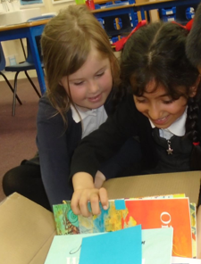
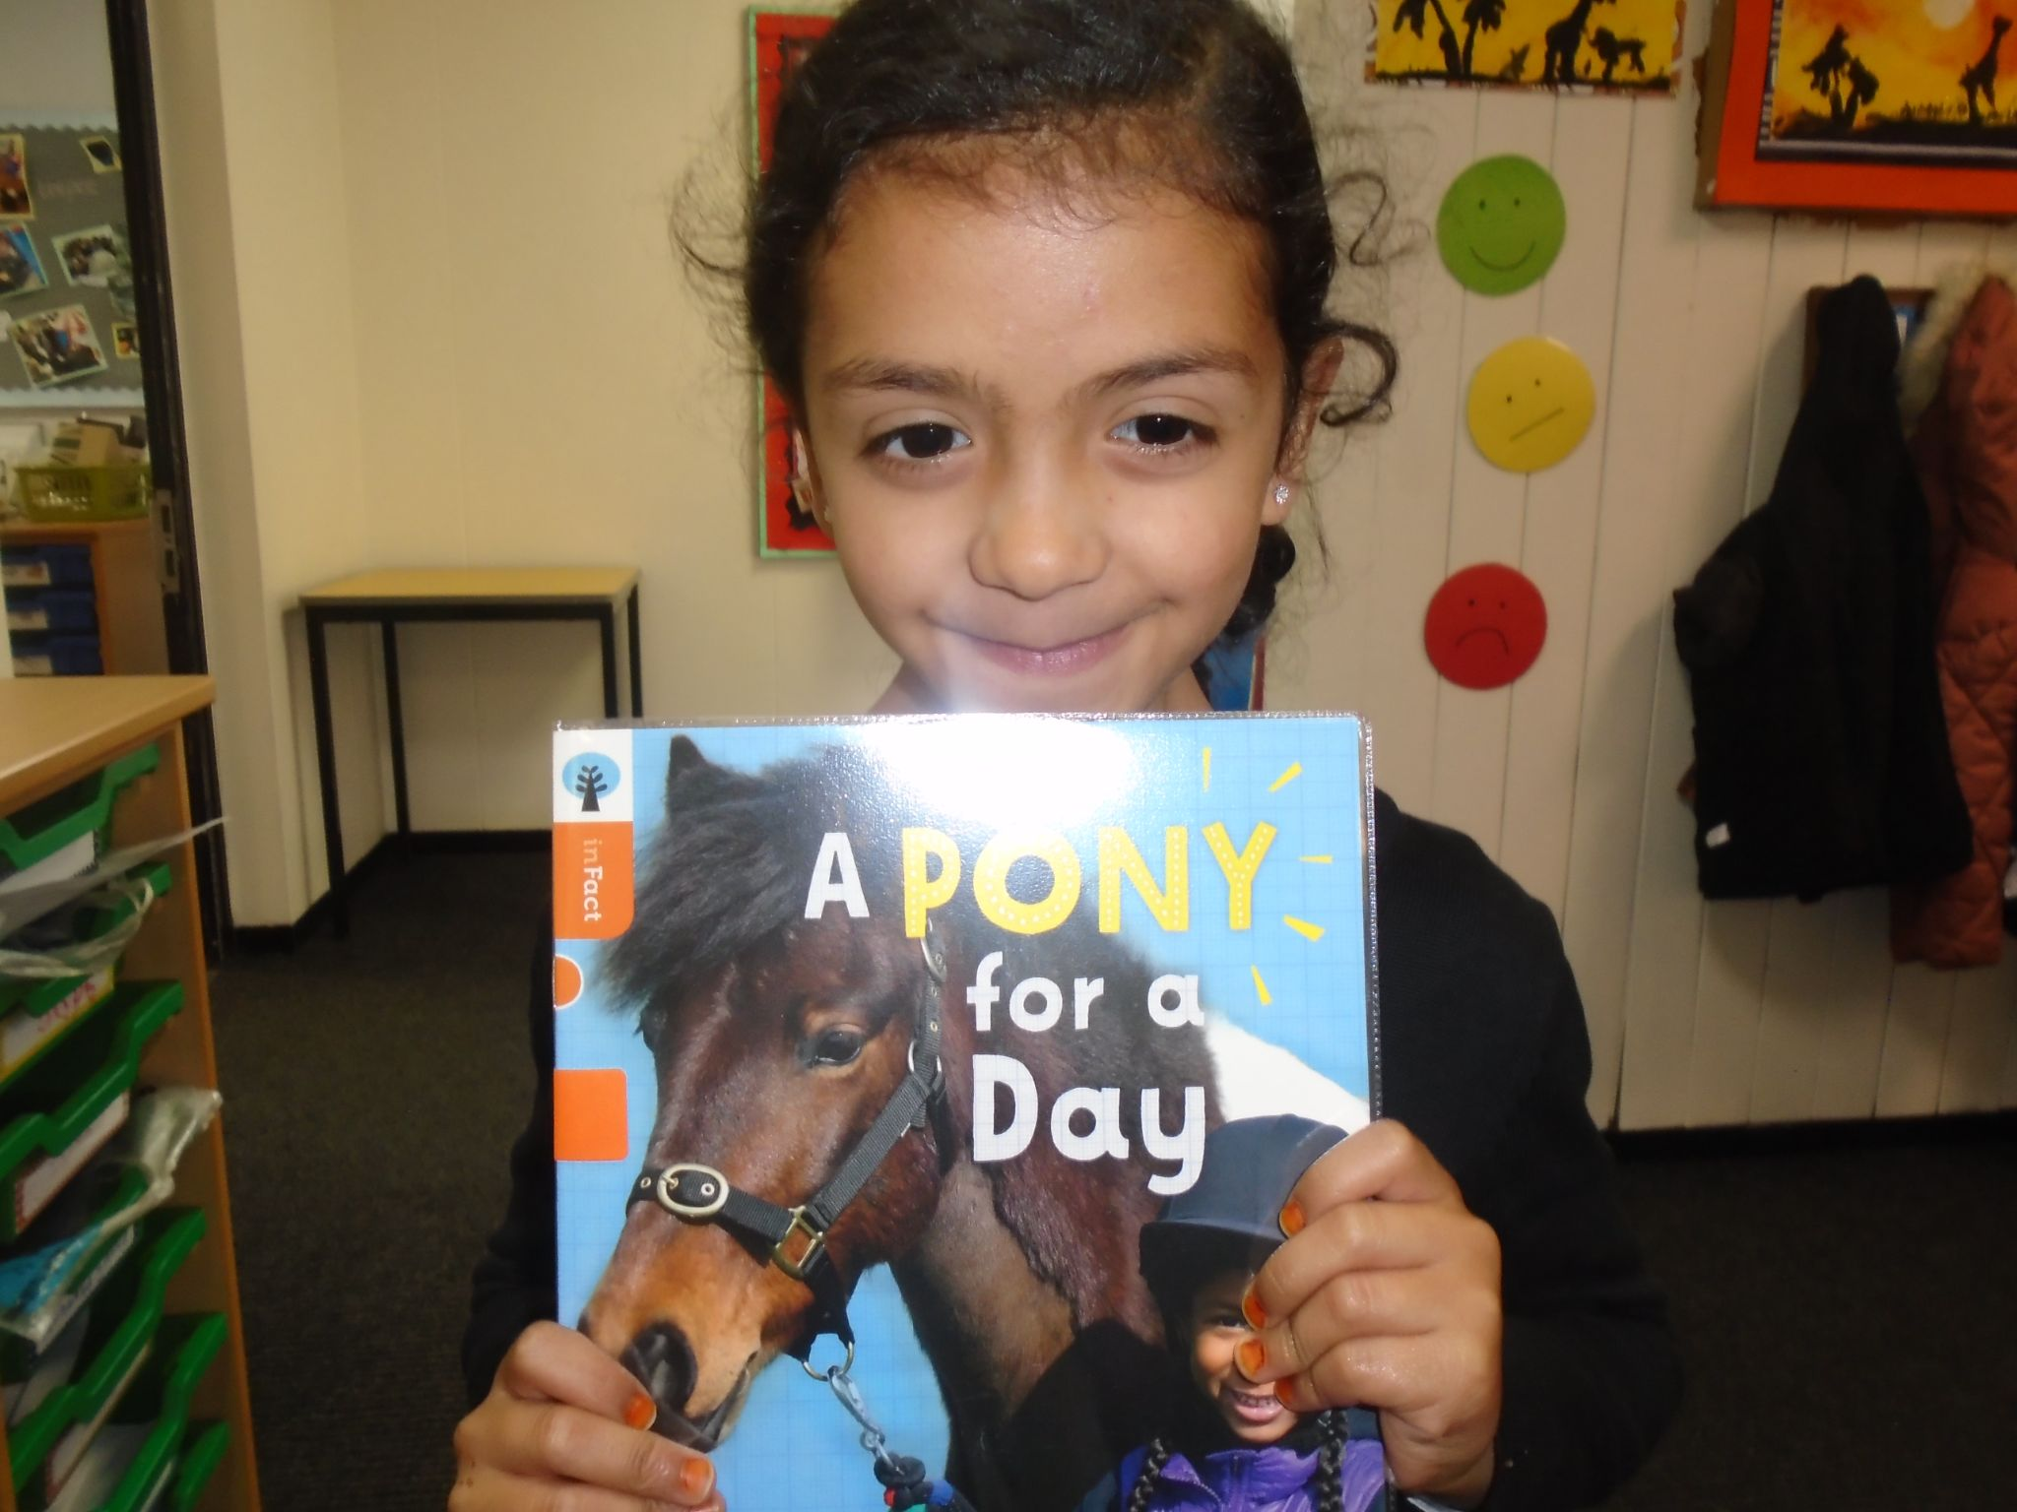
Outline
A flood of books…
We are lucky enough that over the years we have invested in quality guided reading books and the RWInc phonics storybooks which support other aspects of our reading provision.
The school’s policy is for each pupil to borrow two books from school for home reading every week; one a matched reader chosen by the teacher and the other a ‘free choice’ book. This element of choice is intended to promote reading for pleasure.
Unfortunately much of our book stock was old, had seen better days and was not very appealing. Also the books were not representative of new authors and titles. Our headteacher agreed to support the purchase of new stock. We found collections of books that included older and newer titles, novels, picture books, classics and a range of beautiful fiction books.
Then for the exciting part… the pupils got to unpack the books, browse and chatter amongst themselves.
“I love horses! I’m so excited!”

Slide 5

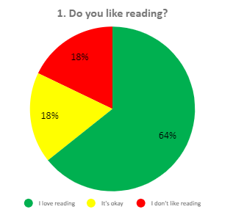
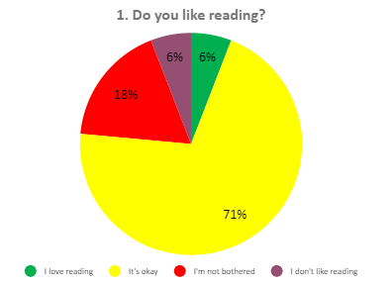
A-Z Challenge
Using the suggestion from our TRG, we created a PADLET A-Z to challenge the staff’ knowledge of children’s authors. It revealed that most teachers and TAs listed well-known authors and had limited knowledge of newer authors. Feedback from colleagues was they found it easier to recall titles than authors.
Surveys
To find out more about the reading habits of the children, we used the OU reading for pleasure survey. This revealed that the youngest pupils had a love for reading. The responses further up the school revealed that the pupils were more confident in their abilities but they had a higher percentage of pupils stating that reading was ‘ok’.

Slide 6
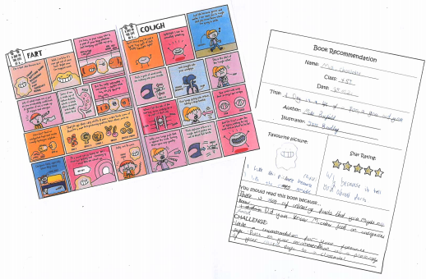

We selected 3 pupils from the UKS2 classes that had written quite negatively about reading either in comments about their own ability or comments about enjoyment.
We spoke to the teacher and paired them up with pupils who were known avid readers and who had the most positive responses in the survey. They were tasked with selecting a page from a book to read, review and recommend. Each pair took turns to do this and passed on a blank recommendation to another pupil in the class.
Copies of the book were also left in the classroom reading area for free reading time.

Slide 7
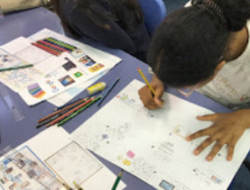
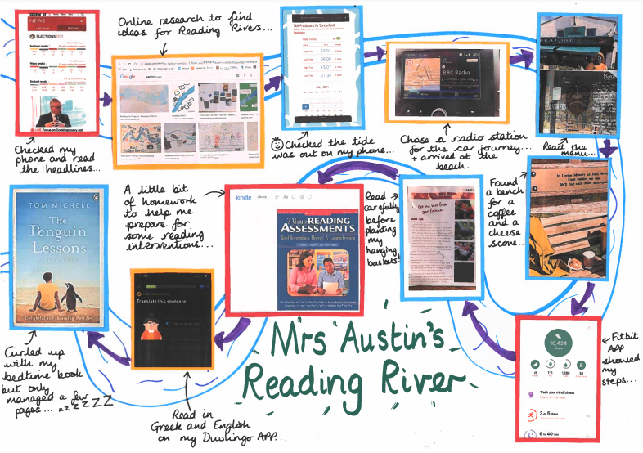
Reading floats on a sea of talk (James Britton)
In order to help shift the views the pupils seemed to have of their reading, we tried out the reading rivers activity. I particularly liked the variety of examples in John Biddle’s EOP and used them as inspiration.
First of all, I decided to model a river of my own and deliberately chose a weekend so I could show a variety of reading opportunities. I shared this with each class and asked the children to create their own reading rivers.
Discussion around reading opportunities happened naturally across the school.

Slide 8
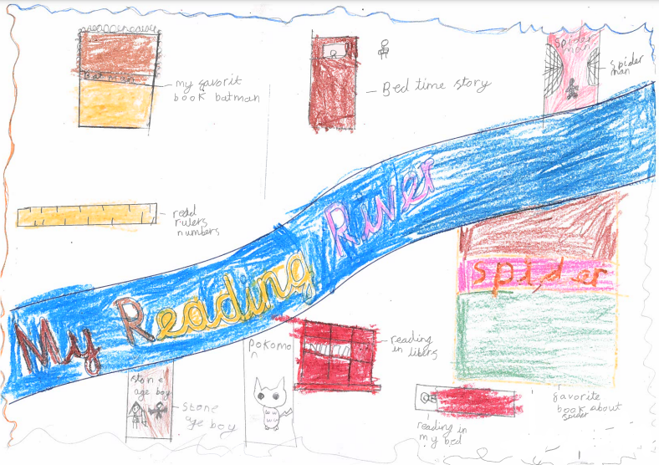
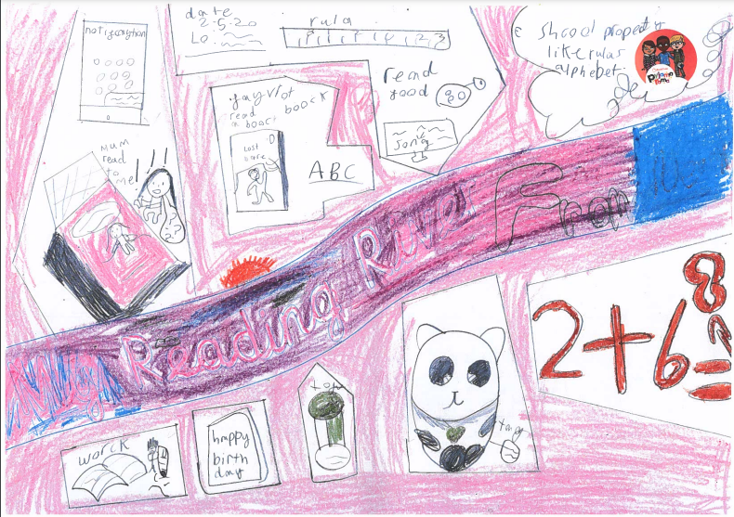
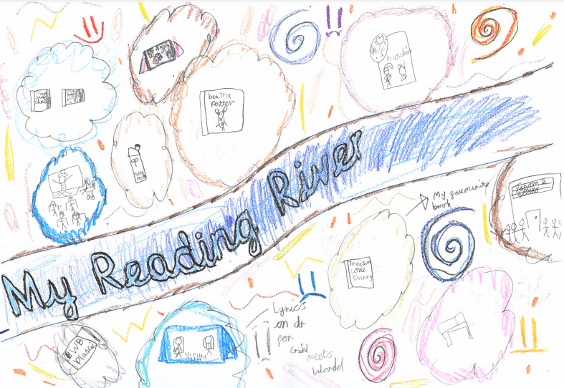
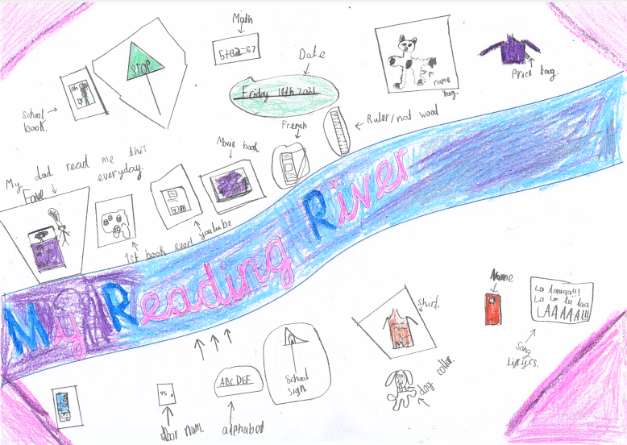
Some of the children’s reading rivers:

Slide 9
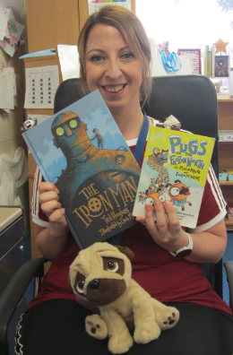
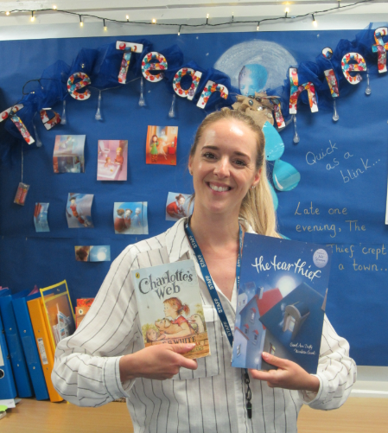
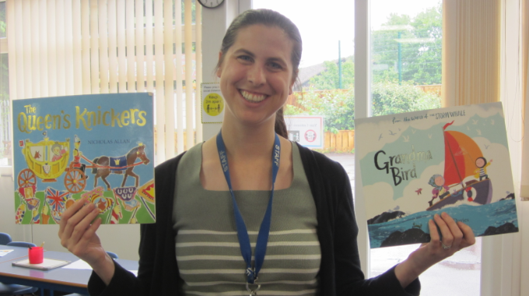
Old but gold vs new and bold
I’ve always loved children’s books but remember the advice from my PGCE English tutor who recommended regular trips to the children’s bookshops. The intention being to keep up to date with the newest publications whilst also developing an appreciation of the children’s classics. So whenever I can, I browse the children’s section of Waterstones. Also, one thing which caught my attention in the online sessions, was the idea of having favourites known as ‘old but gold’ and ‘new and bold’. With this in mind and after the findings from the A-Z challenge, we asked the staff to select their ‘old but gold’ and ‘new and bold’ titles.

Slide 10
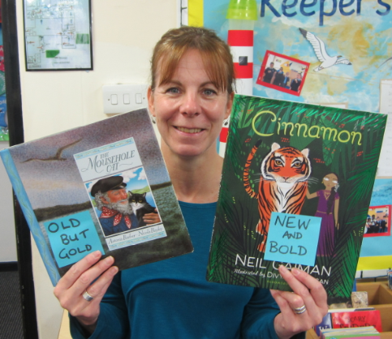
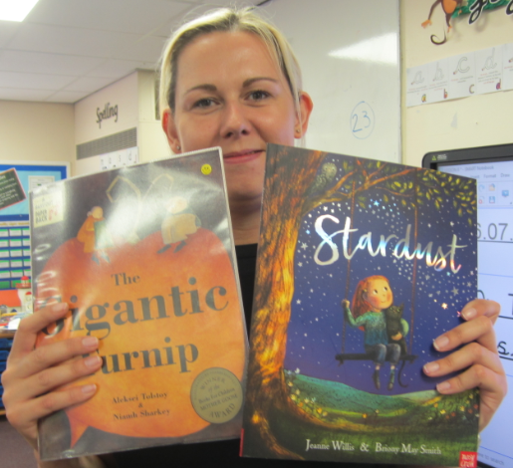
Impact
The discussion which came out of the reading rivers activity was so beneficial because the children realised just how much reading they did in one day and that is was a vital life-long skill. They also realised that they read for pleasure far more often than they thought and in short bursts throughout the day.
The 3 Y5 pupils’ comments proved more positive in a second survey and one even asked for another copy of the book for the classroom reading area. It seems that pairing each pupil with a pupil who talks positively about reading has had a positive impact.
The staff commented on how often they recalled the well-known authors or books especially those they read as children. The ‘old but gold’ and new and bold’ activity encouraged the staff to seek out newer or less well-known titles. We are now using a reading for pleasure book basket in each classroom, so are planning a wider range of texts for our daily read alouds. Also the staff have contributed titles they would recommend which have been added to our ‘reading for pleasure spine’.

Slide 11
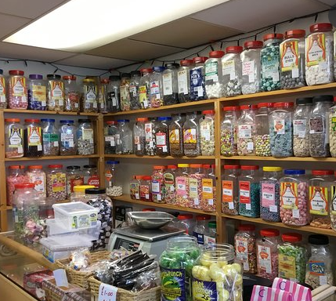
Reflections on impact the TaRs research had on practice
Through participating in the project, we realise the importance of reading for pleasure, hope to build on our successes and continue raising the profile of reading for pleasure.
We have thoroughly enjoyed the project, however we feel as if we have been like children in a sweet shop! We were enthusiastic about so many of the ideas shared during the sessions. If we were to repeat the project, we would like to select one activity and carry it out in more depth. For example there are ways we could have extended the reading rivers activity to the wider community using it as a homework activity or asking the parents to create their own rivers.

