Slide 1
5th June 2020

Slide 2
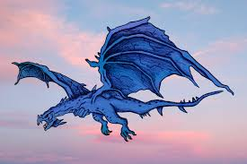
Question 1
Q1) American astronauts Doug Hurley and Bob Behnken’s trip to the International Space Station (ISS) was made in a rocket and capsule system provided by a private company, SpaceX, what is the manned capsule on the rocket called?

Slide 3
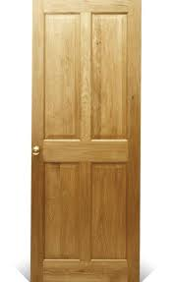
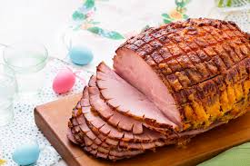
Question 2
Q2) Dominic Cummings, Boris Johnson’s advisor incurred a lot of criticism by going to a home near his parents when he had corona virus, in which English County?

Slide 4
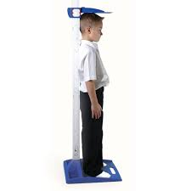
Question 3
Q3) Why has a team of Chinese surveyors climbed Mount Everest, becoming the only climbers to summit the world's highest peak during the coronavirus pandemic?

Slide 5
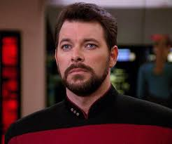
Question 4
Q4) Which country has become the first the first in Central America to legalise same-sex weddings?
???????

Slide 6
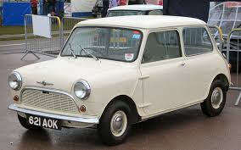
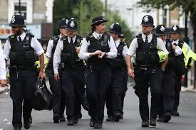
Question 5
Q5) In which US city was an African American killed by a policeman kneeling on his neck sparking protests and riots across the USA this last week?

Slide 7
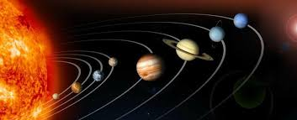
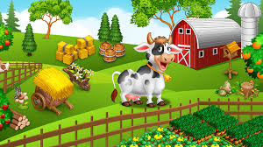
Question 6
Q6) The go-ahead has been given to build the UK’s biggest what, covering 900 acres on the north Kent coast?

Slide 8
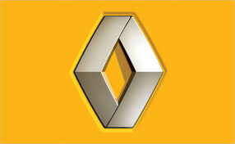
Question 7
Q7) Which French car manufacturer is cutting 15,000 jobs worldwide as part of a €2bn (£1.8bn) cost-cutting plan after seeing sales plunge because of the virus pandemic?

Slide 9
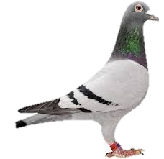
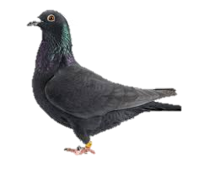
Question 8
Q8) Which was the first spectator sport to return to Britain as lockdown is eased with the first competition being held on the 1st of June?

Slide 10
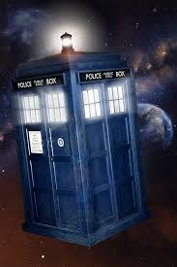
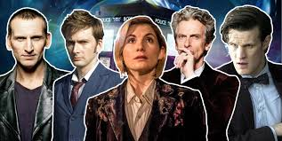
Question 9
Q9) President Trump has ended the US support and ties with which United nations medical organisation ?

Slide 11
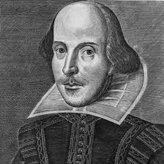
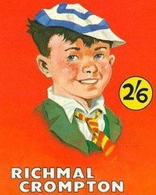
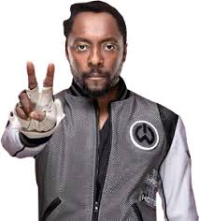
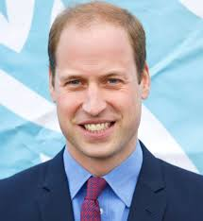
Question 10
Q10) Which British Formula 1 team, one of the most successful teams in F1 history, which dominated the sport in much of the 1980s and 1990s is up for sale after posting a £13m loss last year?

Slide 12
The Answers

Slide 13
Question 1
Q1) American astronauts Doug Hurley and Bob Behnken’s trip to the International Space Station (ISS) was made in a rocket and capsule system provided by a private company, SpaceX, what is the manned capsule on the rocket called?
Dragon capsule

Slide 14
Question 2
Q2) Dominic Cummings, Boris Johnson’s advisor incurred a lot of criticism by going to a home near his parents when he had corona virus, in which English County?
Durham

Slide 15
Question 3
Q3) Why has a team of Chinese surveyors climbed Mount Everest, becoming the only climbers to summit the world's highest peak during the coronavirus pandemic?
To check its height

Slide 16
Question 4
Q4) Which country has become the first the first in Central America to legalise same-sex weddings?
Costa Rica
???????

Slide 17
Question 5
Q5) In which US city was an African American killed by a policeman kneeling on his neck sparking protests and riots across the USA this last week?
Minneapolis

Slide 18
Question 6
Q6) The go-ahead has been given to build the UK’s biggest what, covering 900 acres on the north Kent coast?
Solar farm

Slide 19
Question 7
Q7) Which French car manufacturer is cutting 15,000 jobs worldwide as part of a €2bn (£1.8bn) cost-cutting plan after seeing sales plunge because of the virus pandemic?
Renault

Slide 20
Question 8
Q8) Which was the first spectator sport to return to Britain as lockdown is eased with the first competition being held on the 1st of June?
Pigeon Racing

Slide 21
Question 9
Q9) President Trump has ended the US support and ties with which United nations medical organisation ?
WHO (World Health Organisation)

Slide 22
Question 10
Q10) Which British Formula 1 team, one of the most successful teams in F1 history, which dominated the sport in much of the 1980s and 1990s is up for sale after posting a £13m loss last year?
Williams

