Slide 1
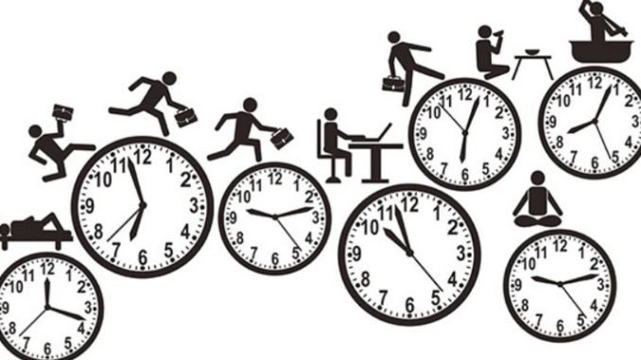
Title: Coronavirus and Maintaining a Good Routine
Focus on Goals – By the end of the lesson you will be able to:

Slide 2
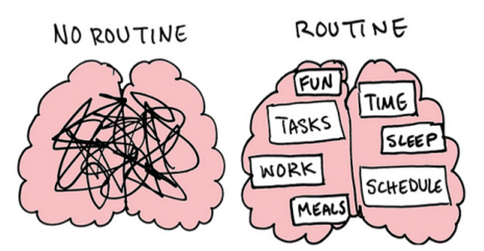
Coronavirus has caused a lot of sudden changes, and for a lot of people our lives have completely changed.
Many of the activities or routines we once had are no longer doable.
It’s easy to feel like our days are aimless.
If you’re struggling with this, it’s okay, you are not alone!
The experts all agree that setting and sticking to a regular schedule is key, even when you’re all at home all day - keeping some structure is important!
Consistency and structure are calming during times of stress and you benefit from knowing what’s going to happen and when.

Slide 3
Early Morning:
Wake up at a set time
Have some breakfast
Go over the work that needs to be completed for the day
Morning:
Get dressed for the day ahead - simply getting out of your pyjamas and getting dressed will automatically make you feel more productive.
At this point you should feel ready to start your work for the current day – everybody will have different tasks to do during this time so I recommend fully throwing yourself into whatever it is that you are doing.
This will help to focus your mind and bring you into the present moment, which is something that I think that everybody could benefit from at the moment.

Slide 4
Lunch time:
Have a break from the work you are doing, this could include getting in some for of exercise (following government guidance of course).
Make sure you’re eating at the right times, and try to maintain a balanced diet.
Afternoon:
Following the completion of your tasks for the day, spend some time planning the next day - it is so important to be organised and to be constantly setting achievable goals as this will help to keep your mindset positive and focused.
Do something to keep active. This could be a home workout (there are loads online) or simply going for a walk – it is super important to keep your body moving if you feel able to, as you will not only feel the physical benefits, but also the mental benefits.

Slide 5
Early Evening:
This is now the time to start to relax and to calm your mind and thoughts – I recommend putting your phone away as much as you can during this time as it will help to relax you more (difficult, I know).
Activities could include reading or pampering yourself in some way, but feel free to do anything during this time that relaxes you and makes you happy.
Once you are relaxed, this is the time that you could be contacting friends and family via text or Facetime as it’s SO IMPORTANT to keep talking – it is easy to forget that your friends and family are still available to contact, but please try and do this as much as possible as you never know when somebody needs cheering up.

Slide 6
Evening:
Make sure you have dinner, this could be time spent with family and reflecting on the day you’ve all had. You may be sick of the sight of the people you’re living with but it is important that you keep talking to each other and maintain these relationships.
You could spend time together watching a movie, but it is important to think of activities that make us happy that we can do indoors, so try and think of your preferred evening activity and do it.
Just before going to sleep, put your phone away again and think of things that you are grateful for – although this might sound cheesy, it is so beneficial to do this, especially during a time where the world seems so unfair.

Slide 7
Now it is your turn – use the template and come up with a routine that you are going to try and follow for the following week, there are some helpful hints and tips for mental wellbeing to assist you with this too.
I hope that this routine has been somewhat helpful and can hopefully inspire you to KEEP GOING and STAY STRONG.
The important thing is if you make a routine but don’t always feel like you can stick to it, that’s fine. Listen to your body.
But if you can, it’s good to try and keep going with things as much as possible. This strange time will pass so there is EVERY POINT in still continuing!
Stay safe. Stay positive. Stay strong.

Slide 8
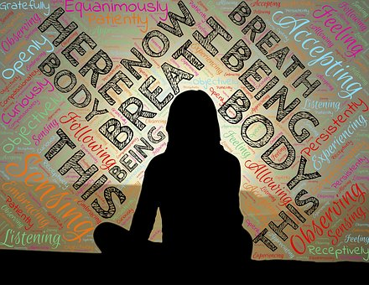
Top Tips for Mental Wellbeing:
Taking breaks from technology. It can create strain on the eyes, disrupt sleep, overstimulate your brain and normally technology is linked to a lack of movement.
Spend time outside in nature. Nature is healing, going to your local park or green space and taking a walk is a great way to destress.
Eat fresh fruit and vegetables daily. Food helps to build and nourish your body, it provides energy and helps you when you’re not feeling well. Aim for at least 5 portions daily.
Breathing exercise. Practice breathing slowly into your stomach, through your nose and out slowly to calm down nervousness. Left and right nostril breathing is all good for enhancing these effects.

Slide 9
Top Tips for Mental Wellbeing:
Find a creative activity. Finding a way to expressive yourself through your chosen form of art from acting, playing an instrument, art, writing short stories or poems is great for relaxing and spending time away from technology.
Limit phone time. Social Media can be a very negative environment and hyperfiltered which can distort how we see and feel about ourselves. Breaks are a good reminder that social media is a filtered highlight reel, not real life.
Talk about your problems. They can seem much worse in your head, especially if you don’t talk about them and let them build up.

Slide 10
Top Tips for Mental Wellbeing:
Meditation. Close your eyes for a few minutes each day and just focus on breathing. You don’t need to anything else but witness your thoughts and feelings.
Drink plenty of water. We are over 70% water and dehydration can cause low energy amongst other undesirable symptoms.
Write your feelings on paper. Keeping a journal, can help ease a troubled mind when you’re not ready to talk about what is bothering you.

