Slide 1

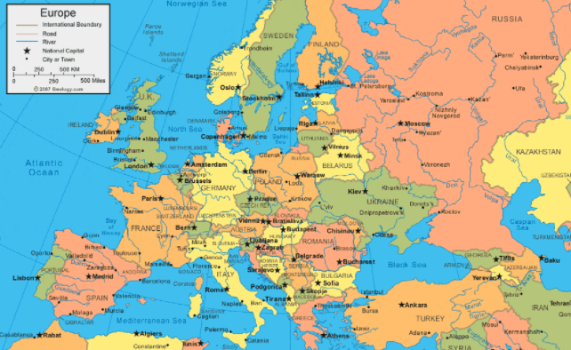
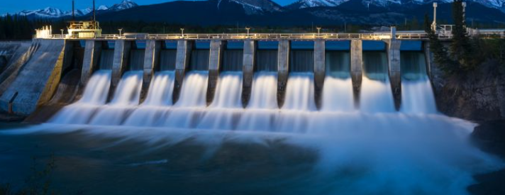
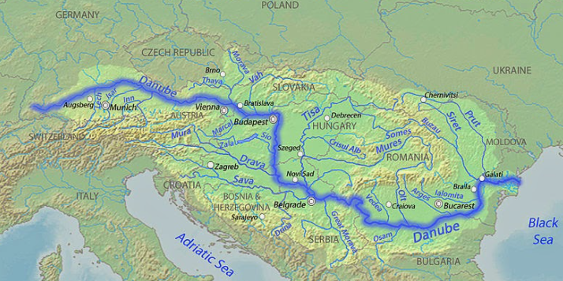
Year 3 Knowledge Organiser: Geography
Eastern and Central Europe
Map of the Europe
Key Knowledge:
1. Geographical knowledge and skills:
What is a continent? What are the 7 continents and 5 oceans?
Which countries and capital cities are located in central and eastern Europe?
Which three seas are located in Eastern and Central Europe.
2.Geographical Enquiry:
What is the importance of the river Danube?
3.Physical Geography:
What are the different landscapes of Russia?
What is the longitude and latitude of eastern and central Europe?
4. Human Geography:
How do humans use the river Danube?
Vocabulary
Central Europe - Austria, Czech Republic, Germany, Hungary, Liechtenstein, Poland, Switzerland
Eastern Europe – Romania, Moldova, Bulgaria, Russia
hydroelectricity
freight
irrigation
fishing
tourism
farming
Hydroelectric Power
River Danube

