Slide 1

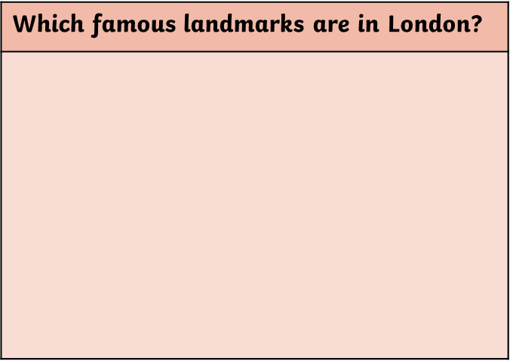
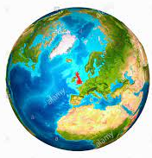
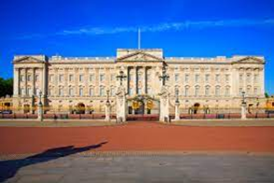
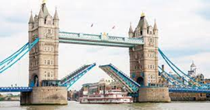

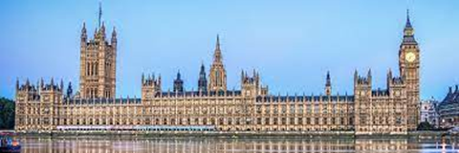
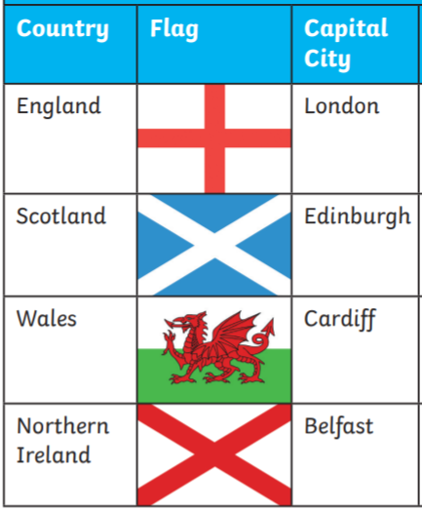
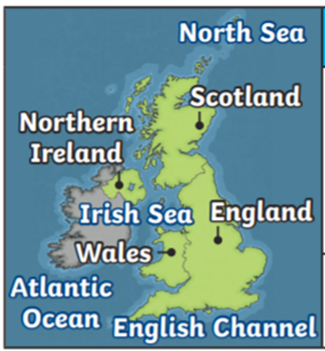
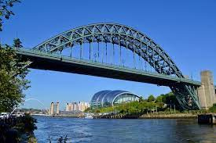
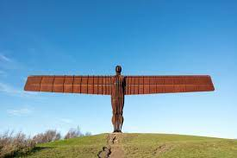
Year 1 Knowledge Organiser – Geography
The United Kingdom
Where is the United Kingdom?
What are the flags of the United Kingdom? What are it’s capital cities?
Planet Earth
The Union Flag
Buckingham Palace
Tower Bridge
The United Kingdom
The Houses of Parliament
Which countries are part of the United Kingdom? Which seas surround it?
Which town do we live in? Which city is nearest to us? What landmarks are nearby?
Newcastle
Gateshead
The Tyne Bridge
The Angel of the North
The Sage
River Tyne

