Slide 1

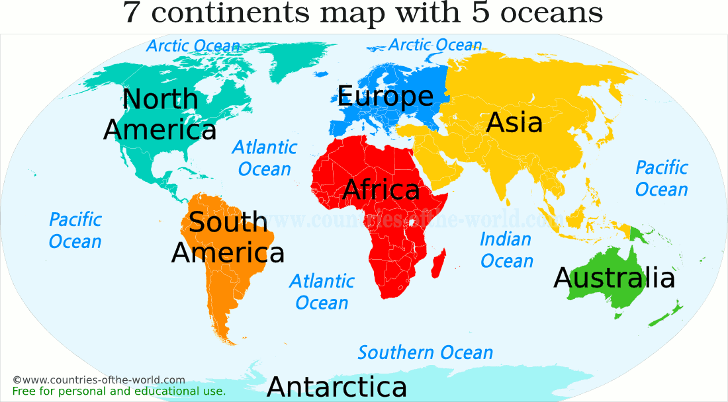
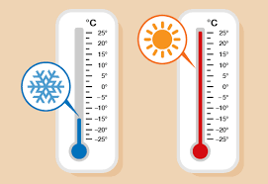
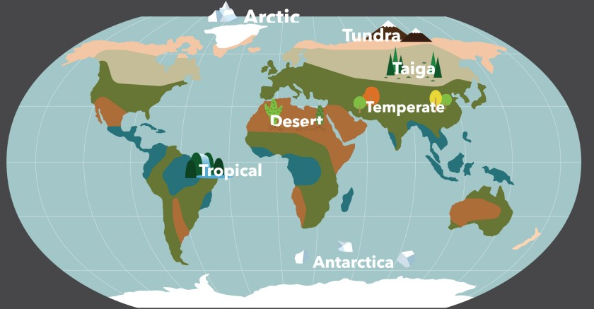
Year 3 Knowledge Organiser: Geography
The Living Planet
Map of the World
Key Knowledge:
1. Geographical knowledge and skills:
What is a continent? What are the 7 continents and 5 oceans?
Locate the North and South poles.
2.Geographical Enquiry:
What does the weather look like in the UK? Does it look different in different parts of the world?
What is the different between weather and climate?
3.Physical Geography:
What is the difference between the desert and a rainforest? Can you name major biomes? Which animals are suited to certain biomes?
Vocabulary
Continent: Africa, Antarctica, Asia, Australasia, Europe, North America and South America.
Ocean: The Arctic Ocean, the Atlantic Ocean, the Indian Ocean, the Pacific Ocean and the Southern Ocean.
Climate
Biomes
Map
Atlas
Temperature
Equator
Temperature
Biomes

