Slide 1
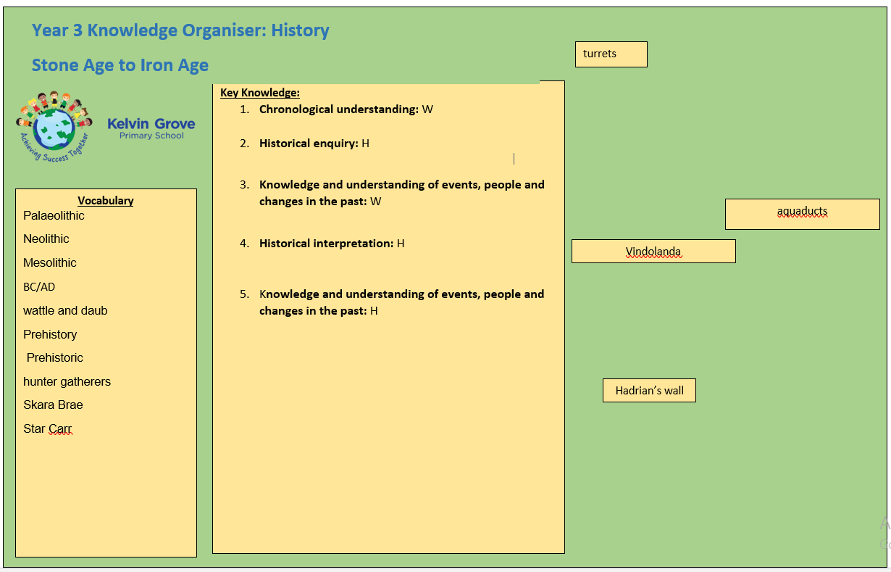
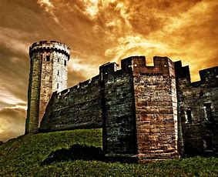
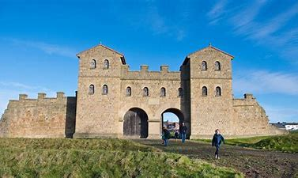
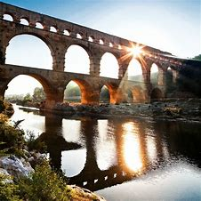
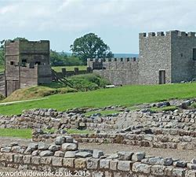
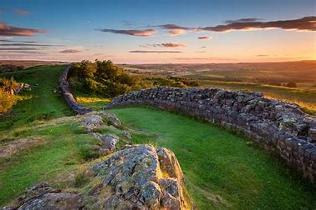
Year 3 Knowledge Organiser: History
Romans
fort
Key Knowledge:
When did the Romans invade Britain? Were they successful? Who ruled Italy during these invasions?
How has life changed after they invaded Britain? Are there similarities and differences in past and present lifestyle?
How did the Romans impact how we live today? What technologies and developments did they bring to Britain?
Why was Hadrian’s wall built? Who built the wall? Why were there turrets, forts and milecastles? Why is Vindolanda significant?
Vocabulary
Romans
Soldiers/ military
Emperor Hadrian
Celts
Tribes
Money
Wealth
BC Before Christ
AD Anno Domini

Slide 2
Year 3 Knowledge Organiser: History
Romans
fort
Key Knowledge:
Chronological understanding: When did the Romans invade Britain? Who ruled Italy during these invasions?
Historical enquiry: How has life changed after they invaded Britain?
Knowledge and understanding of events, people and changes in the past: What did the Romans bring with them to Britain? Where is Italy and Britain?
Knowledge and understanding of events, people and changes in the past: Why was Hadrian’s wall built? Who built the wall?
Vocabulary
Romans
Soldiers
Emperor Hadrian
Tribes
Money
BC Before Christ
AD Anno Domini

