Slide 1

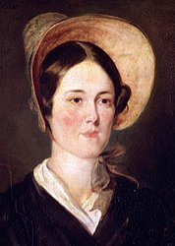
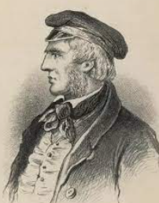
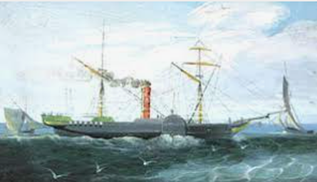
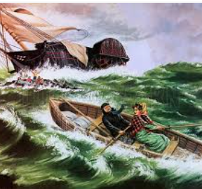
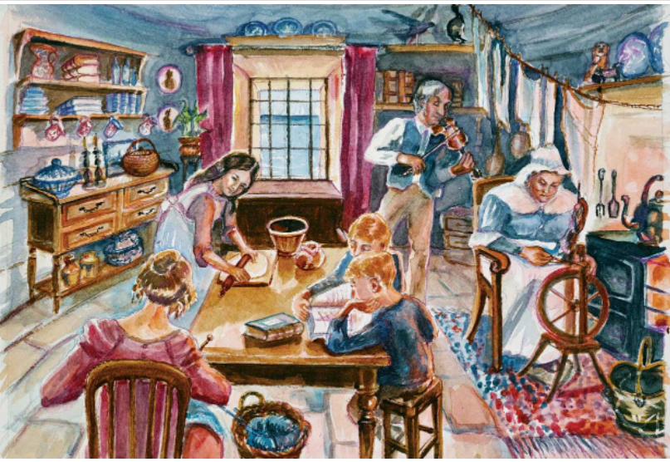
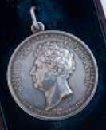
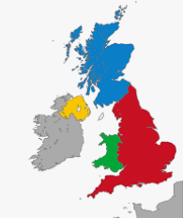
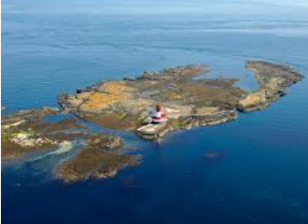
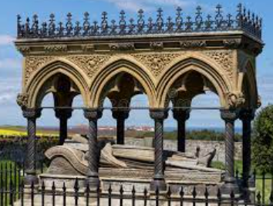
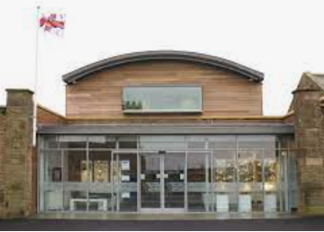
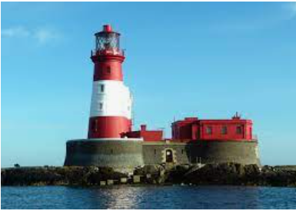
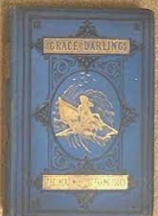
Year 1 Knowledge Organiser – History
Grace Darling
Who was Grace Darling?
What was her life like?
Why is Grace Darling considered a significant person? What did she do?
Born 24th November 1815
Grace’s father, William was the lighthouse keeper.
S.S. Forfarshire
7th September 1838
shipwreck
Died 20th October 1842 (age 26)
Her mother was called Thomasin.
survivors
coble
rescue
Grace had 4 brothers and 4 sisters.
oars
First woman awarded the Silver Medal for Bravery
Where did she live?
The Farne Islands, off the Northumberland Coast
How is she remembered?
Grace Darling Memorial
Book – The Heroine of the Farne Isles
Longstone Lighthouse
The Grace Darling Museum
No one else lived on the island,

