Slide 1

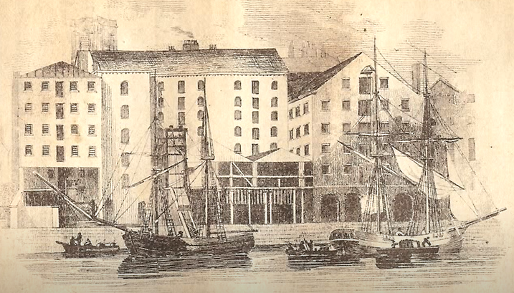
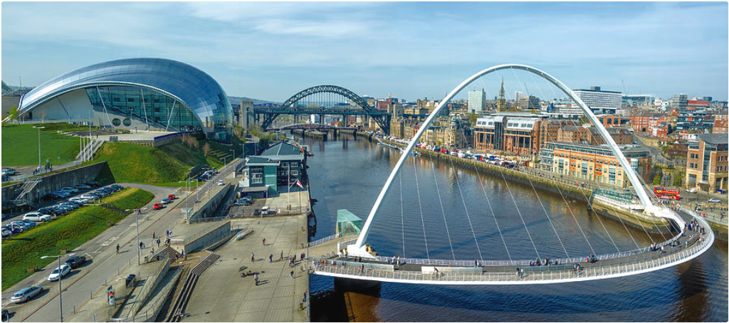
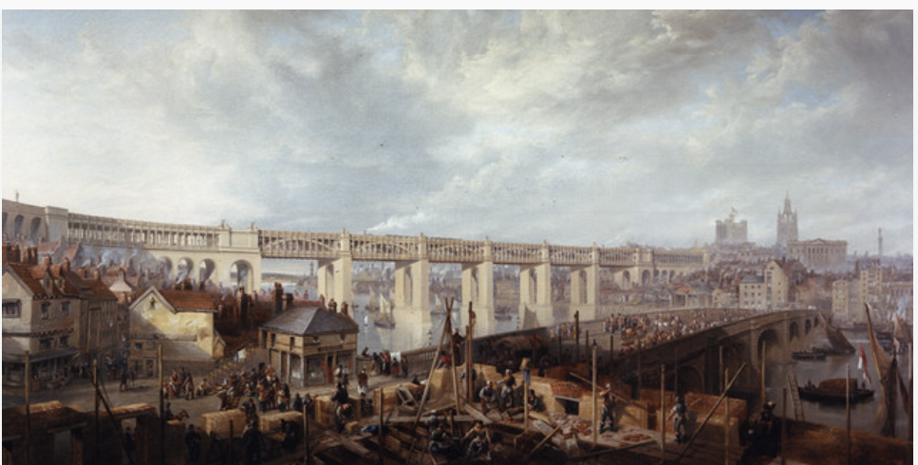
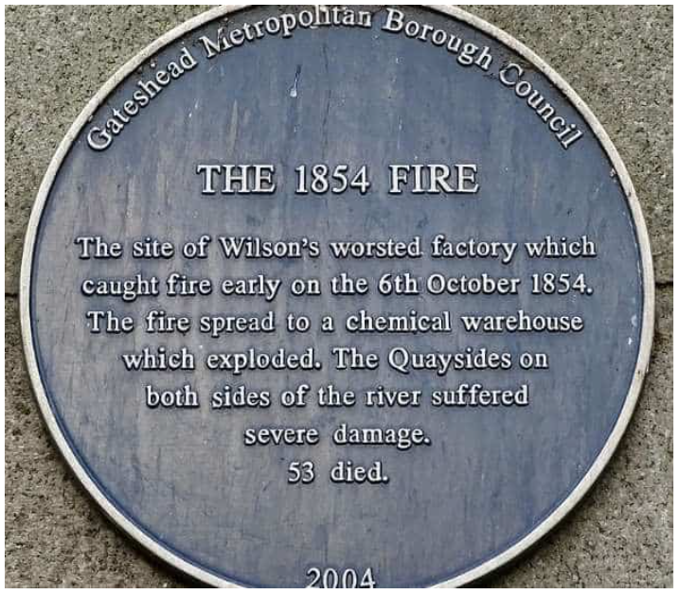
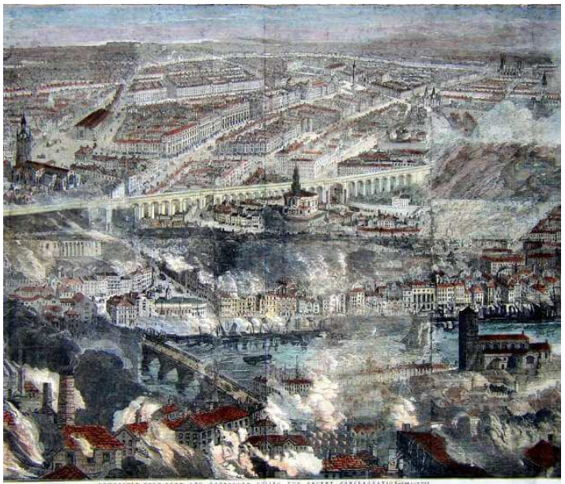
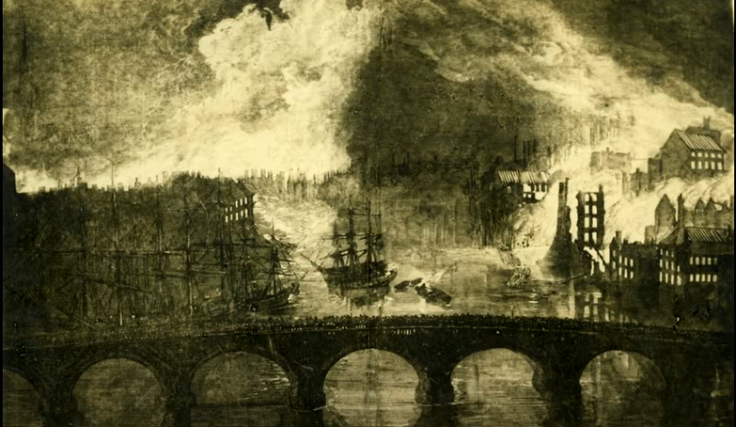
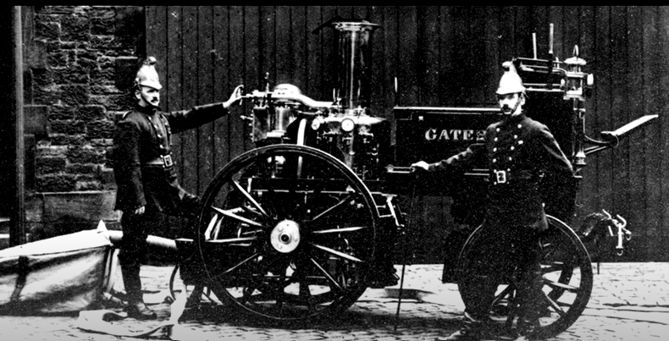
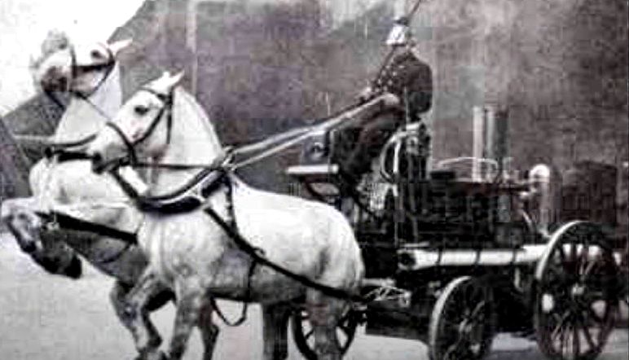
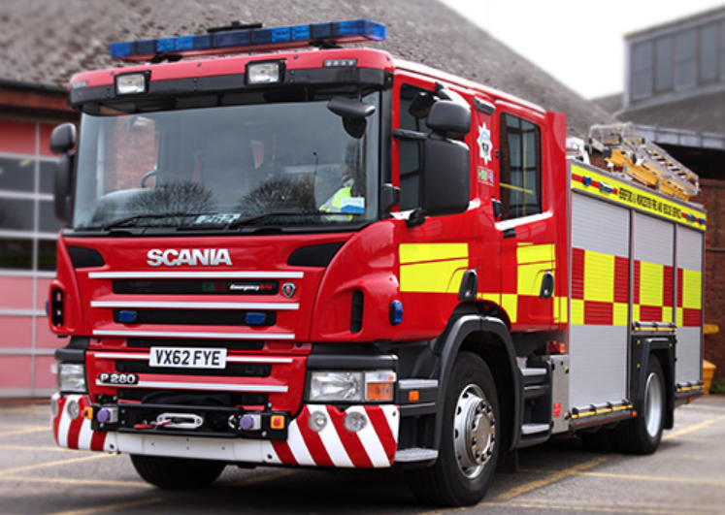
Year 1 Knowledge Organiser – History
The Great Fire of Gateshead
Then (Before I was born) |  | Now
 | Where did it happen?
 | What happened?
 | How was it put out?
High Level Bridge
Gateshead
warehouses
Quayside
Newcastle
River Tyne
6th October 1854
Wilson’s Warehouse
Worsted
Wool
Oil
flames
explosion
fire
Bartram’s Warehouse
Chemicals
Sulphur
horse-drawn fire engine
water pumps
river water

