Slide 1
Ruby Bridges
by
Ava

Slide 2
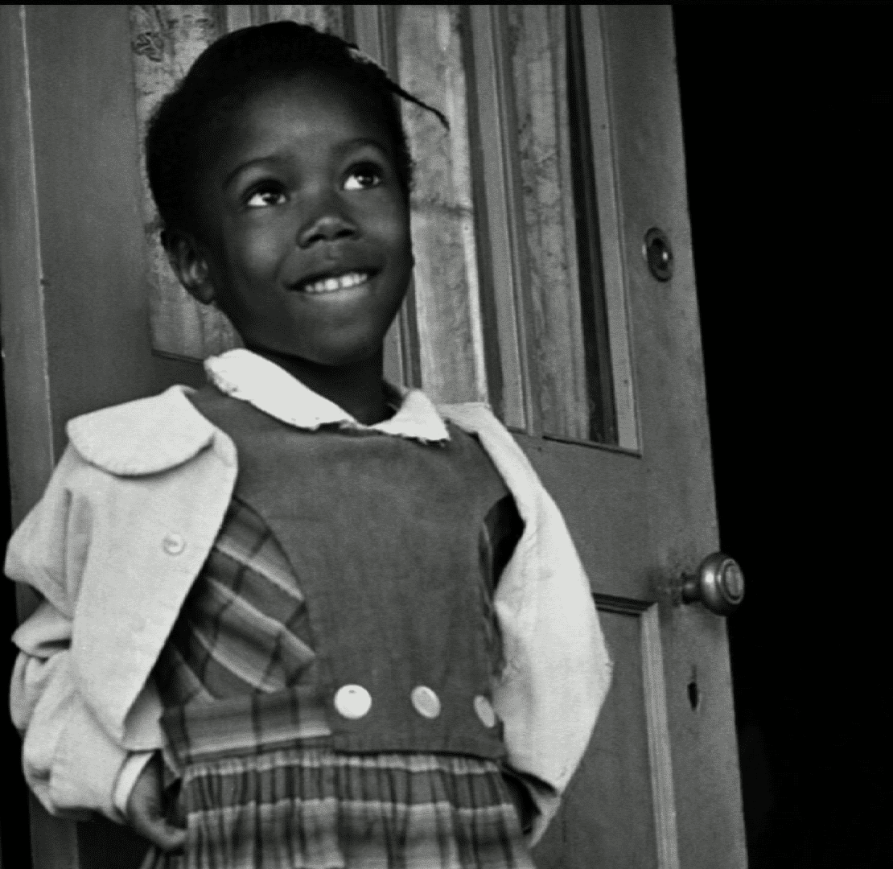
Who is Ruby Bridges?
Ruby was born the same year that a very important Supreme Court.Ruby Bridges was born on September 8,1954.Ruby bridges family would plant crops but they didn’t own the land. Her family was not rich but they were poor.

Slide 3
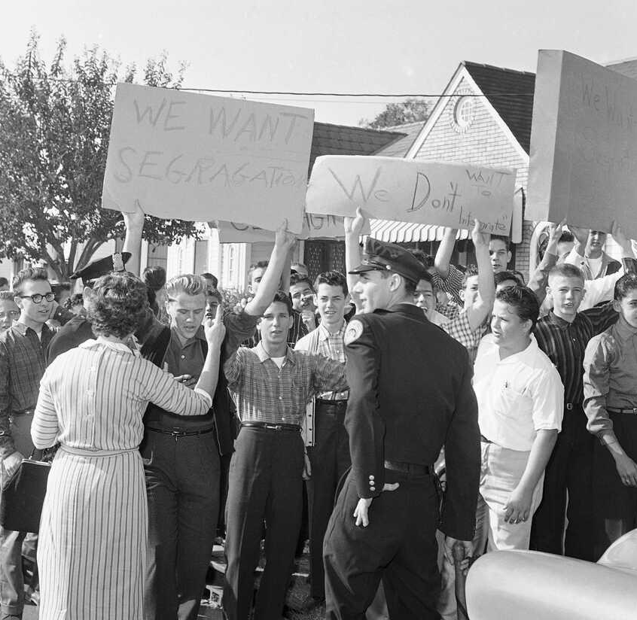
What was America like before 1960?
Black people would not be aloud to got to white school because it was illegal. White people had there own bathroom,school,restaurant,car,bus,house and toys. The country Louisiana did not follow that rule of black and white people.

Slide 4
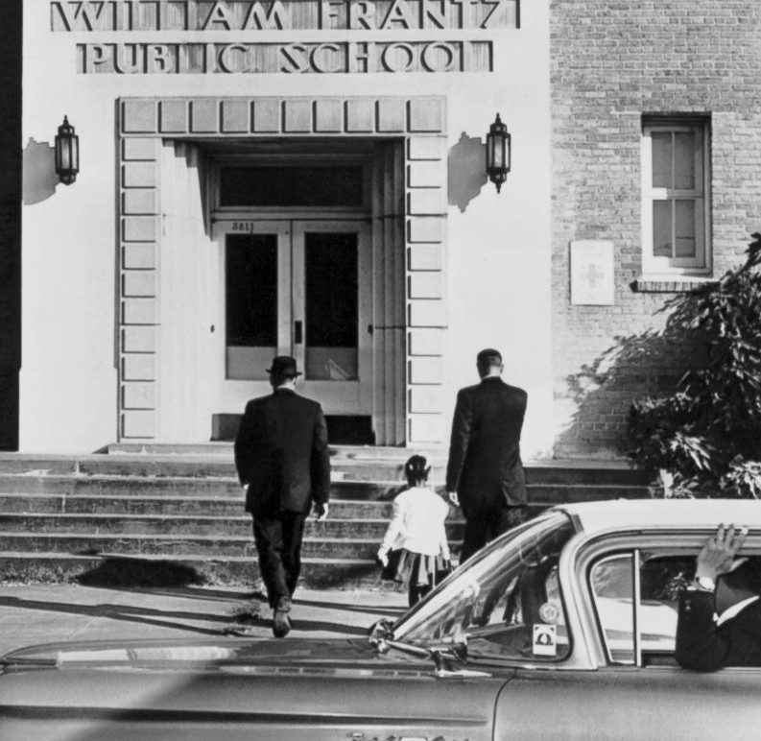
Ruby going to school
Ruby bridges was 6 years old when she went to William grants Elementary school with all white children.Ruby had went to school on 14,of November 1960.when it was ruby's first day she walk with four police people even going to the toilets.But everyone noticed Ruby wouldn’t cry once.

Slide 5
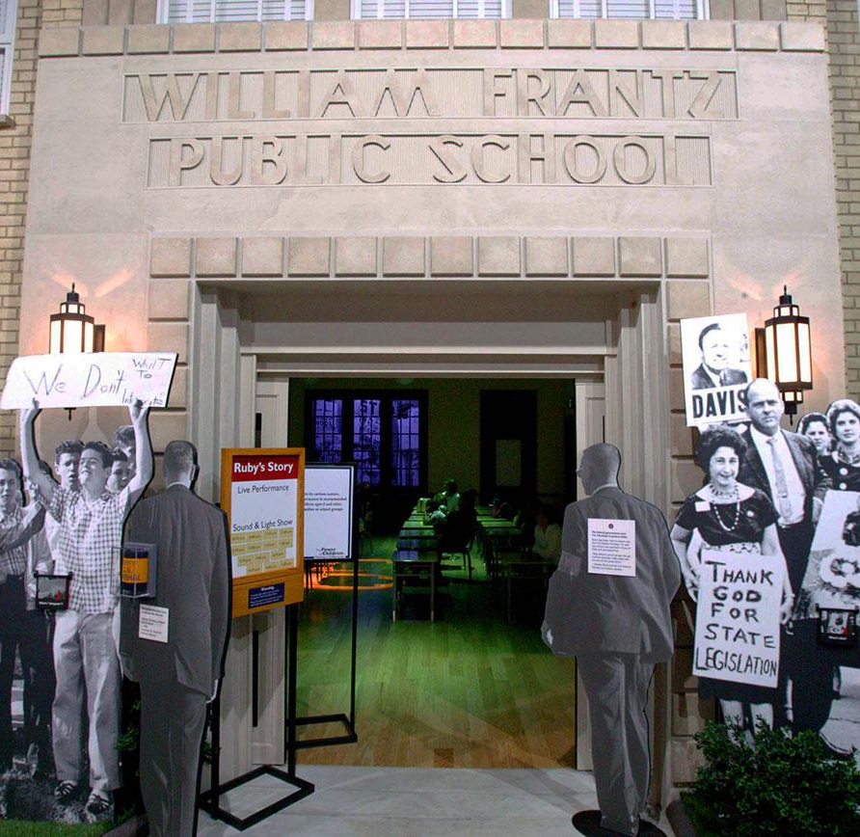
Problems at school
When Ruby was walking to school on her second school a woman said she would poison her.Ruby would feel lonely because there was Ruby and miss Henry was white so she was not popular.miss Henry was the only teacher that would teach Ruby.

Slide 6
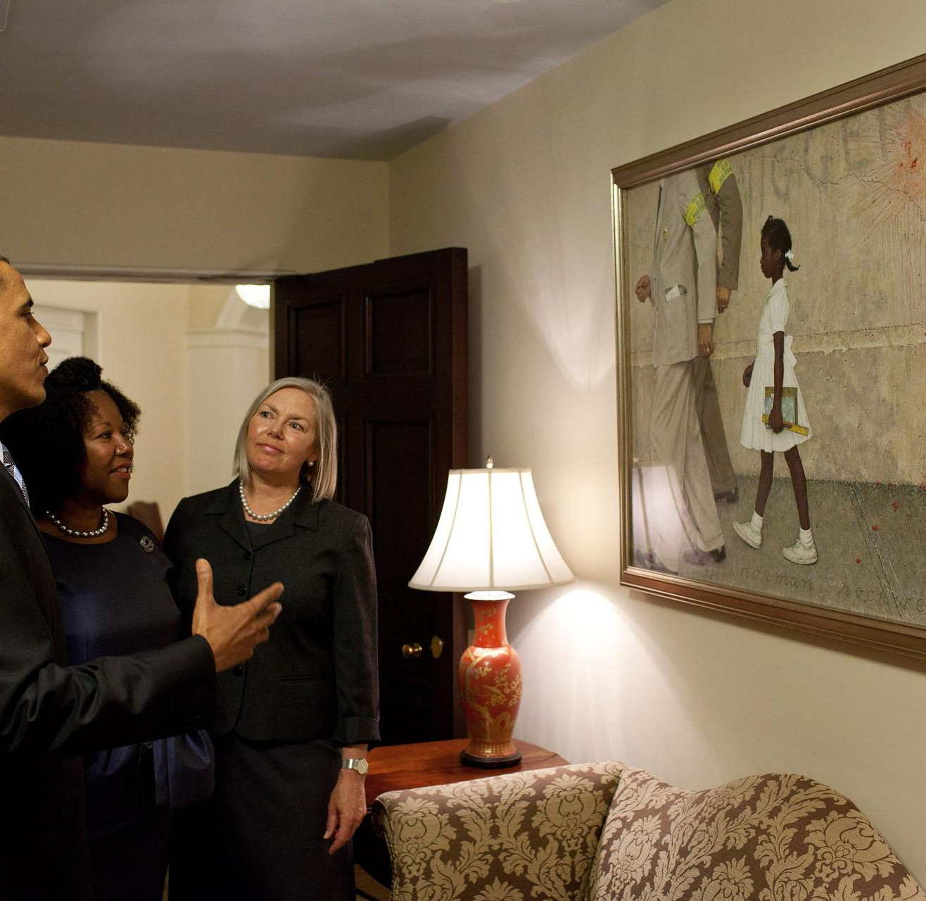
Ruby’s later life
Ruby received an education.In 1993 she learned her brother had been shot and killed in New Orleans ,Louisiana. After Ruby found out her brother died she felt melancholy.

