Slide 1
Ruby Bridges
by
Richard

Slide 2
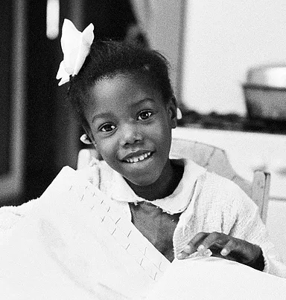
Who is Ruby Bridges?
On September 8th,Ruby Bridges was born in Mississippi.Her family was not that wealthy so they moved to New Orleans to seek better Opportunities. Did you she was determined to get lots of good education?

Slide 3
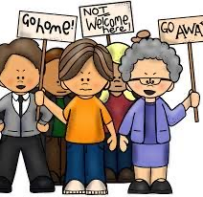
What was America like before 1960?
Segregation was mainly in America,especially in the south.Often in the USA,black people did not mix with white people.Did you know that people could not even mix in Restrooms so one side was for black people and one was for white people?

Slide 4
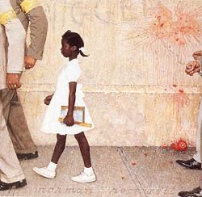
Ruby going to school
On November 14,1960 Ruby Bridges made history.She was the first African American girl to ever go to an all white school.The police had to escort her everywhere around the school,even when she went to the restroom.On her first day,white kids began to chuck things at her and she tried to encore them.

Slide 5
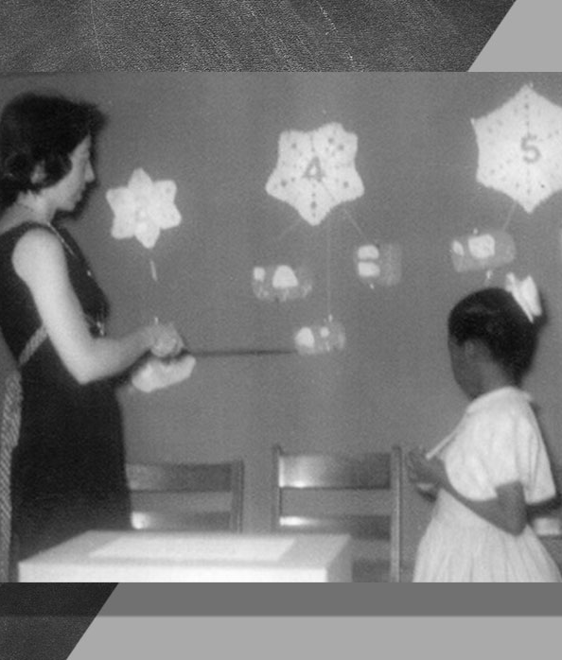
Problems at school
Ruby was sadly the only one to be in her classroom so she couldn’t make any friends in her first year.She was extremely determined to get lots of good education. She really enjoyed studying with her teacher Miss Henry because she was the only person she knew in the school.

Slide 6
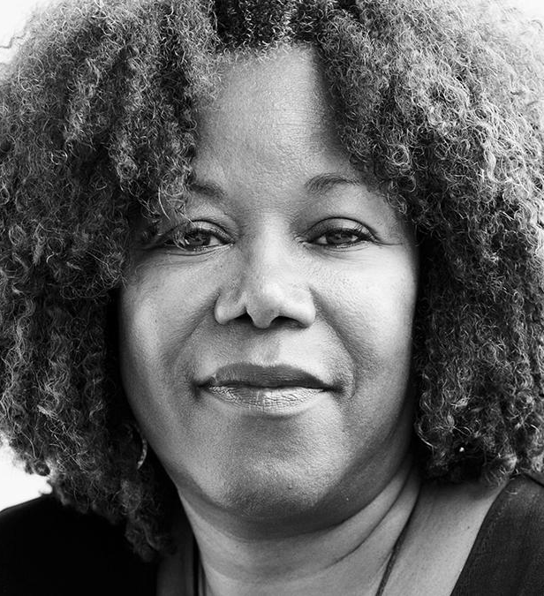
Ruby’s later life
Now in modern age,Ruby bridges is a Civil Rights Activist with her own company with lots of good workers.Did you know that when she was in her office,she found out that her brother was shot and killed

