Slide 1
Ruby Bridges
by
Asmin

Slide 2
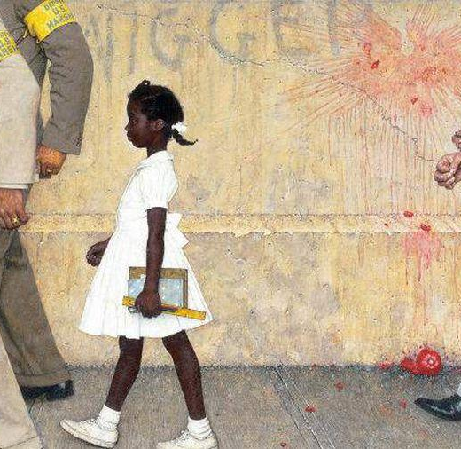
Who is Ruby Bridges?
Ruby Nell Bridges-who was a brave little girl born in 8 September 1954,Mississippi-is famous for being the first African American student to attend an all-white William Frantz Elementary school in 1960.She moved to New Orleans in 1958 at just four years old to get a better education(at William Frantz Elementary school).Ruby is working as a civil rights activist to try and stop segregation in parts of the world and is making changes to help people with different skin colour.

Slide 3
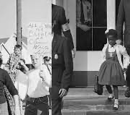
What was America like before 1960?
In the early 60s ,segregation of people based on their skin colour was common in the United States especially in the South.Because of people’s race,black people were treated unfairly for example:they couldn’t drink out of the same fountain,they had separate toilets,restaurants and even black children were not allowed to attend the same school!

Slide 4
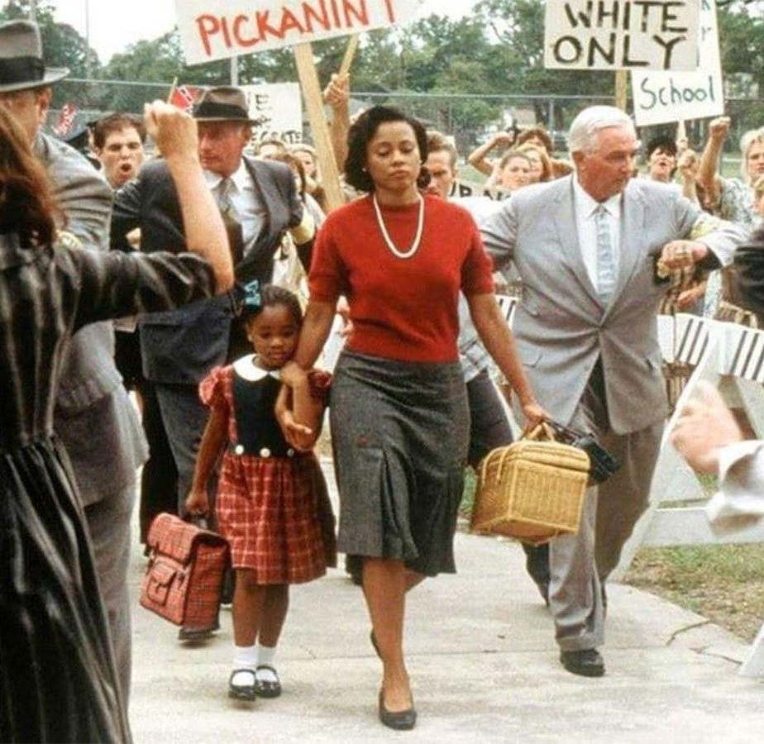
Ruby going to school
In 1960 despite Supreme Court stating that segregation was illegal,in many states and schools across America,it was not followed like Louisiana.When court ordered for schools to segregate,Ruby passed a test that made her selected for the process and was allowed to attend William Frantz Elementary School.

Slide 5
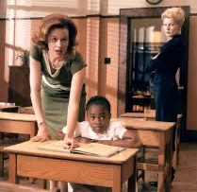
Problems at school
On the first day of attending school,something heartbreaking happened to Ruby as when she was going to school,she thought that she was being cheered on by a crowd of people however,it turned out that they were angry instead.That same year,many parents stopped their children from attending the school for a year just because she had a different race.Only one abroad teacher was willing to teach young Ruby at the time and she never had the schools food after an incident happened where a women threatened to poison her.

Slide 6
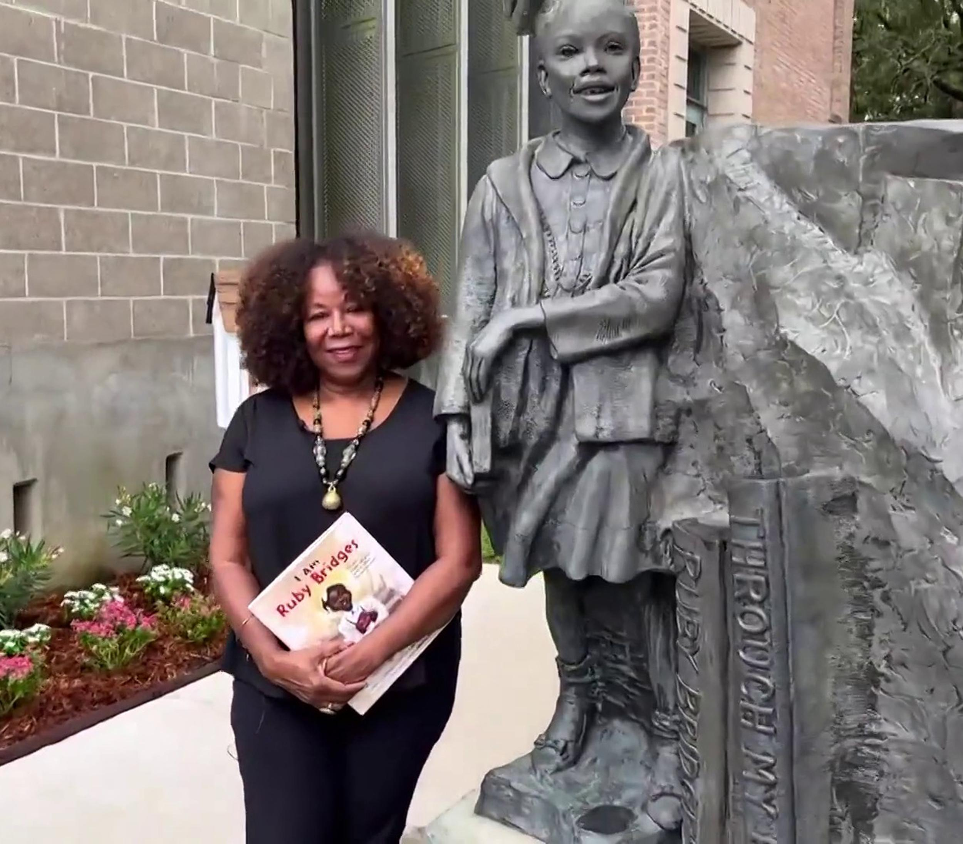
Ruby was thrived in school and was determined to have a great education throughout her life.Unfortunately,in 1993,Ruby experienced a heartbroken setback when her brother was shot and killed in New Orleans,Louisiana.After that horrible moment in her life,she worked as a civil rights activist to help stop segregation in places of the world.When she went to visit the White House to see Barack Obama,he exclaimed”If it wasn’t for you,I would probably not be here today!”

