Slide 1
Ruby Bridges
By. Kenny

Slide 2
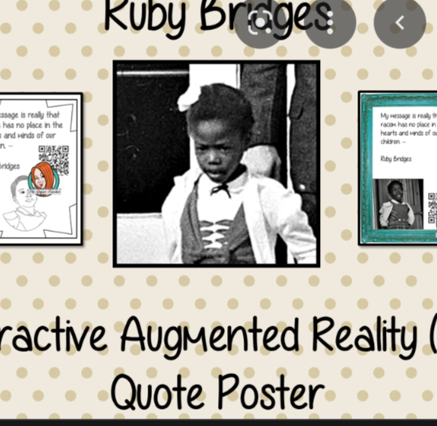
Who is Ruby Bridges?
Ruby Nell Bridges was born September 8 1954 in Mississippi USA. She moved to New Orleans Louisiana when she was young. She was the first black student to attend William Frantz elementary school(like a British primary school)when she grew up she protested for black civil rights she has made changes by stopping segregation. Today she is 68

Slide 3
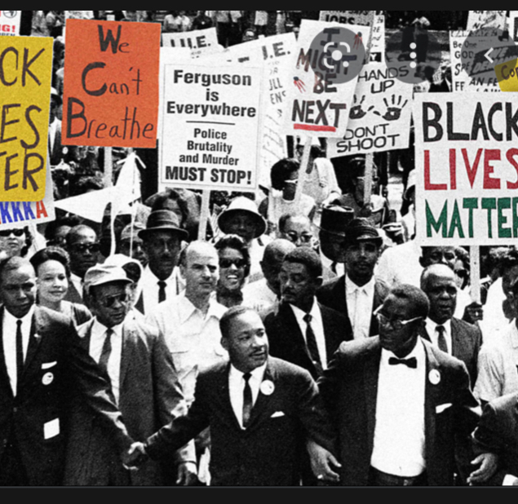
What was America like before 1960?
In the 1950s USA black students were not allowed to a school whith white pupils. Because of segregation black people were not allowed to use or attend the same:drinking fountains toilets or restaurants as white people.

Slide 4
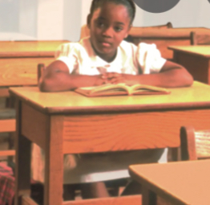
Ruby going to school
When ruby was born the supreme courts ruled that segregation was unconstitutional but some people especially in New Orleans did not follow these rules. In order to get into William Frantz elementary,she had to take a test(which she passed). Ruby’s parents had mixed feelings on her going to school her mother wanted her to go whereas her dad didn’t because of severe bullying (racism).

Slide 5
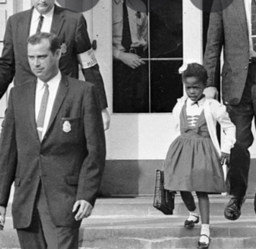
Problems at school
Ruby could not be in the same class as her white peers. A woman threatened to poison her and somebody else threatened her with a black doll in a coffin.

Slide 6
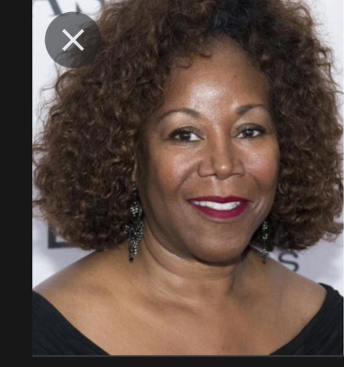
Ruby’s later life
She protested for black civil rights. Her brother was killed so she protested once again. She is now 68 and lives a happy life.

