Slide 1
Year 6 SATs Tests 2022
9th-12th May 2022

Slide 2
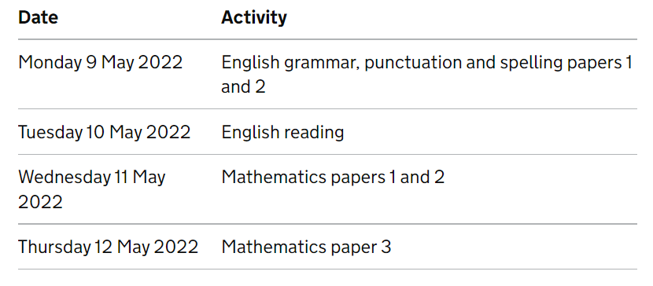
Time Table for the Week

Slide 3
The Big Picture
Children are formally assessed against national expectations at the end of each Key Stage.
End of KS1 – Y2
End of KS2 – Y6
Children will be assessed against the national curriculum.
The expectations have remained inline with recent years.
We continually assess the children to prepare them for the next steps in their learning.

Slide 4
Scaled scores
Every pupil will receive:
A raw score for each test
A scaled score: 100 = national expectation
Confirmation of whether or not they attained the expected national standard.

Slide 5
English Grammar, Punctuation and Spelling Test
The test will assess children’s ability in grammar, punctuation, spelling and vocabulary.
Paper 1 has short answer questions (40-50 questions) assessing grammar, punctuation and vocabulary (50marks) . Paper 2 assesses spellings (20 marks).
If requested, questions can be read to the child.

Slide 6
The Reading Test
Children are allowed 1 hour for the reading test.
The test will include 3 or 4 different texts – past examples include stories, poems, explanations, classic texts, interviews and accounts.
The questions will range from simple retrieval to more advanced inference and deduction.
The level of vocabulary the children have to access is incredibly high.

Slide 7
The Reading Test
Children can refer back to the texts in the reading booklet throughout the tests.
Questions are: shorter closed response items and longer, more open response types.
Questions are worth 1, 2 or 3 marks.

Slide 8
The Reading Test

Slide 9
Writing
There is no writing test.
Children will be given a writing level based on continuous teacher assessment throughout the year.
Increased focus on handwriting. Children must show consistent evidence of legible, joined handwriting.

Slide 10
Mathematics Tests
There are 3 tests:
- Paper 1– Arithmetic: 30 minutes
- Paper 2 – Reasoning: 40 minutes
- Paper 3 – Reasoning: 40 minutes
If requested, questions can be read to the child.
Children’s marks from all three tests are aggregated to calculate their overall mathematics mark.

Slide 11
Top Tips
Ensure children have a good nights sleep before the tests.
Breakfast provided during SATs week.
Use the techniques taught by Tranquil Treehouse.
Talk to them about the tests.
The tests are important for the children to show what they can do.

Slide 12
Top Tips
Use Mathletics at home.
Times tables (Times Table Rock Stars and Numbots).
Reading at home – Reading Plus and Accelerated Reader.
Easter revision homework.
Attendance and punctuality.

Slide 13
Life after SATs…
Results will be sent back to school in the first few weeks of July.
The test results and a teacher assessment is reported to Secondary schools and parents.
Tests indicate what a child can do on ONE DAY, the teacher assessment gives an overview of the child’s ability over time.

