Slide 1
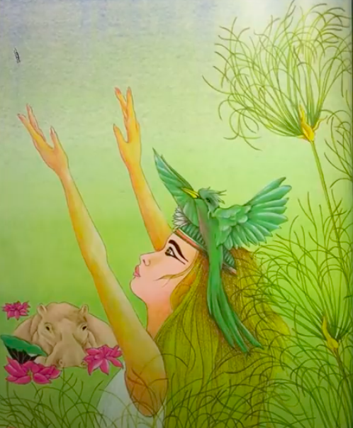
The Egyptian Cinderella.
Wednesday 7th October 2020.
L.O. To write a letter as Rhodopis, using key moments from the story.

Slide 2
Success criteria.
I can write in chronological order.
I can share a character feelings.
I can write in past tense and the first person.
I can gather evidence from a text.

Slide 3
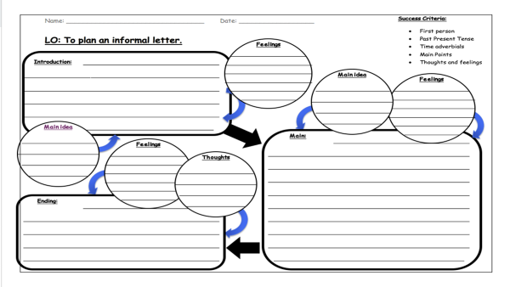
Letter planning.
Using the grid, fill out the sequence of events from Rhodopis’ point of view.
Kidnapped by pirates: how do you think Rhodopis felt about being kidnapped as a young girl? What did she think was happening?
Remember, use evidence from the text and your inferencing to fill in her point of view.

