Slide 1
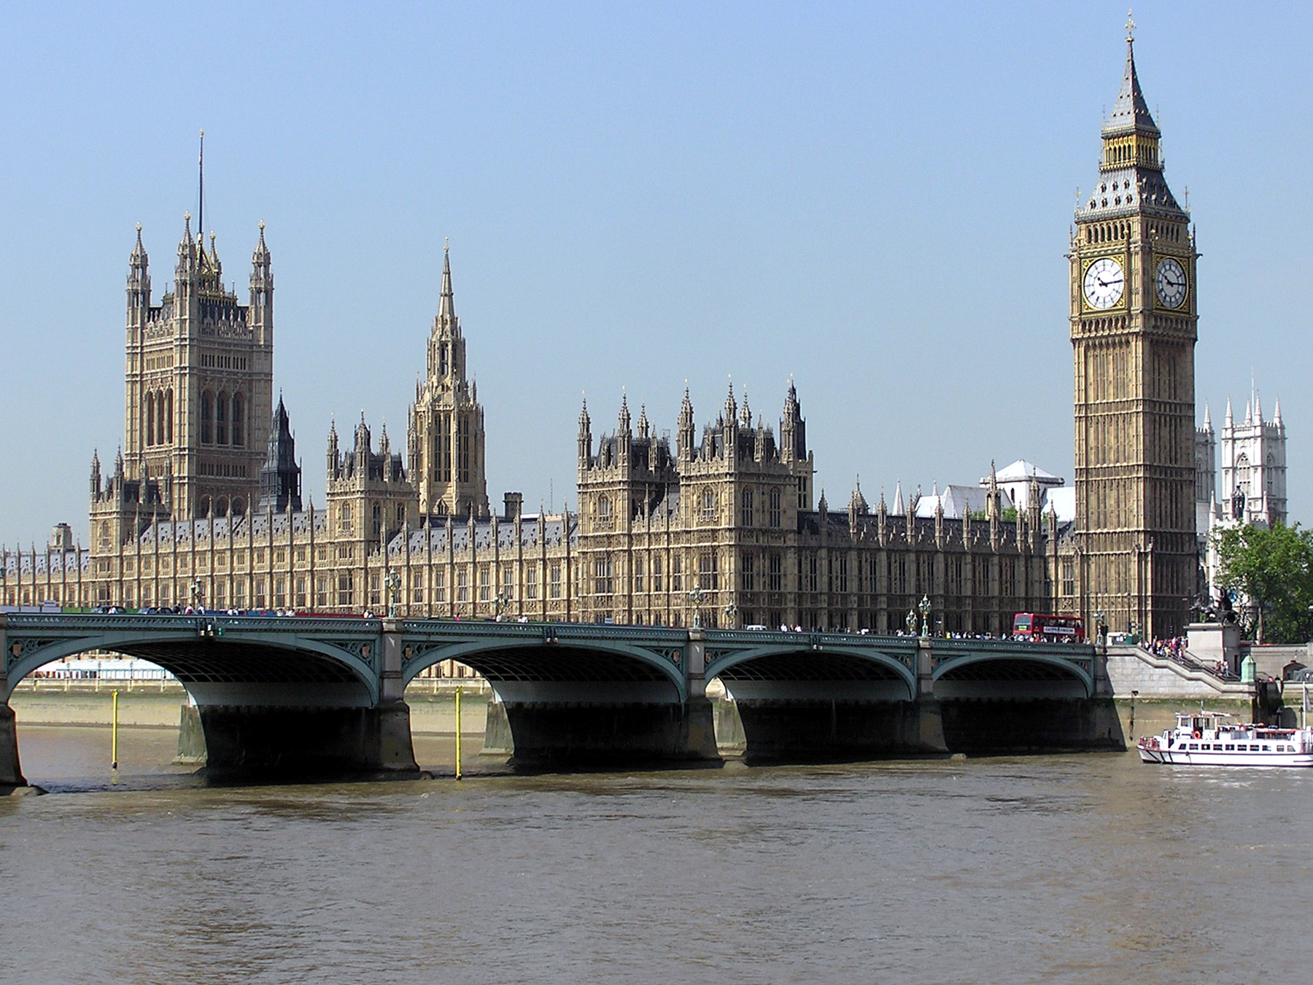
London 2026
30th April -1st May 2026

Slide 2
London 2026 | Day 1 | Day 2
Morning | Leave school at 5.45am and travel to London by luxury coach Breakfast stop on the way to London. Movies on the Coach | Breakfast at the Youth Hostel Travel by tube to Houses of Parliament and Downing St
Afternoon | Arrive in London and Visit the Tower of London and Tower Bridge. Opportunity to buy souvenirs Tea at Pizza Express | Greggs packed lunch on our walking tour , visiting Buckingham Palace, Trafalgar Square, etc. The London Eye Experience –see London from135 metres
Evening | Travel by tube to the West End and Theatre. Coach will collect us and take us back to Thameside Youth Hostel | Leave London at approx 4.30pm Tea in McDonalds on the way home Quiz with prizes on the bus Arrive home 10.30pm Approx.

Slide 3
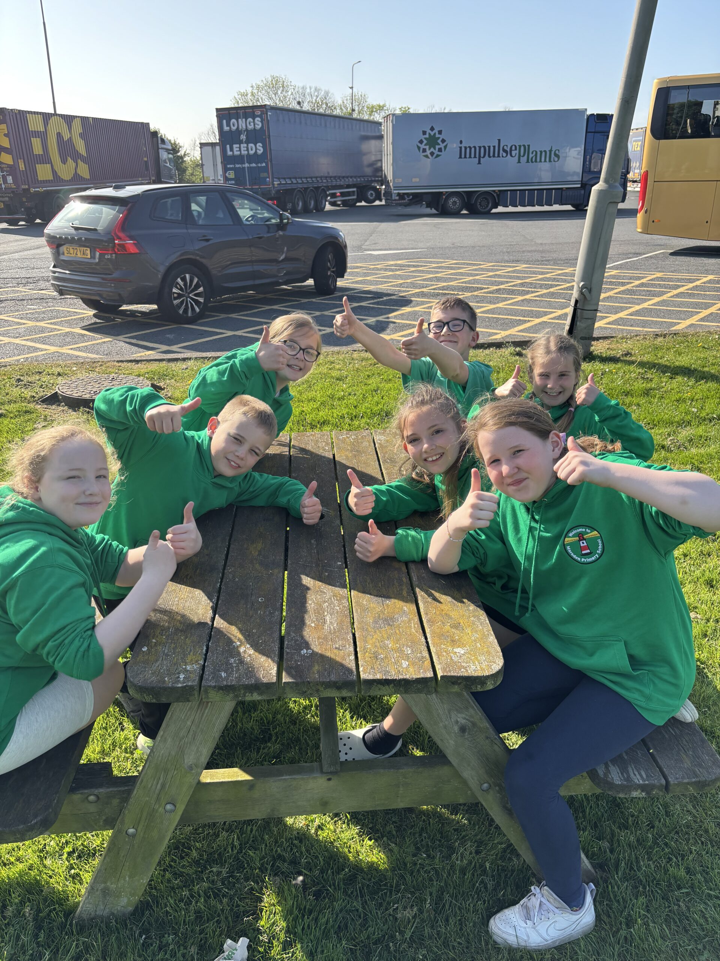
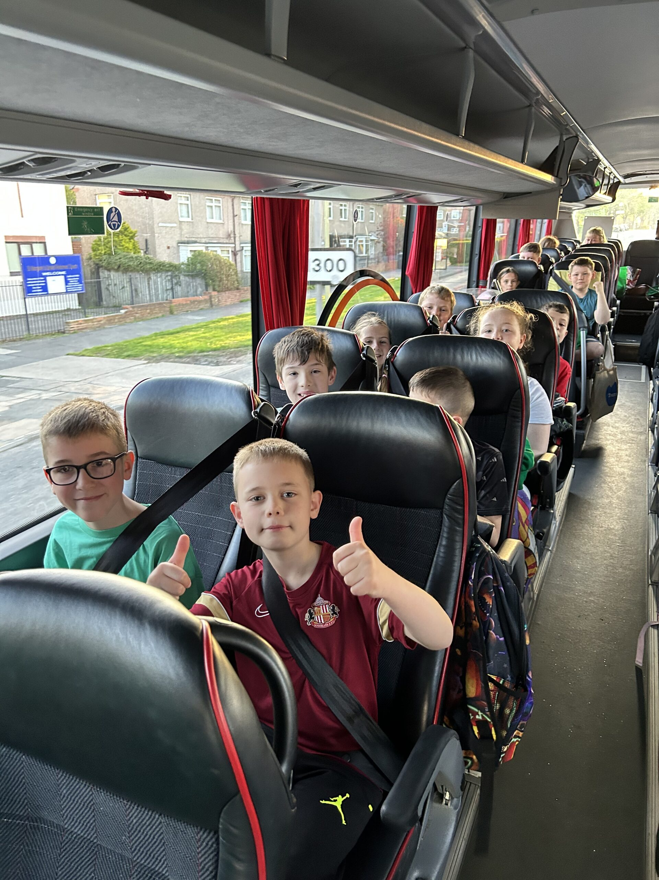
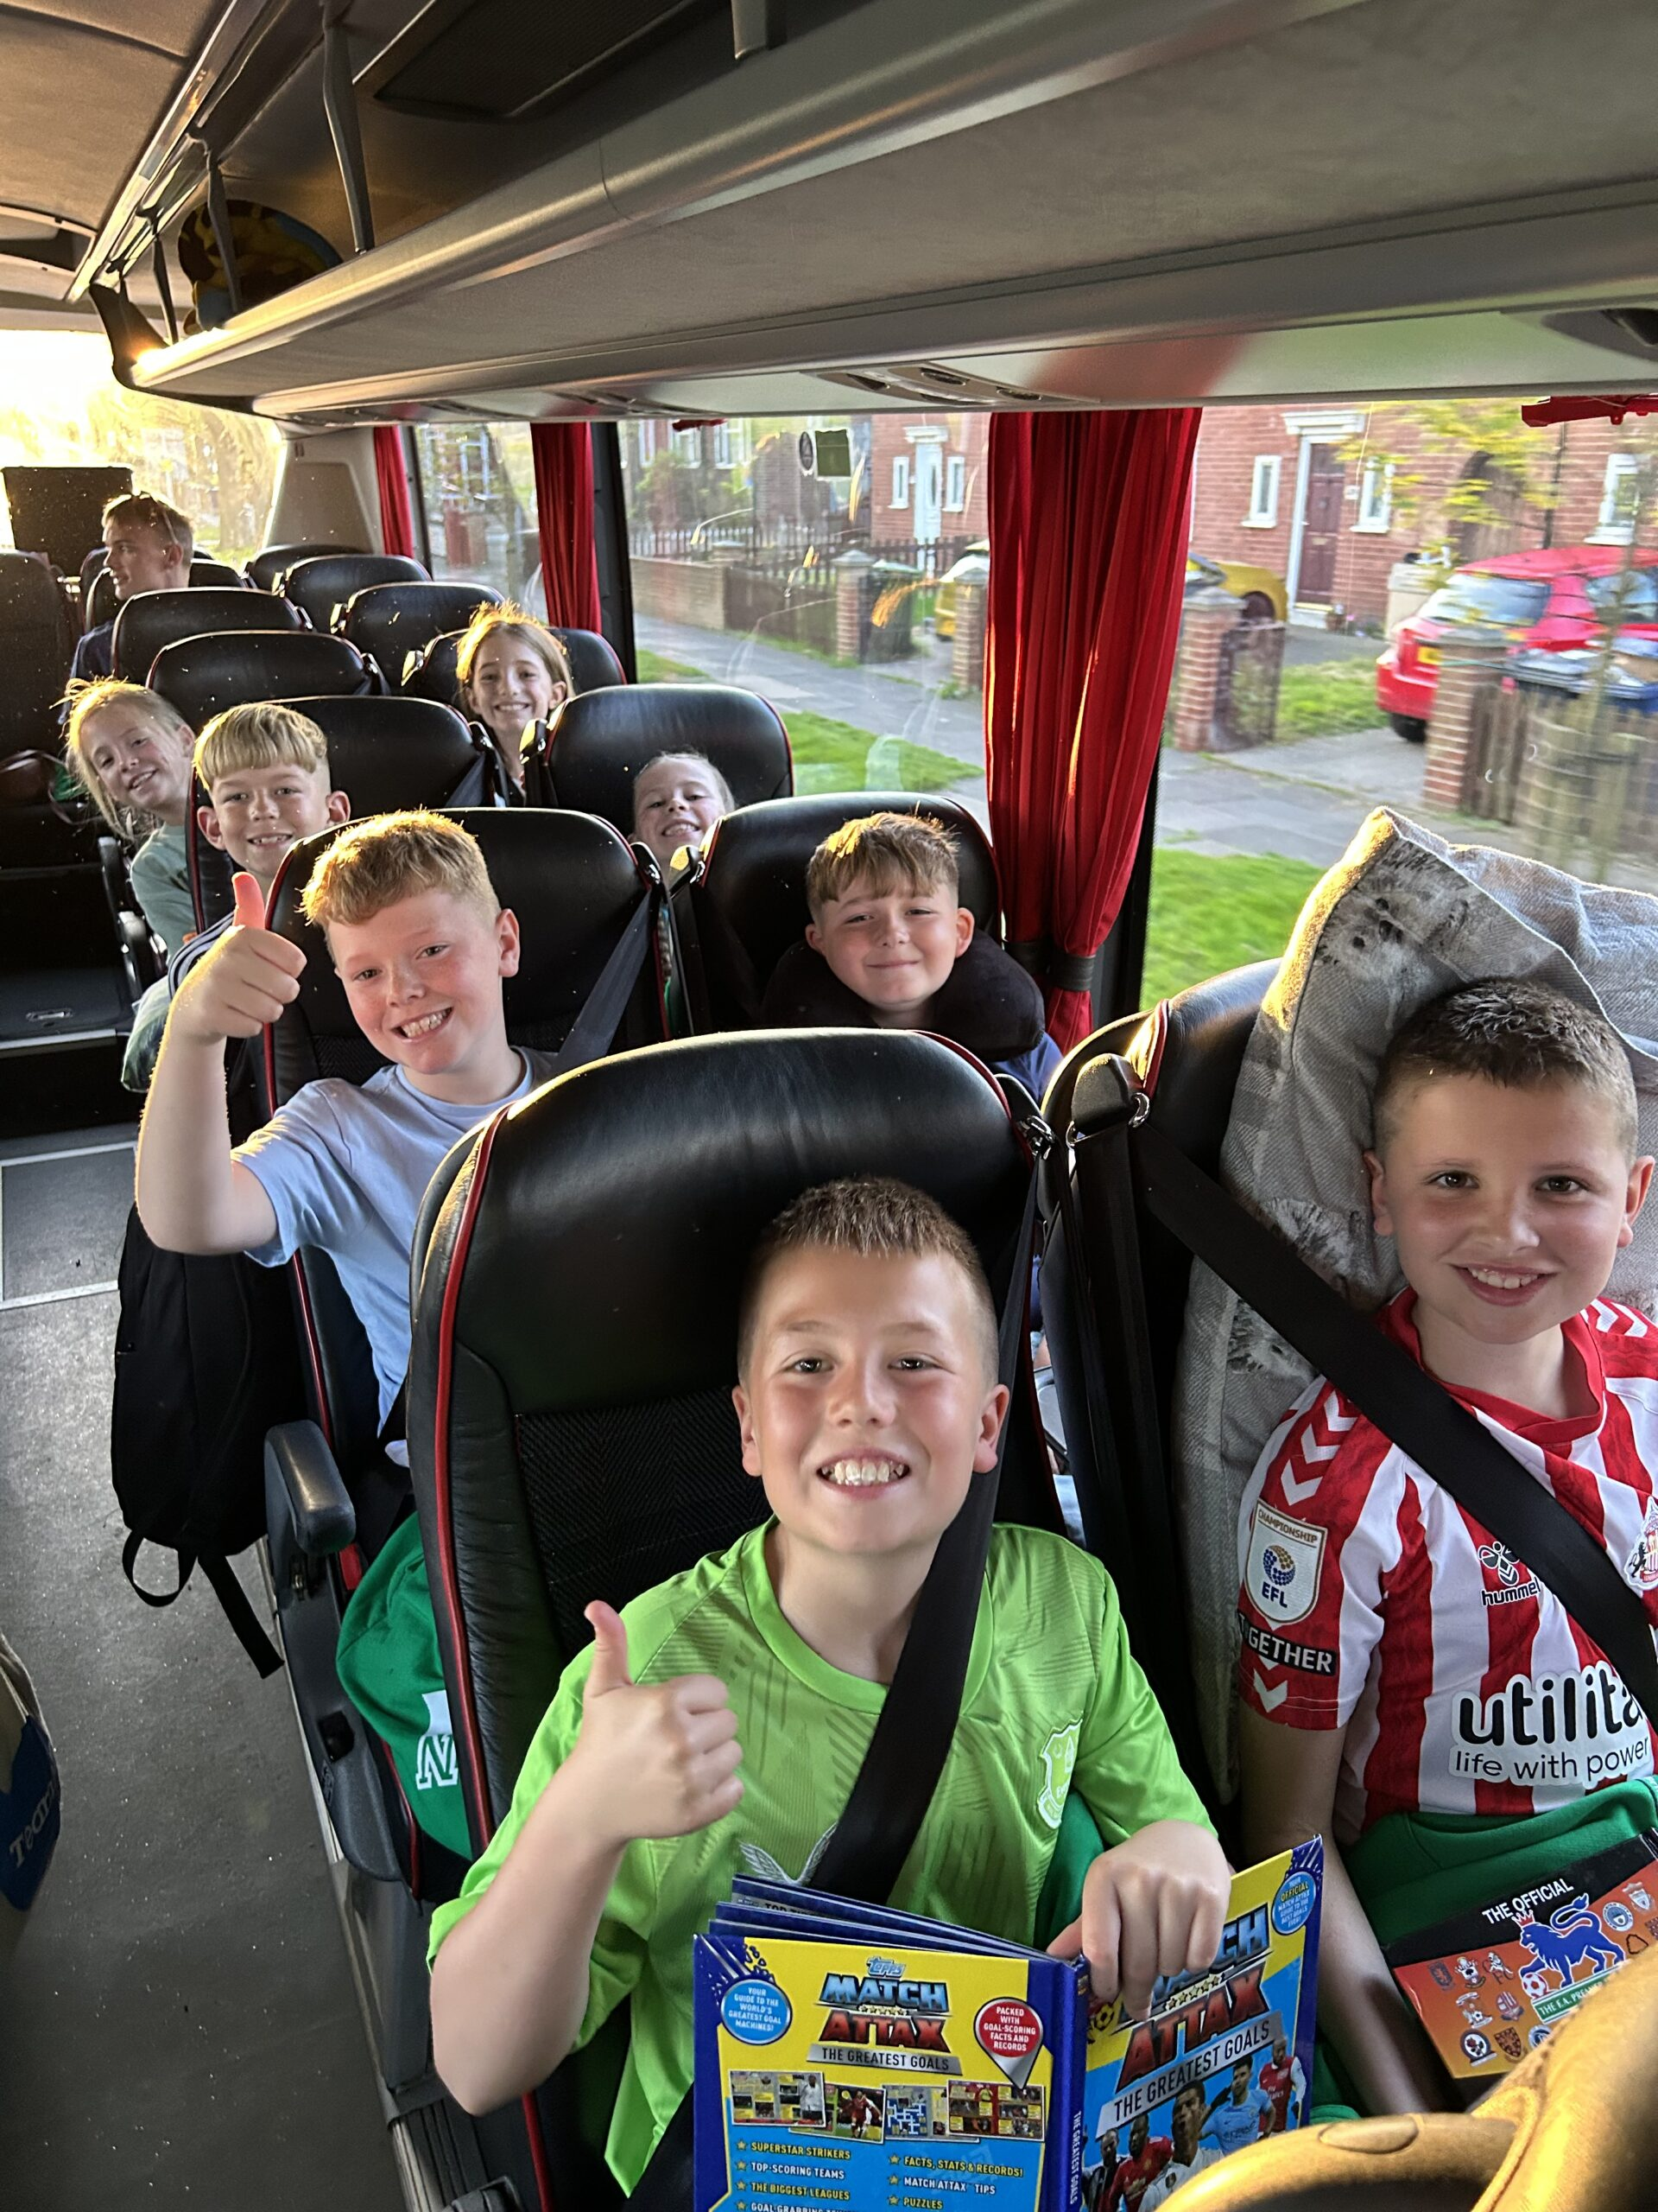
It’s a 6AM departure
Looking smart in our London Hoodies!!!!
It’s an early start ,the bus leaves at 5.45 am !!!!!!! . Breakfast will be at the services about 8am. We will be accompanied by Mrs Marshall, Mrs Coffey , Mrs Hanratty, Mrs Bevan, Mrs Ruddock and Mr Ruddock

Slide 4
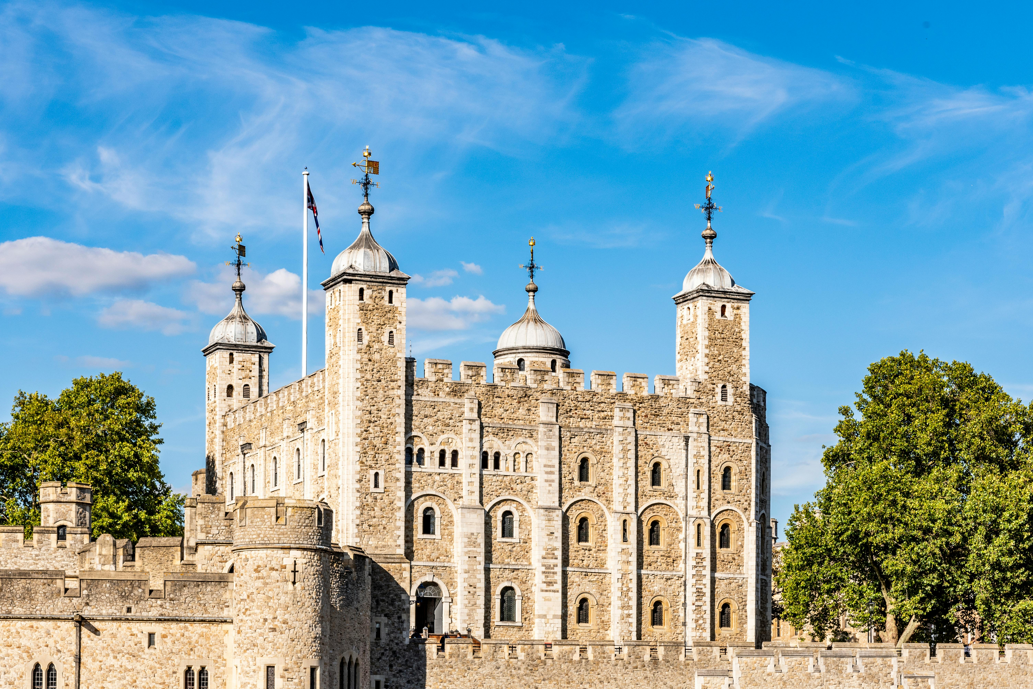
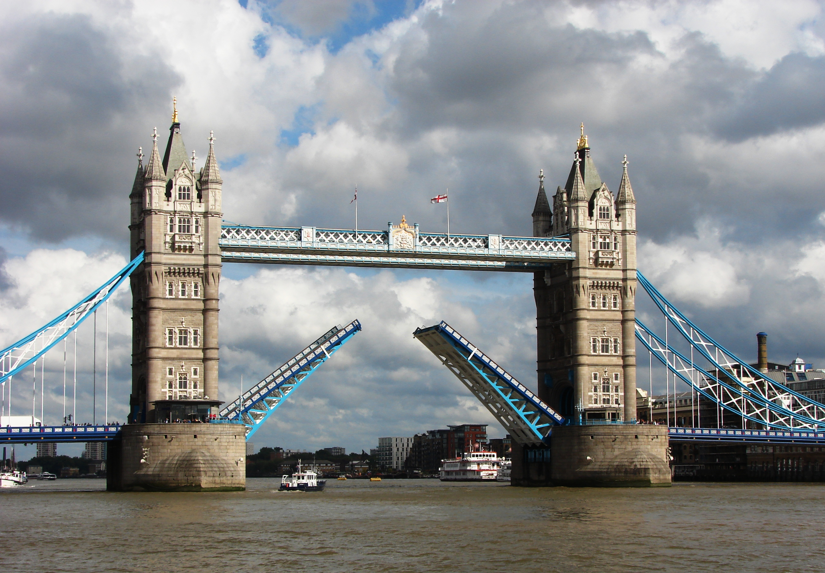
Visit the Tower of London and see where Anne Boleyn had her head chopped off.
Take the tour of the Crown Jewels and see the crown that was used in the Coronation of HRH King Charles
Take part in a workshop to learn about the Pirate Prisoners at the Tower
This Photo by Unknown Author is licensed under CC BY-SA

Slide 5
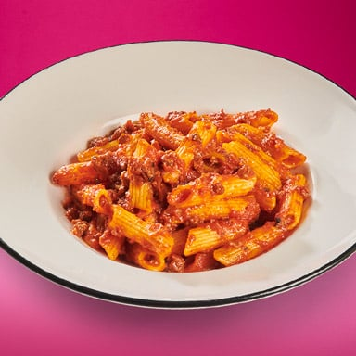
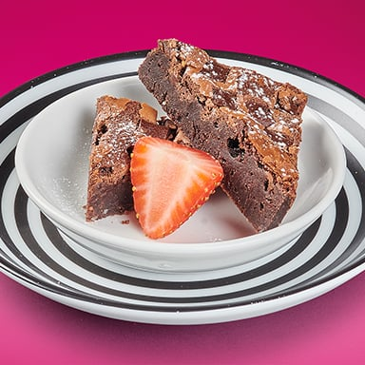


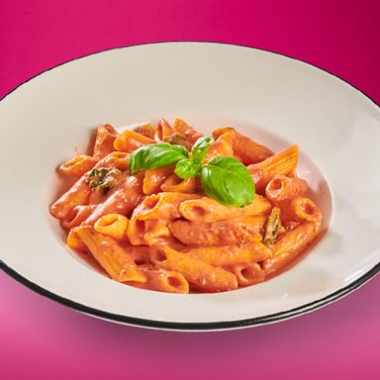


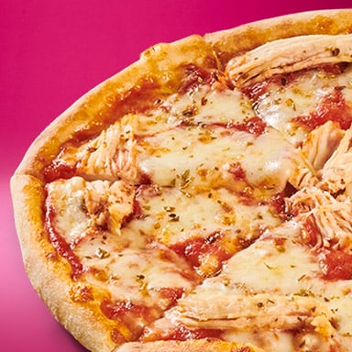
Tea in Pizza Express
Pasta Bolognese
Margherita
Brownie
Pepperoni
Pasta Napoletana
Quorn with Vegan Mozzarella
Sundae
Pollo

Slide 6

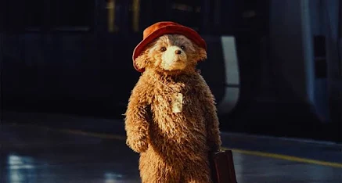
West End Musical- Paddington
@The Savoy Theatre

Slide 7
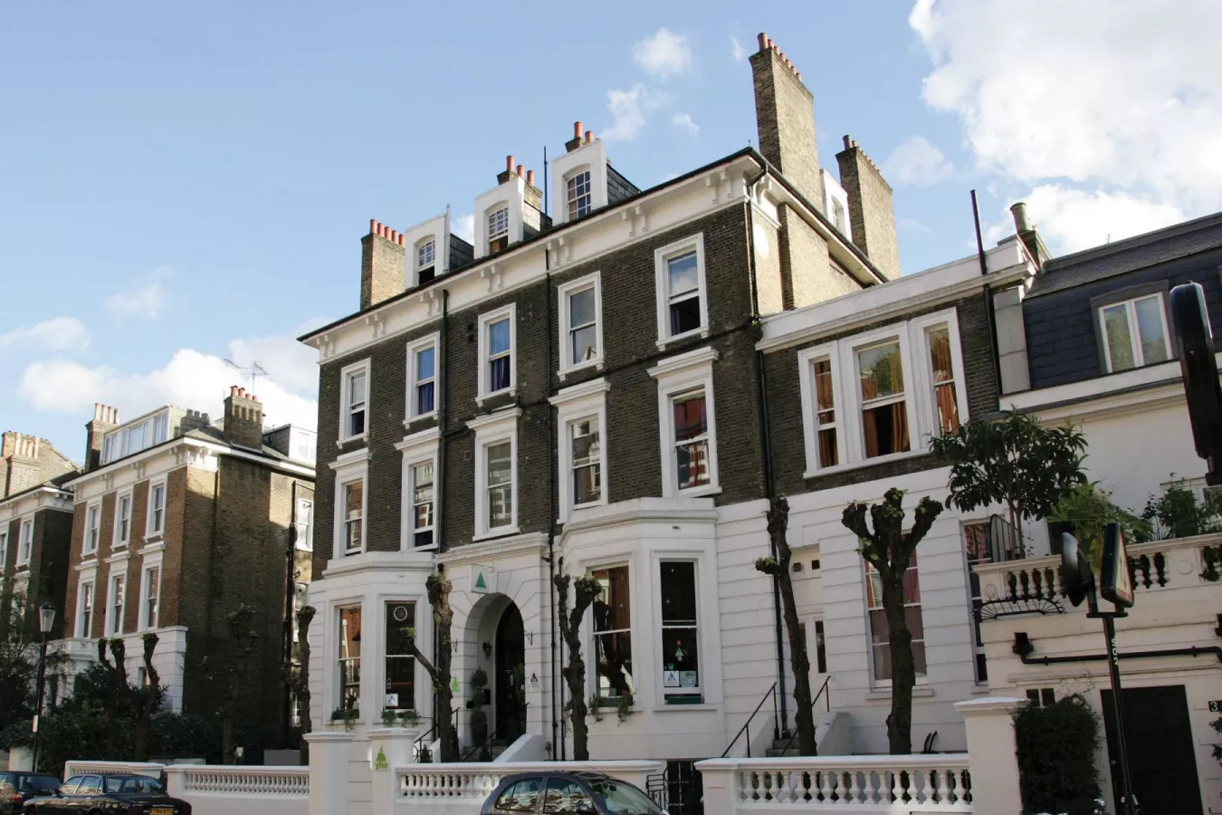
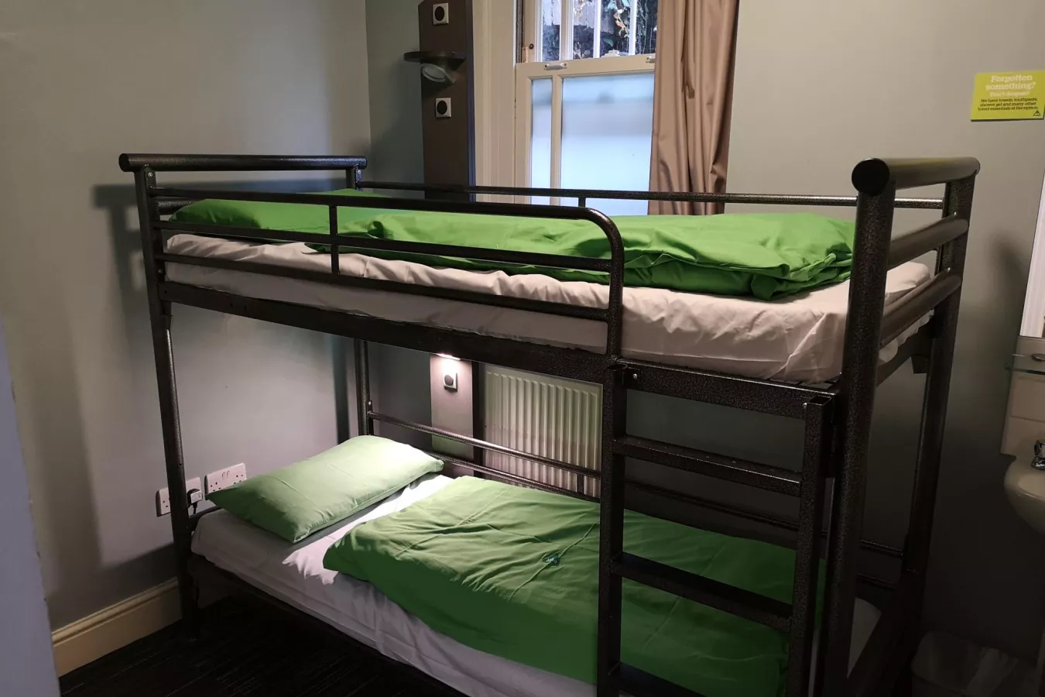
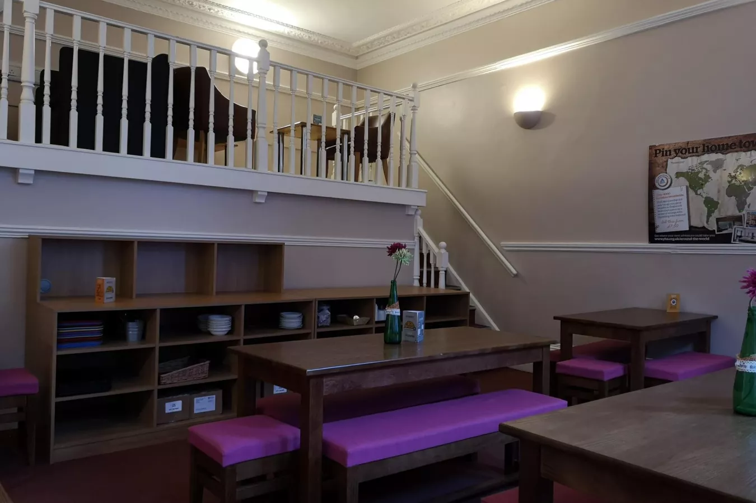
Earls Court Youth Hostel
Our

Slide 8
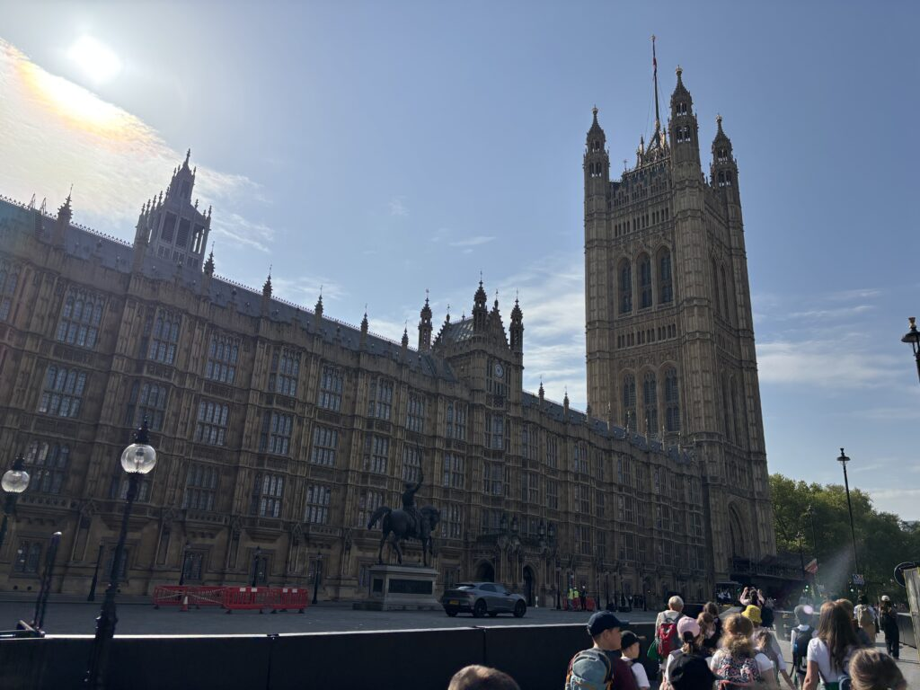
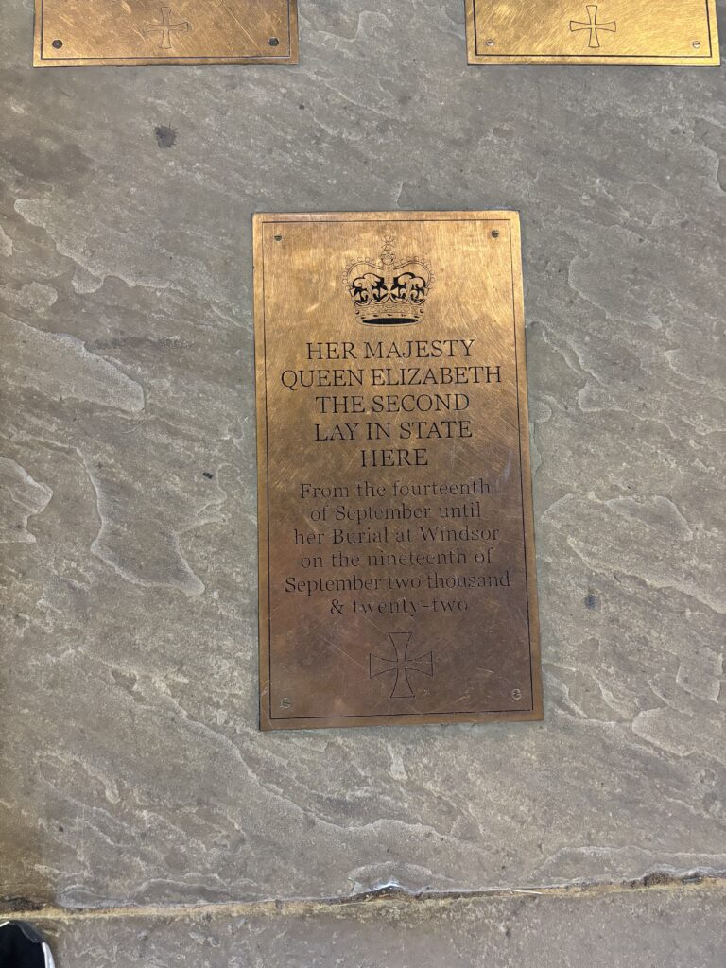
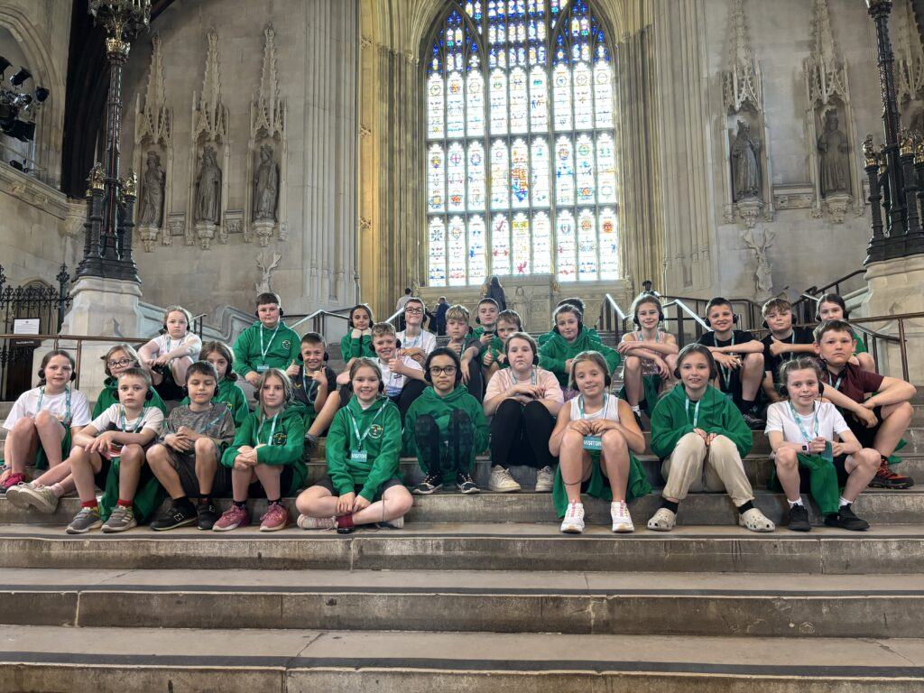
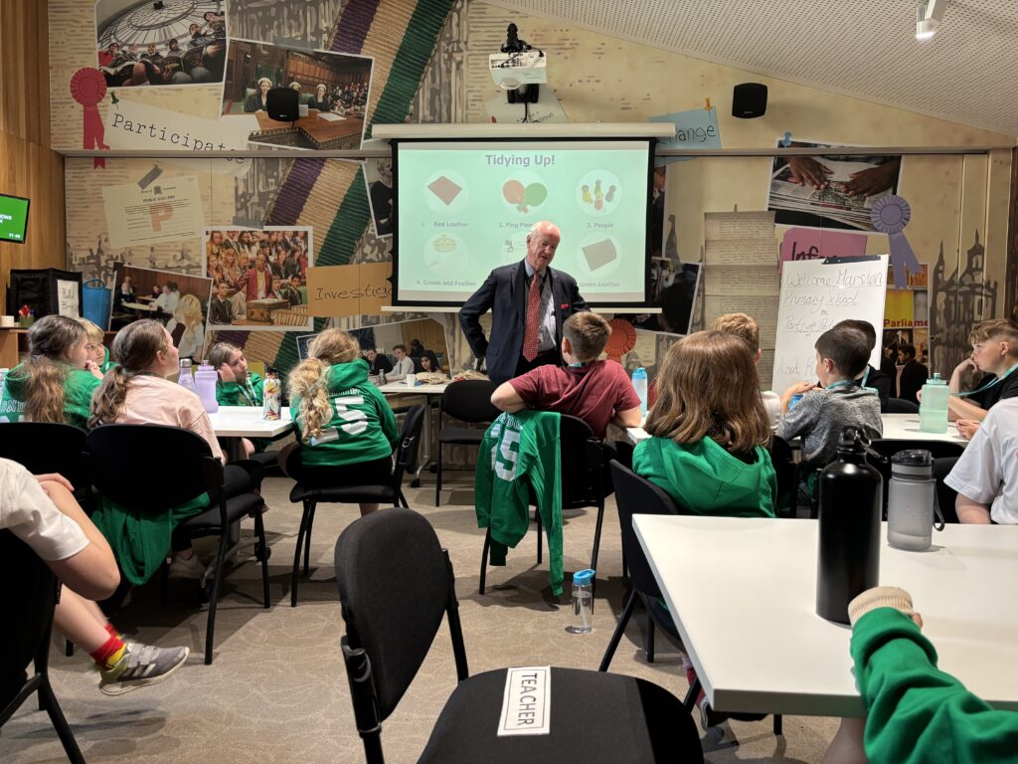
Houses of Parliament

Slide 9
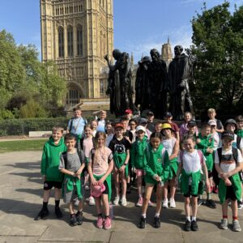
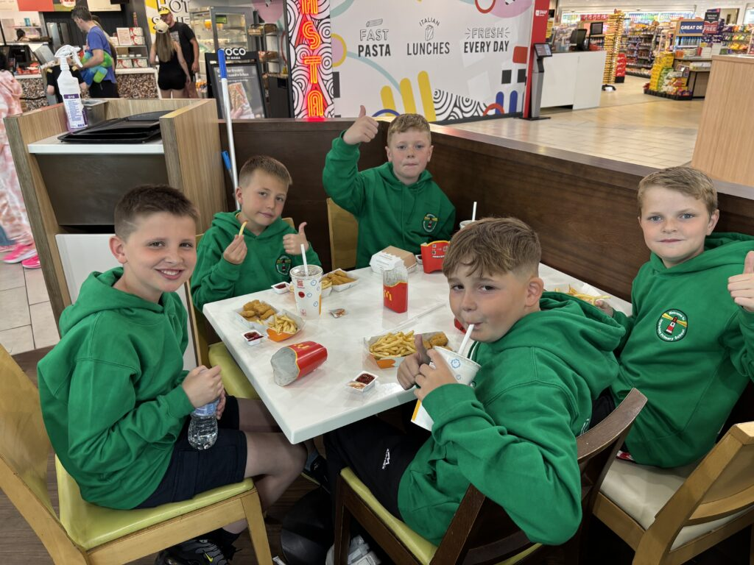
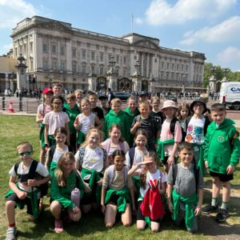
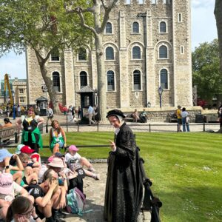
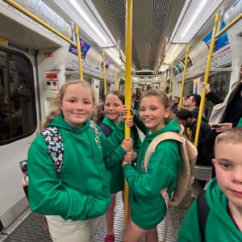
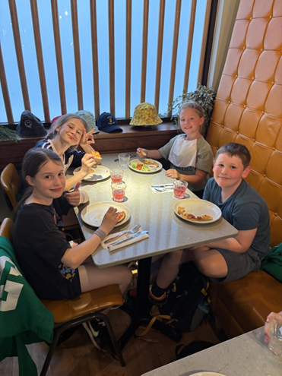
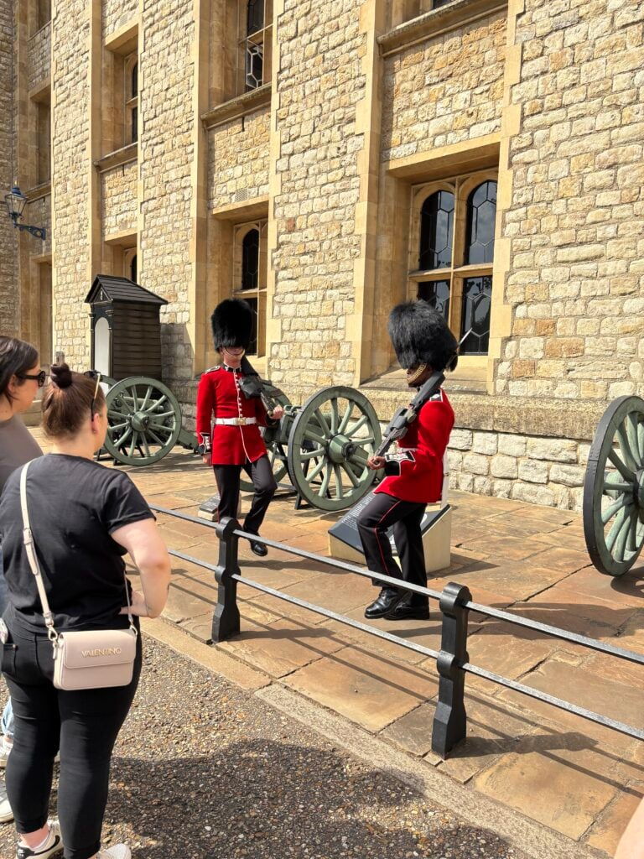
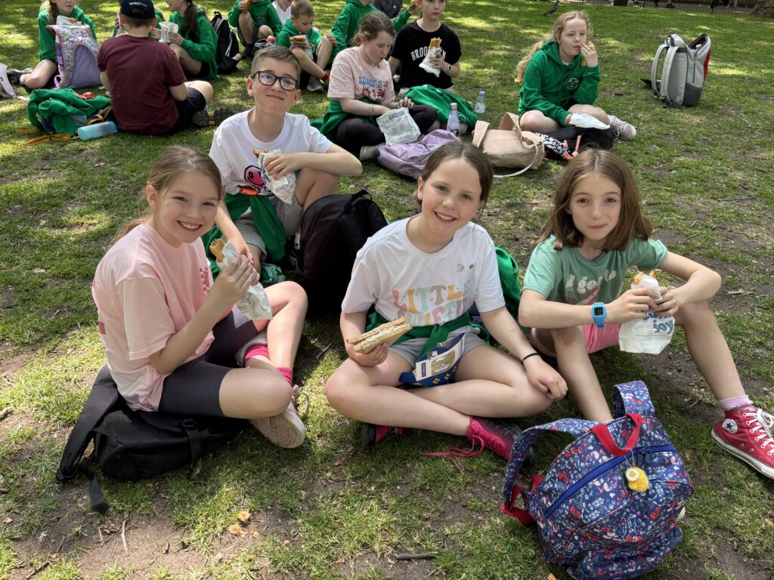
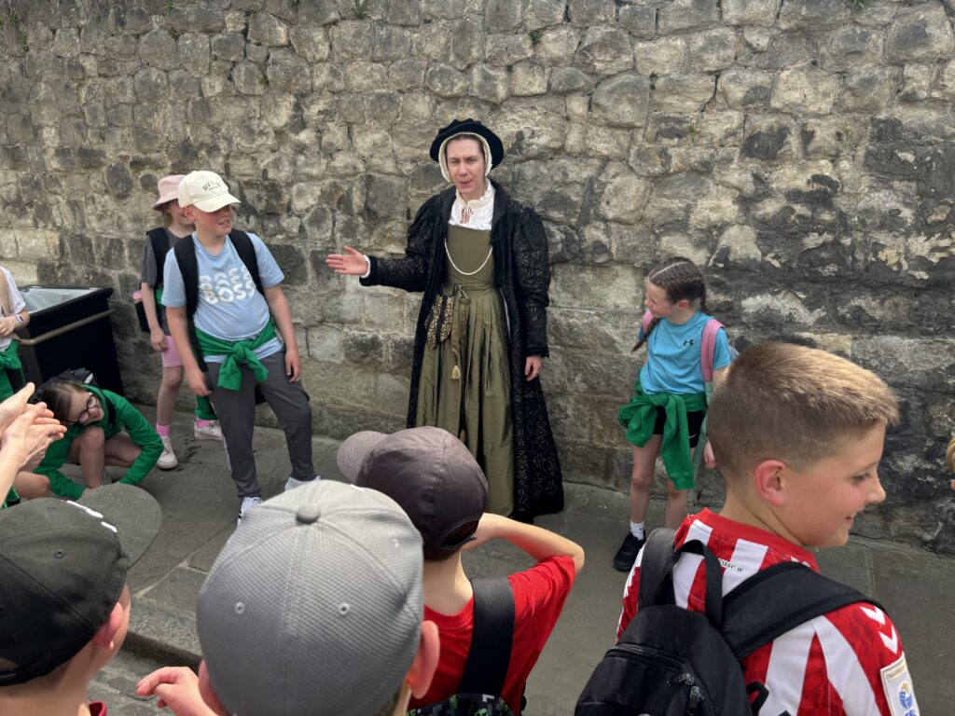
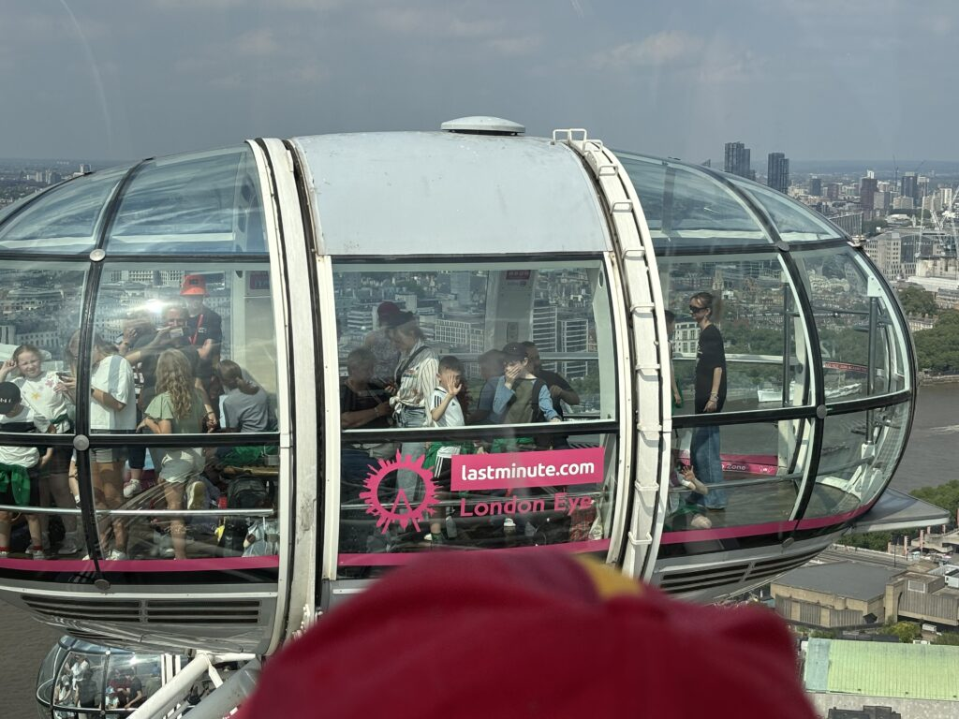
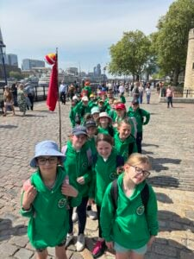
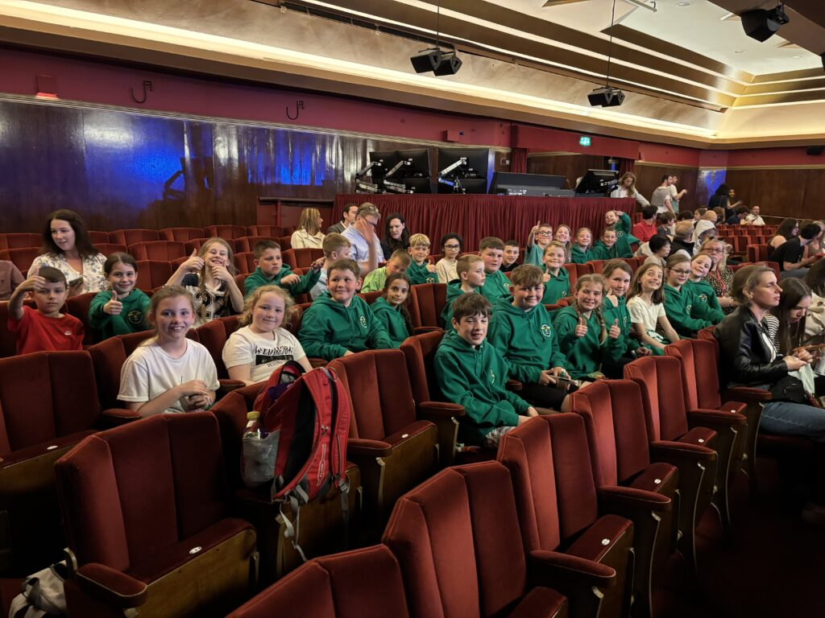

Slide 10
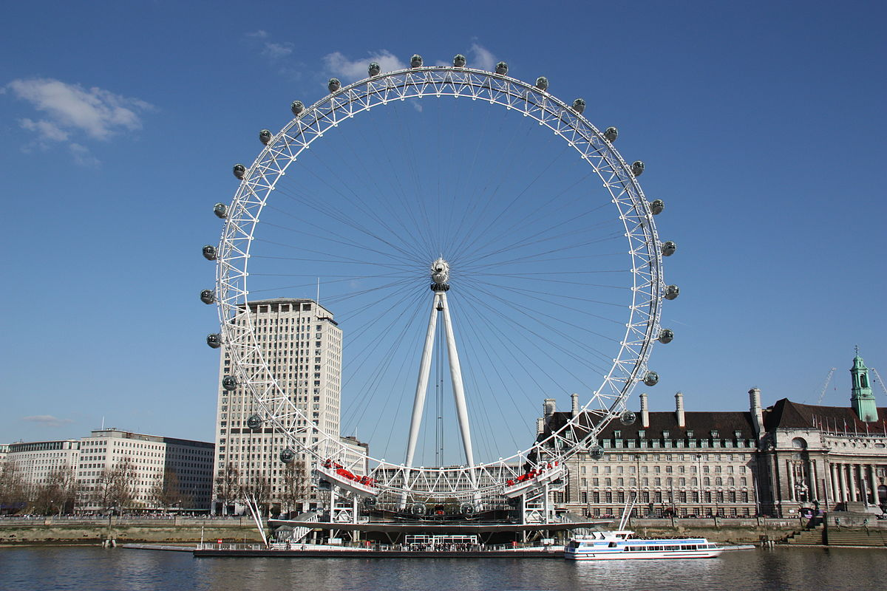
Any questions???
Our final experience before travelling home. The London Eye.
On the way home tea will be in McDonalds

Slide 11
What do I need for London ?
Breakfast and Packed Lunch on Day 1 – try to bring this in a disposable container.
Plastic water bottle – this can be refilled at various point during the visit.
A small backpack to carry around London and up to £15 spending money in a purse or wallet if you want to buy souvenirs. This must be in your backpack
Clothing kit in a travel bag/case. (List to follow)
Books /magazine/paper/pens etc. To keep you entertained on the bus.
A pillow or blanket or teddy .

Slide 12
Please do not bring………
Mobile phones
Cameras
Valuable items(or anything that is really important to you)
Products- creams, make-up etc
Aerosol deodorants
Any extra food or sweets

Slide 13
London Kit List
Please arrive at school in –
Comfortable clothes and your London Hoody.
Tshirt , joggers/leggings or shorts (weather dependant)
Comfortable trainers- we will be walking a lot.
A raincoat – something that can be easily carried if not required.
Please pack in your backpack-
Your breakfast for day 1
Your lunch for day 1
A refillable plastic water bottle
A maximum of £15 spending money in a purse/wallet
Any small activities for on the bus(pens ,paper, books,) - these can be left on the bus
Sun cream /hat
Please pack in your overnight bag-
1 set of clothes for the Friday
1set of spare clothes
Towel and toiletries , toothbrush and toothpaste
Underwear and socks
Pyjamas
Please do not bring – Fizzy drinks, sweets or extra food .

