Slide 1
London 2025
1/ 2nd May 2025

Slide 2
London 2025 | Day 1 | Day 2
Morning | Leave school at 5.30am and travel to London by luxury coach Breakfast stop on the way to London. Movies on the Coach | Breakfast at the Youth Hostel Travel by tube to Houses of Parliament and Downing St
Afternoon | Arrive in London and Visit the Tower of London and Tower Bridge. Tea at Pizza Express | Packed lunch on our walking tour , visiting Buckingham Palace, Trafalgar Square, etc. The London Eye Experience –see London from 135 metres
Evening | Travel by tube to the West End and Theatre. Coach will collect us and take us back to Thameside Youth Hostel | Leave London at approx 4pm, after a visit to the souvenir shop for the journey home with a stop at McDonalds Arrive home 10.30pm Approx.

Slide 3
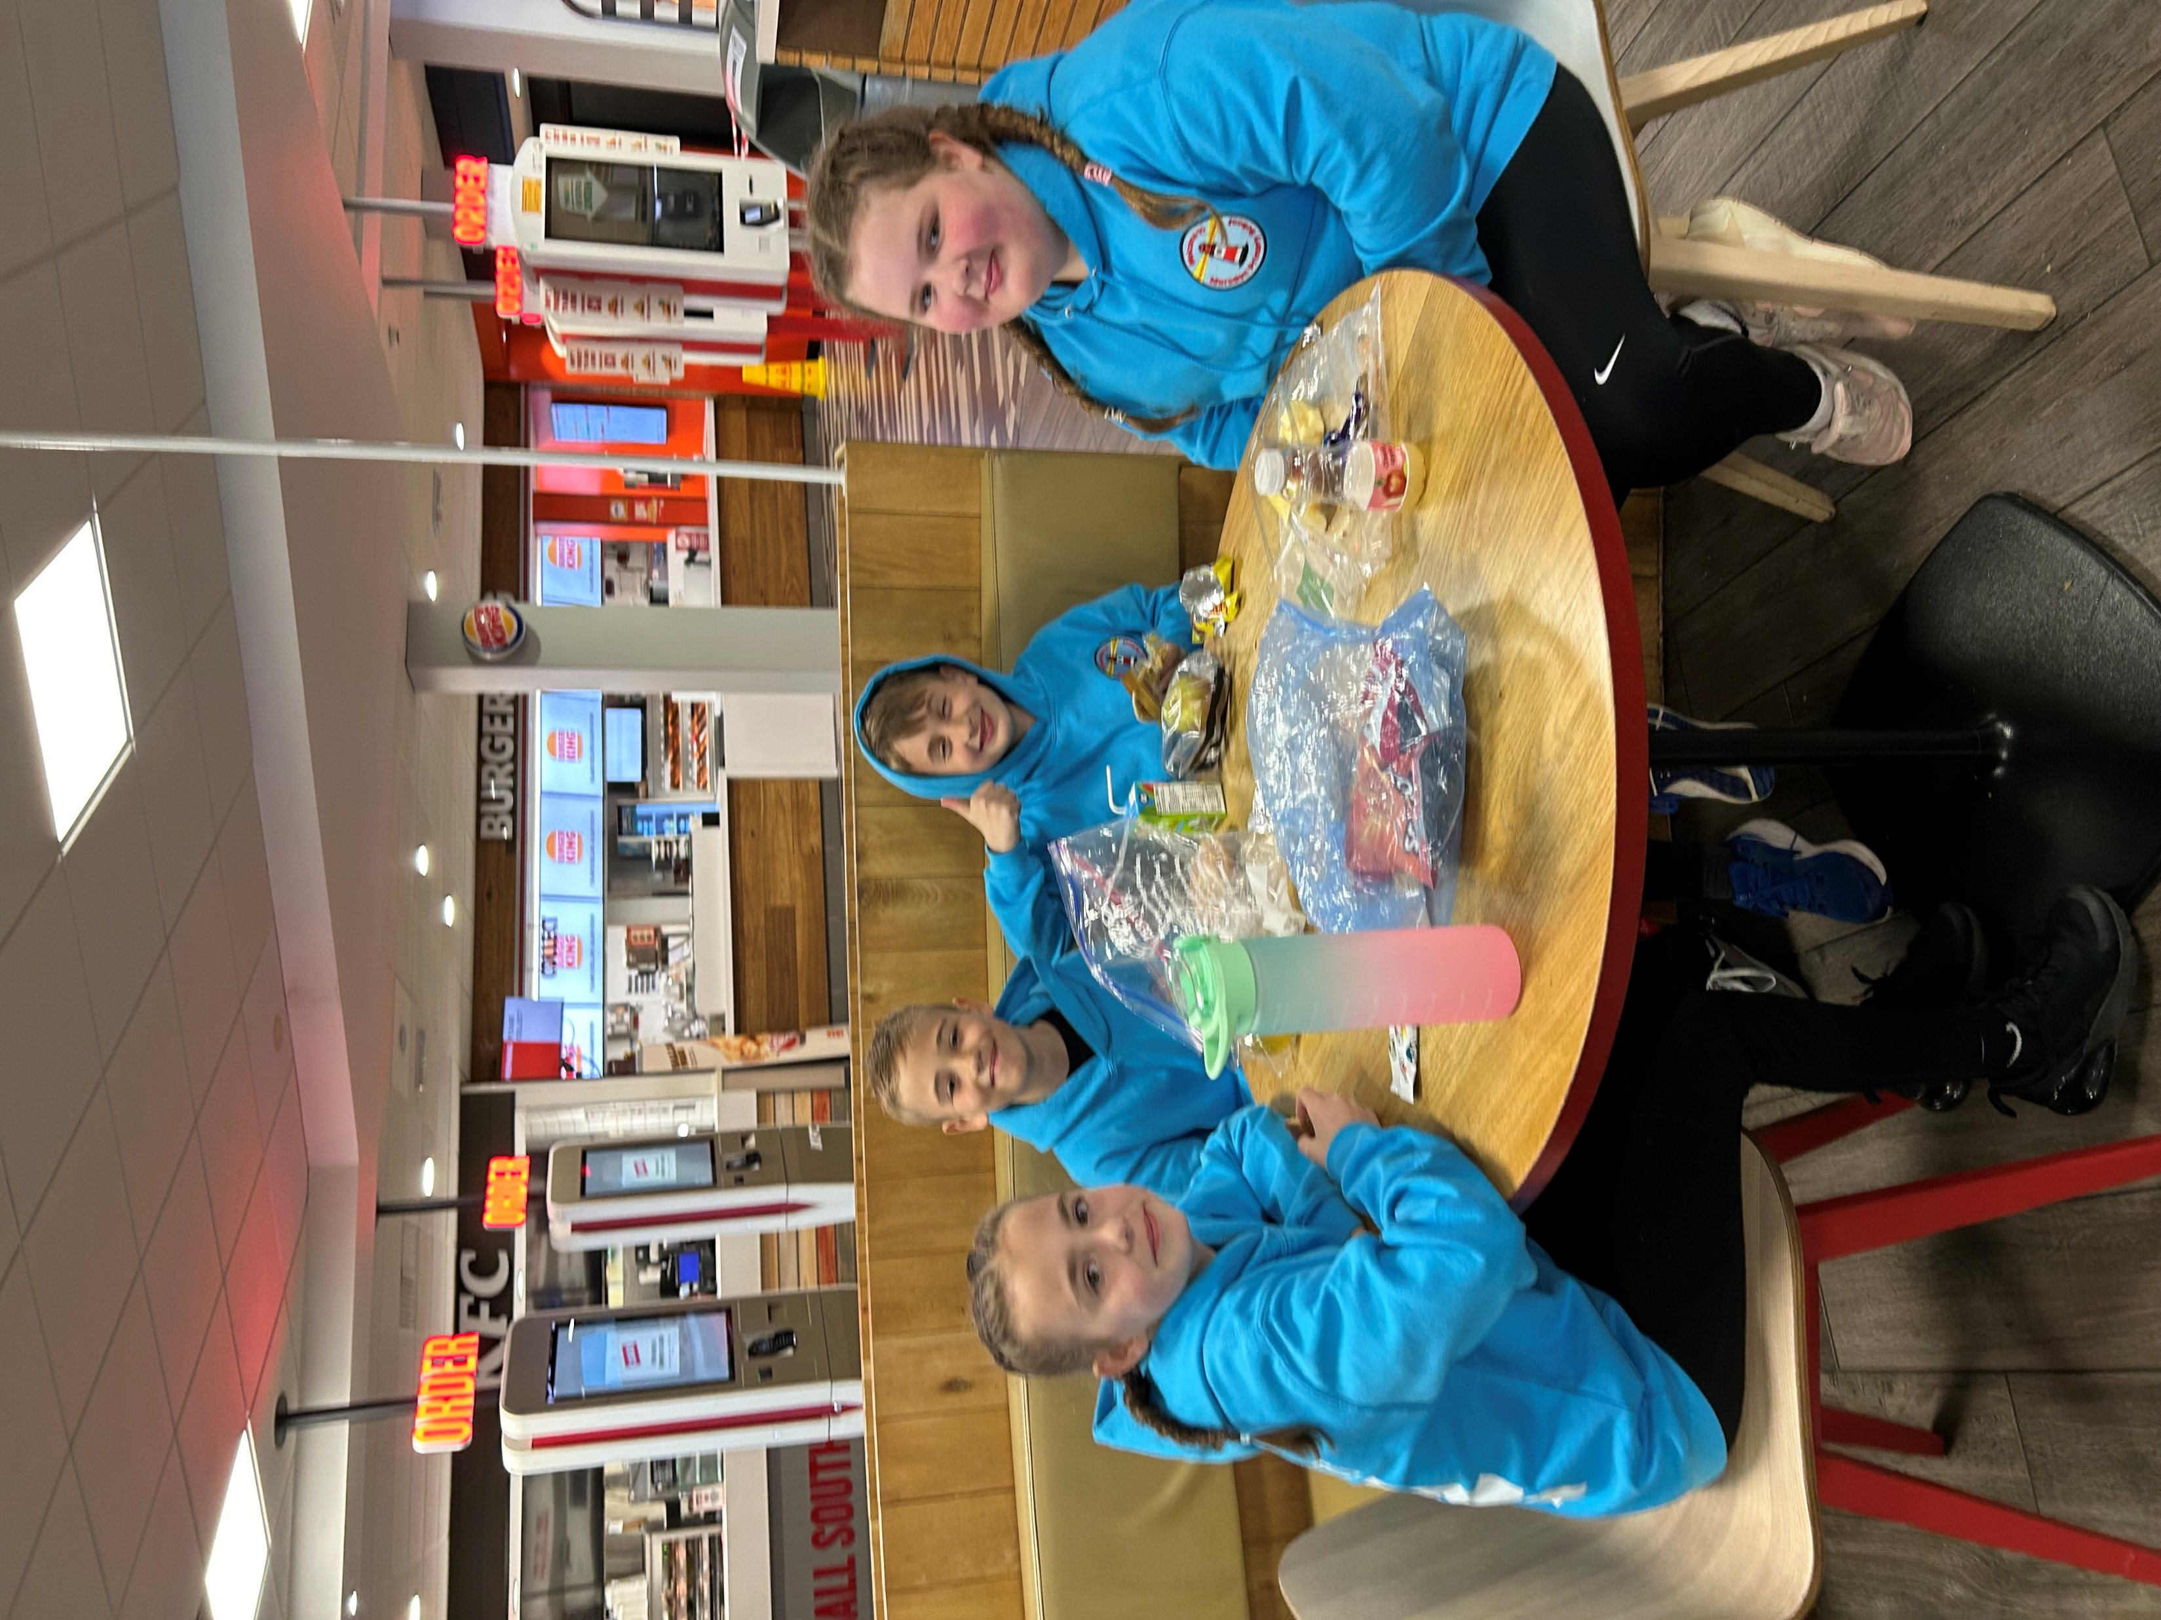
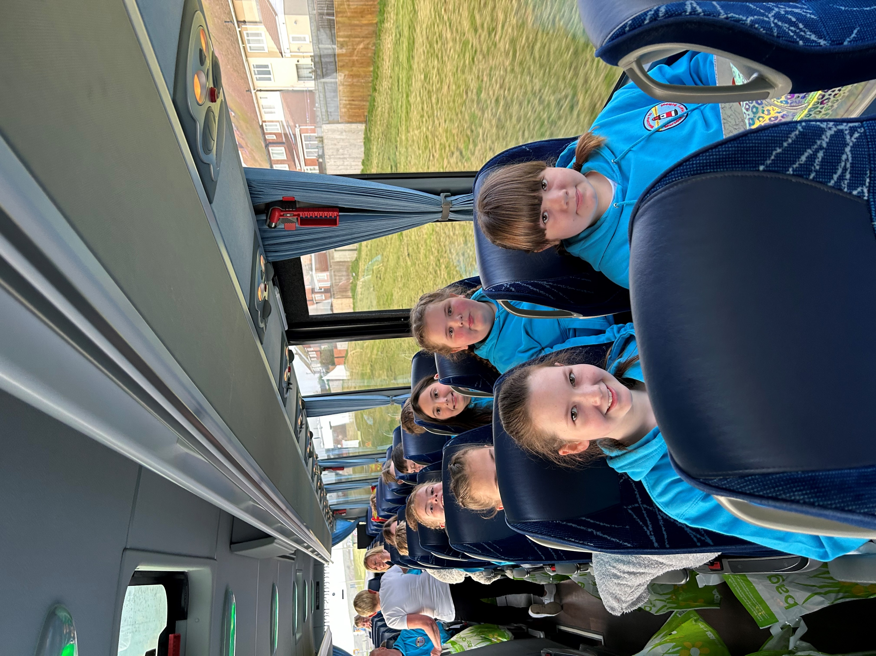
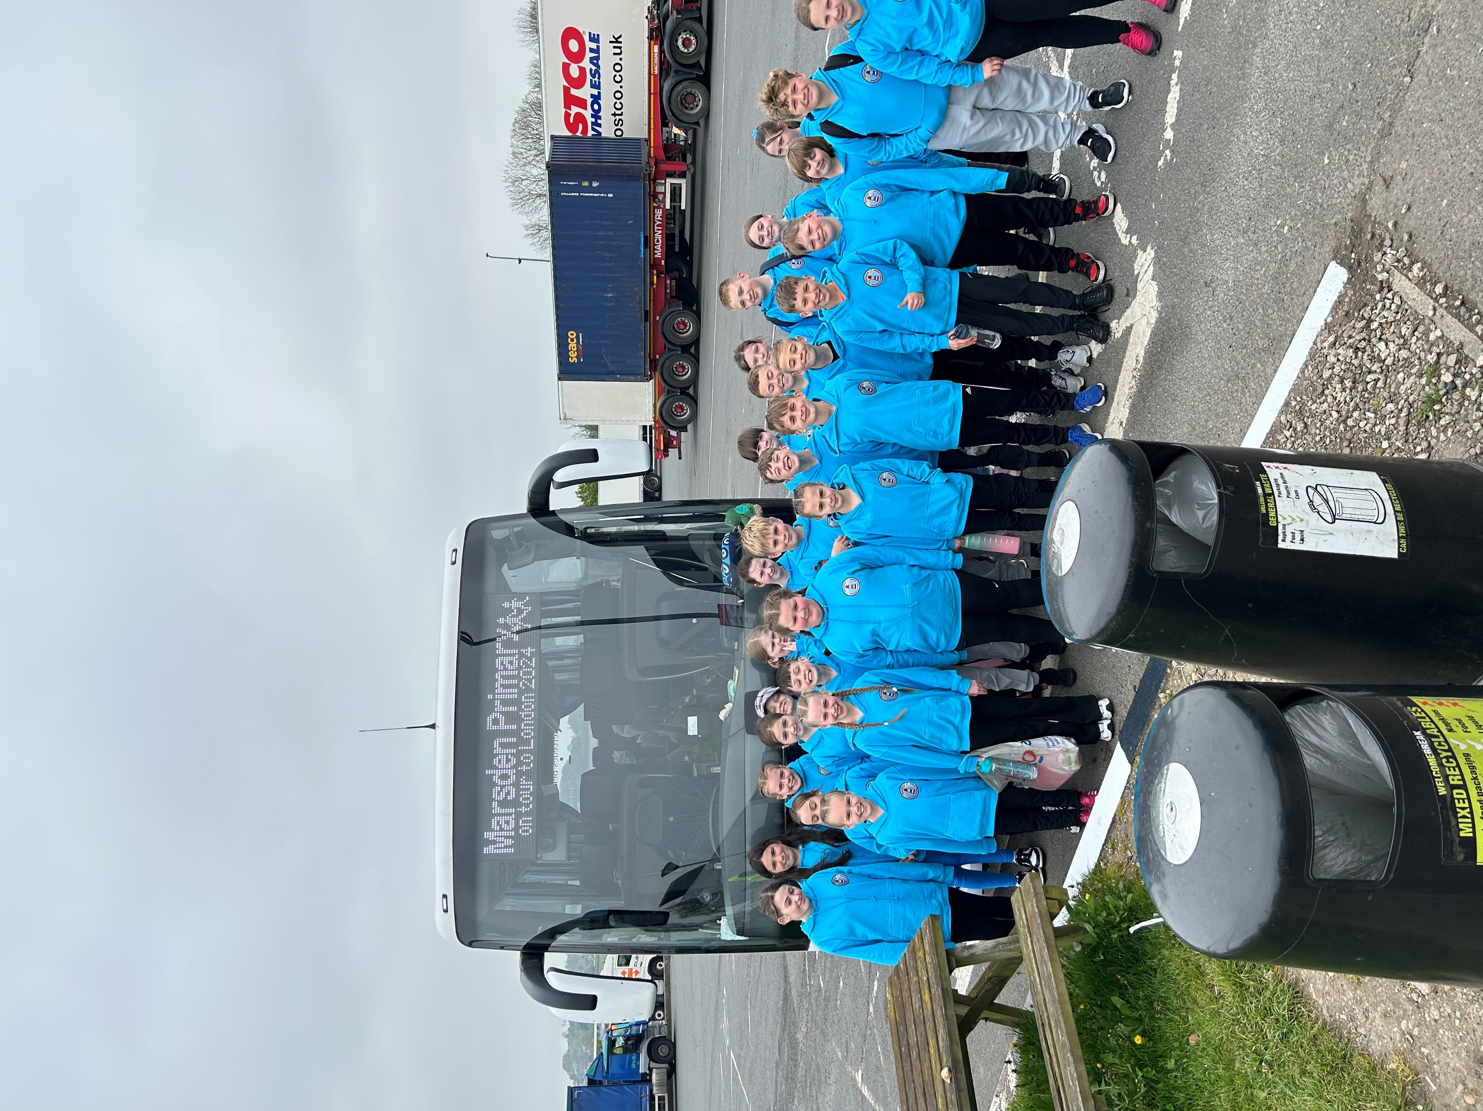
It’s a 6AM departure
Looking smart in our London Hoodies!!!!
It’s an early start!!!!!!! . Breakfast will be at the services about 8am. We will be accompanied by Mrs Marshall, Mrs Coffey , Mrs Hanratty, Mrs Bevan, Mrs Ruddock and Mr Ruddock

Slide 4
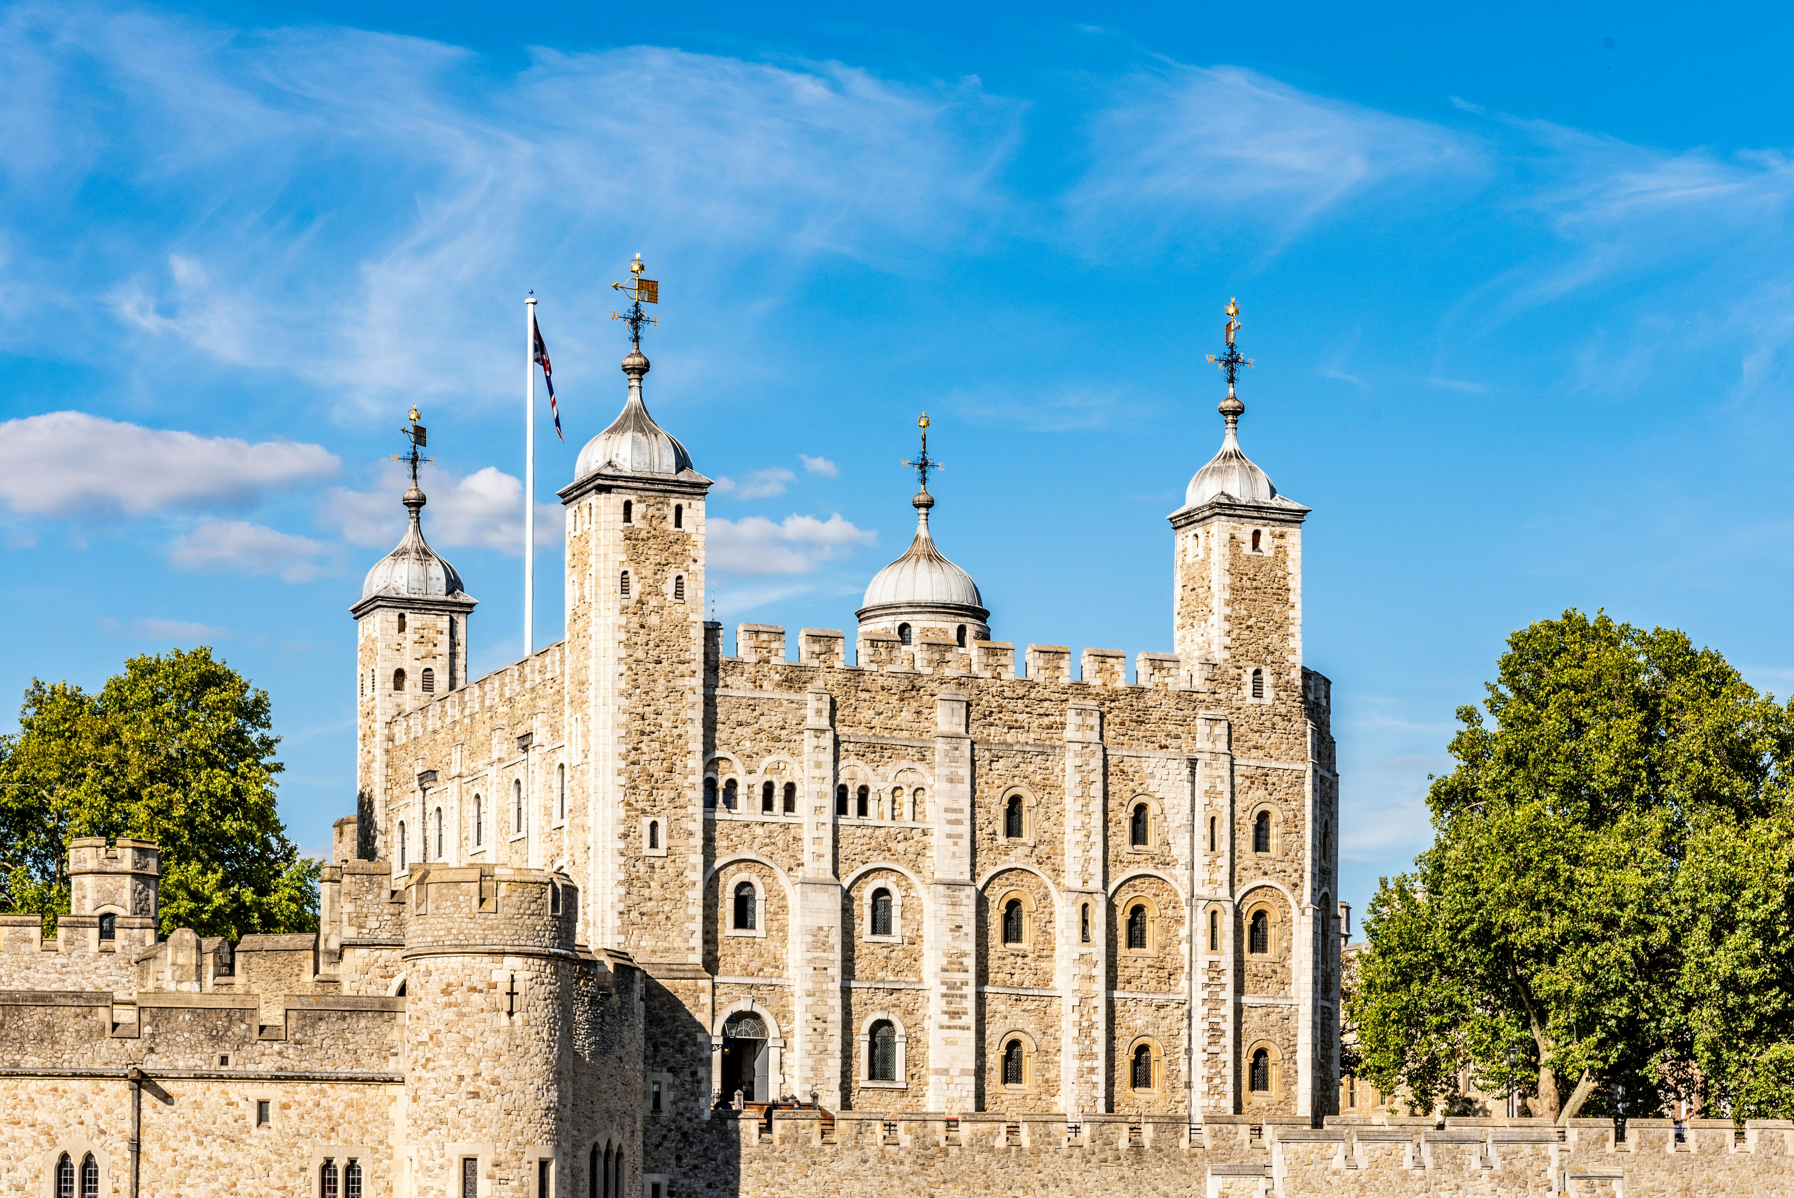
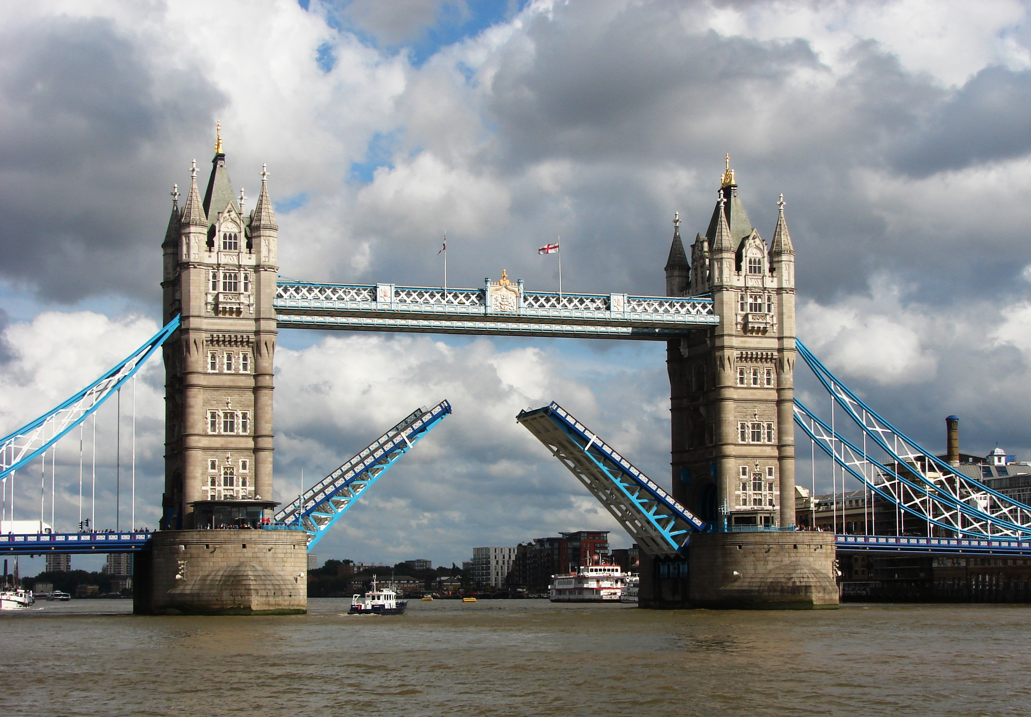
Visit the Tower of London and see where Anne Boleyn had her head chopped off.
Take the tour of the Crown Jewels and see the crown that was used in the Coronation of HRH King Charles
Take part in a workshop that brings to life the story being Henry VIII wives .
This Photo by Unknown Author is licensed under CC BY-SA

Slide 5
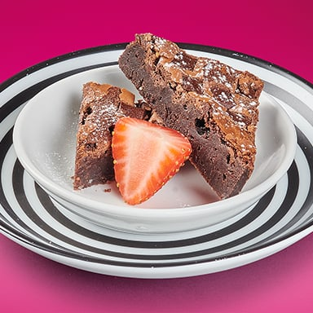
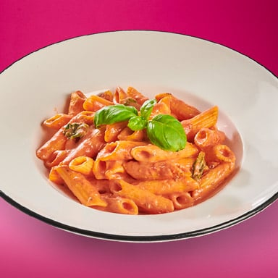
Tea in Pizza Express
Pasta Bolognese
Margherita
Brownie
Pepperoni
Pasta Napoletana
Quorn with Vegan Mozzarella
Sundae
Pollo

Slide 6
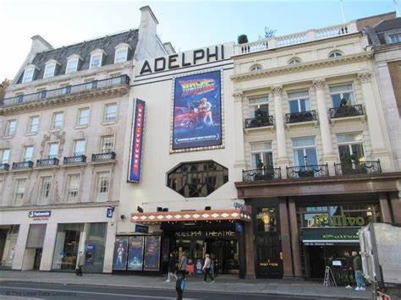
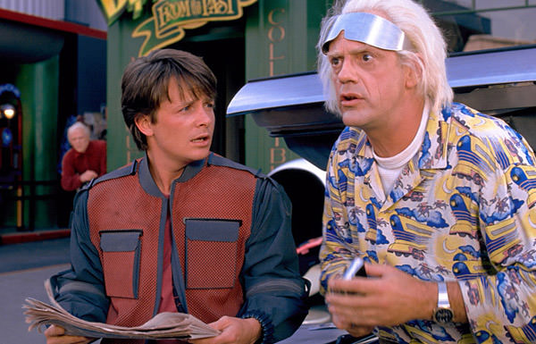
West End Musical –Back to the future
This Photo by Unknown Author is licensed under CC BY-SA
This Photo by Unknown Author is licensed under CC BY-SA-NC
This Photo by Unknown Author is licensed under CC BY-NC-ND

Slide 7
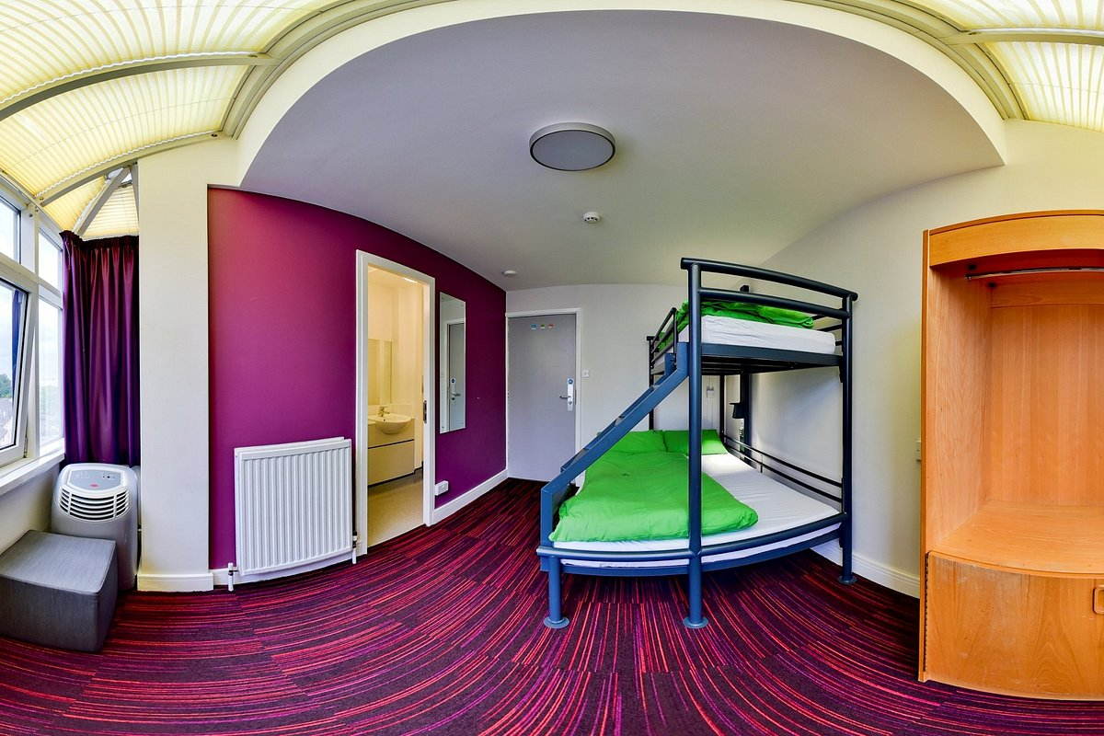
Thameside Youth Hostel
We have a floor to ourselves.
All rooms are En-suite
Breakfast in served on the ground floor

Slide 8
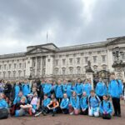
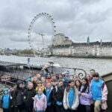
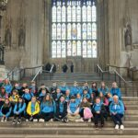
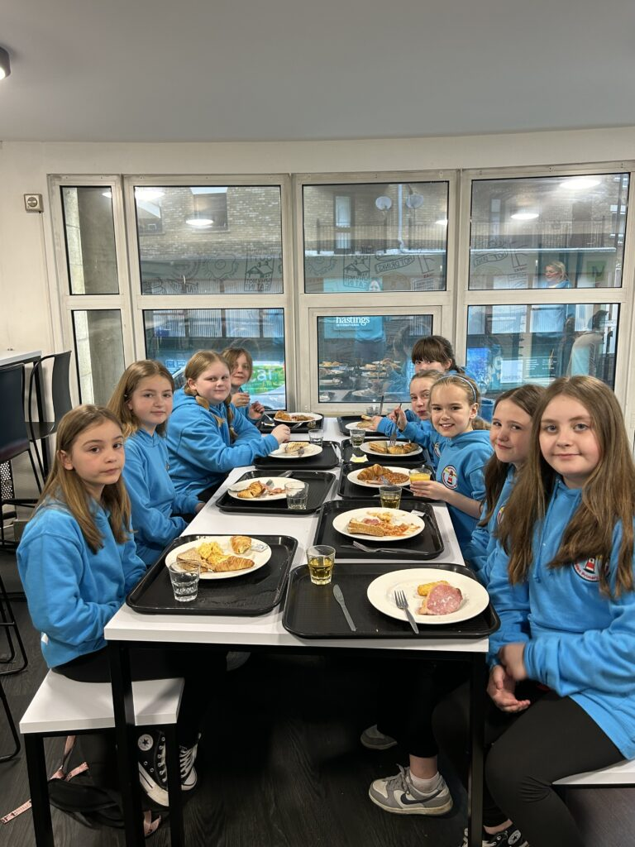
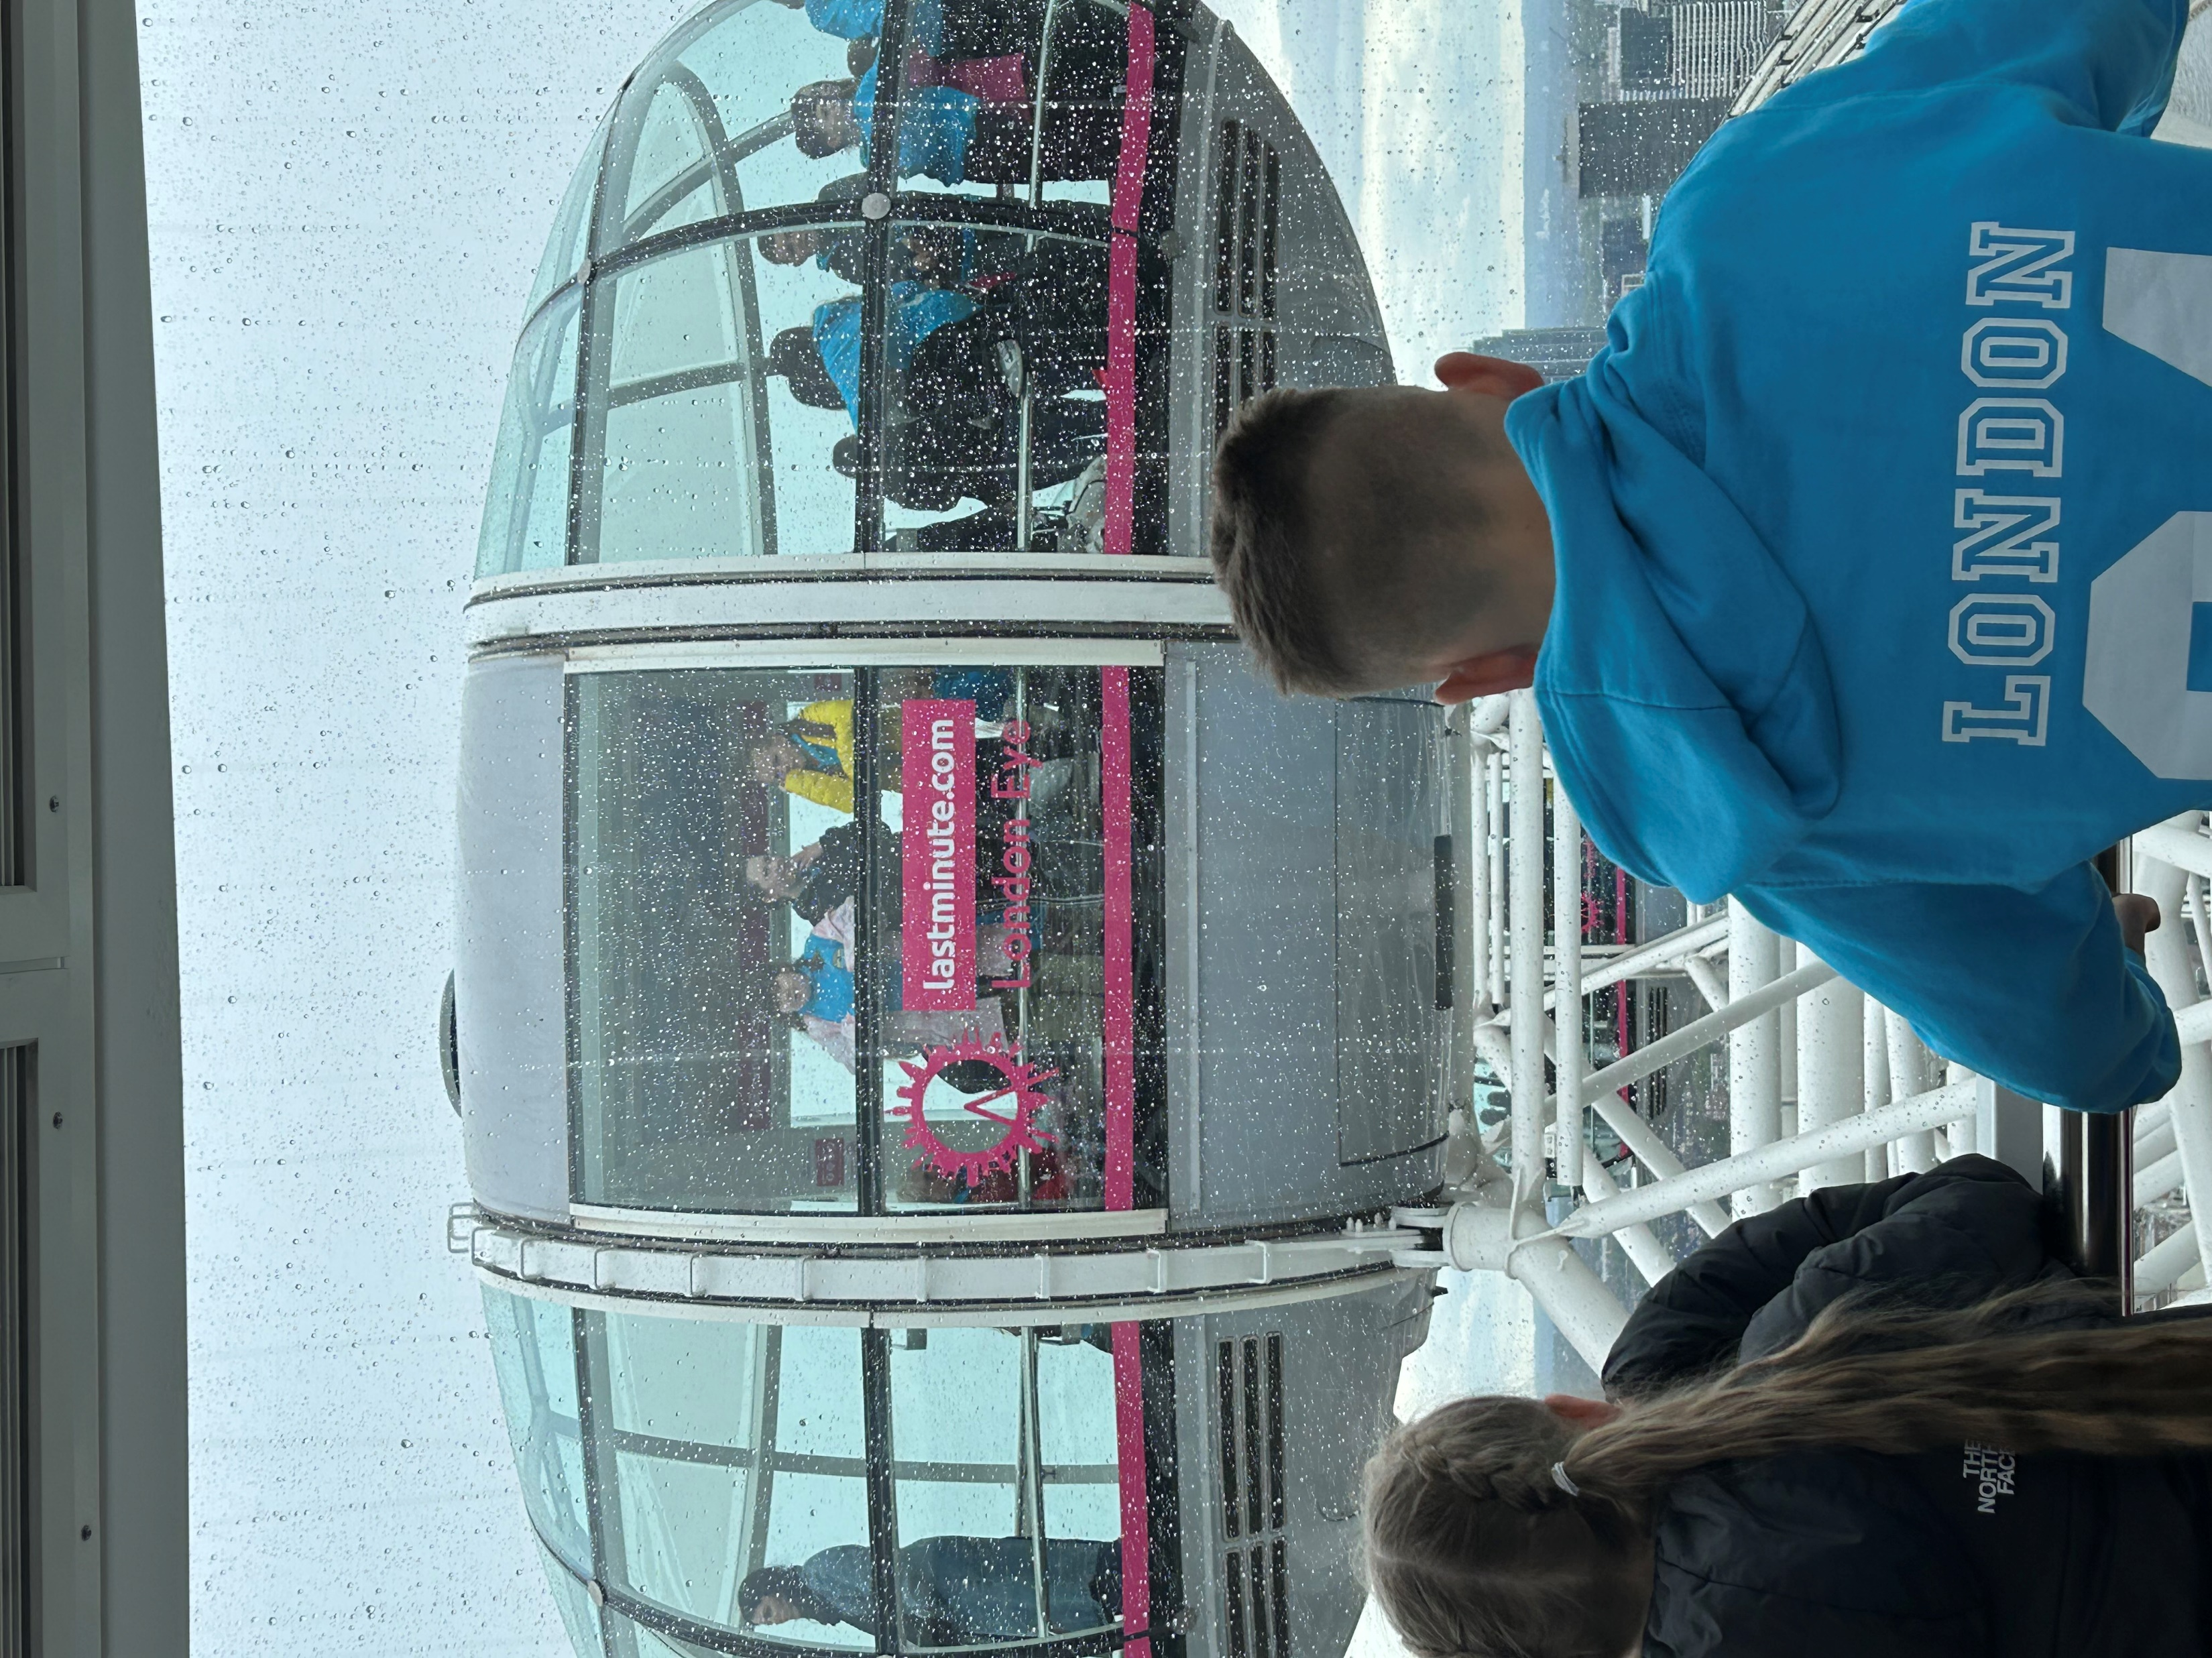
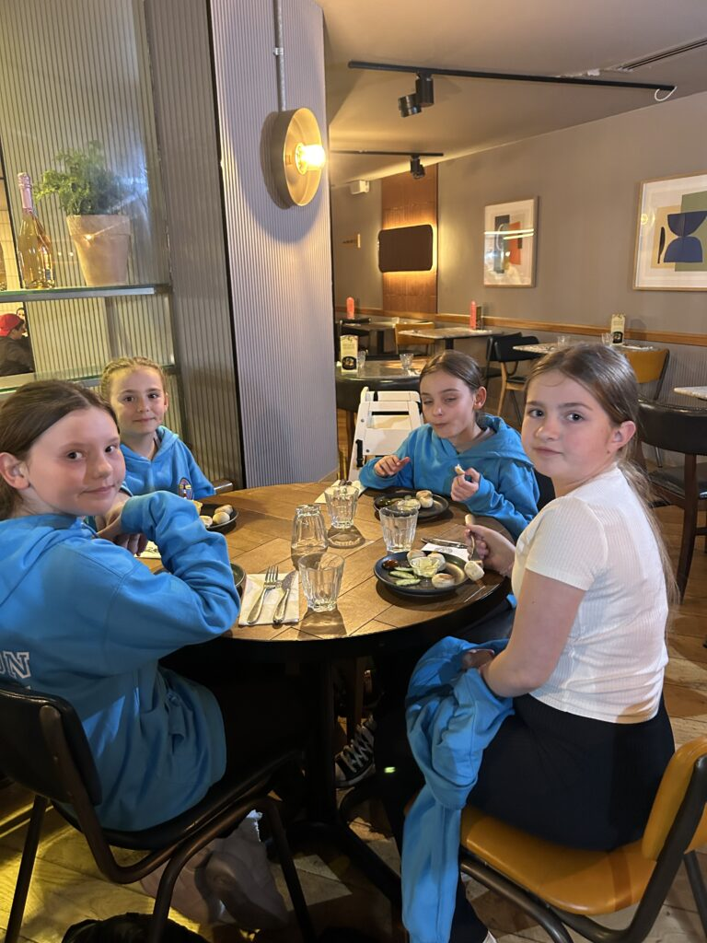
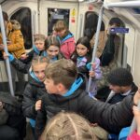

Slide 9
Any questions???
Our final experience before travelling home. The London Eye.
On the way home tea will be in McDonalds

Slide 10
What do I need for London ?
Breakfast and Packed Lunch on Day 1 – bring this in a disposable container.
Water bottle – this can be refilled at various point during the visit.
A small backpack to carry around London and £15 spending money in a purse or wallet if you want to buy souvenirs. This must be in your backpack
Clothing kit in a travel bag/case. (List to follow)
Books /magazine/paper/pens etc. To keep you entertained on the bus.
A pillow/blanket/teddy .

Slide 11
Please do not bring………
Mobile phones
Cameras
Valuable items(or anything that is really important to you)
Products- creams, make-up etc
Aerosol deodorants
Any extra food or sweets

