Slide 1

Providing Quality
Early Years Education
Marsden Primary EYFS

Slide 2
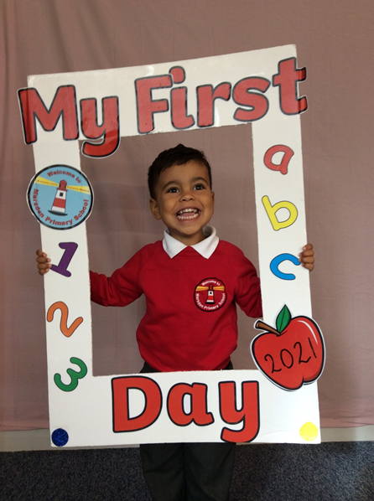

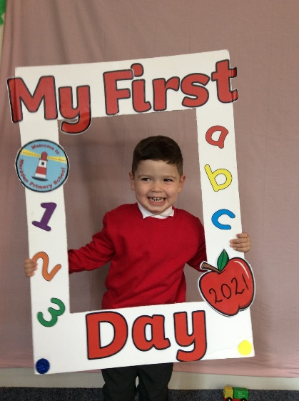
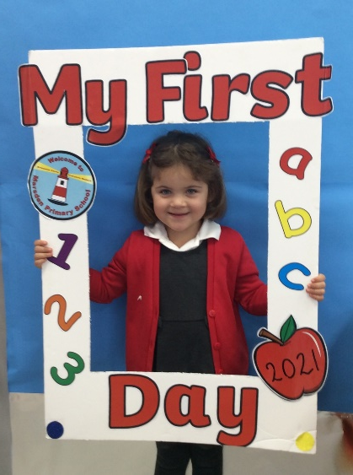
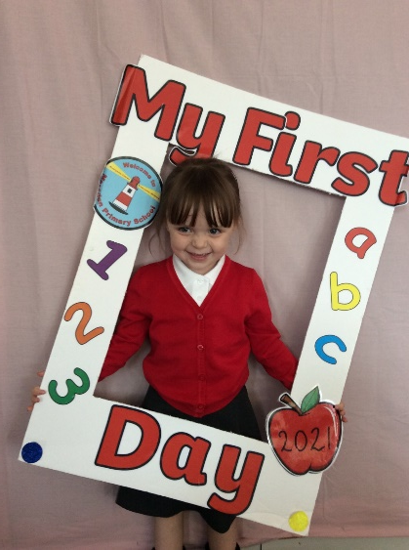
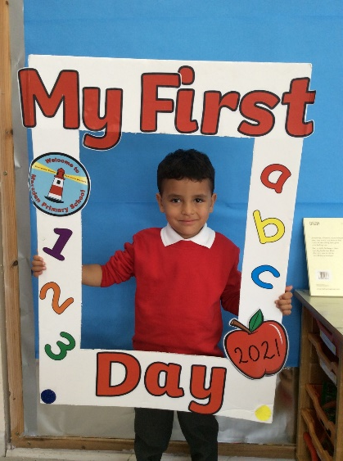
Provision at Marsden

Slide 3
Our Team
Mrs Hanratty – EYFS Lead and Nursery Teacher
Miss Corr- Teaching Assistant (Nursery)
Mrs Coffey- Family Liaison and Nursey Support (PM)
Mrs Carr- Reception Teacher
Mrs Lewis- Teaching Assistant (Reception)
Ms Gilbert- SEND Co-Ordinator
Mrs Marshall- Head Teacher

Slide 4
Our Curriculum
The Early Years curriculum focuses on seven areas of learning.
Personal, Social and Emotional Development
Communication and Language
Physical Development
Literacy
Mathematics
Understanding of the World
Expressive Arts and Design

Slide 5
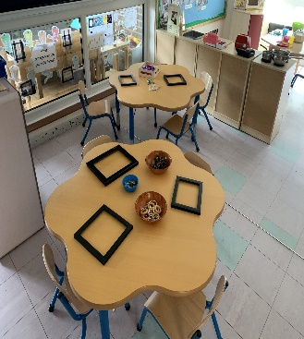
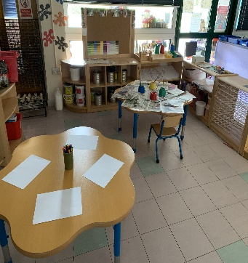
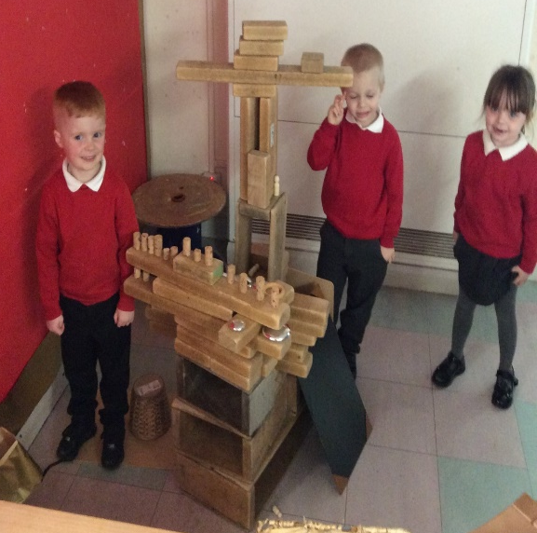
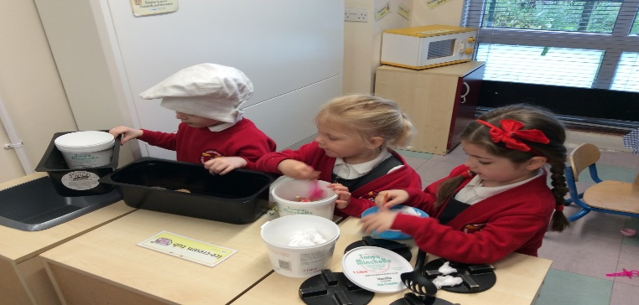
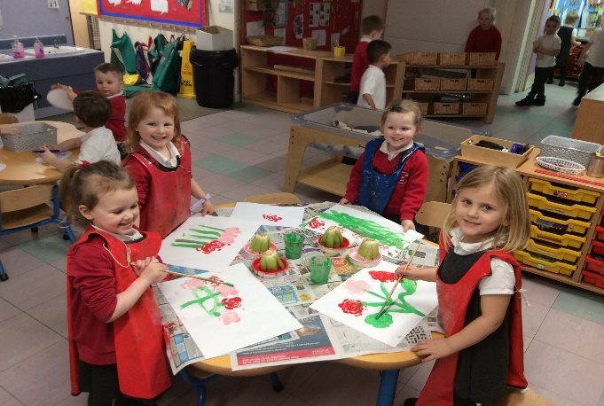
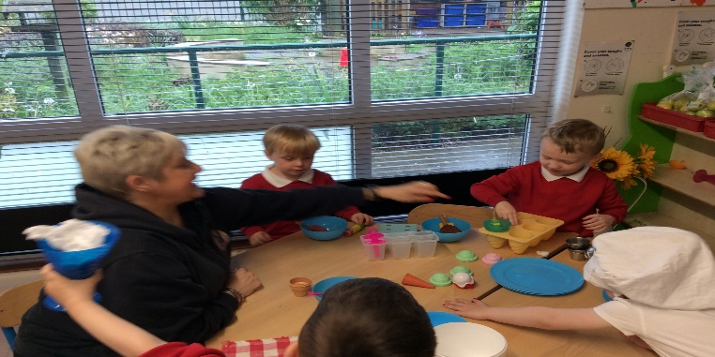
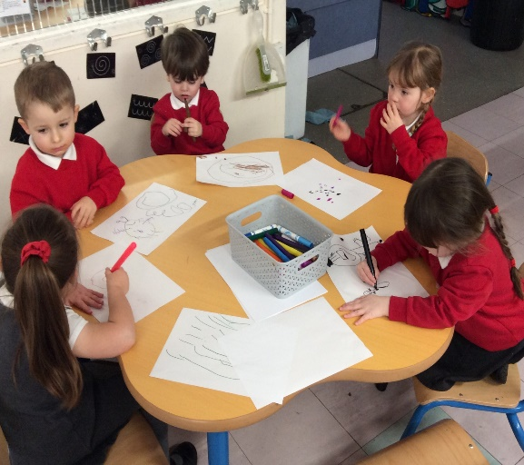
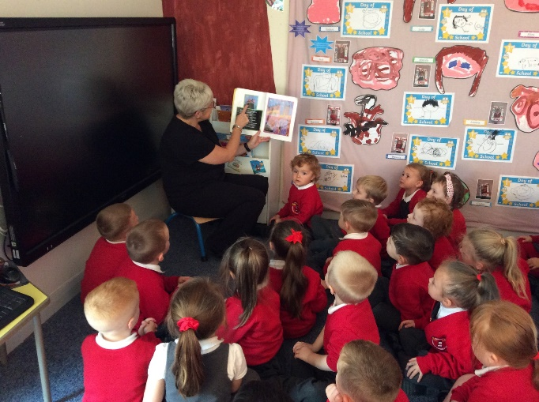
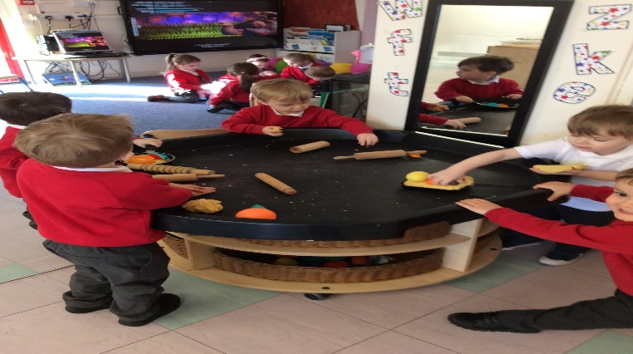
Nursery Environment

Slide 6
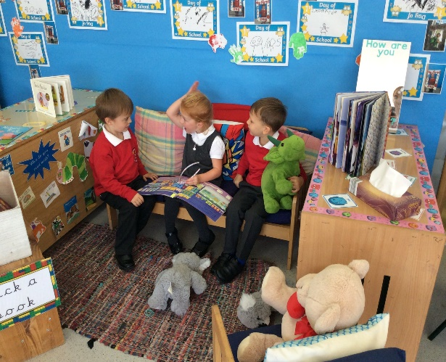
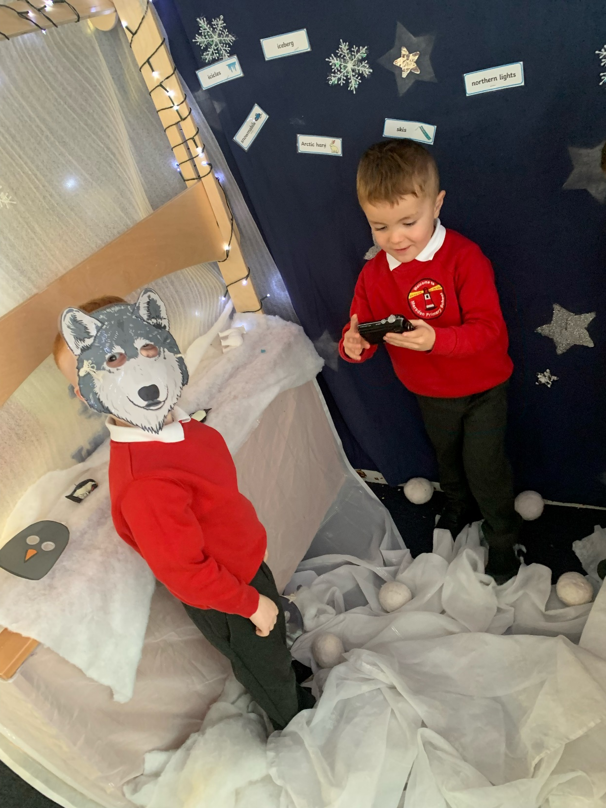
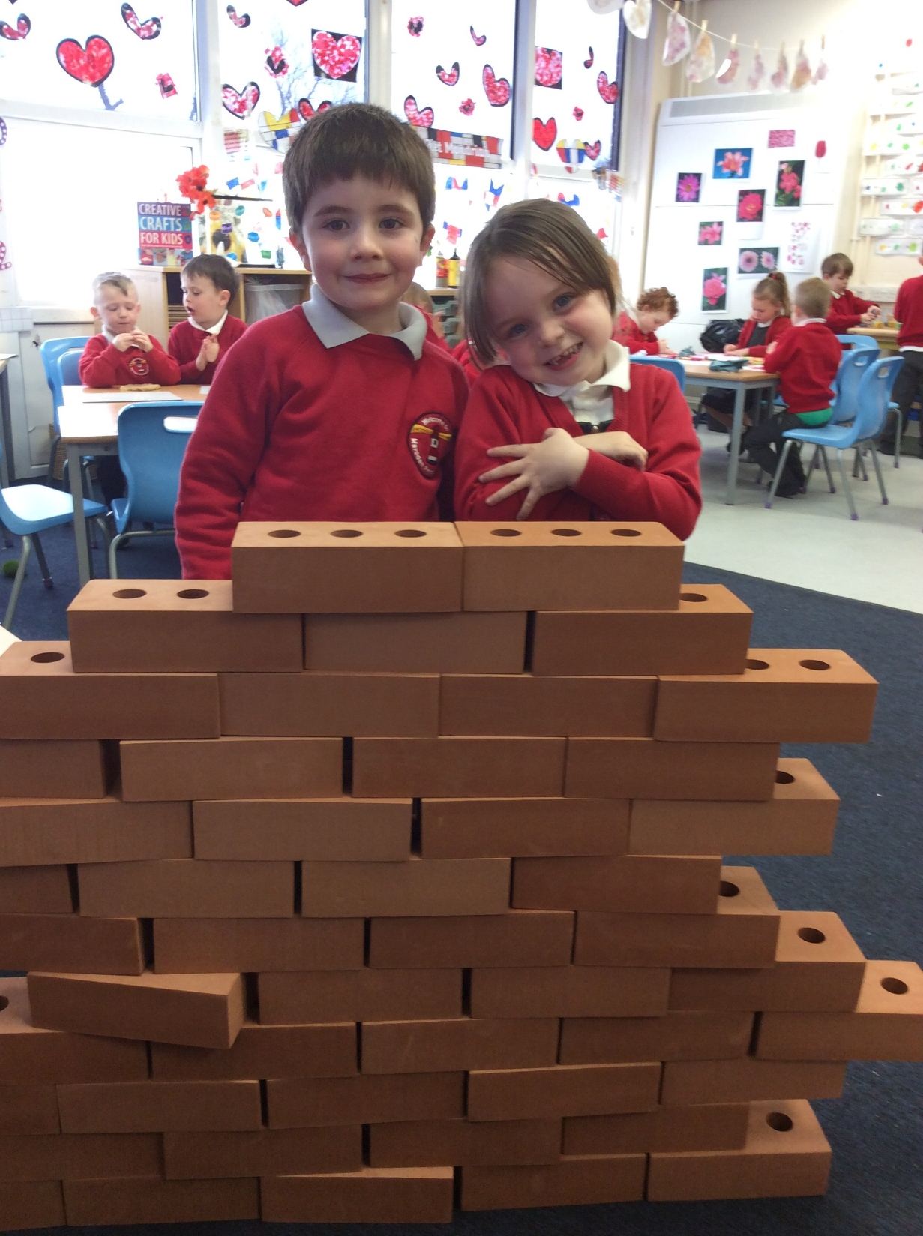
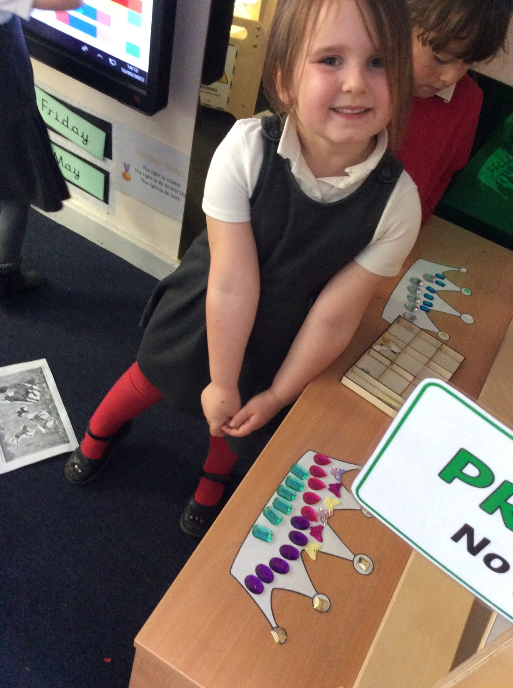
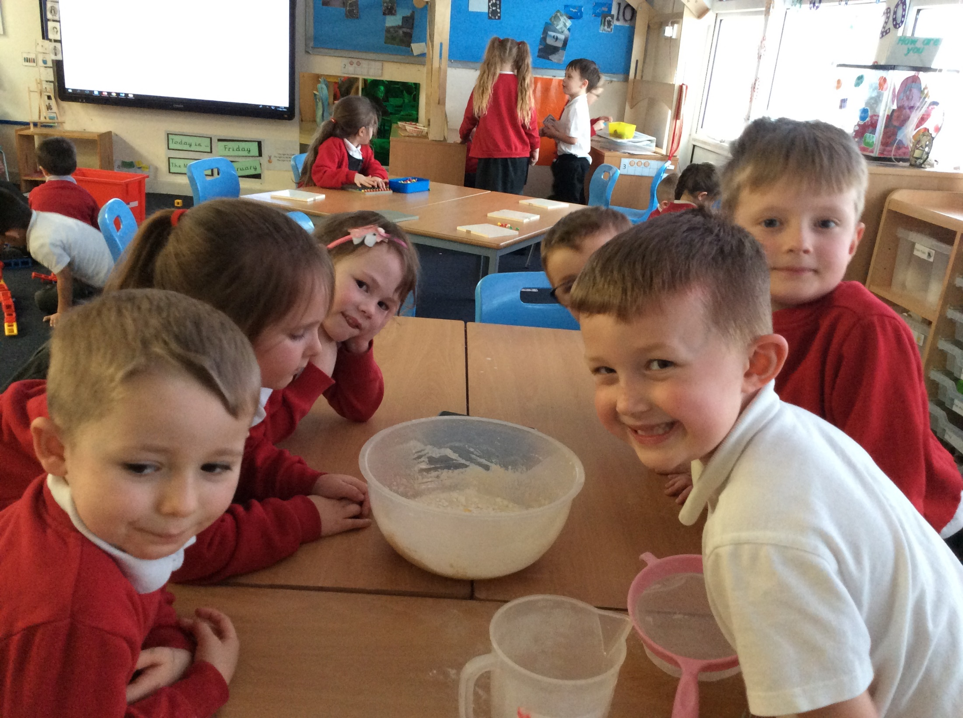
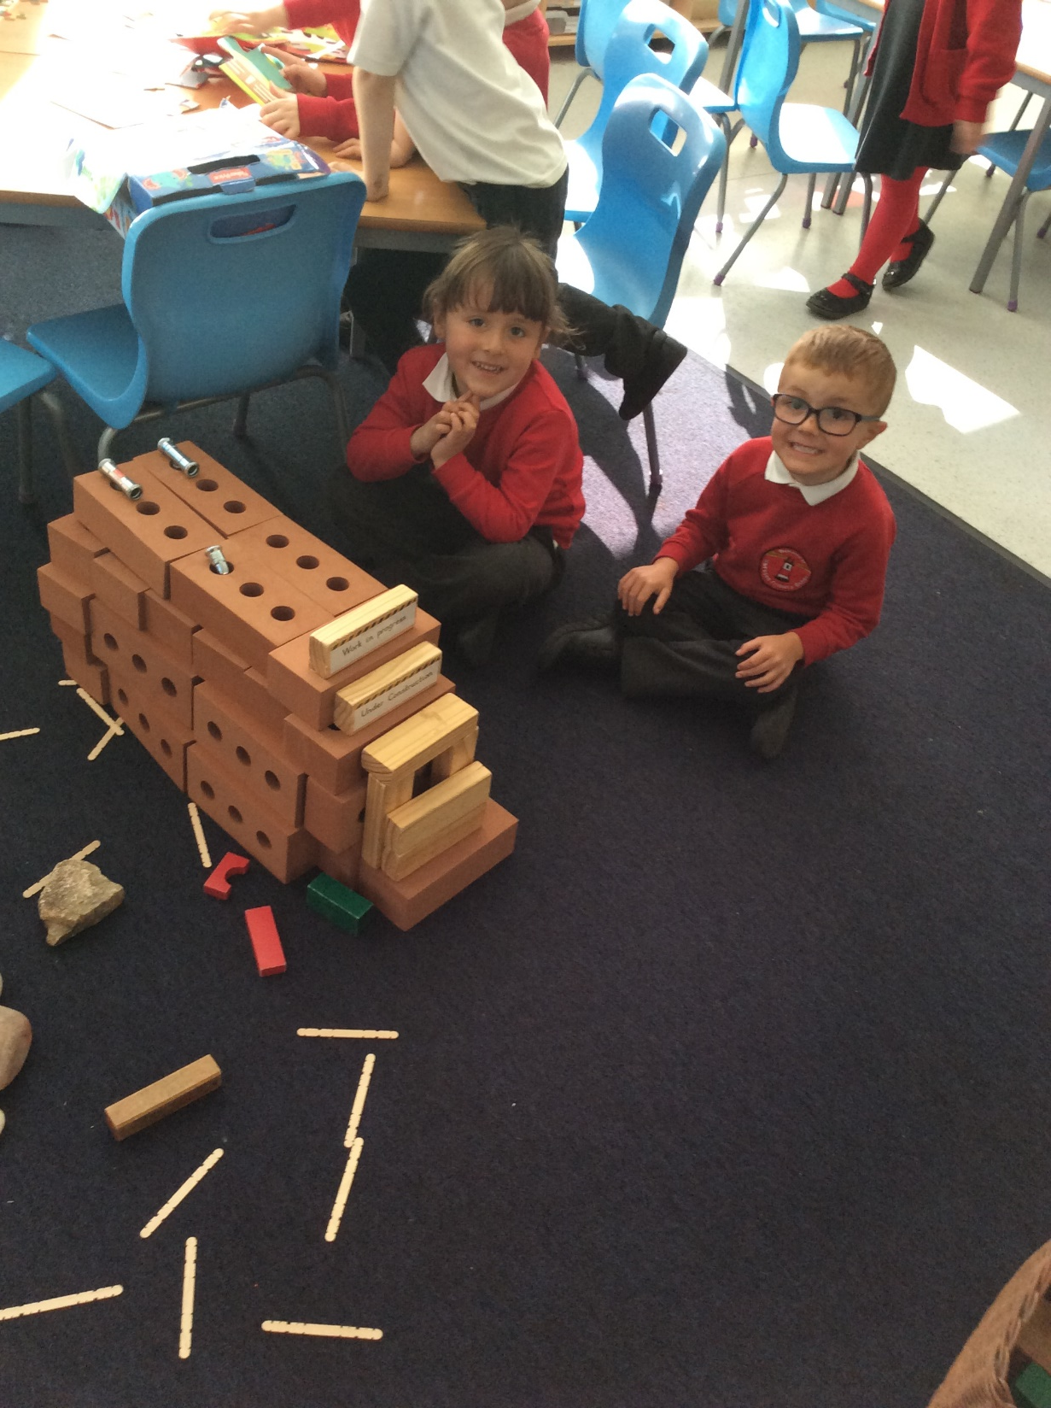
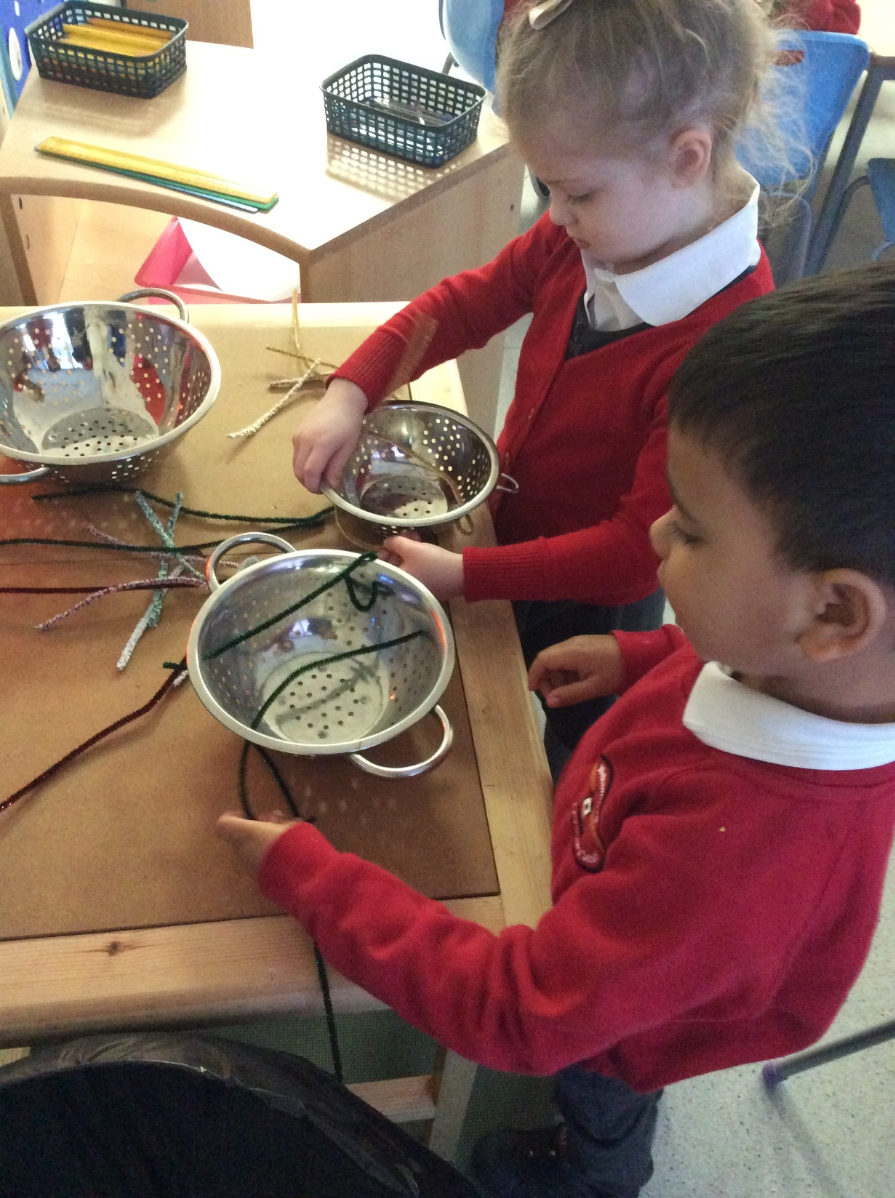
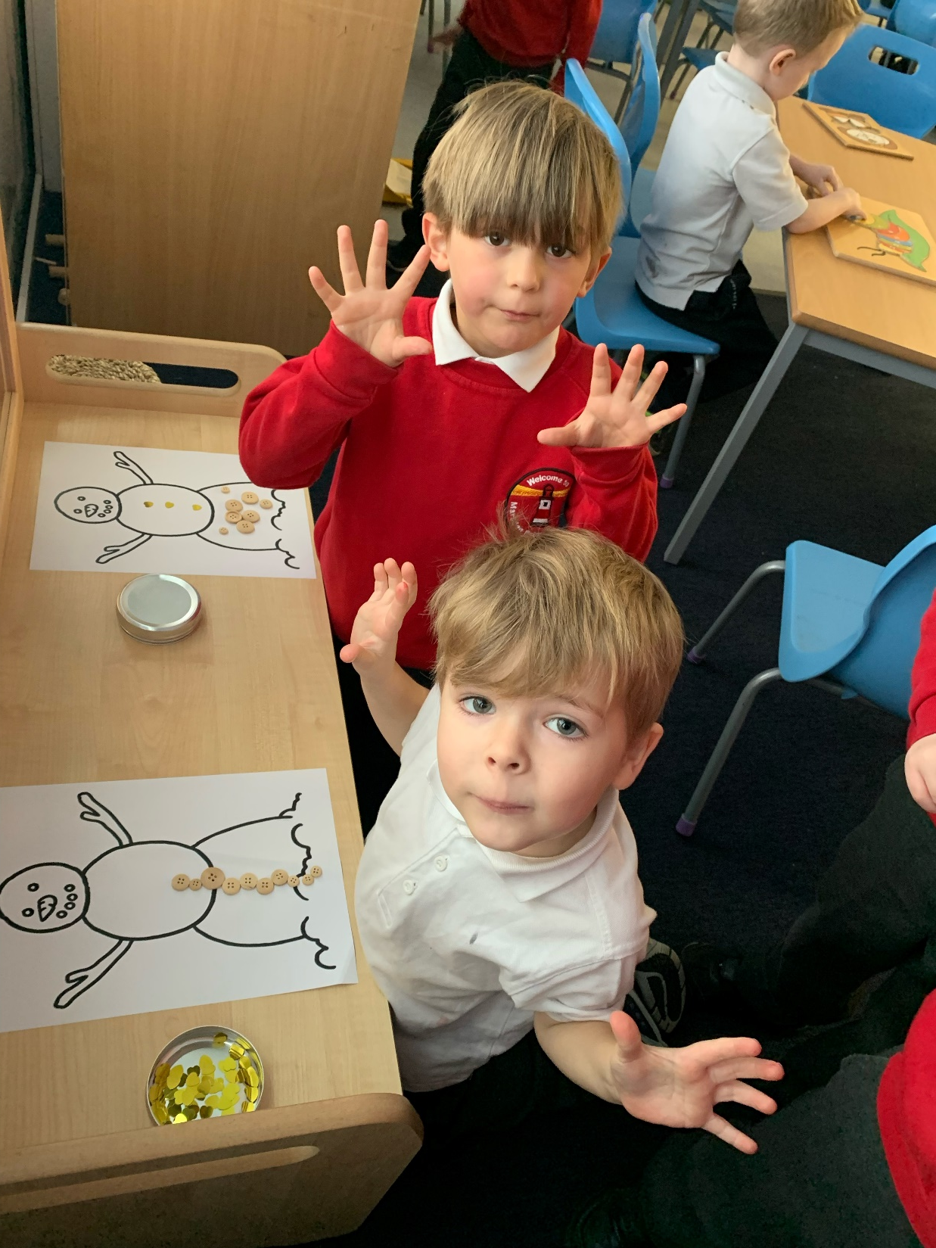
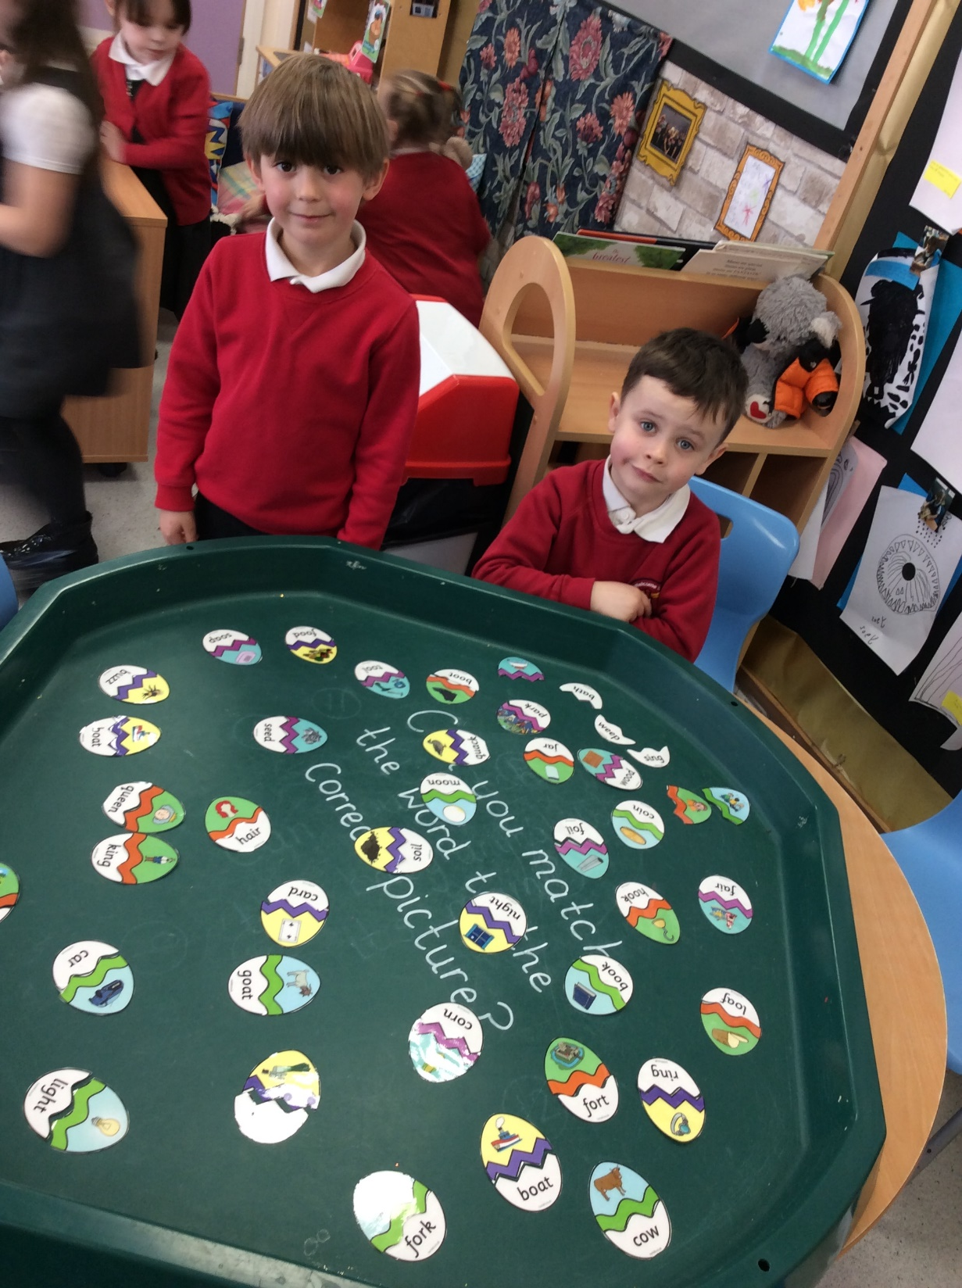
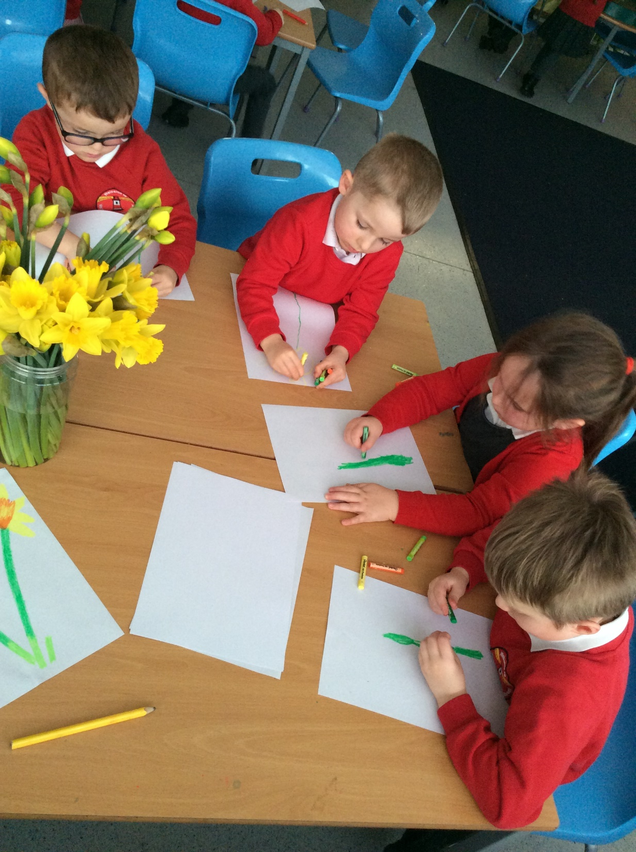
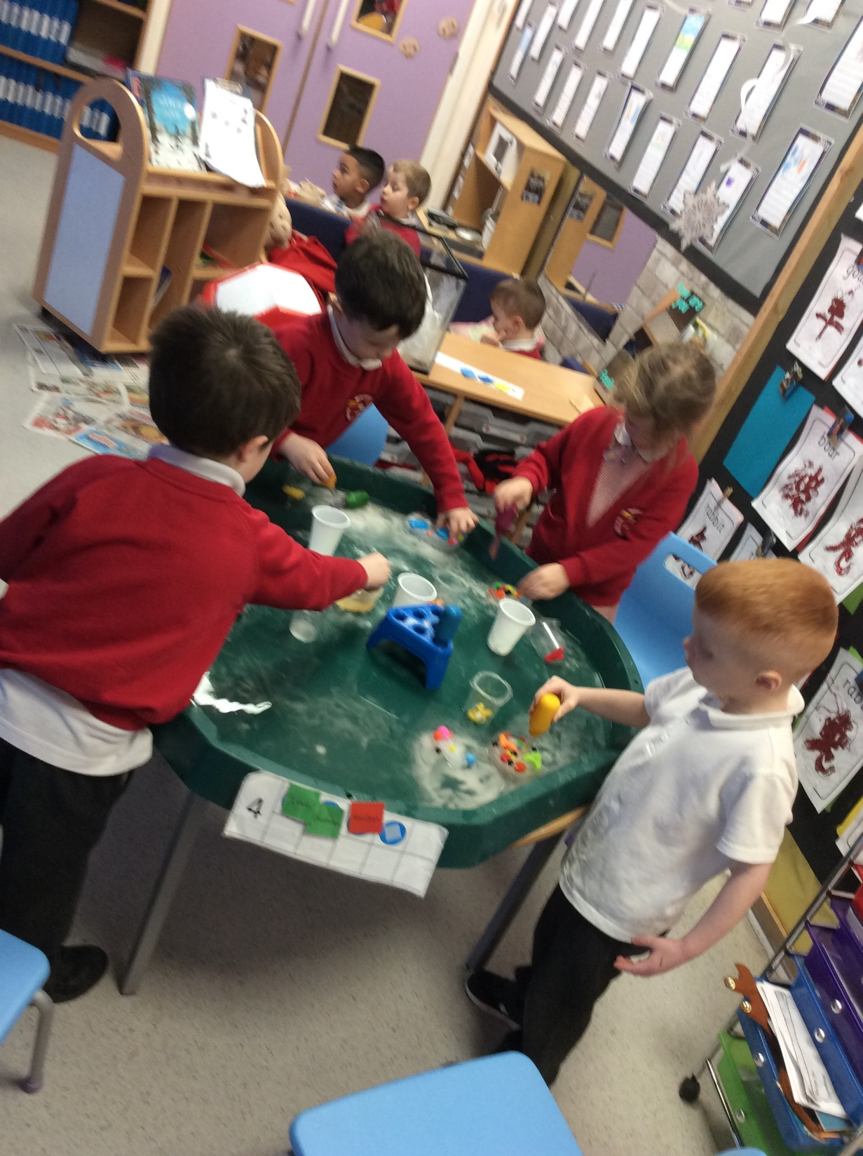
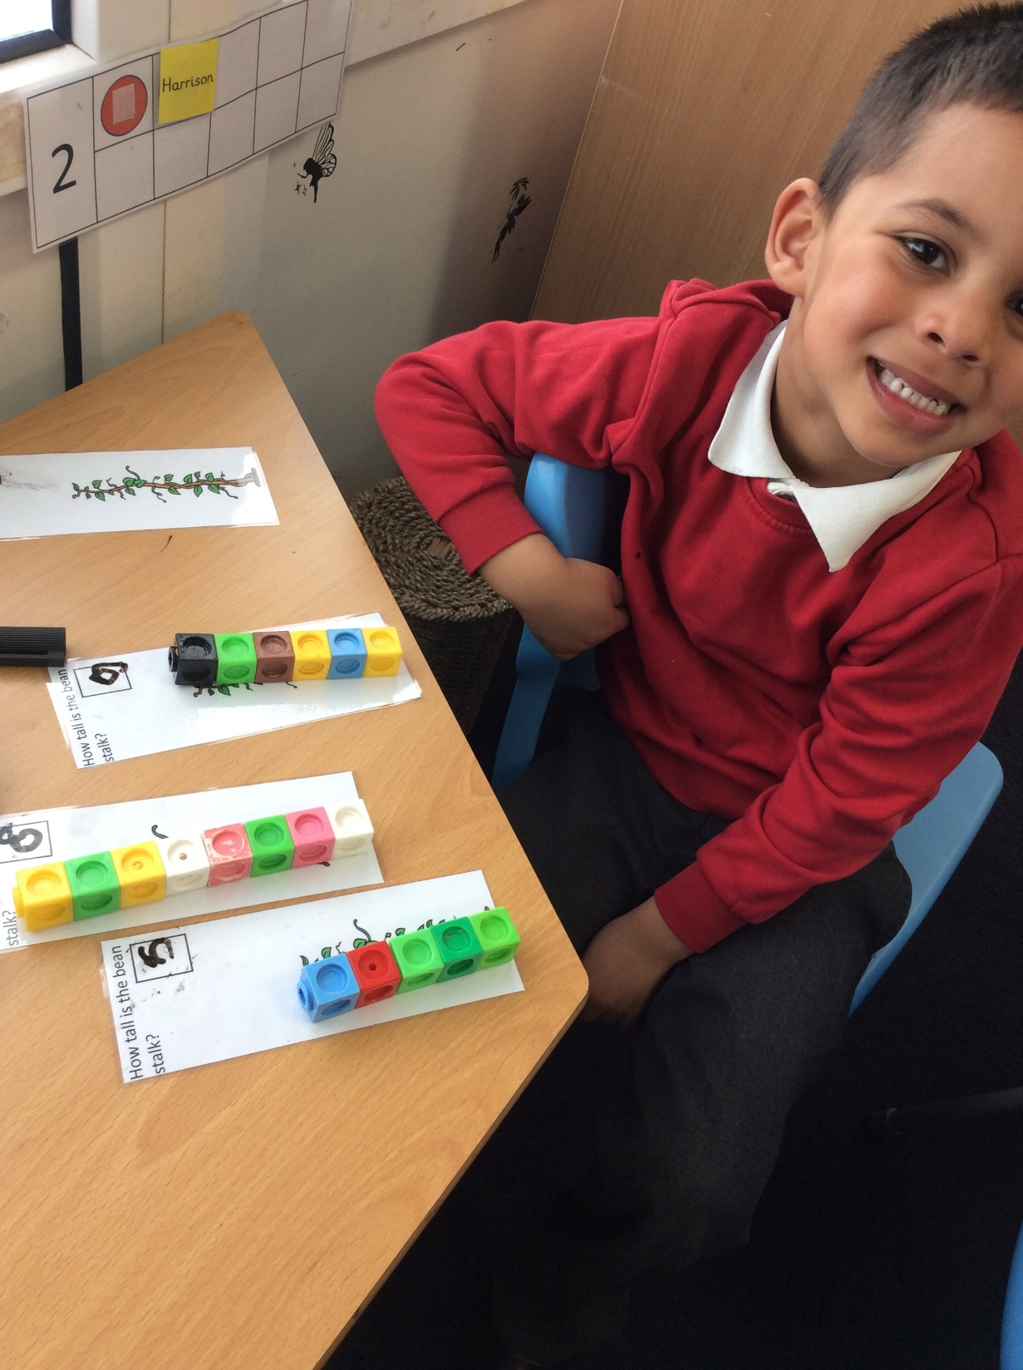
Reception Environment

Slide 7
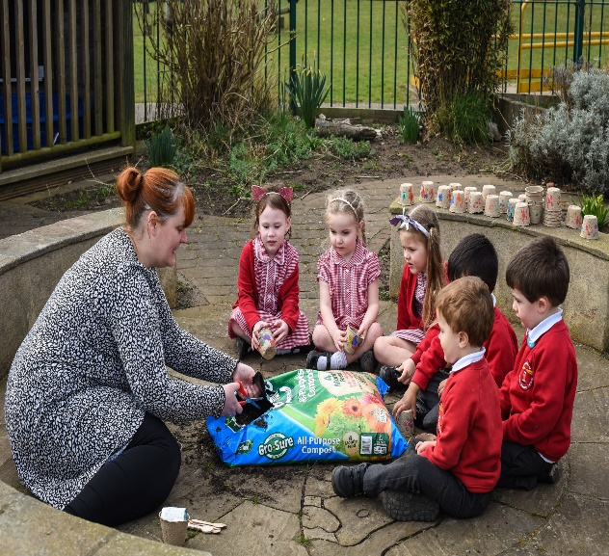
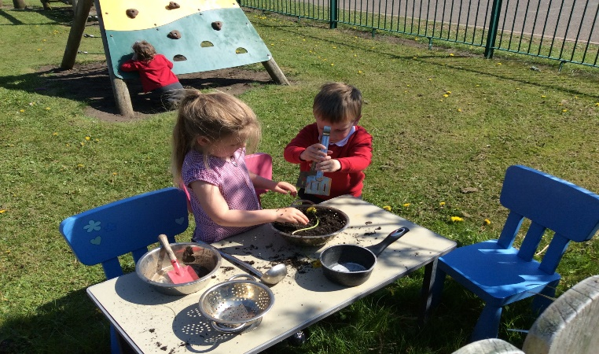
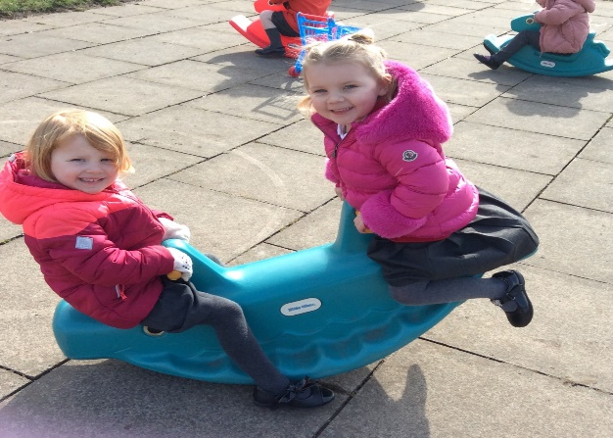
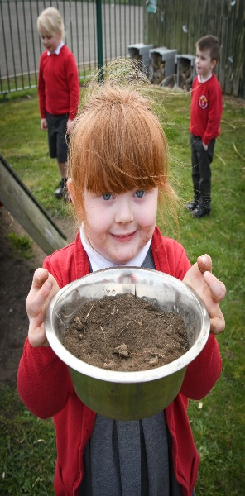
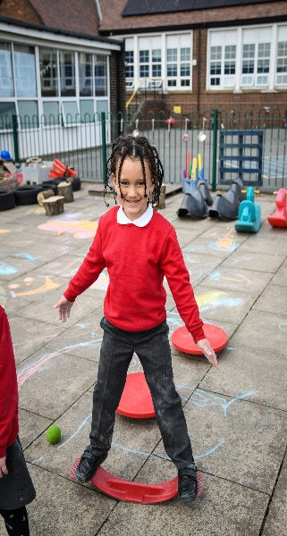
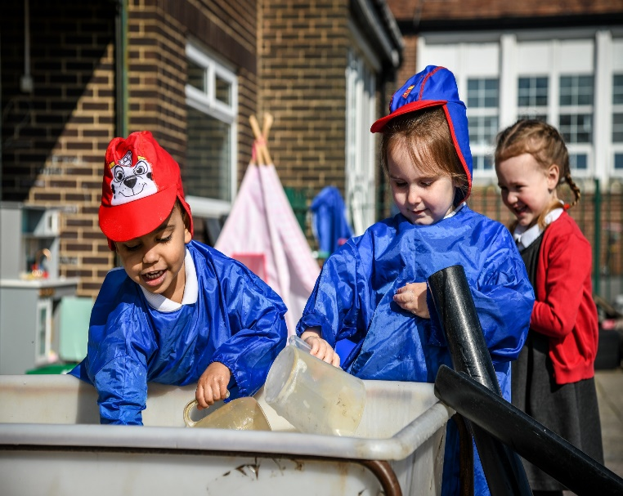
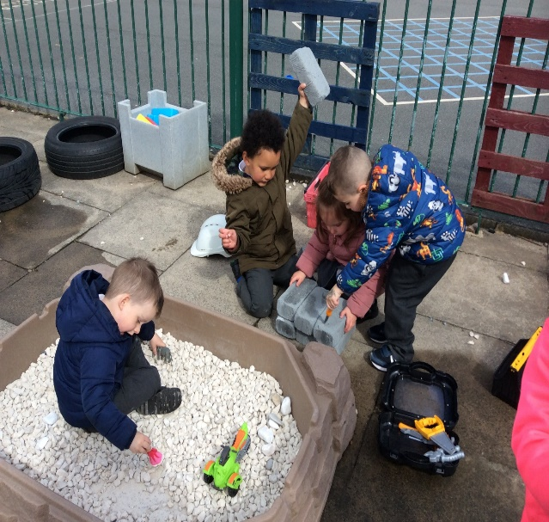
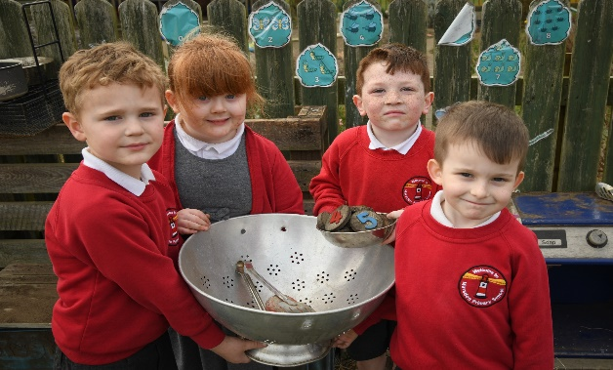
Outdoor Environment

Slide 8
Sessions at Marsden Primary EYFS?
Nursery
Morning session- 8.45am-11.45am
Afternoon session-12.30pm-3.30pm
30 Hours Placement- 8:45am-3:30pm
Reception
8:45am-3:25pm

Slide 9
15 Hour Placement
AM Session
8:45-9:00- Rhyme Time/Welcome/Register
9:00-9:30-Phonics/Maths Adult Led Task
9:30-10:30- Child Initiated Time (Indoor)/Challenge
10:30-10:45-Milk and Fruit
10:45-11:30- Child Initiated Time (Outdoor)
11:30-11:45-Story Time
11:45-Home Time
PM Session
12:30-1:00- Outdoor Provision
1:00-1:05-Rhyme Time/Welcome/Register
1:05-1:30-Phonics/Maths
1:30-2:15 Child Initiated Time (Indoor)/Challenge
2:15-3:00-Child Initiated Time (Outdoor)
3:00-3:15-Milk and Fruit
3:15-3:30-Story Time
3:30-Home Time

Slide 10
30 hour placement
8:45-9:00- Rhyme Time/Welcome/Register
9:00-9:30-Phonics/Maths Adult Led Task
9:30-10:30- Child Initiated Time (Indoor)/Challenge
10:30-10:45- Water
10:45-11:15- Child Initiated Time (Outdoor)
11:15-11:30- Prepare for Lunch
11:30-12:00-Lunch in the Hall
12:00-12:45- Outdoor Break- Physical Development
12:45-1:00- Team Work Task
1:00-2:15-Prime Areas Development Time/Child Initiated Time
2:15-3:00-Child Initiated Time (Outdoor)
3:00-3:15-Milk and Fruit
3:15-3:30-Story Time
3:30-Home Time

Slide 11
Reception
8:45-9:00-Morning Activity/Wake up Shake up/Register
9:00-9:30-Phonics
9:30-10:10-Child Initiated Time
10:10 – 10:15 - Milk
10:15-11:00- Literacy
11:00 - 11:45-Maths
11:45-12:15-Lunch in the Hall
12:15-1:00-Outdoor- Physical Development
1:00-2:30-Challenge / Reading / Child Initiated Time
2:30-2:45-Dough Disco
2:45-3:10-Handwriting
3:10-3:20-Story Time
3:25-Home Time

Slide 12
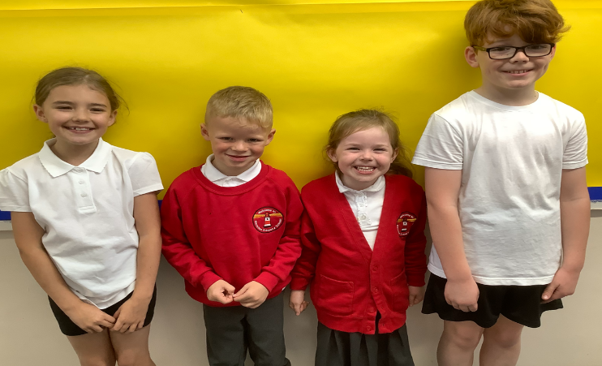
Uniform
Grey skirt or pinafore dress; grey trousers; red sweatshirt or cardigan; white blouse or polo shirt; grey, white or black ankle or knee socks or tights; black footwear; red and white check summer dress; black sandals may be worn in the summer term.
Footwear – the school wants all children to grow into healthy adults. We believe that it is dangerous for children to wear shoes with platform soles or high heels in school, so we do not allow this. We require all children to wear black footwear, as described in the school’s uniform list.
Our PE uniform comprises:
Indoor – White T-shirt, black shorts, well fitting black gym shoes
Outdoor – White T-shirt, black shorts/jogging bottoms, trainers
School sweatshirts, cardigans, waterproof jackets, book bags, T-shirts, shorts, gym shoes and PE bags may be purchased from our uniform supplier ‘Total Sports North East Limited’ via the school office.
Please make sure all uniform has
your child’s name in.

Slide 13
Additional Information
30 Hours- Wraparound lunchtime care 11.30-12.15pm chargeable to parent at a cost of £2.00 per day/£10.00 per week, to be paid in advance.
School Dinners- Nursery £2.20 per day/Reception- Free
PE bag
Change of clothes
Water bottle
Library

Slide 14
Thank You

