Slide 1


South Tyneside Young Carers
South Tyneside Young Carers Service
Humankind &TEN

Slide 2
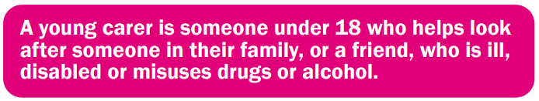
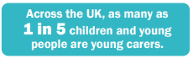
What is a Young Carer?
Young Carers are defined as “children and young persons under 18 who provide or intend to provide care, assistance or support to another family member. They carry out, often on a regular basis, significant or substantial caring tasks and assume a level of responsibility that would usually be associated with an adult. The person receiving care is often a parent but can be a sibling, grandparent or other relative who is disabled, has a chronic illness, mental health problem or other condition connected with a need for care, support or supervision.” (Becker, 2000, p 378)

Slide 3
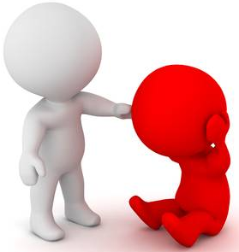
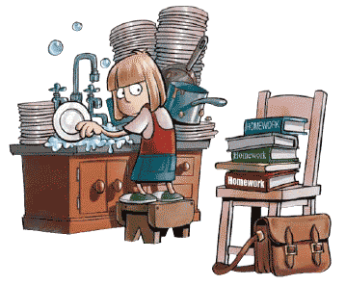
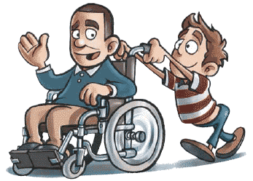
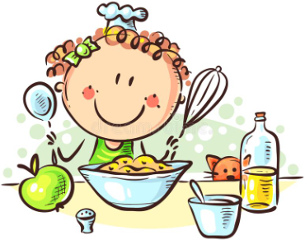
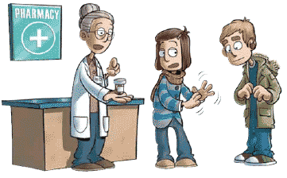
What might a Young Carer do ?
Practical Tasks, such as cooking, housework and shopping
Physical Care, such as helping someone out of bed
Emotional Support, such as talking to someone who is distressed or upset.
Managing the family budget and collecting prescriptions
Helping to give medicine
Helping someone communicate
Looking after brother and sisters
Dealing with emergencies

Slide 4
Aims of our Young Carers service is to…
Identify hidden Young Carers
Improve the quality of lives of Young Carers
A break away from their caring role
A chance to meet new friends in similar situations
An opportunity to just be children and have fun
Reduced Isolation
Someone to talk to
Somewhere to go and feel safe and supported
Support to improve school attendance
Improve emotional and physical health

Slide 5

Humankind South Tyneside Young Carers

Slide 6
Humankind South Tyneside Young Carers Service
We provide the Young Carers Statutory Assessment
Open access referrals.
5-24yrs.
Agree a length of time to work with young carer and their family
Provide focused interventions to promote resilience, coping skills and independence from services.
1-1 support, small groups, activities and family support.
Referral to TEN Young Carers

Slide 7







TEN South Tyneside Young Carers Respite Support Service

Slide 8
TEN South Tyneside Young Carers
What We Offer
Referral and signposting to Humankind Young Carers
Welcome Pack and Initial Meeting
Respite Activity Packs (Arts & Craft Packs, Family Cooking Packs)
Age Appropriate Respite Activity Sessions
School Holiday Activity Programmes
Residential Breaks
Monthly School Drop In Sessions and Peer Support
Homework Help
Personal Development Workshops and Training i.e. First Aid, Safeguarding
Duke of Edinburgh Award
Volunteering Opportunities
Family Support: Advice and Advocacy, Parent Forums & Family Activities

Slide 9
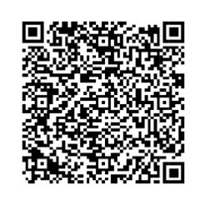
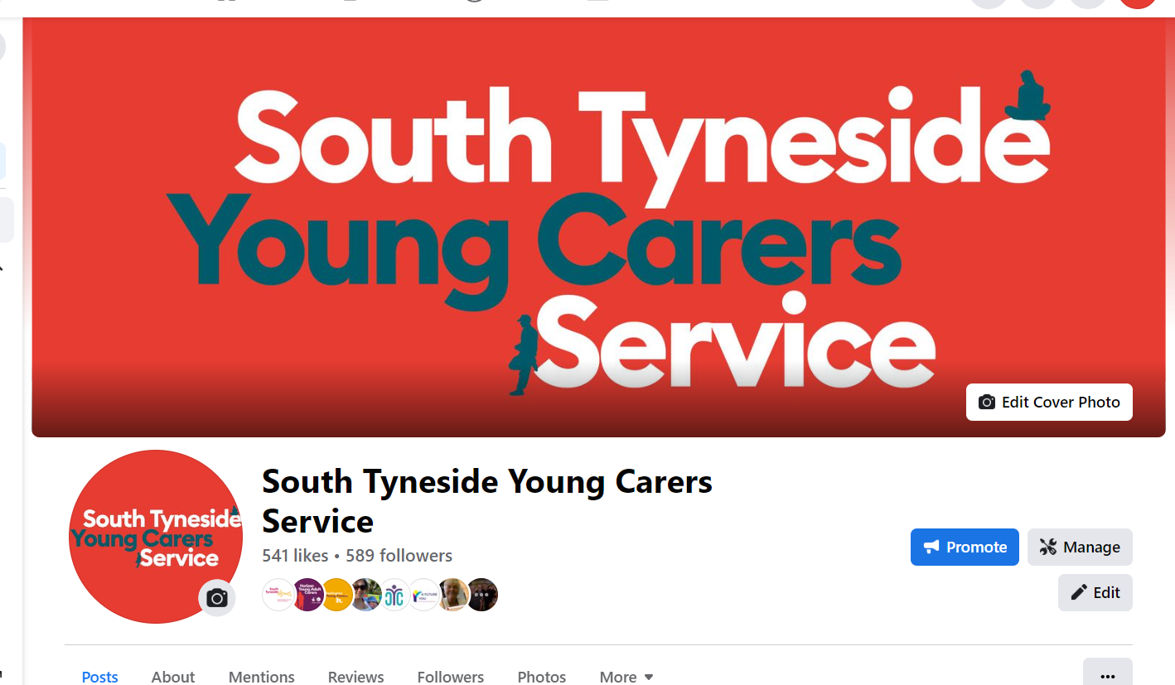
What to do next if you think you are a young carer.
Talk to your teacher or an adult at home about this.
Make a referral
Scan me for the referral form
Follow us on facebook
Give us a call or e mail
E Mail: STYC@humankindcharity.org.uk
Telephone : 01325 731 160

Slide 10
Meet the Young Carers Teams
Levi Cosker: YC’s Programme Lead
Jayne Plummer: YC’s Activity Officer
Tracey Arthur: YC’s Admin/support worker
Sarah Raistrick: YC’s Lead Practitioner
Leanne Moffatt: YC’s Support Coordinator
Claire Symons: YC’s Support Coordinator

