Slide 1
Welcome to our Phonics information sharing session

Slide 2
Phonics and Early Reading
Part 1 – How we teach phonics
Part 2 – How we teach reading
Part 3 – Supporting at home

Slide 3
What is Phonics?
Phonics is a way of teaching children how to read and write.
It helps children hear, identify and use different sounds that distinguish one word from another in the English language.

Slide 4
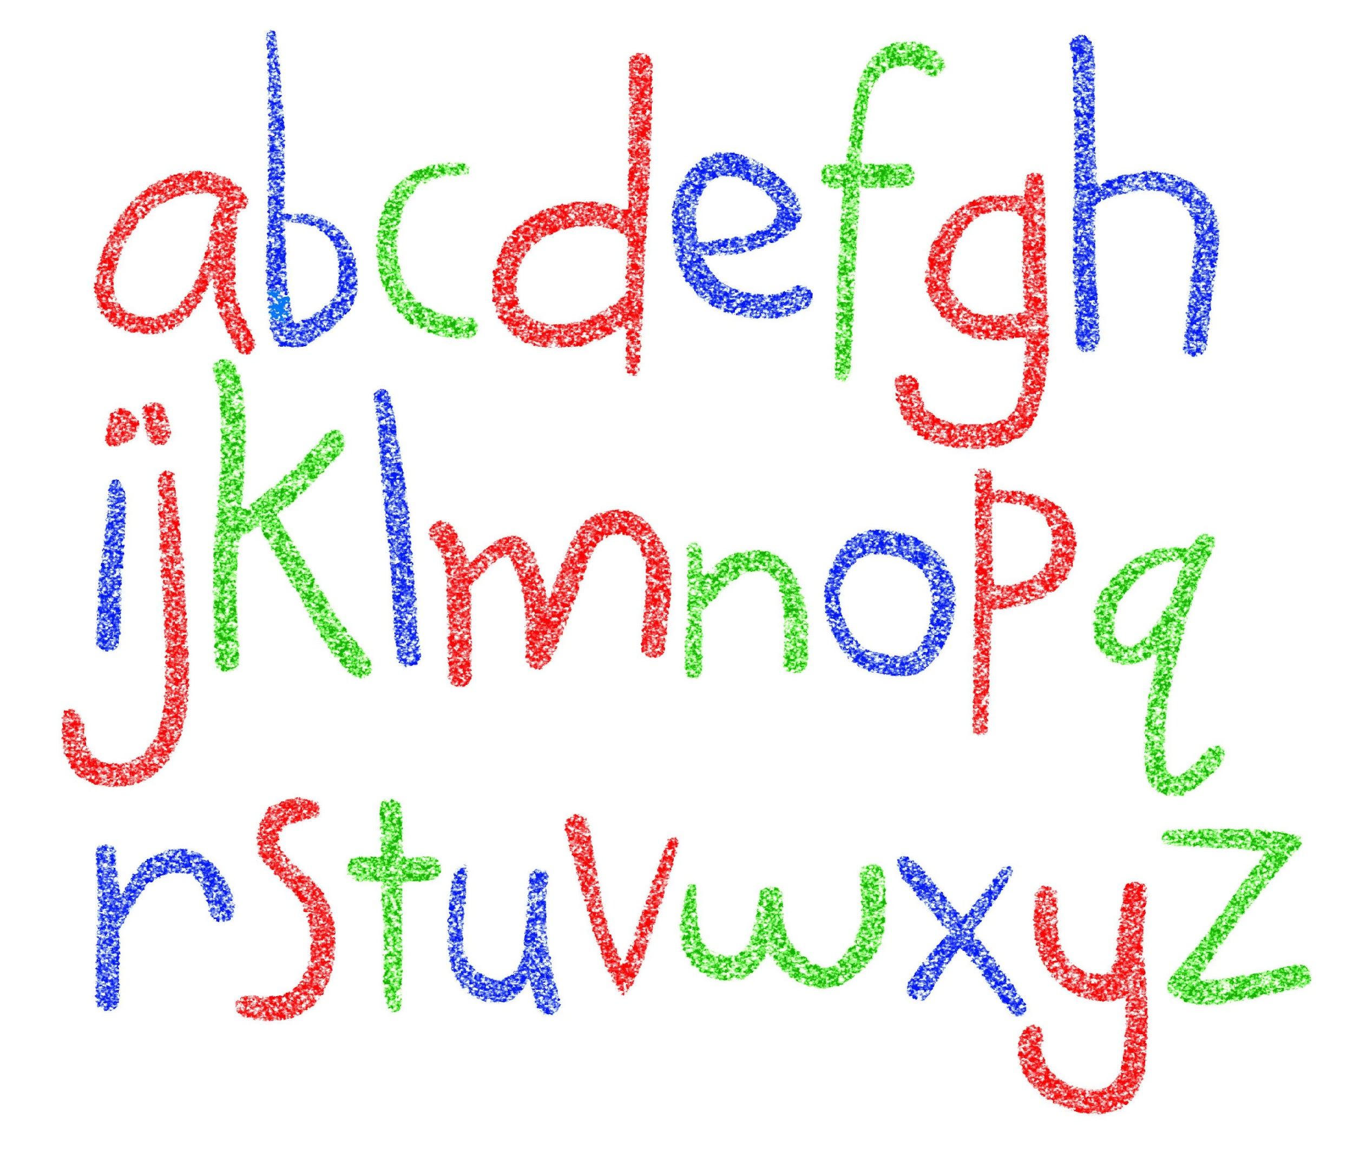
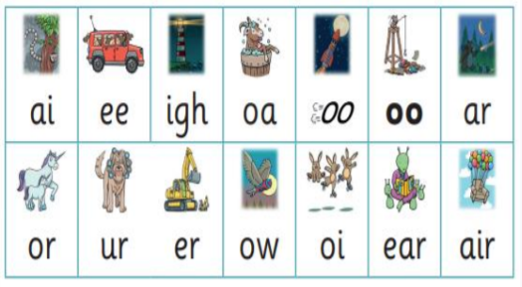
Did you know?
The English language has:-
26 letters
44 sounds
Over 100 different ways to spell
those sounds

Slide 5
New DFE Guidance for Early Reading and Phonics
The journey to independent reading and writing begins with Phonics
www.littlewandlelettersandsounds.org.uk
Why ‘Little Wandle’?
Excellent training for all staff to ensure consistency.
Every aspect of phonics and reading included in a detailed, thorough and systematic approach.
Engaging resources without distracting from the learning.
Comprehensive system for identifying and supporting children requiring extra help
Useful support for parents.

Slide 6
How we teach Phonics…
Daily Phonics sessions with additional small group/ individual ‘Keep up’ sessions.
Specific order of teaching
Synthetic phonics
v-e-t
Correct pronunciation is vital - Videos on LW
https://www.littlewandlelettersandsounds.org.uk/resources/for-parents/
Revisit previously taught sounds at
start of each lesson
Repeated practice

Slide 8
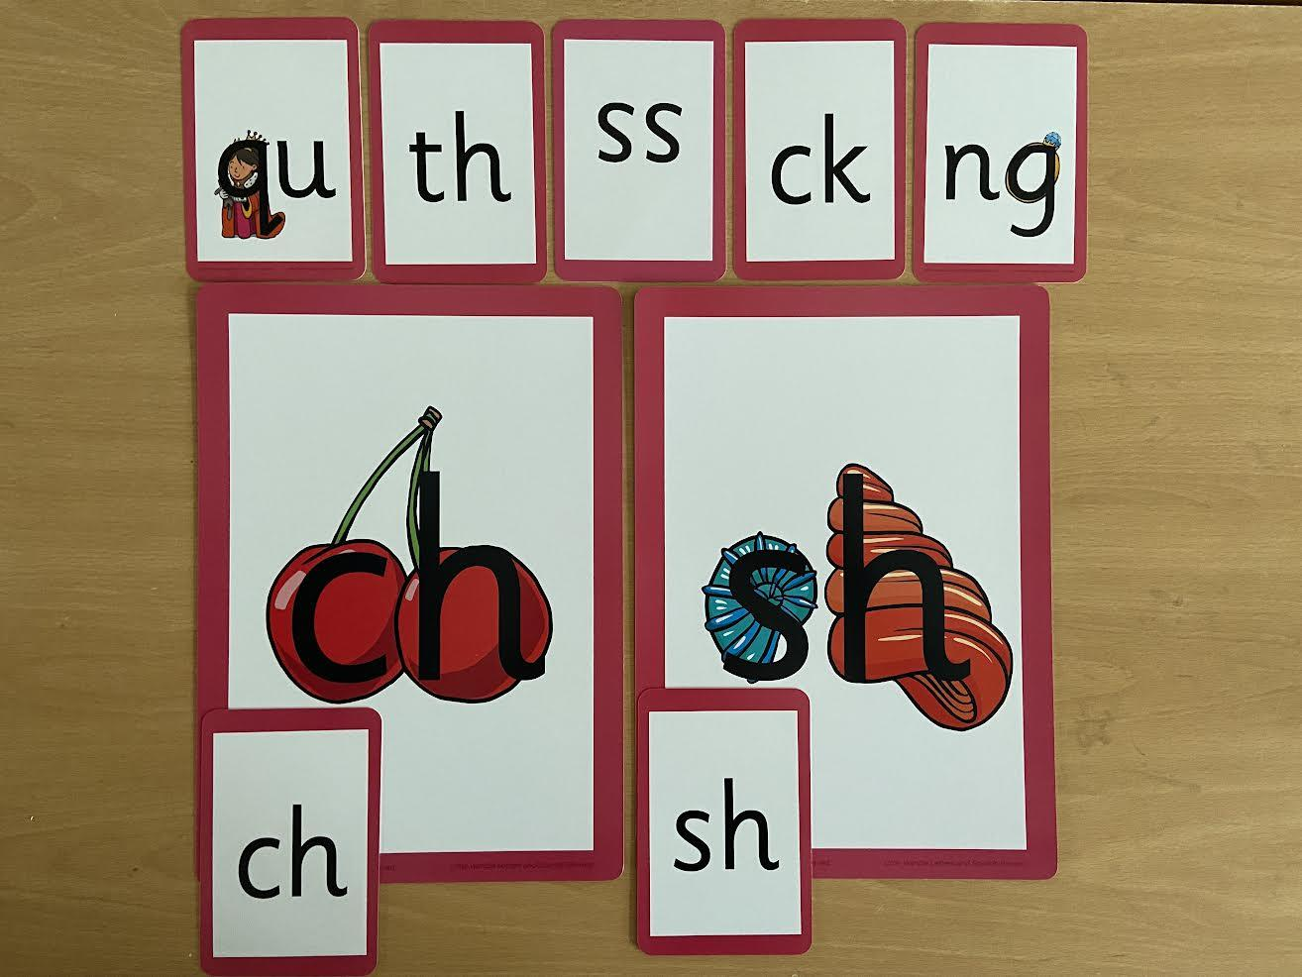

Slide 9
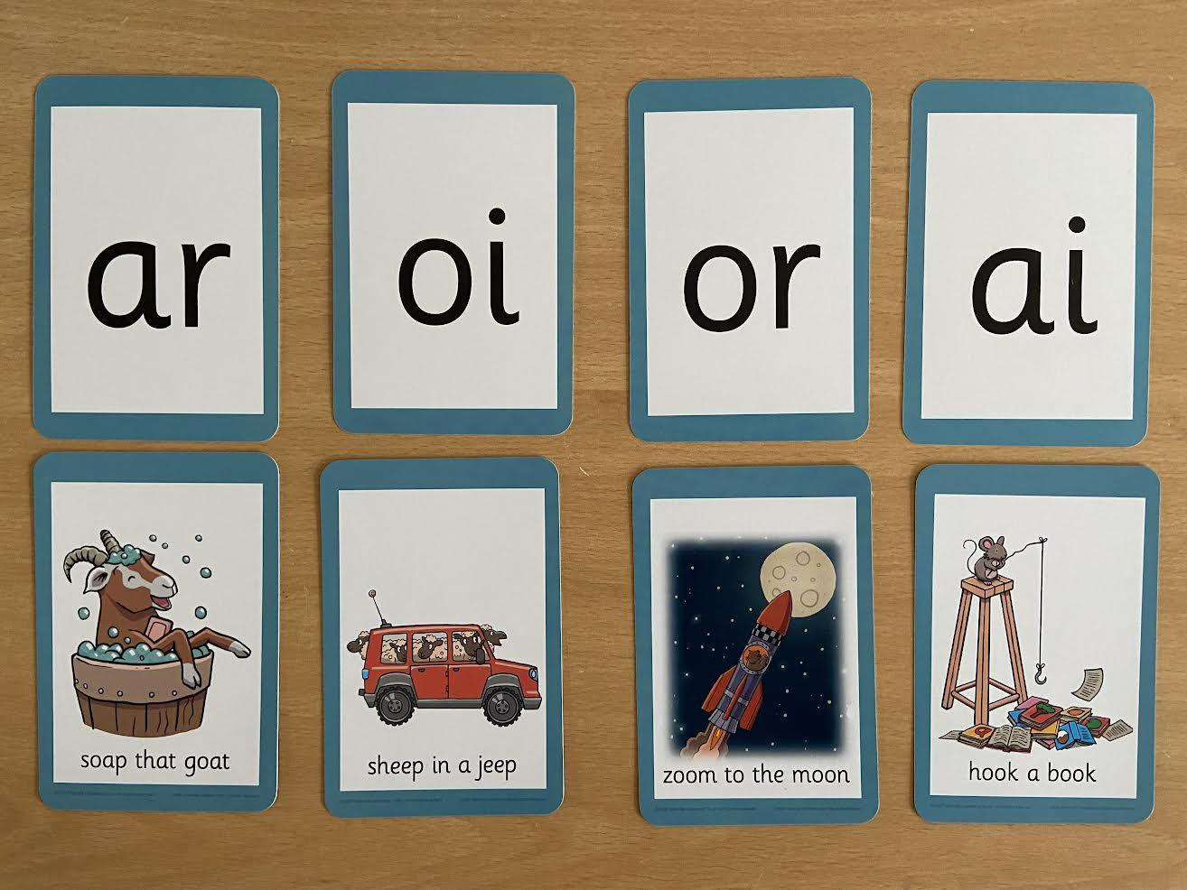

Slide 10
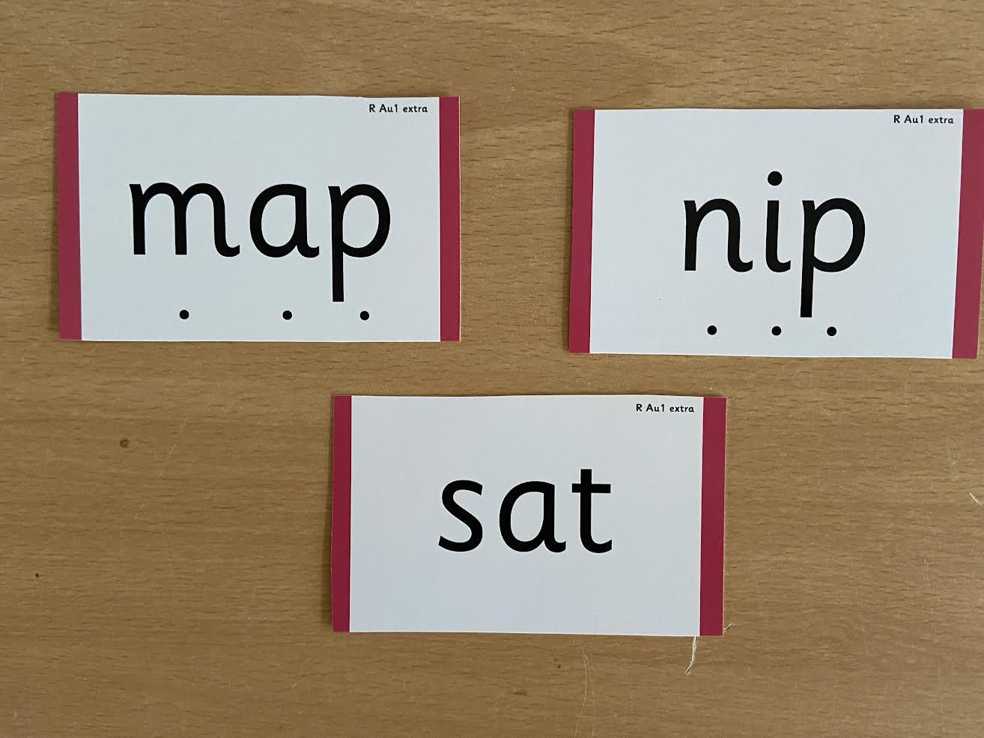

Slide 11
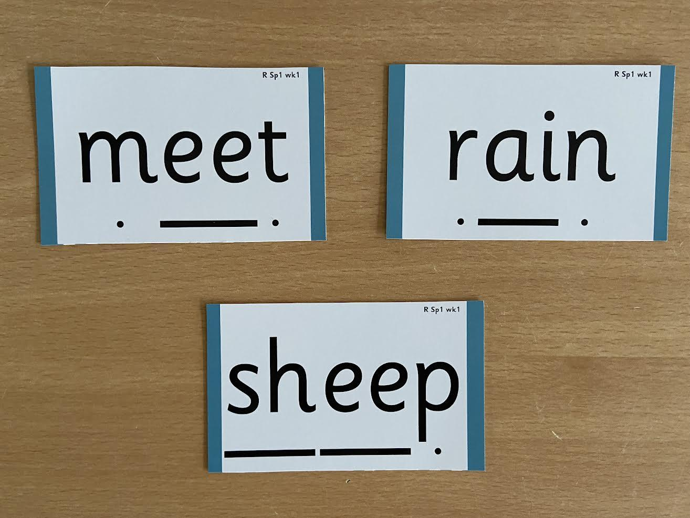

Slide 12
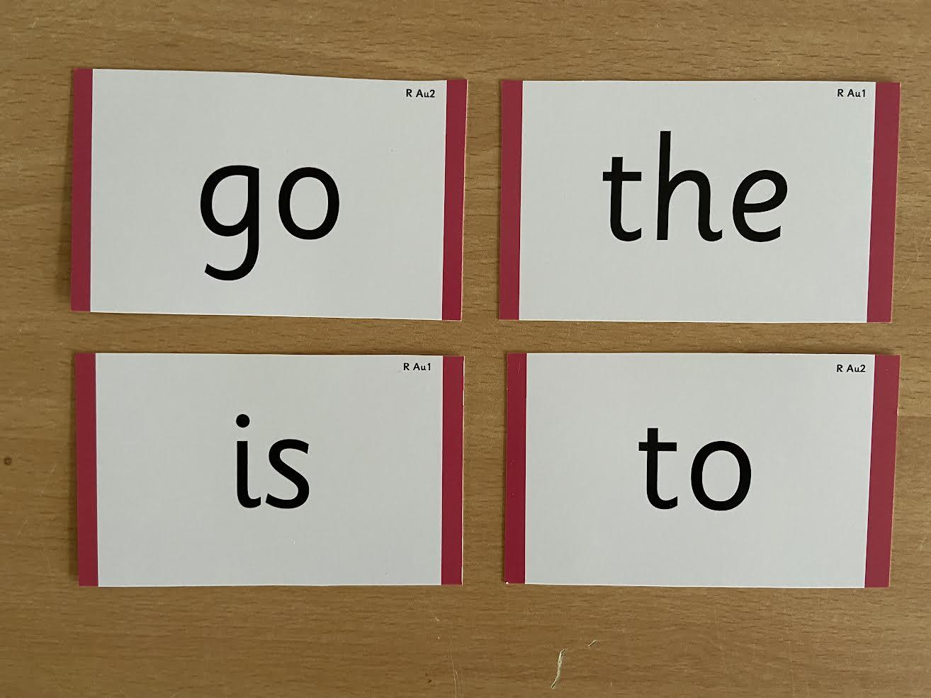

Slide 13
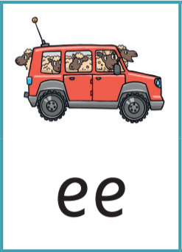
You may hear your children say…
-phonics (also known as ‘synthetic phonics’) – The teaching of reading by developing awareness of the sounds in words and the corresponding letters used to represent those sounds.
-phoneme - Any one of the 44 sounds which make up words in the English language.
-grapheme – How a phoneme is written down. There can be more than one way to spell a phoneme. E.g-the phoneme ‘ay’ is spelt differently in each of the words ‘way’, ‘make’, ‘fail’, ‘great’, ‘sleigh’ and ‘lady’.
-blending – Putting together the sounds in a word in order to read it, e.g.
‘f – r – o – g, frog’
-segmenting – Breaking a word into sounds in order to spell
them, e.g. ‘frog, f – r – o – g’’
-Digraph- 2 letters making one sound
-Trigraph- 3 letters making one sound

Slide 14
Reading
We want children to
love reading
Learning to read should be
a positive experience
We want children to read
for pleasure and be life
long readers
Reading should be
enjoyable
Reading underpins children’s access to the curriculum
and clearly impacts on their achievement
Notes:
We all know how important learning to read is and the impact it has on a childs success - it has to be a positive experience
Whats the reality? Reluctant to read because they find it hard
Frustration stress tears – that’s just the parents
Important to look at the big long term picture

Slide 15
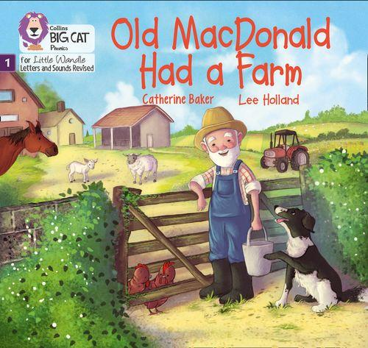
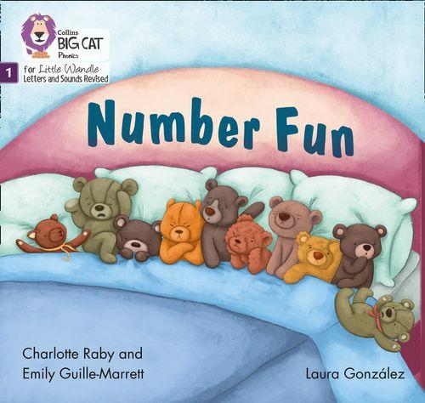
Once children have a secure knowledge of a number of
GPC’s (Grapheme Phoneme Correspondences)
and are confidently blending, they will be ready for
reading books.
Prior to this they may have wordless books which develop great language skills and teach children the layout of books and how to handle books.

Slide 16
How we teach reading
Reading practice sessions are:
Books are :
Timetabled 3 times a week
matched to children’s
secure phonic knowledge
and word reading
Taught by trained teacher or
teaching assistant
read three times
Taught in small groups
sent home
Notes:
Quite a big difference to how reading was previously taught

Slide 17
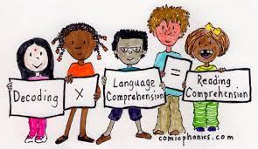
Reading Practice Books carefully matched so children can read
fluently and independently
3 Reads – each one begins with some quick sounds and words practice
Decoding
Prosody
(intonation, expression)
3. Comprehension
When children take their book home to read they should be 95% fluent.
Please do not worry that a book is too easy – your child needs to develop
fluency and confidence in reading. Re-reading a book they have had before
helps develop fluency – this is the goal.
Celebrate their success!!!

Slide 18
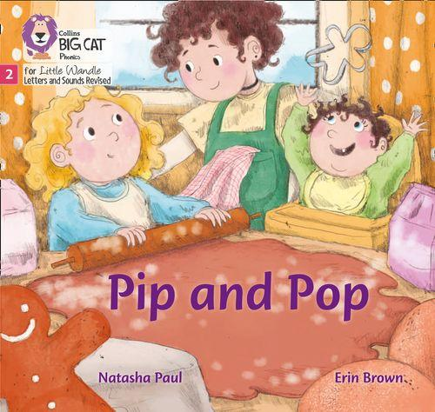
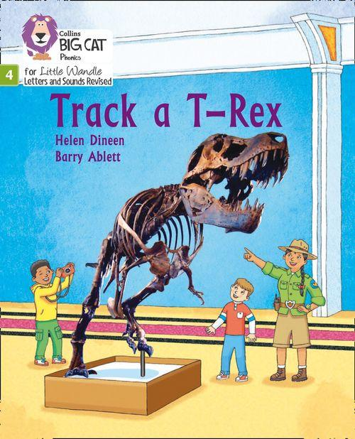
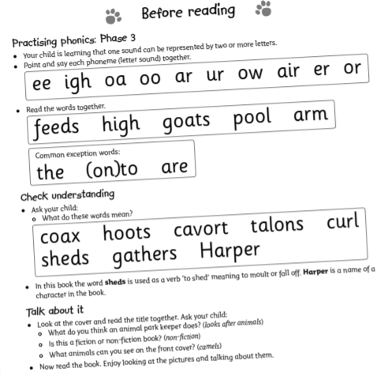
How do we decide which books children read?
Children are assessed, then LW matches which books
Should be allocated for their secure phonic knowledge.
Children will take their Reading Practice Book home
(after reading it 3 times in school)
.
Share the front cover page before reading – this
cover sounds and words contained in the book.
Celebrate, praise, talk about the book with you child.
Please make sure books are in book bags and
returned by Wednesday as they may be
needed for other groups.
Please look after our books – lost or damaged books will need to be replaced.
Notes:
Children will not be changing book multiple times a week as previously
Reading groups will be set up so you will be notified of when your book will be sent home/ need to be back in school
Groups will change!

Slide 19
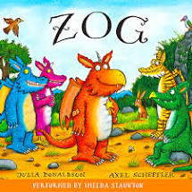
Supporting at home.
Reading for pleasure books
Children will also bring home a ‘reading for pleasure book’ from our class library each week.
To become lifelong readers, it is essential that they read for pleasure.
Children may not be able to read this book independently but these books offer a wealth of opportunities for talking about the pictures and enjoying the story or information text.
Enjoy the book together and
foster a love of reading!

Slide 20
What else can you do?
Please look at the Little Wandle videos and guidance for parents.
Support children in learning the alphabetic code.
Let your child “show off” their reading to you and celebrate and praise all the way!
Share books with your children for pleasure.
Support school in helping your child learn to read.

Slide 21
Phonics Screening check
In Year 1 all children will sit a Phonics Screening check during a week in June.
What is it?
The test contains 40 words, which the children will read aloud to a teacher. It will take around 10 minutes in total, however children will all complete the test at their own pace.

Slide 22
Phonics Screening check
The test contains 20 real words and 20 nonsense (alien) words.
The nonsense words will be shown next to an image of an alien to remind children it is not a real word that they will have read before.
Pseudo words are included
because they will be new to all pupils.
Parents will be informed by the end of the term and confirm if they have met the standard threshold.

Slide 23
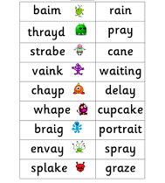
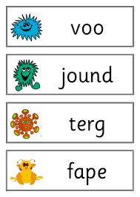

Slide 24
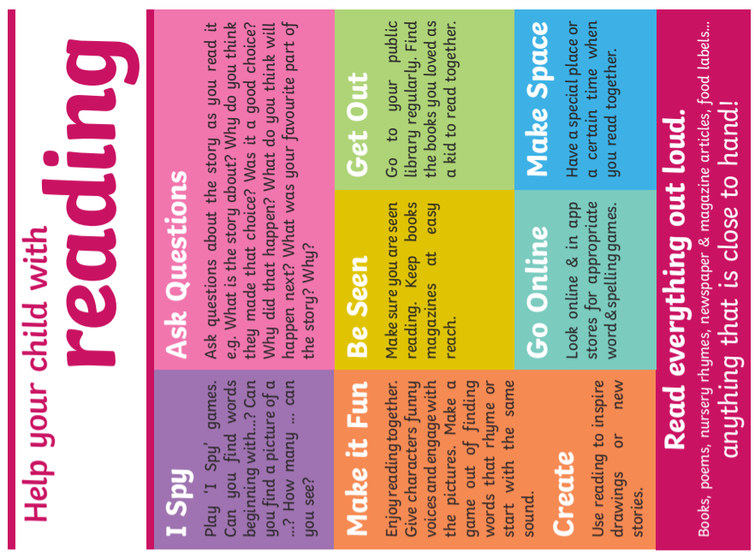

Slide 25
Any Questions?

Slide 26
www.littlewandlelettersandsounds.org.uk

