Slide 1
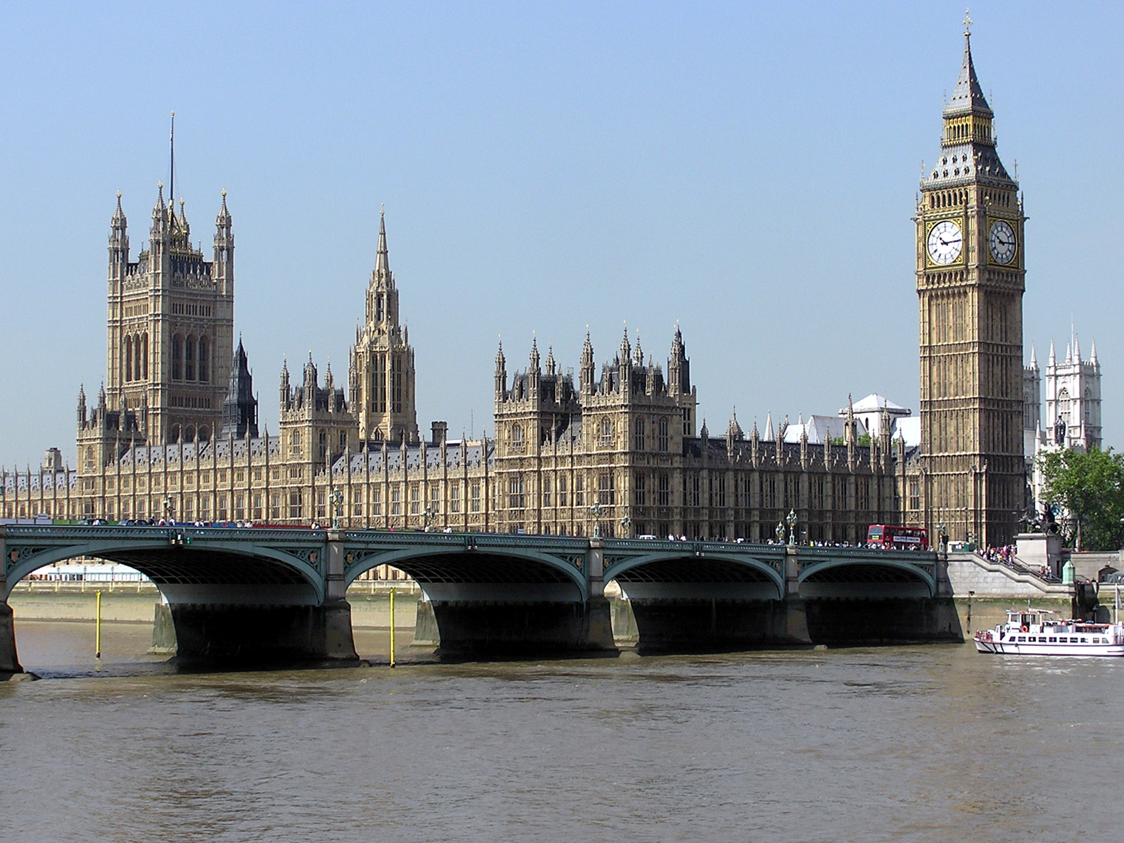
London 2022
31st March- 1st April 2022

Slide 2
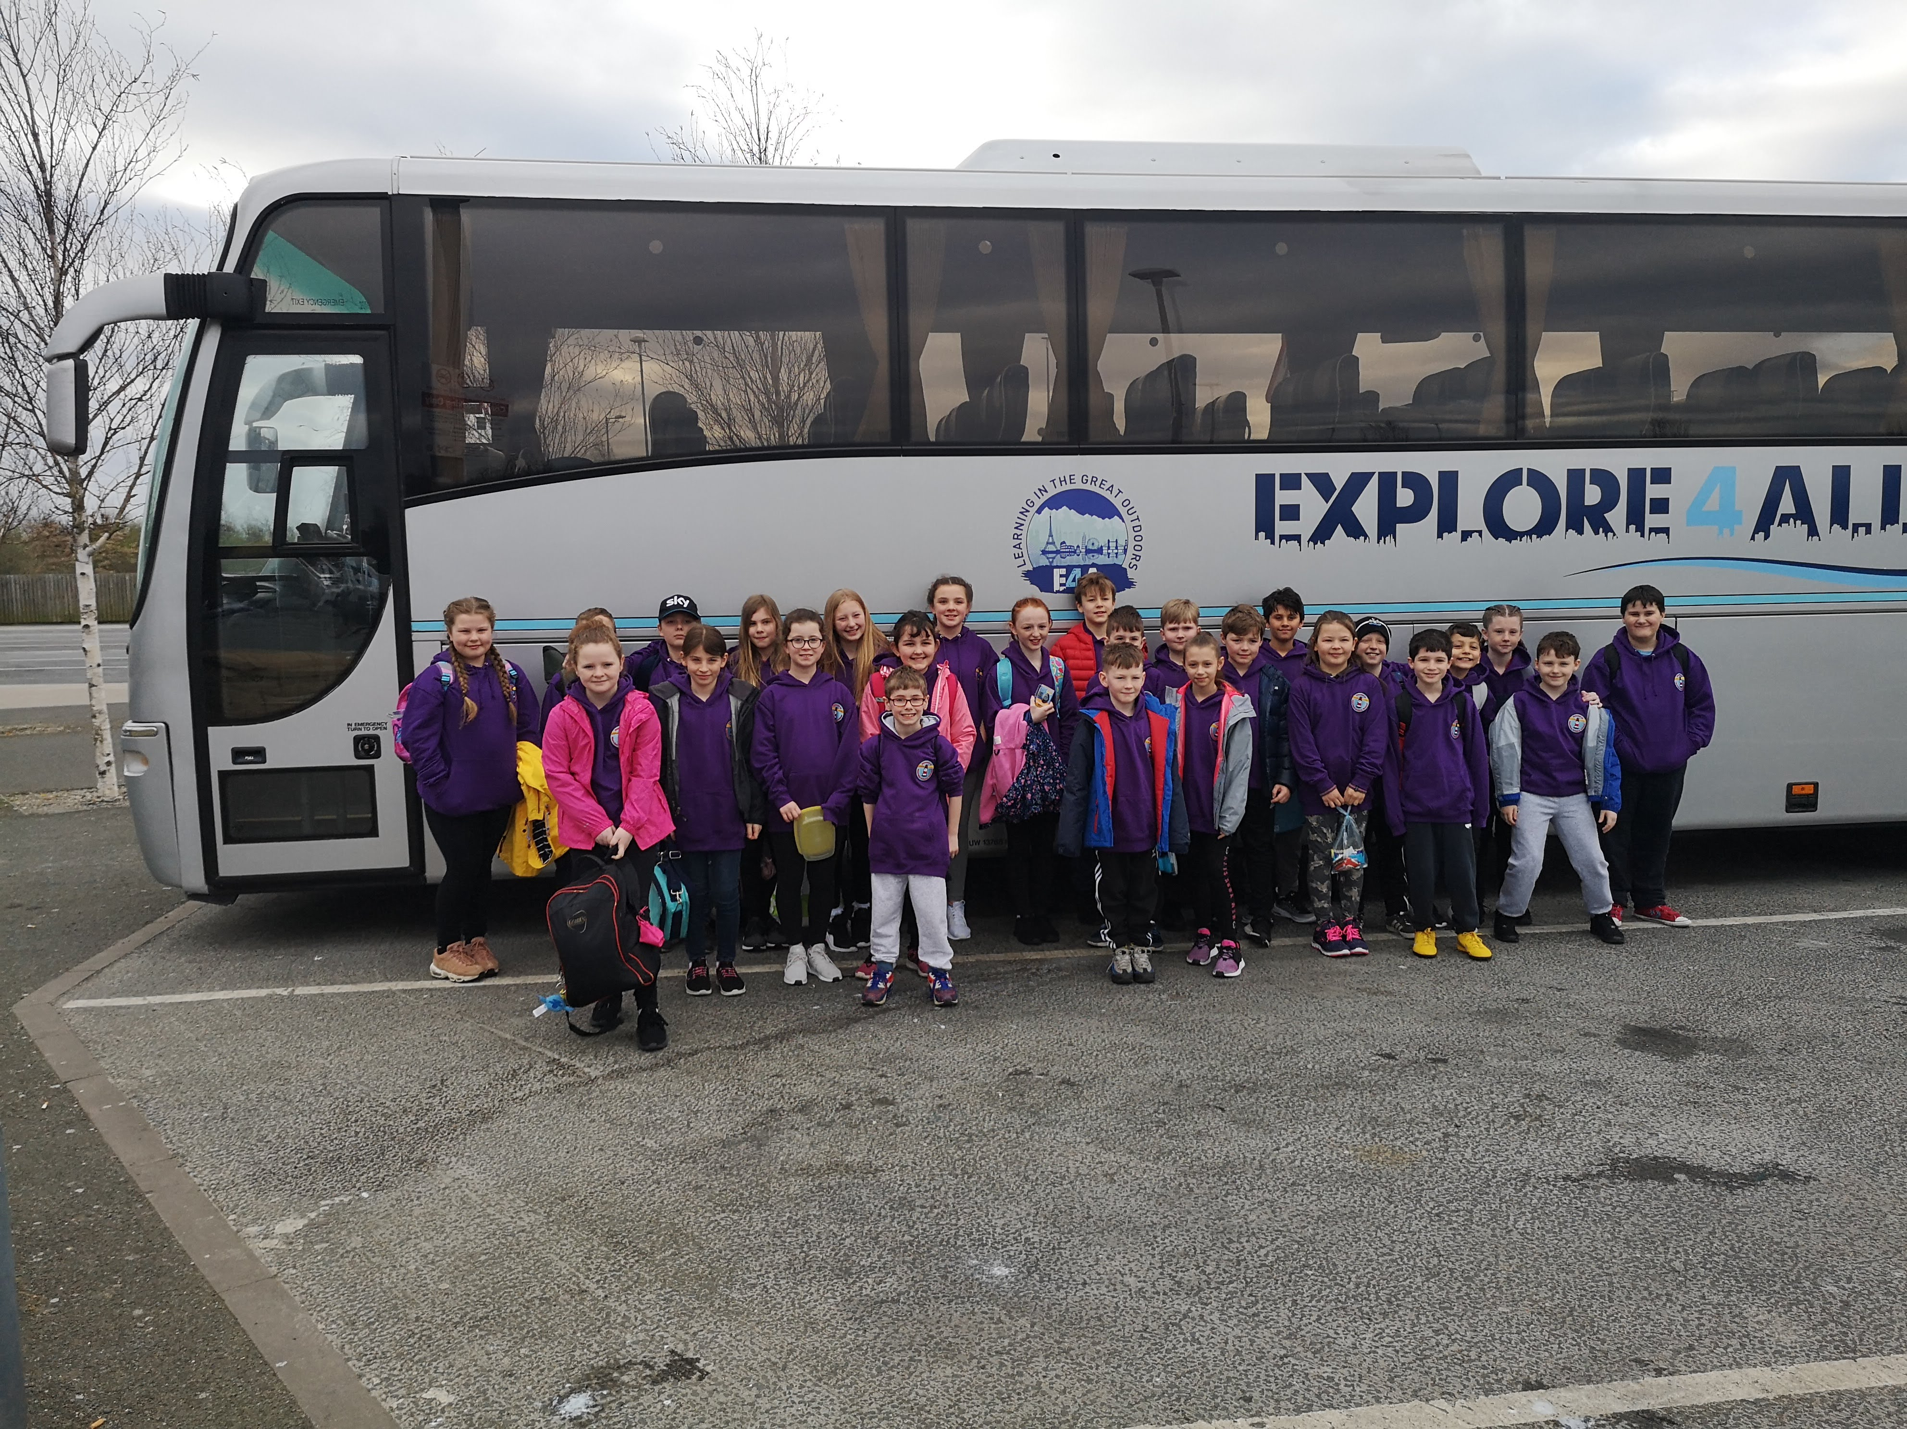

Slide 3
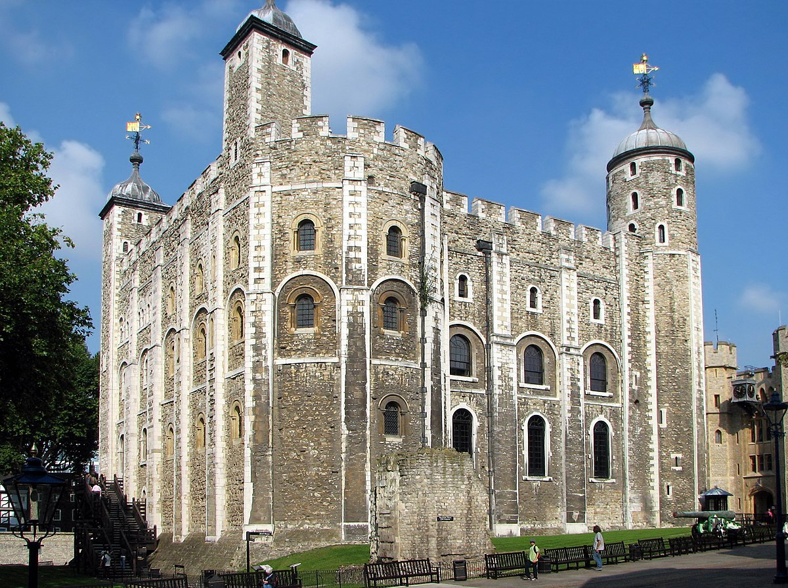
We will visit the Tower of London and experience all the History that it provided . We will see the Beefeaters, Ravens and Crown Jewels

Slide 4
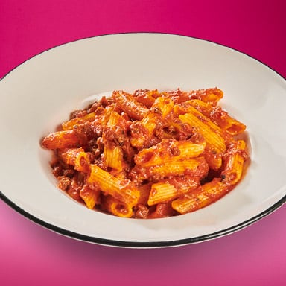
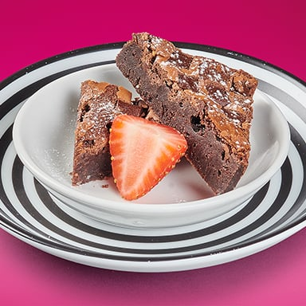

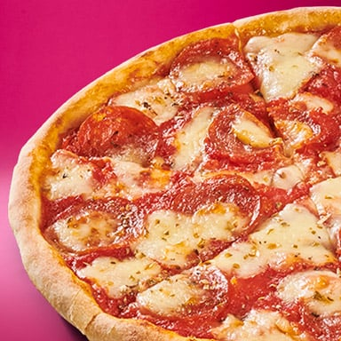
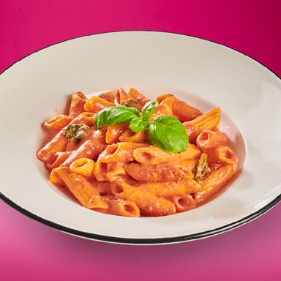
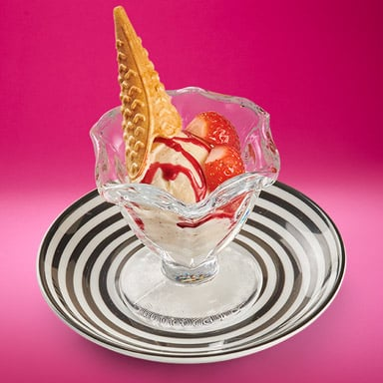
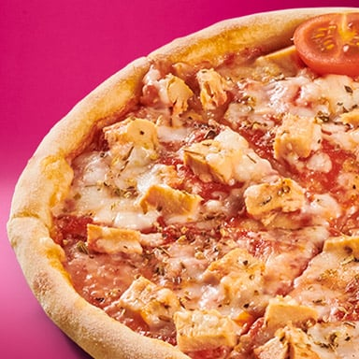
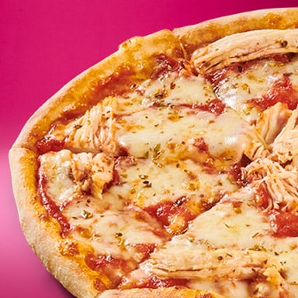
Tea in Pizza Express
Pasta Bolognese
Margherita
Brownie
Pepperoni
Pasta Napoletana
Quorn with Vegan Mozzarella
Sundae
Pollo

Slide 5
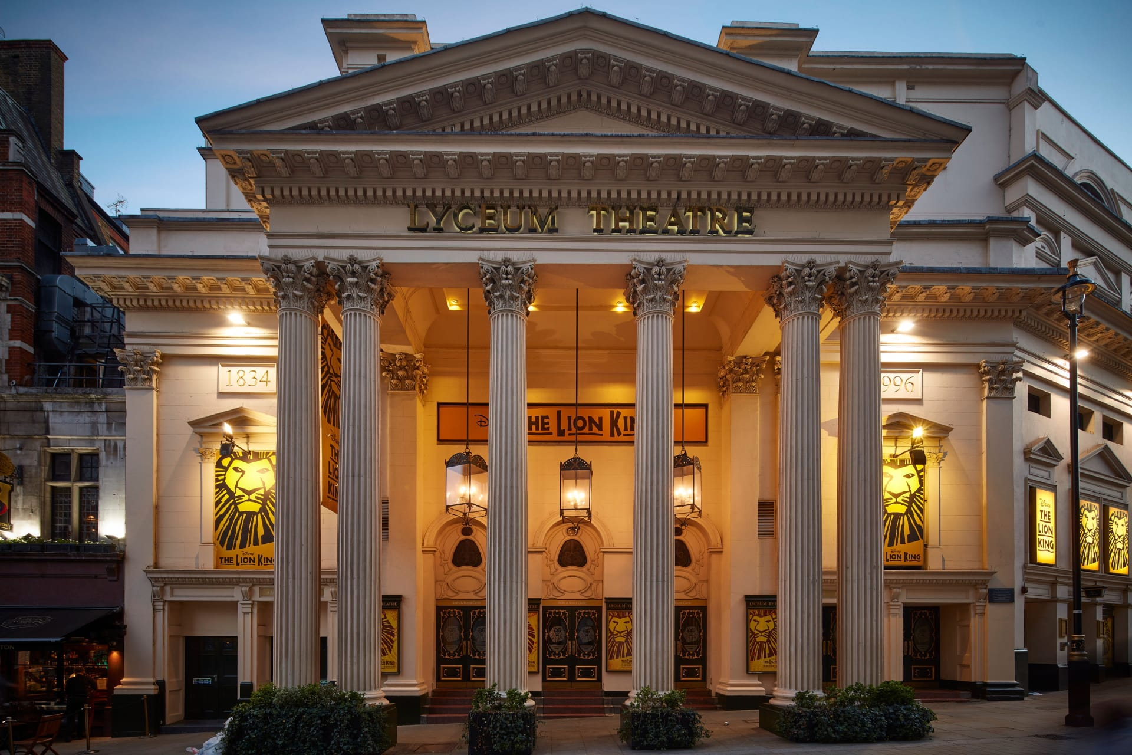
West End Theatre
The Lion King

Slide 6
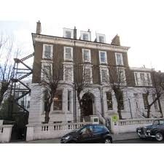
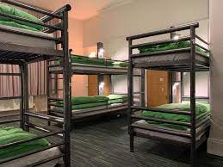
Earls Court Youth Hostel
* We have a floor to ourselves
* The floor is locked
* Breakfast in served on the ground floor

Slide 7
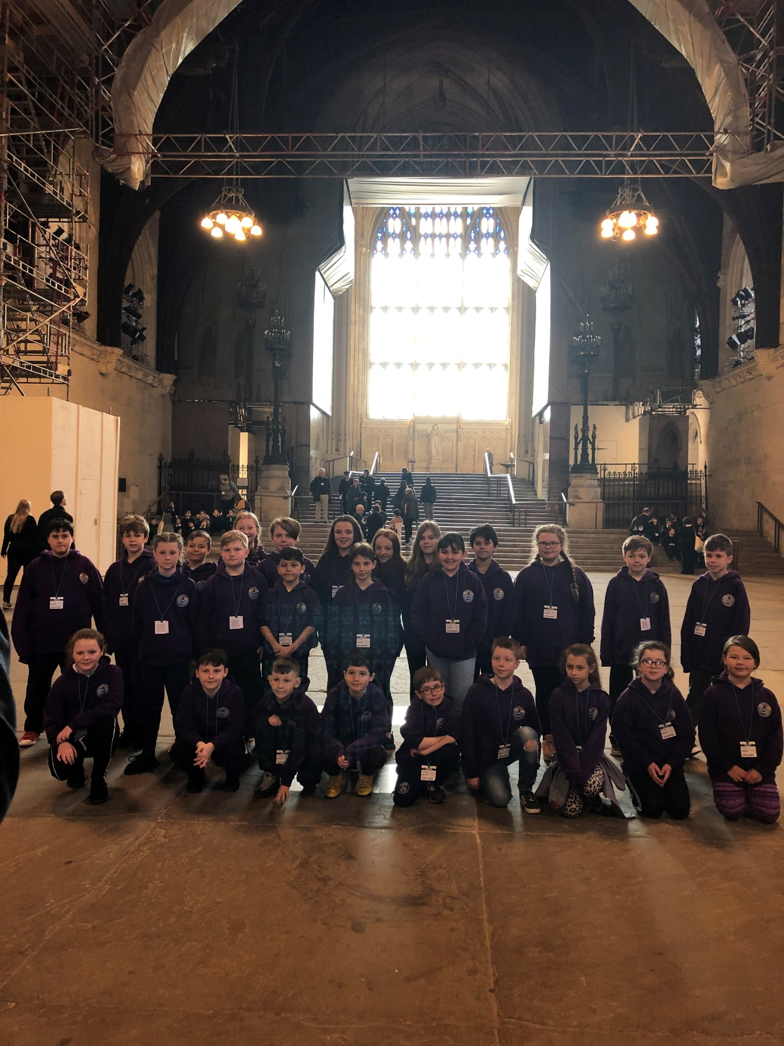
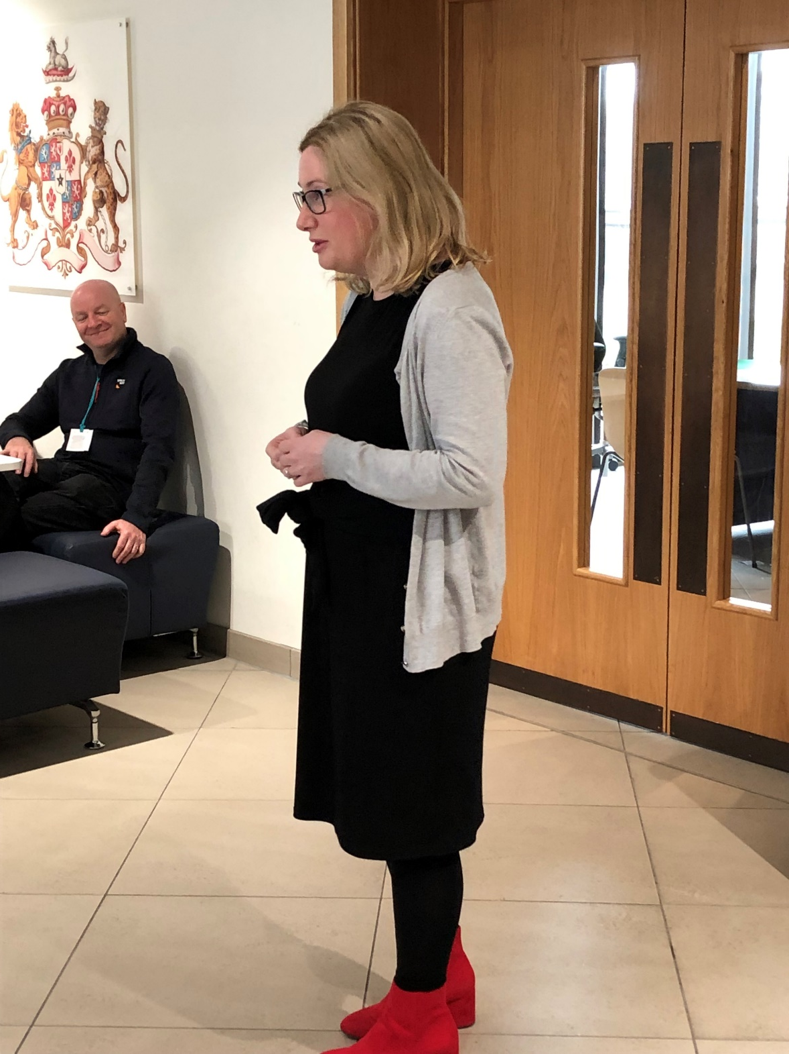
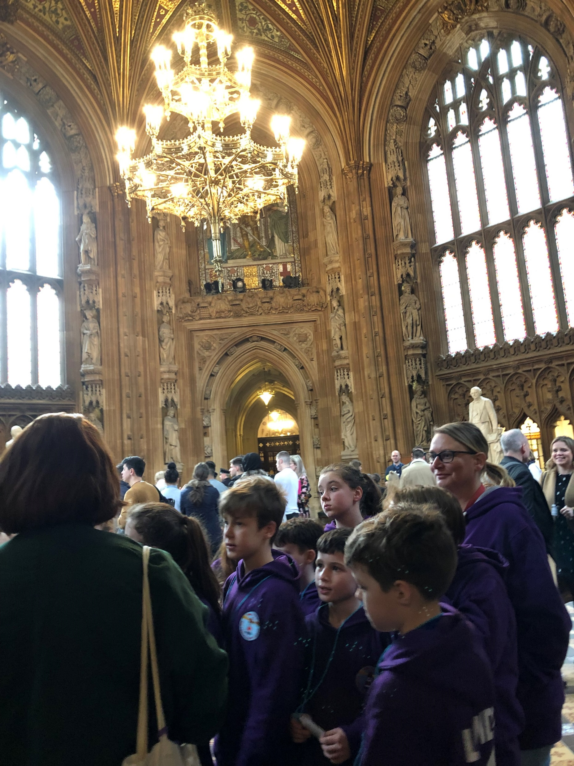
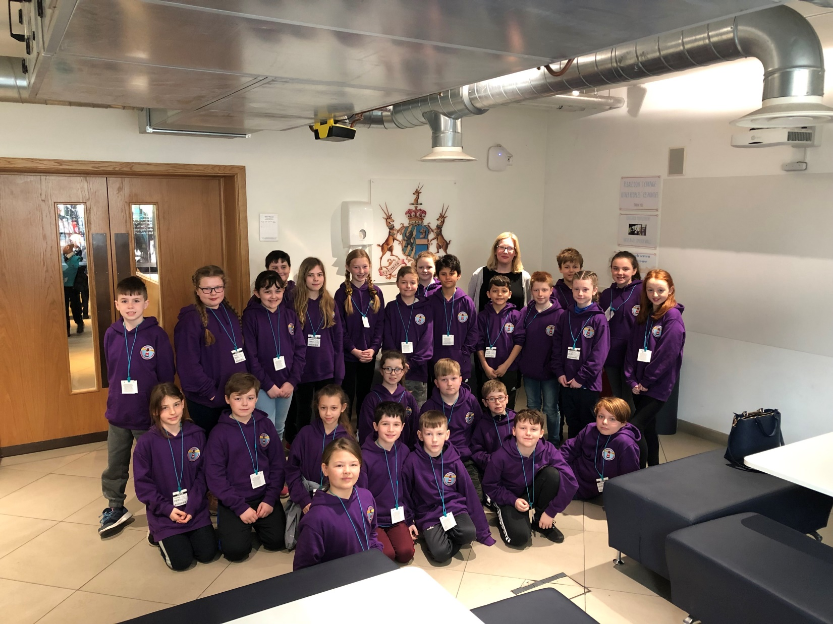
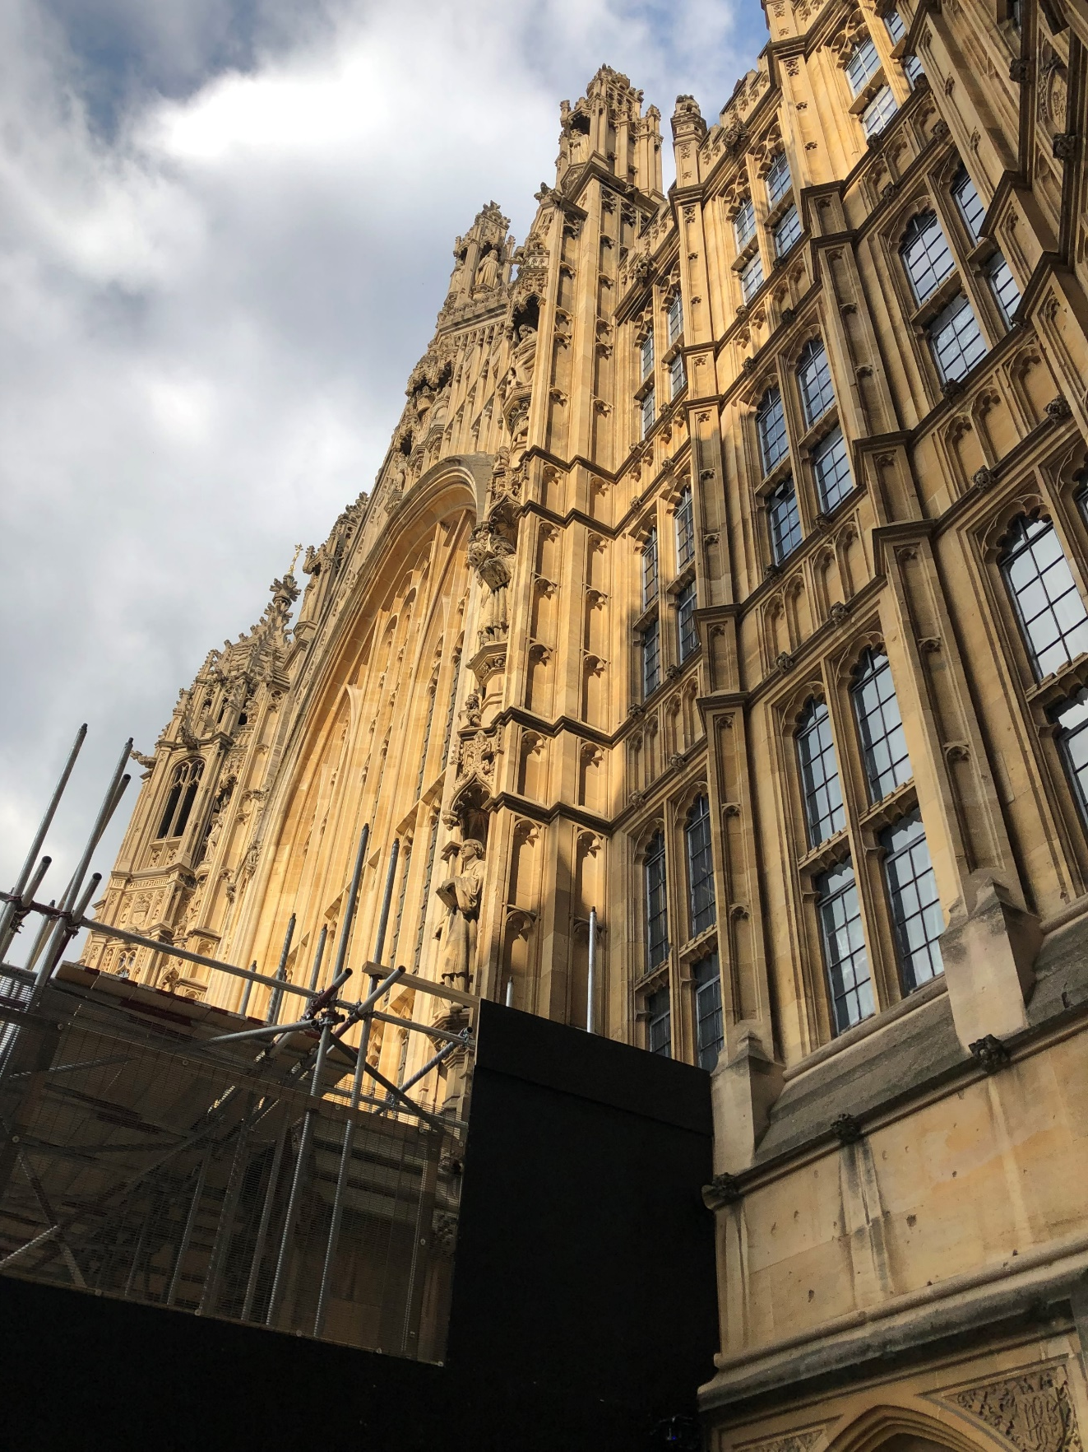

Slide 8
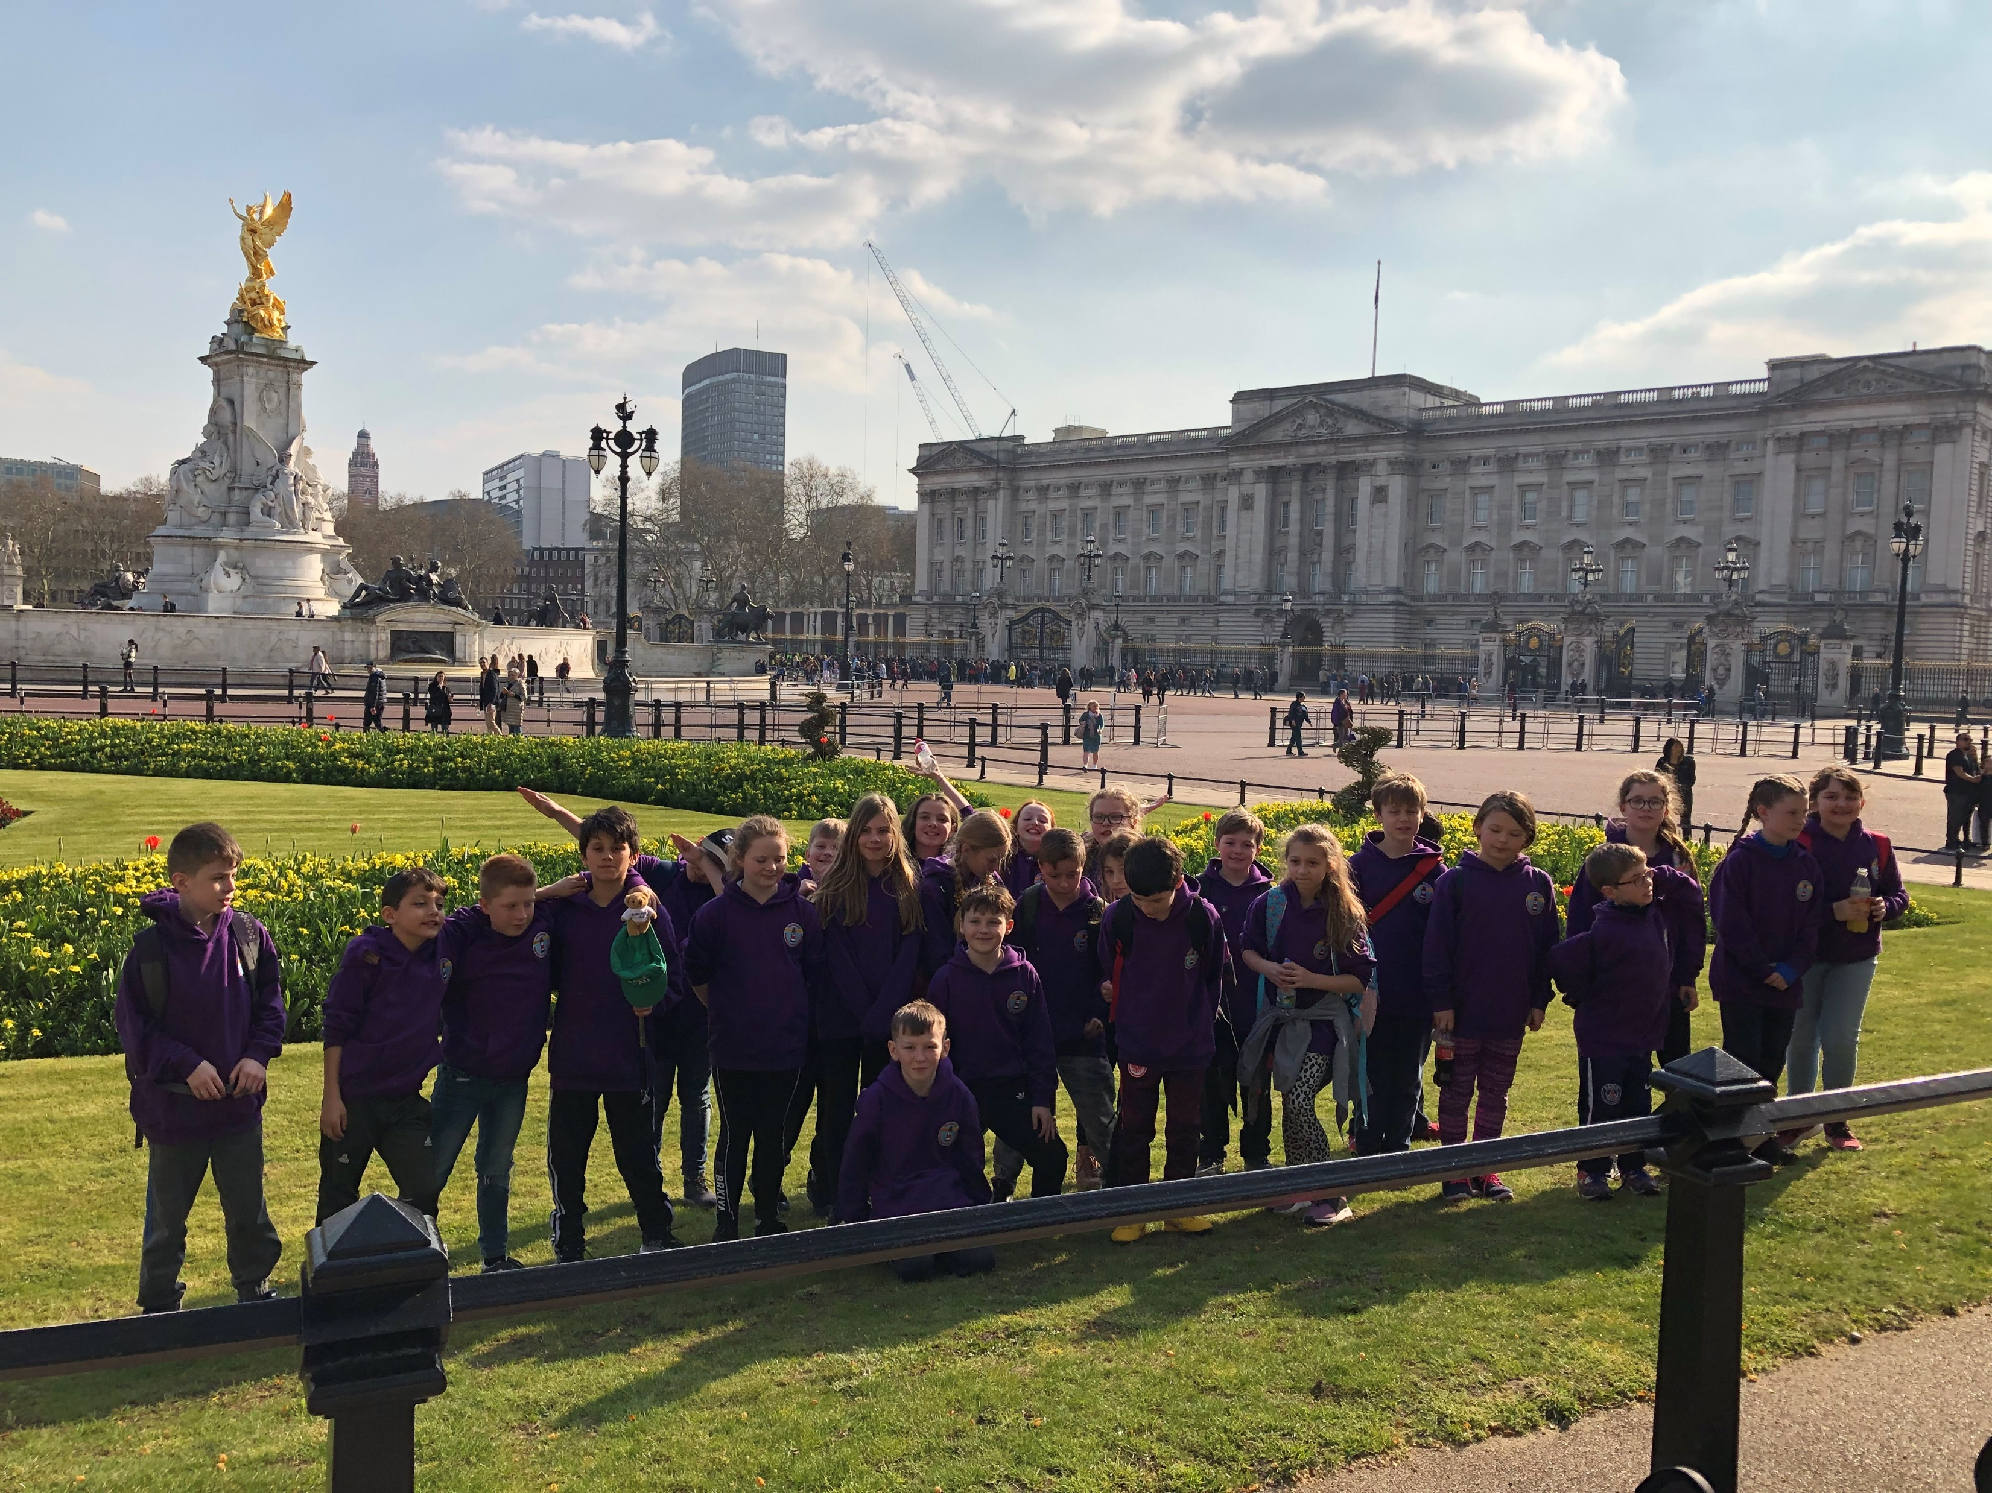
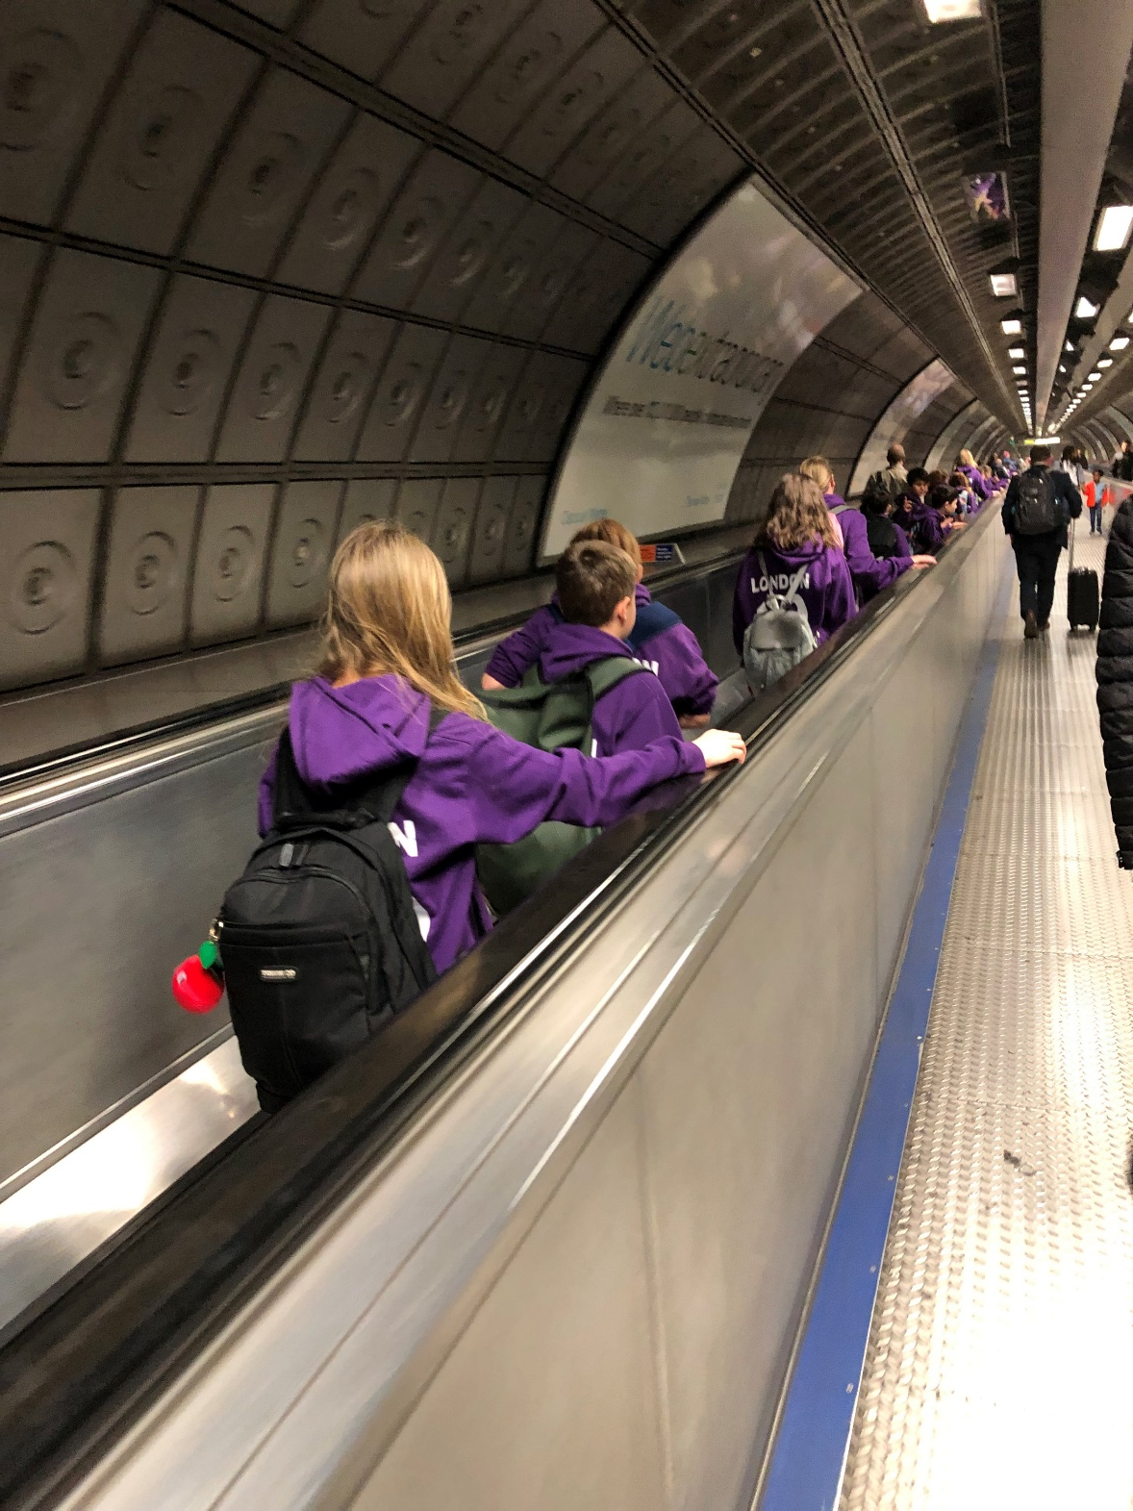
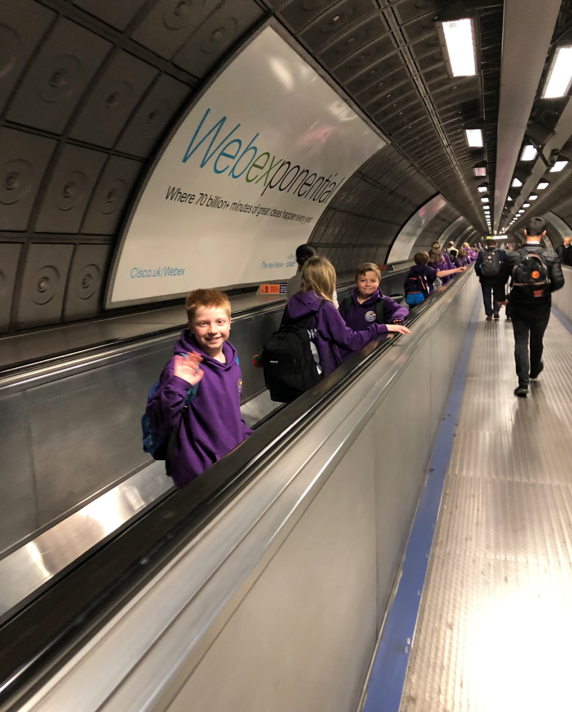

Slide 9
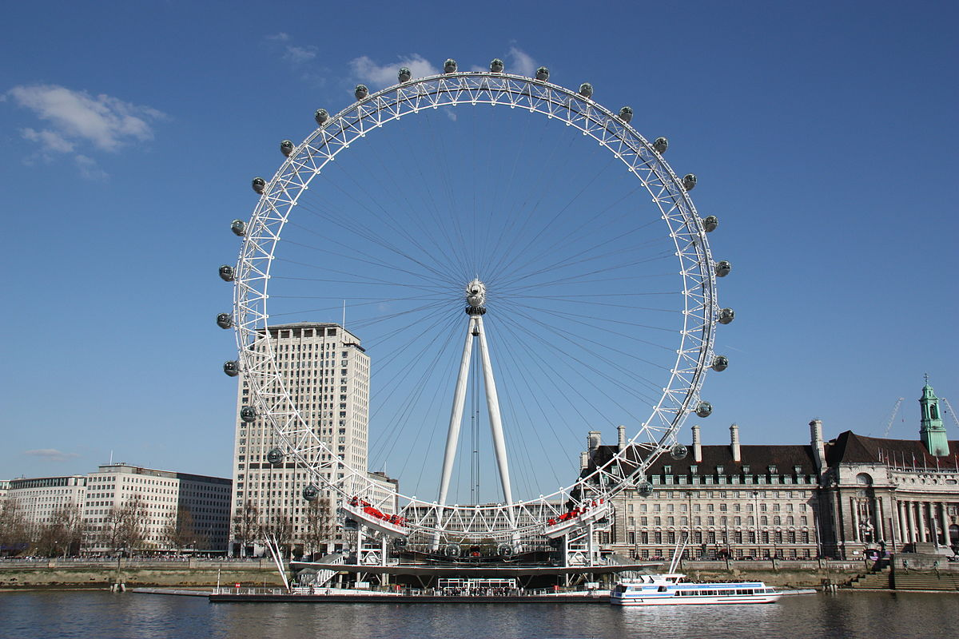
Any questions???
Our final experience before travelling home

Slide 10
What do I need for London ?
Breakfast on day 1
Packed Lunch on Day 1 – try to bring this in a disposable container.
Water bottle – this can be refilled at various point during the visit.
Medication and travel sickness bands/ tablets if you need them
A small backpack to carry around London and £10 spending money in a purse or wallet if you want to buy souvenirs.
Clothing kit(as per the list) in a travel bag/case.
Books /magazine/paper/pens etc. To keep you entertained on the bus.
A pillow or blanket .

