Slide 1

Thurston Outdoor Centre
Monday 31st January– Friday 4th February 2022

Slide 2
Organisation – What to pack???
A minimum of:
2 pairs of thick hiking socks (not cotton) and sufficient normal daywear socks
1 pair of old trainers or plimsolls for water activities (they will get wet)
1 pair of indoor shoes or slippers
1 pair of outdoor shoes
4 warm jumpers/fleece tops
4 T-shirts or polo shirts (or thermal vests)
3 pairs of trousers/joggers (loose fitting – not jeans)
1 pair of gloves or mitts
1 woollen/fleece hat or balaclava
Warm nightwear
Several changes of underwear
Toiletries (toothbrush/ paste, shampoo, shower gel etc.) and 2 towels
Torch and spare batteries
Any personal medication (labelled with name to be handed to a Miss Clark on Monday 31st January)
Pen and pencil
Swimming costume
A bin liner for dirty clothes (end of course)

Slide 3
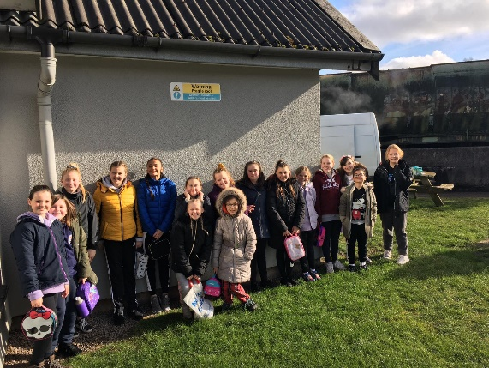
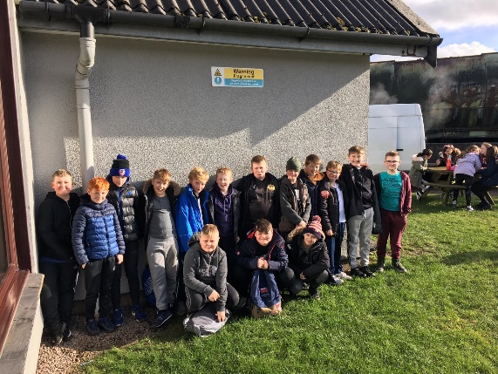
Rules about other things…..
All specialist equipment will be provided but if you have your own walking boots and would like to bring them, please feel free.
Since storage space in the dormitories is limited, please bring only essential clothing.
Please do not bring aerosol products such as deodorant and hairspray.
Mobile phones, electronic games, cameras and devices are not allowed at Thurston or on the bus.
Optional Items
Cuddly toy
A Book
Pack all of your things in ONE bag/ case to go in the boot of the coach, then have a backpack to take on the bus.

Slide 4
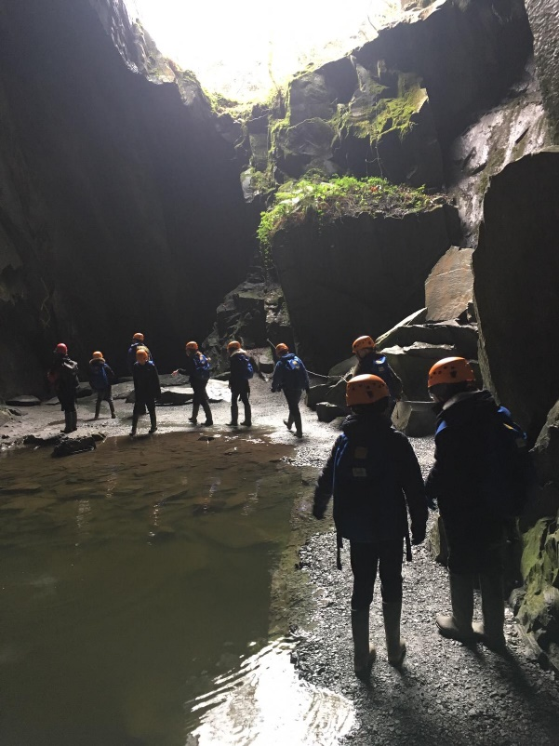
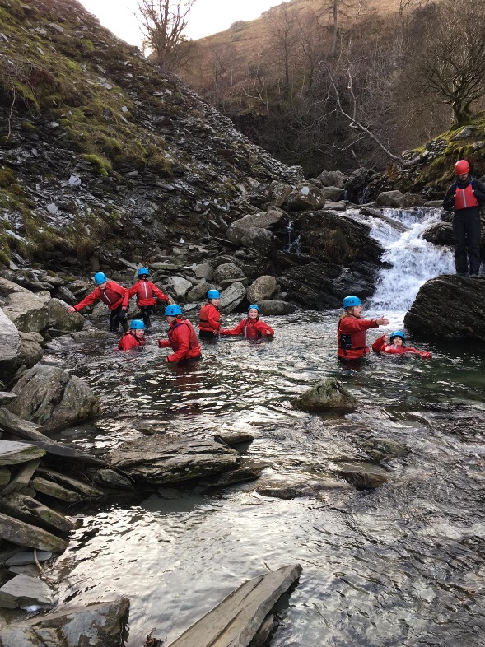
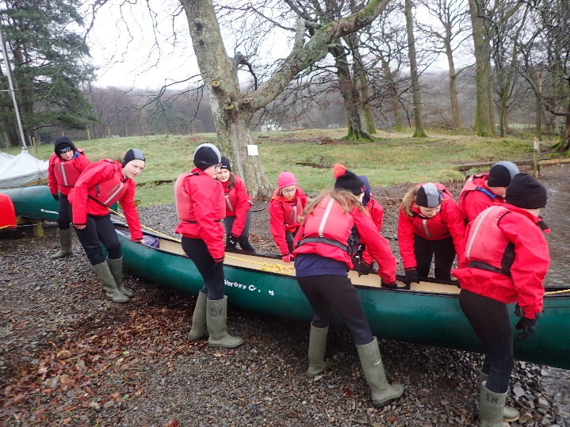
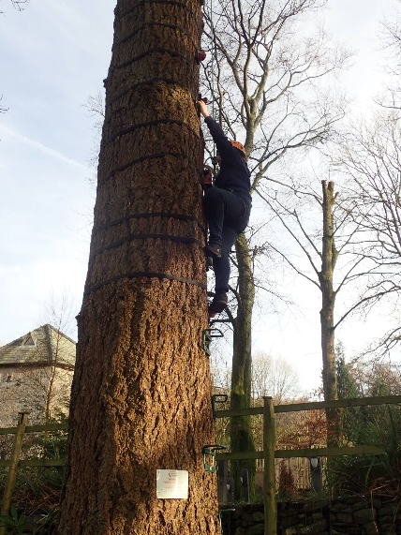
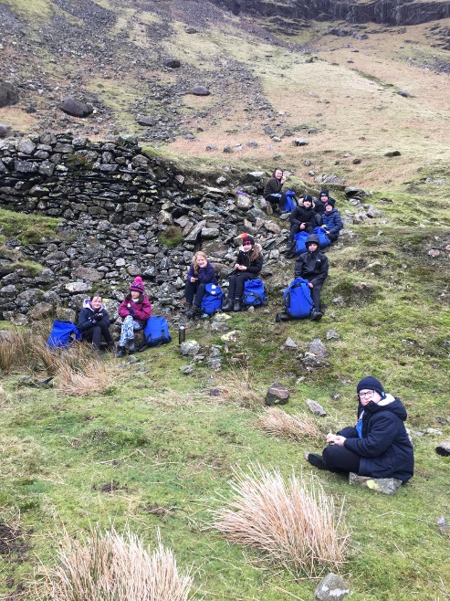
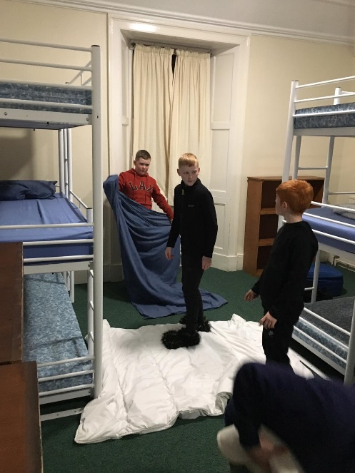
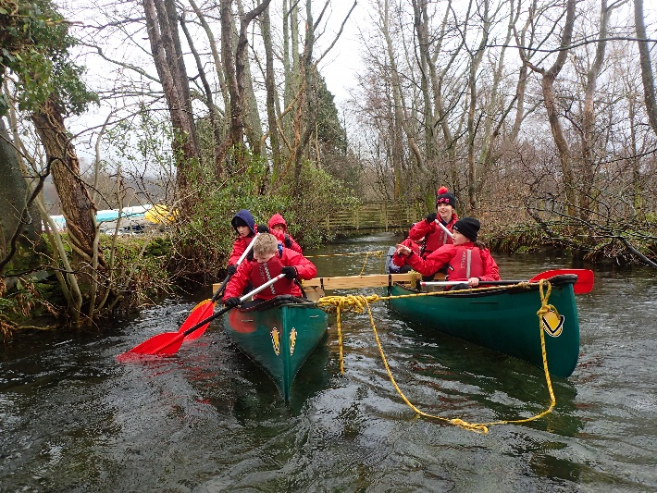
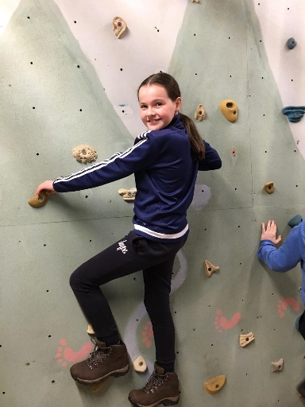
Activities

Slide 5
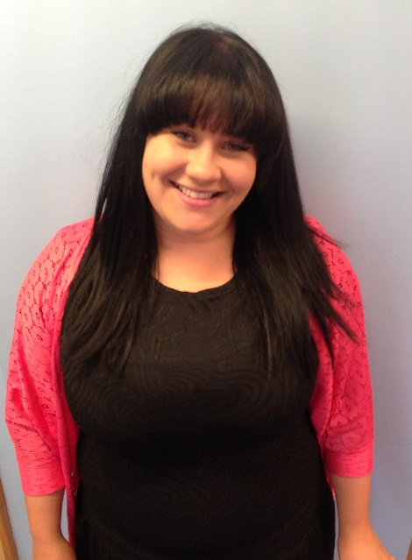
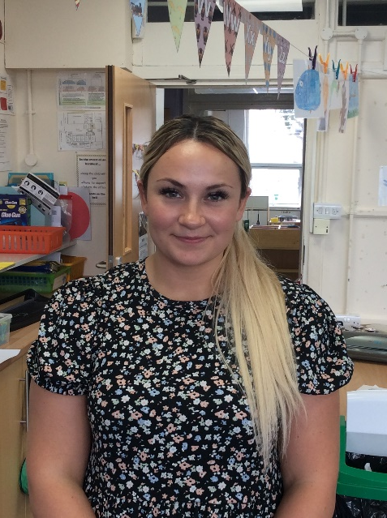
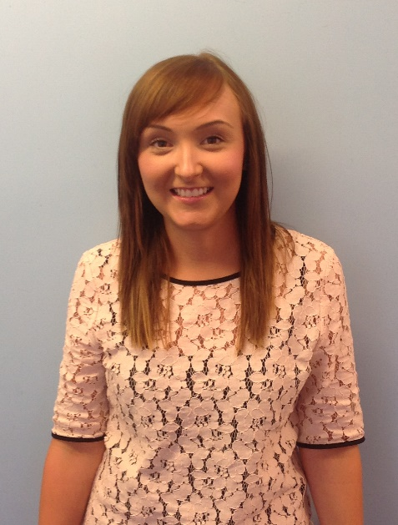
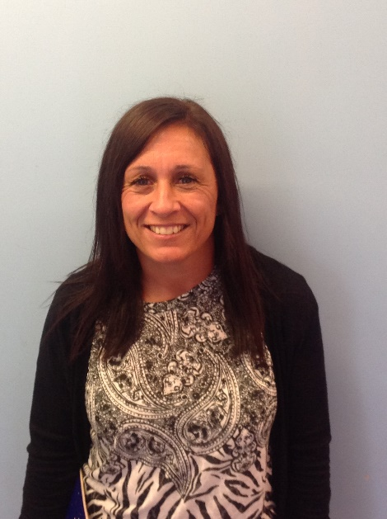
Staff
Miss Kane
Miss Clark
Mrs Reed
Mrs Chrisp

Slide 6
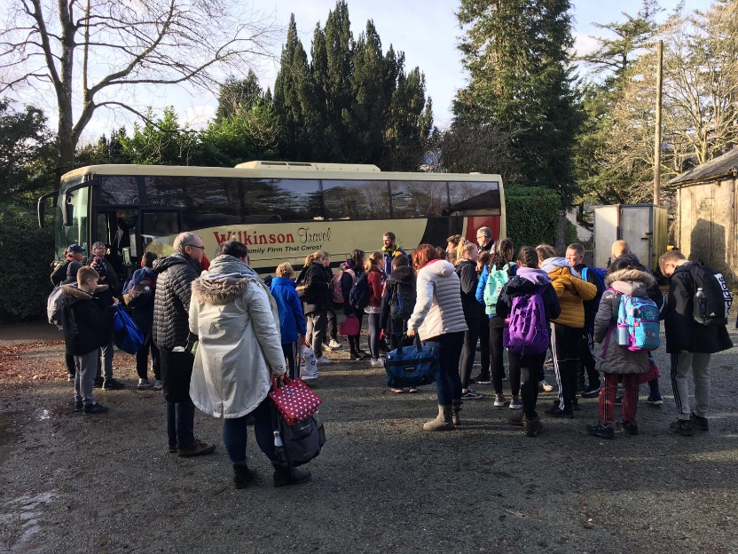
Bus arrangements
On the bus you will need:
A backpack to carry your personal belongings in.
A packed lunch for the journey (A box or bag to be used for the rest of the week.)
A full water bottle (This will be used for the rest of the week.)
A book or magazine
Your choice of warm, comfortable clothing to wear – school uniform is not required.
A warm coat – we will be eating dinner outside!
Travel:
Final times tbc.
The coach will leave school at 9:30 prompt!

Slide 7

Medication
Any medication your child needs must be mentioned on the ‘Registration/Consent form’ and needs to be in a labelled bag separate from the luggage.
Miss Clark will be collecting ALL medication in on Monday morning.
Travel sickness tablets need to be given by parents on the Monday, but please supply enough for the way home!
Any sanitary products need to be with the child or a member of staff, but please let a member of staff know in advance.
Inhalers and asthma medication to be handed in, but will be returned to the children once we are on our way.

Slide 8
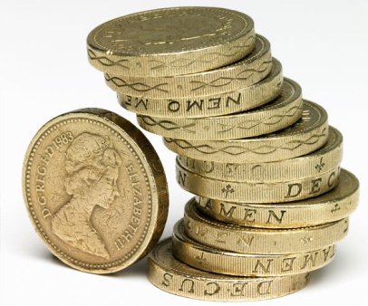
Money
Each child is allowed £10 MAXIMUM to spend on souvenirs. This must be sent in change.
Money needs to be handed into Miss Edwards by Monday 31st January in a purse or money bag with the child’s name on.

Slide 9
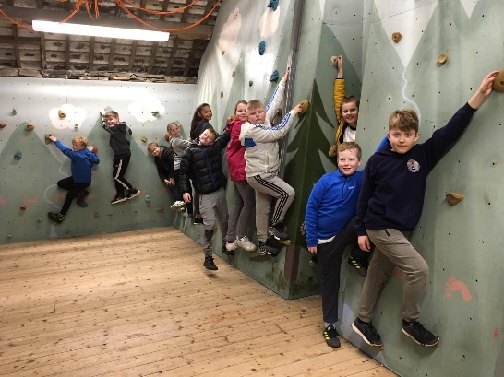
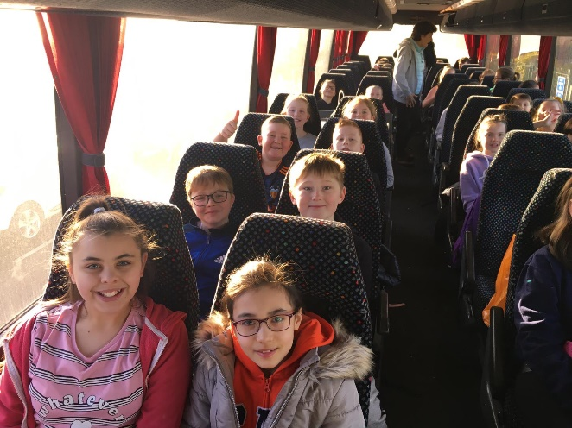
Friendships
You will be asked to choose two friends who you would like to be in a group with or in a room.
Rooms will not be allocated until we get to Thurston.
Girls will be separate from boys.
3 groups for activities

Slide 10
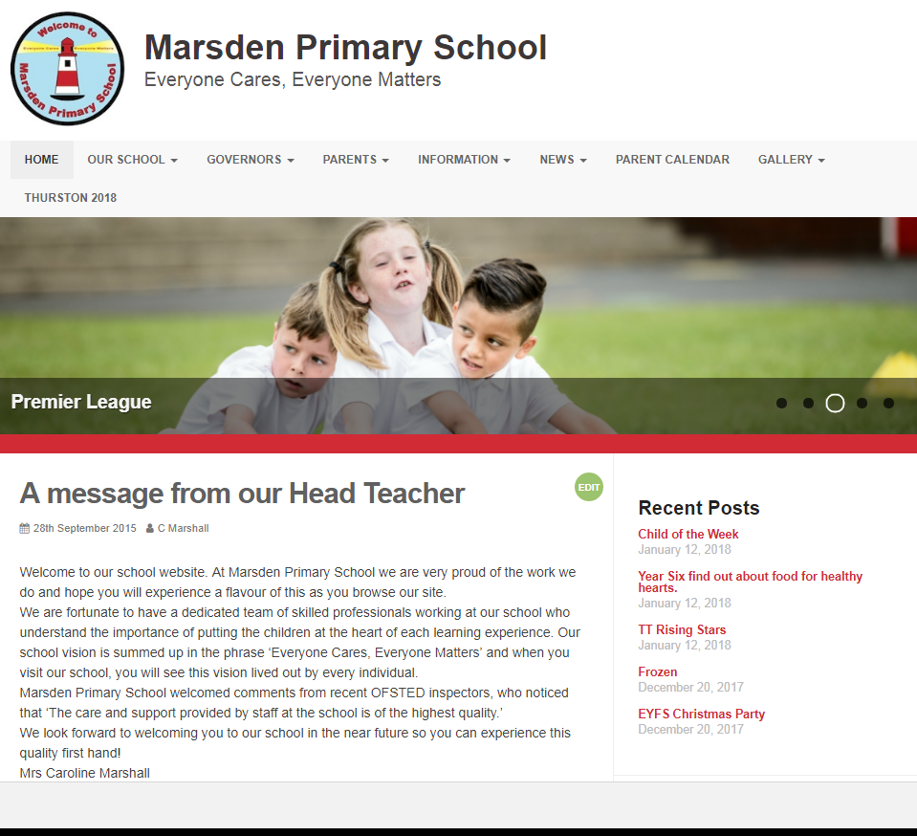
Contact
Parentmail – texts and emails
Website – blogs
Phone calls if needed
No news is good
News!

Slide 11

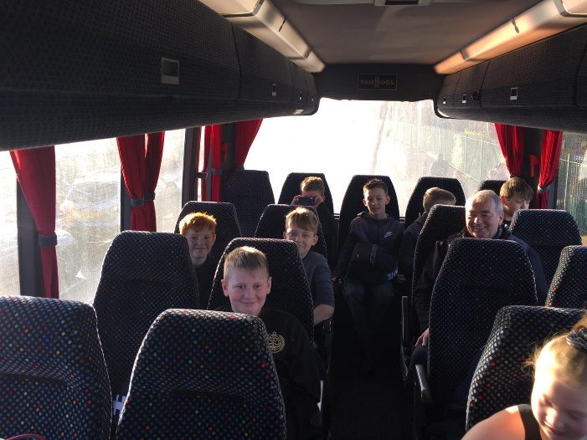
Leave Thurston at 10am
Messages and updates will be sent to parents.
Arrive at school 2:30pm APPROX
Sleep and relax!!!

Slide 12
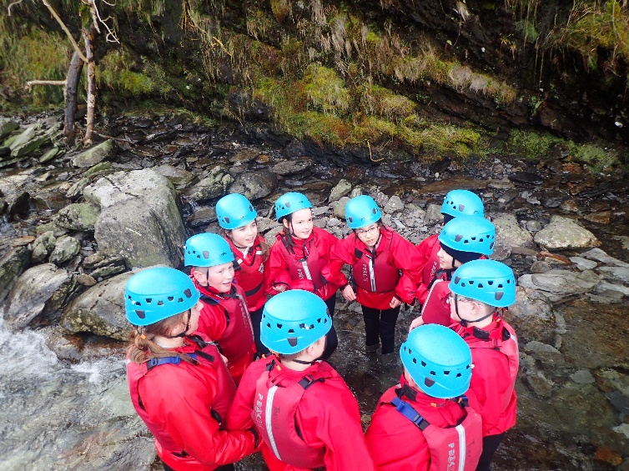
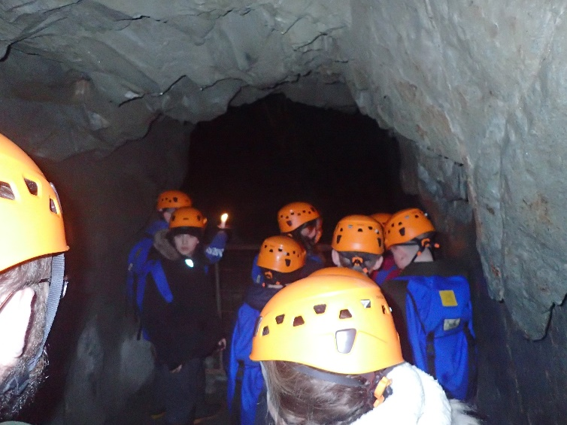
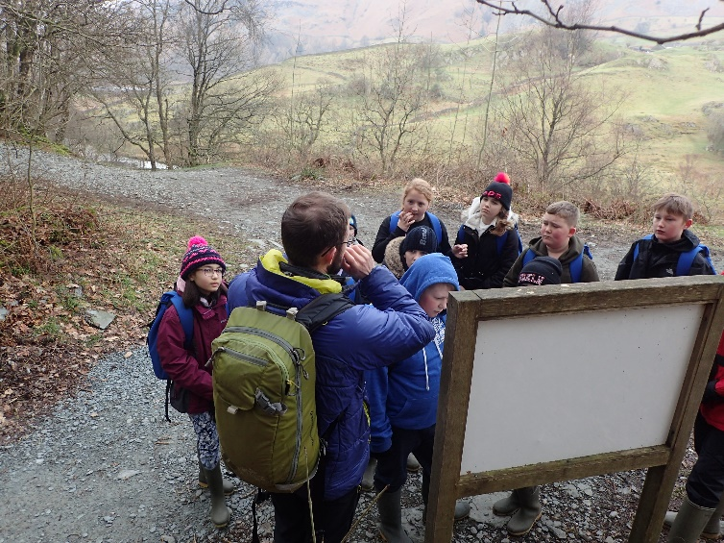
Additional Information
We will continue to provide additional information over the next three weeks.
If you have any urgent questions, please email creed@marsdenprimary.org.uk

