Slide 1
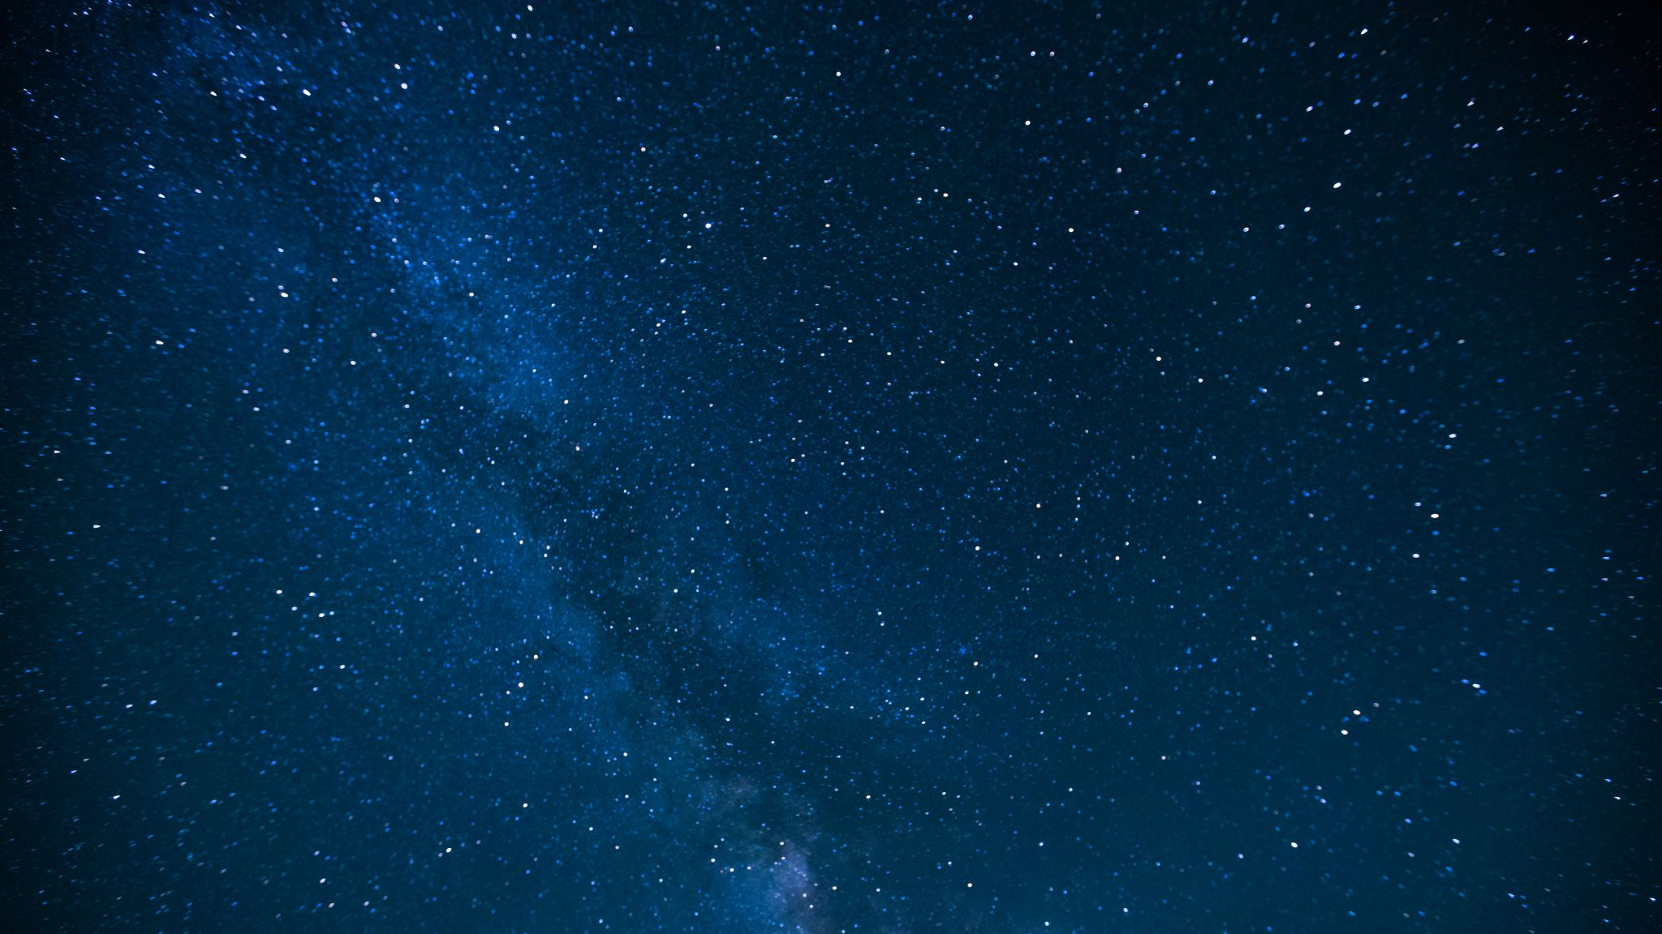
Facts about the solar system
Lucas and Lola.

Slide 2
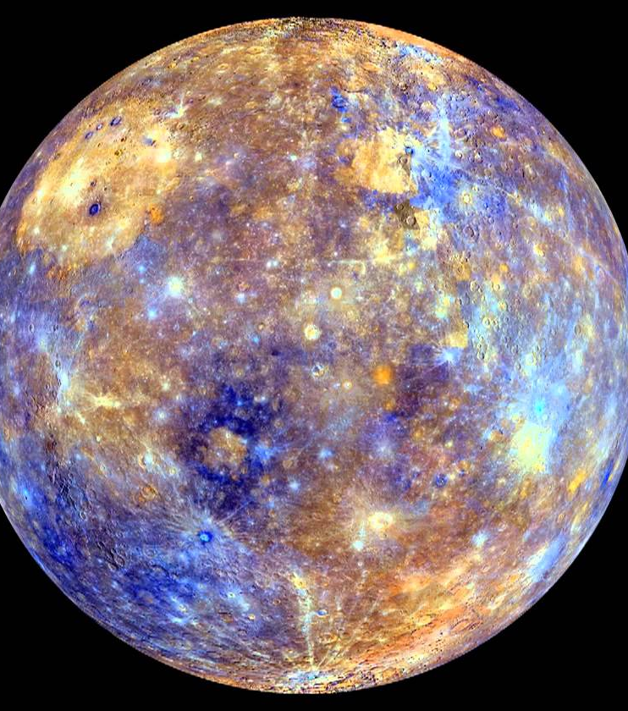
Mercury
Mercury is the closest and smallest planet in the solar system to our sun. It's tempretures can go to –279 ferinheit through the night but through the day it goes up to 801 ferinheit! Mercury has no moons or rings. A year on mercury is 88 Earth days. On Mercury's surface your weight is 38% of your own weight on Earth.
This Photo by Unknown author is licensed under CC BY.

Slide 3
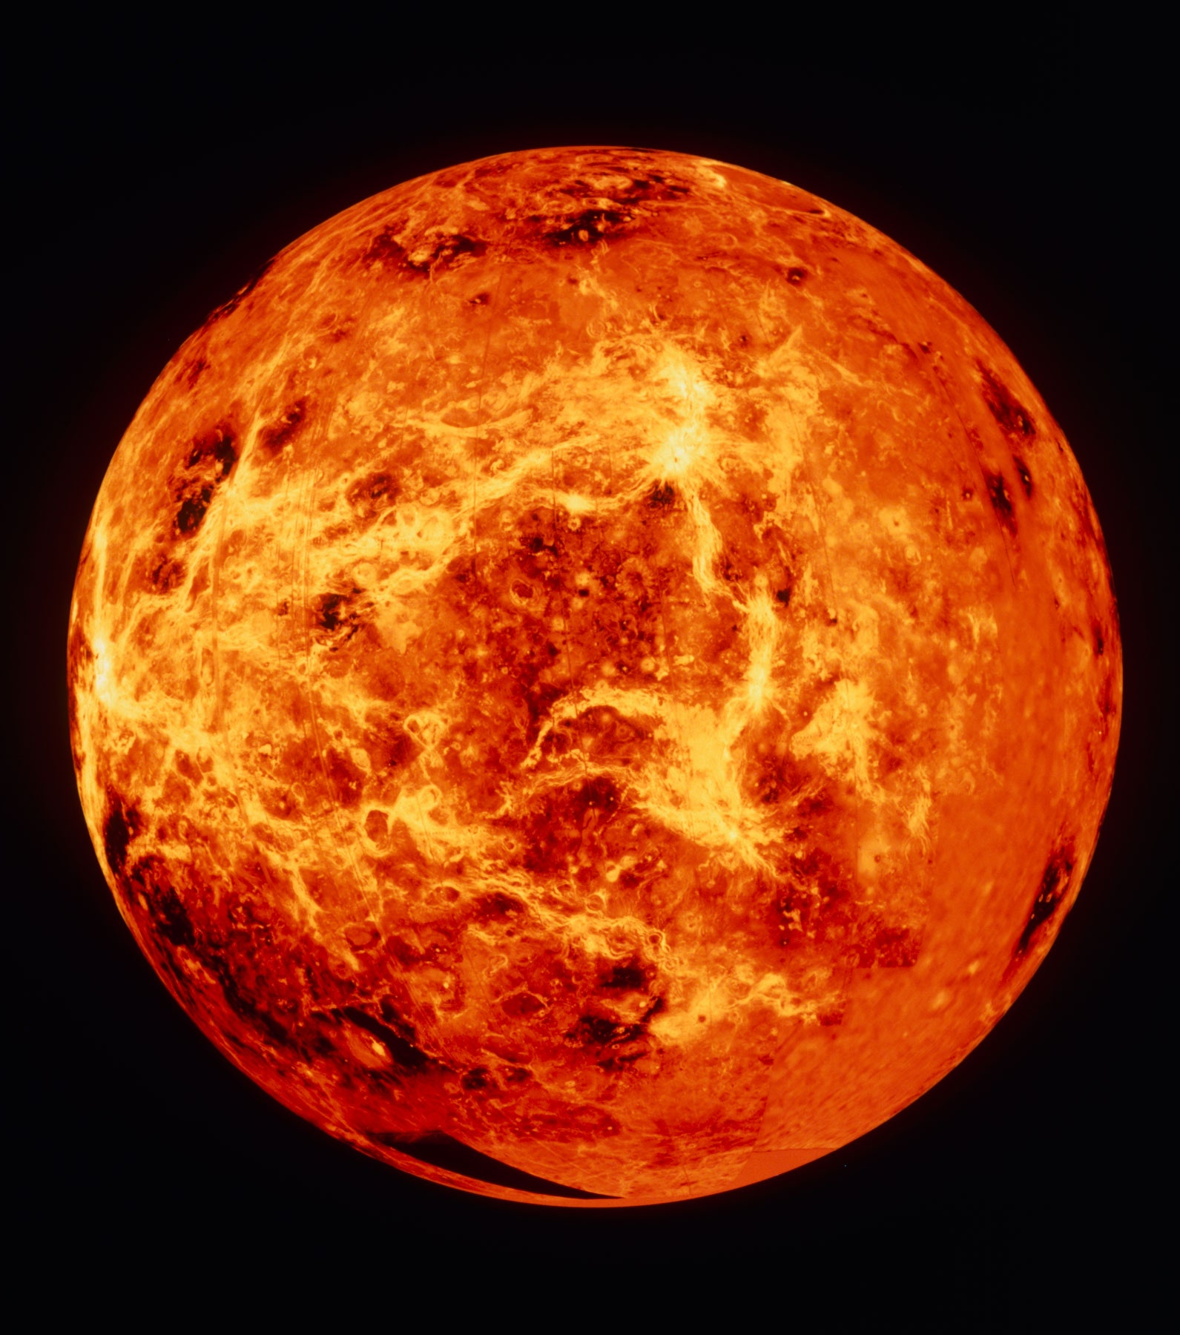
Venus
Venus is the 2nd clostest planet to our sun. Earth has an avarage surface temeperature of 14 degrees celsius, the avarage temeperature on venus is 460 degrees celsius.

Slide 4
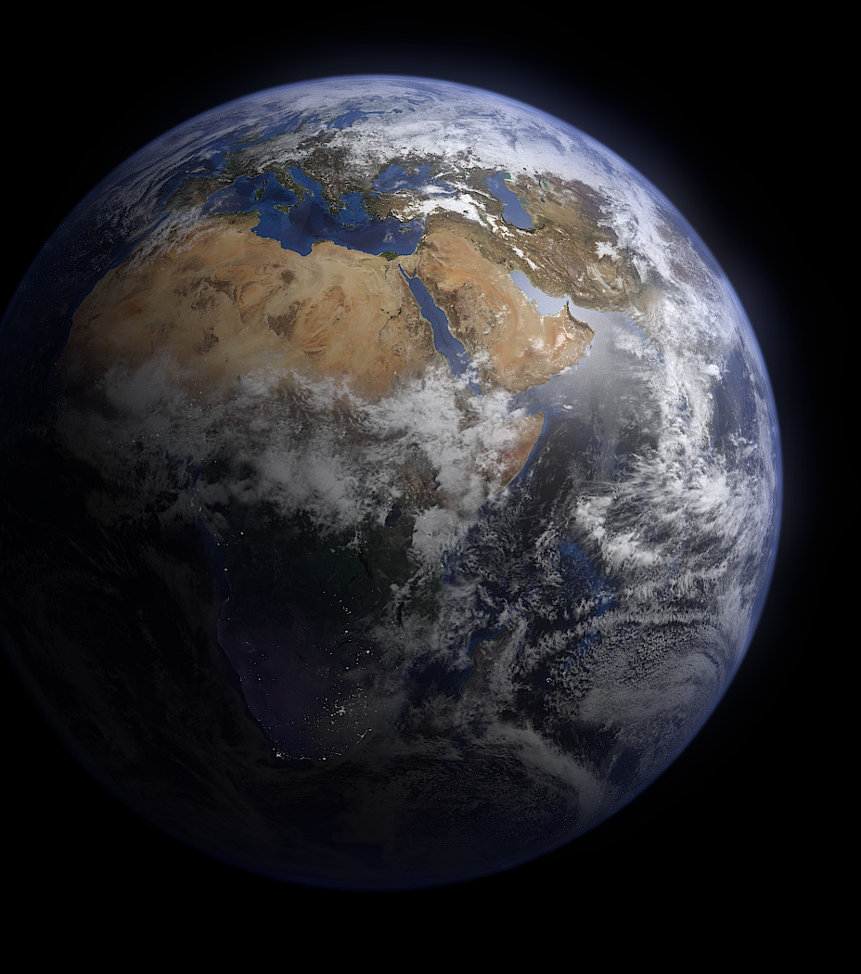
Earth
Earth is around 4.6 billion years old according to scientists. The Earth's atmosphere is composed mainly of nitrogen (78%), oxygen (21%), argon (93%), and carbon dioxide (0.03%). The Earth is the densest planet in the Solar System.
This Photo by Unknown author is licensed under CC BY-SA.

Slide 5
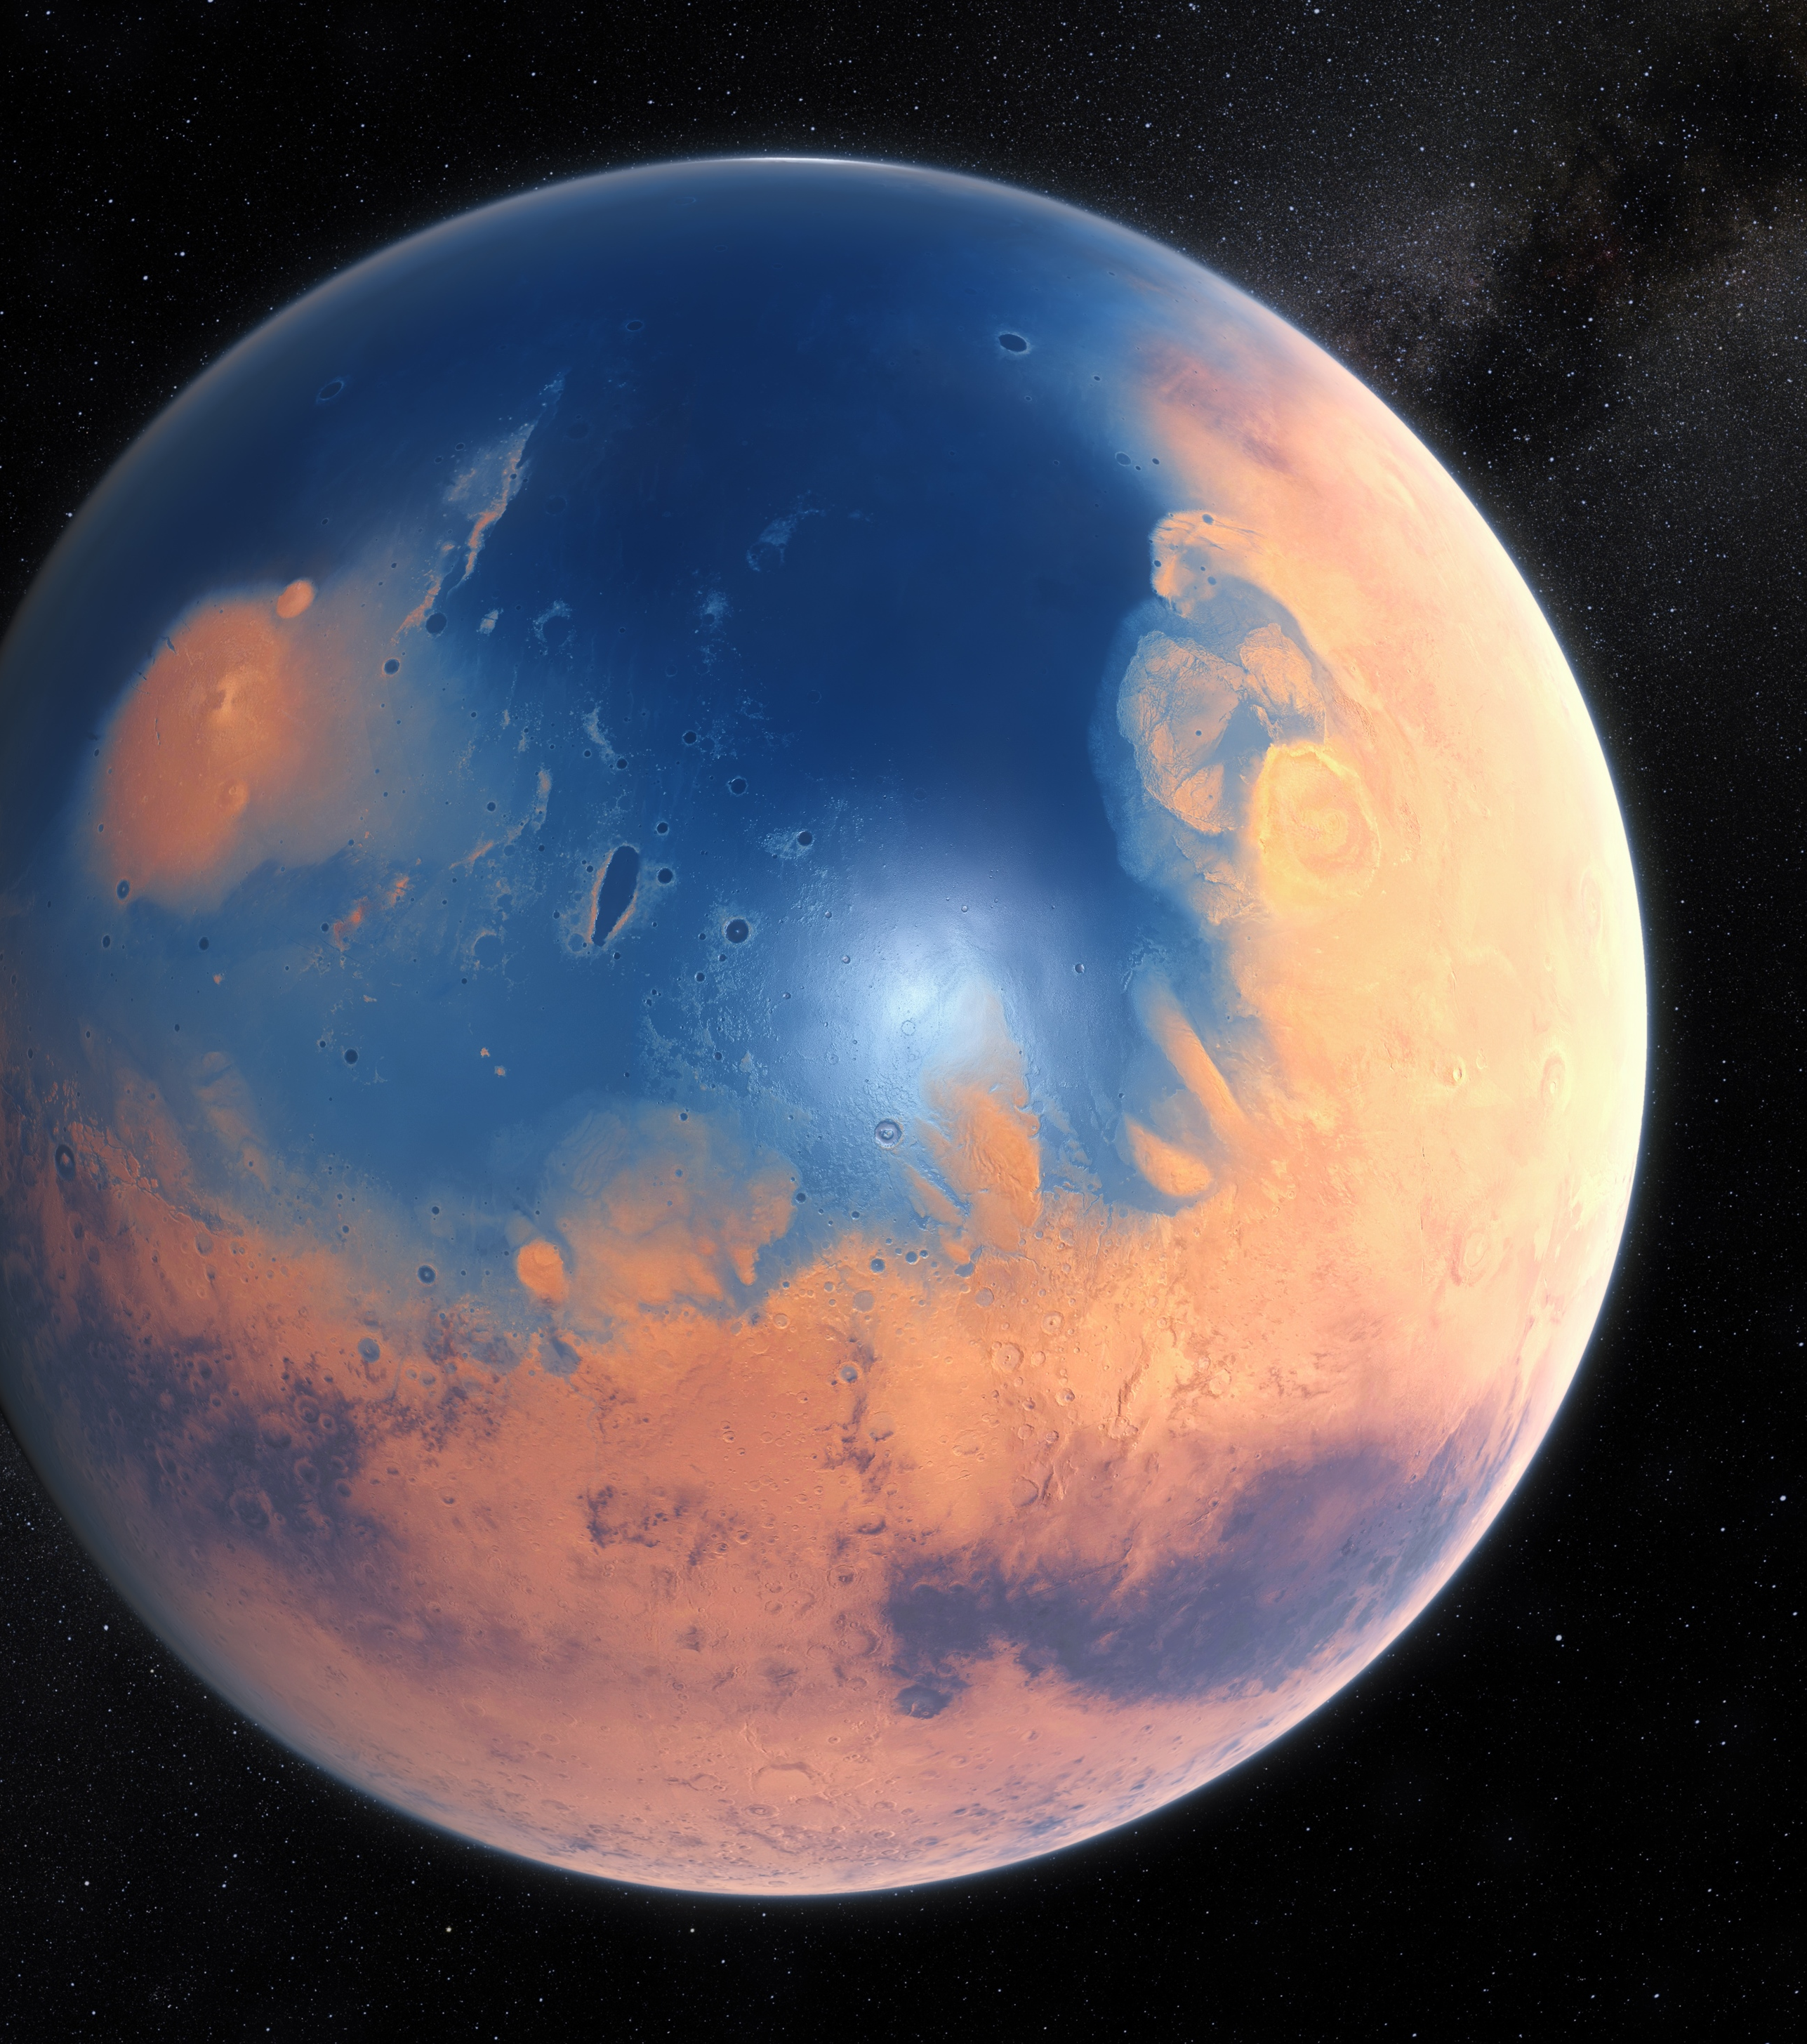
Mars
Mars is the 4th closest planet to the sun with a diameter of 6,794km (53% of earth). A day in Mars is 24 hours & 37 minutes. 687 Earth days is how long a year is on Mars. Mars' mass is (11%) of Earth. Its gravity is 38% of Earths. Its atmosphere is 95% carbon dioxide and 3% nitrgen. Its atmospheric is 1% of Earth's Sea Level and the pressure is unknown. Its atmosphere between the surface is –140 to 20 celsius.
This Photo by Unknown author is licensed under CC BY-SA-NC.

Slide 6
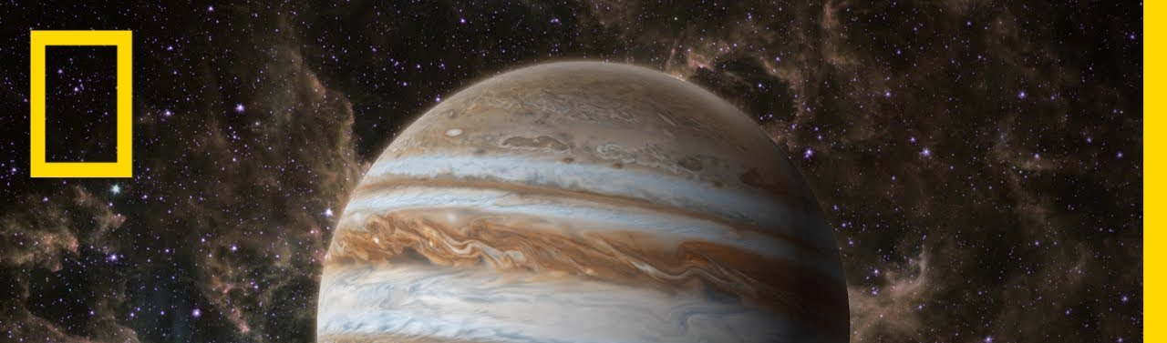
The planet Jupiter is the fifth planet from the sun, and is two and a half times more massive than all the planets in the solar system combined. It is made primarily of gases and is therefore known as a gas giant. The mass of Jupiter is 318 times that of Earth. Jupitar is by far the largest planet in the solar system with a mean diameter of 139,822km (86,881miles). The diameter is 11 times, volume is 1,321, and surface area is 122 times of Earth. Jupiter's mass 318 times larger than Earth.
Jupiter

Slide 7
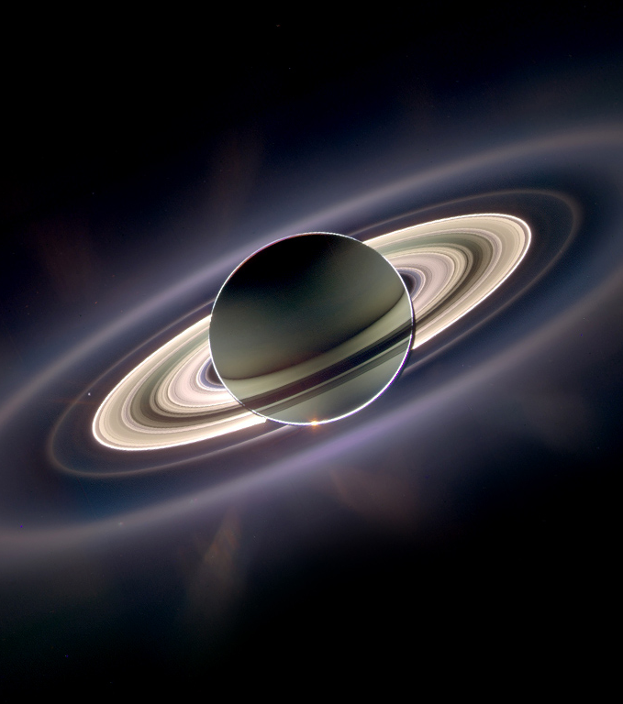
Saturn
Saturn is sixth closest planet to the sun and last of the planets known to ancient civilization. In Roman Mythology Saturn was the father of Jupiter, king of the gods. Saturn is one of the five planets that you are able to see with the naked eye. Saturn was know to the ancients, including the Babylonians and Far Eastern observers. Saturn has oval-shaped storms similar to Jupiter's. Saturn is the flatest planet. Saturn's upper atmosphere is divided into bands of clouds. Saturn orbits the sun once every 29.4 Earth years. It is a gas giant with an avarage radius about nine timesthat of Earth. Saturn is the second largest planet in the solar system, after Jupiter. Although it has only one-eighth the average destiny of Earth, with its larger volume its 95 times more massive.
This Photo by Unknown author is licensed under CC BY-NC.

Slide 8
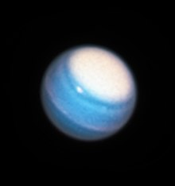
Uranus
It takes Uranus 84 Earth days to orbit the sun. A collision could have caused the unusual tilt on Uranus. Uranus wind speeds can reach up to 900km ph. William Hershel discovered Uranus in 1781. Uranus tilts on its axus once every 17 hours and 14 minutes. Uranus is reffered to a Ice Giant. Uranus hits the coldest temperature than every other planet. A season on Uranus is one long day- (42 years). Uranus has 27 moons. Uranus' atmosphere is ices. Uranus has rings.
This Photo by Unknown author is licensed under CC BY-SA.

Slide 9
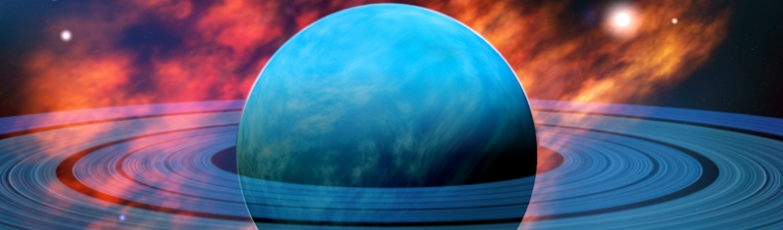
Neptune
While it is the third largest planet with respect to mass, it is only fourth largest in terms of diameter. Due to its blue coloration, Neptune was named after the Roman God Of Sea. Neptune is the eighth furthest planet from the sun and last of the known planets.

Slide 10
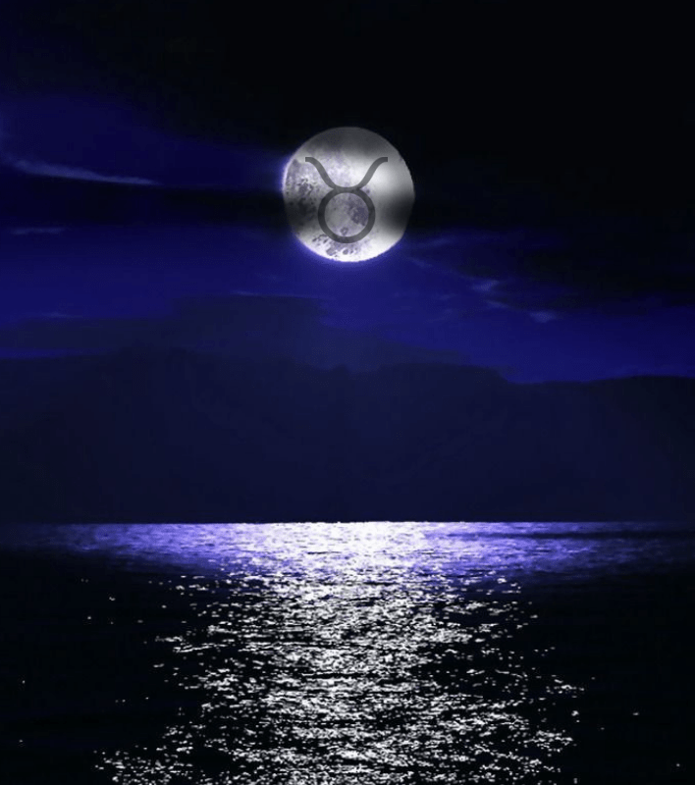
Moon
The dark side of the moon is a myth. In reality both sides of the moon see the same amount of sunlight however only one face of the moon is seen by the Earth. The rise and fall of the tides on Earth is caused by the moon. There is two buldges in the Earth due to the gravitational pull that the moon exerts one on the side facing the moon, and the other on the opposite side that faces away from the moon, The buldges move around the Oceans as the Earth rotates, causing high and low tides aroun the globe. The moon is moving approximitly 3.8cm every year. It is estimated this will continue for around 50 billion years.
This Photo by Unknown author is licensed under CC BY.

Slide 11
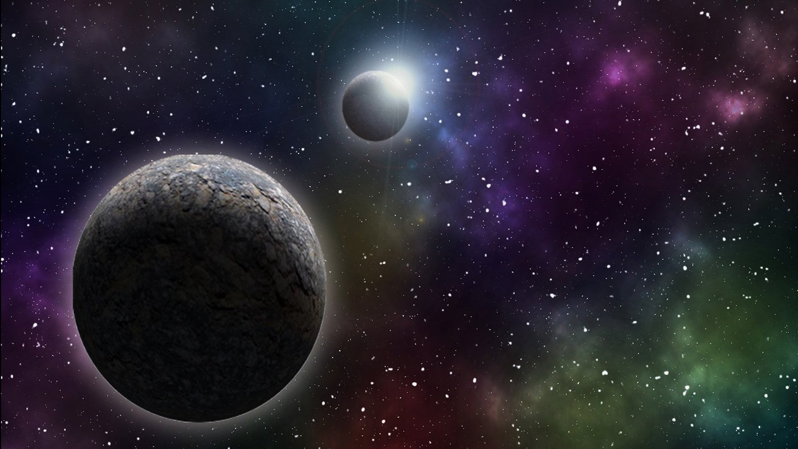
Thanks for watching!!!!
This Photo by Unknown author is licensed under CC BY-SA.

