Slide 1

Manaus
FACTFILE: A city in brazil

Slide 2
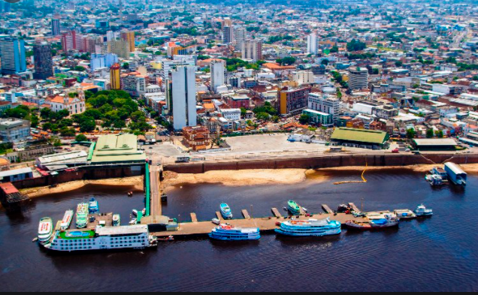
Manaus - General Facts
Manaus is a city in Brazil located in South America.
The population of Manaus is 2,219,580.
The average temperature in Manaus is 31 degrees/ 24 degrees.
Manaus is so close to the Amazon Rainforest you could say they are neighbours!
The city got it’s name because an ancient Mayan tribe called the Manous who lived in that area.

Slide 3
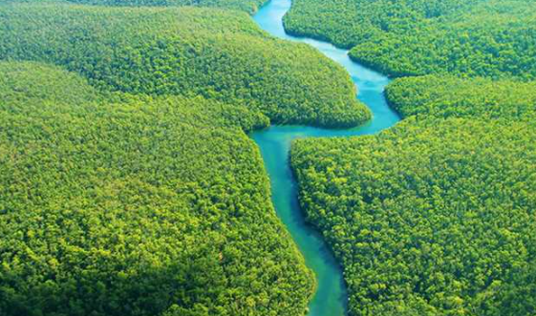
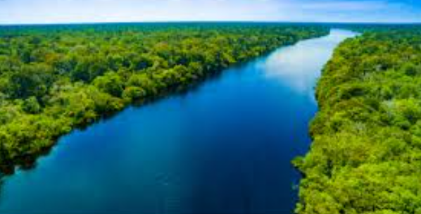
The Amazon River
The amazon river is 11 million years old!!!
It provides 20% of the ocean’s fresh-water supply.
The Amazon River is the 2nd largest river in the world behind the Nile.
Many people have swam the Amazon River but it is dangerous and I advise not to swim the river.
It is 6,400km long and about 2 to 6 miles wide!
The river passes through: Ecuador, Colombia, Venezuela, Bolivia and Brazil.

Slide 4
History of Manaus
The next slide shows how much Manaus has changed over the years.
Manaus was founded 1669.
At one point it was the wealthiest city in Brazil because of the rubber from the trees.
The city’s nickname was the floating city.
For a time it was one of the gaudiest cities in the world.

Slide 5
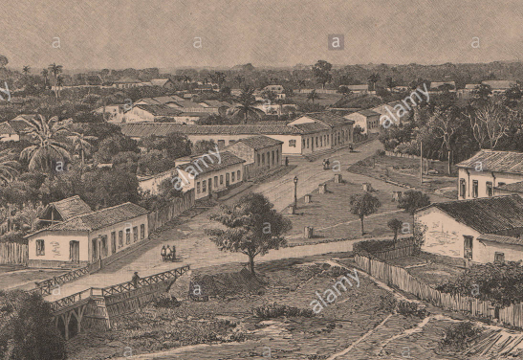
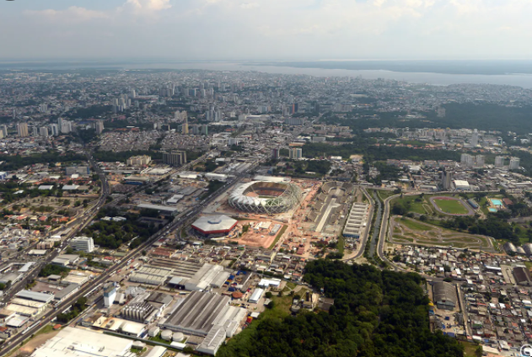
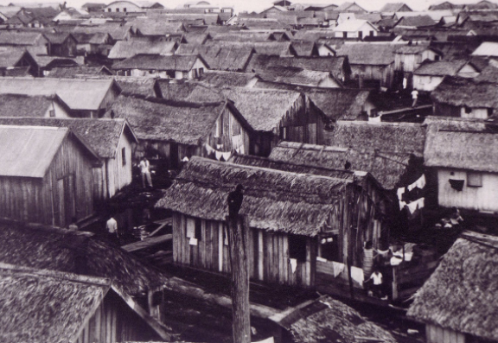
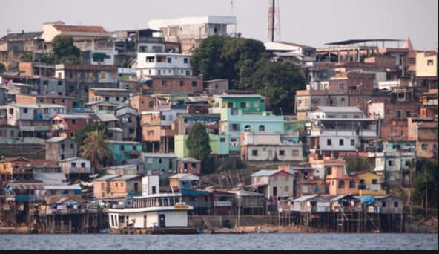
Manaus:
‘Then’ and ‘Now’

Slide 6
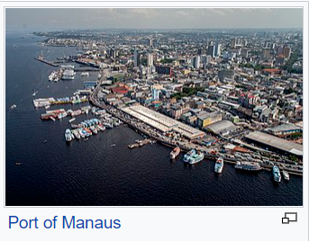
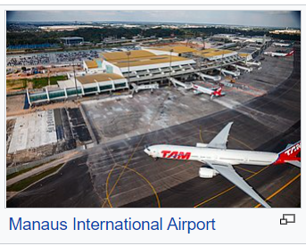
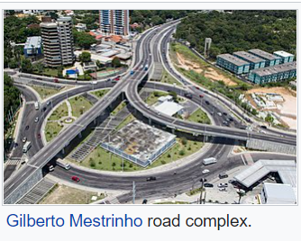
Transportation
Key Facts
Port: The main port is on the bank of the Negro river.
Airport: Eduardo Gomez International Airport is the airport serving Manaus.
Motorway: There are two federal motorways that insect Manaus.

Slide 7
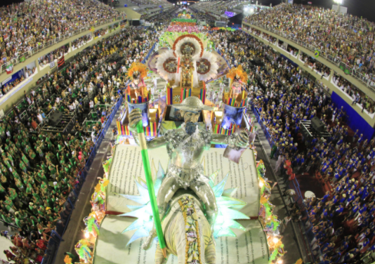
Manaus Carnival
The carnival is called Manaus Carnival
The carnival starts in late February/early March.
May is a good time to visit Manaus as the city hosts Music Festivals
During the summer there are fireworks, riverboats, opera shows & lots of dancing!

Slide 8
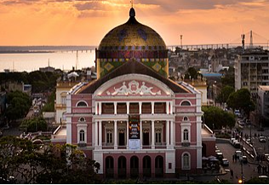
Manaus Attractions
  Amazon Theatre and Opera House
  The opera house is one hundred and twenty years old.
  It represents the city’s heyday during the rubber boom.

Slide 9
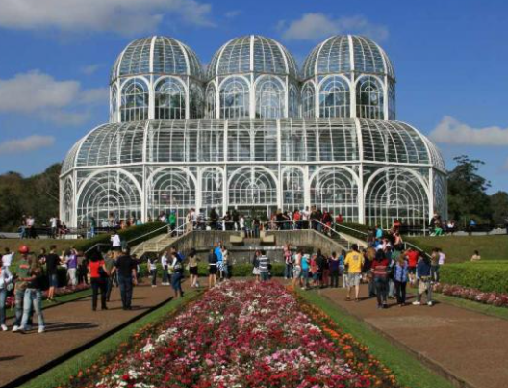
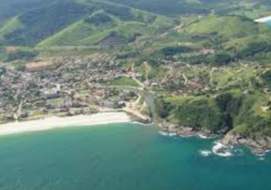
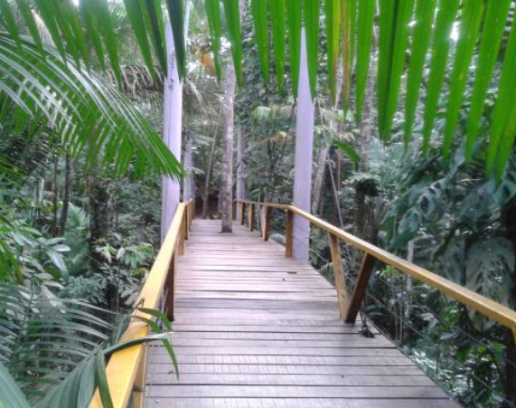
Manaus Attractions
2
Manaus Parks
Here are the three parks:
(1) Ponta Negra Cultural – one of the most important tourist attractions in Manaus
(2) Adolpho Ducke Botanical Gardens – where to find a lot of nature and animals
(3) Mindu Municipal Park – a city park but home to an endangered species of Monkey
1
3

Slide 10
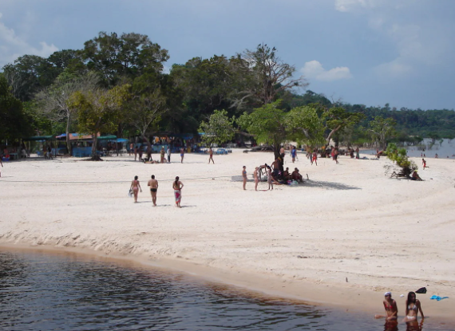
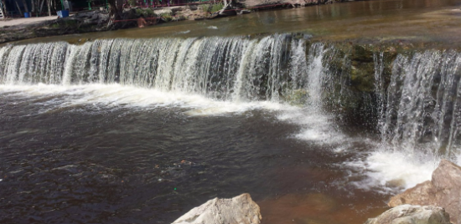
Manaus Attractions
1
Beaches and Waterfalls
(1) Tupe beach is 21 miles from Manaus
  The beach is only accessible by boat or hiking through the forest
(2) The paricatuba waterfall has formed sedimentary rocks
2

Slide 11
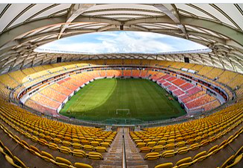
Did you know?
Manaus had a stadium used at the FIFA 2014 World Cup
Arena Amazonia – a view inside the stadium

Slide 12
I hope you enjoyed learning about Manaus… I did!
By Finlay Barker

