Slide 1
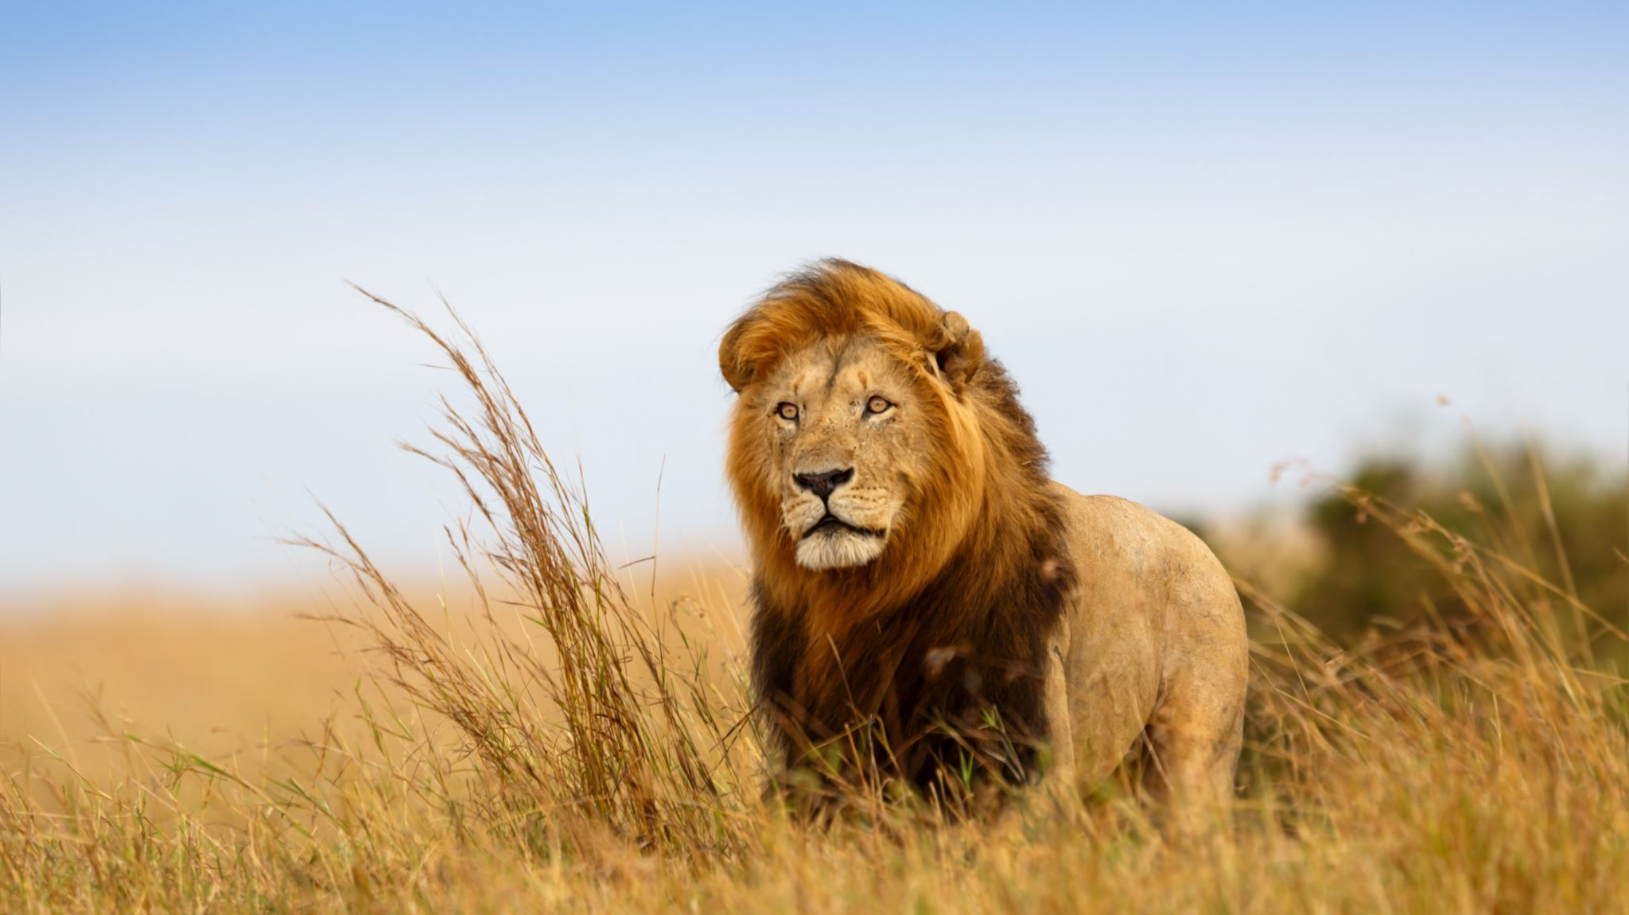
Lion Hunt
By Georgie Burgess

Slide 2
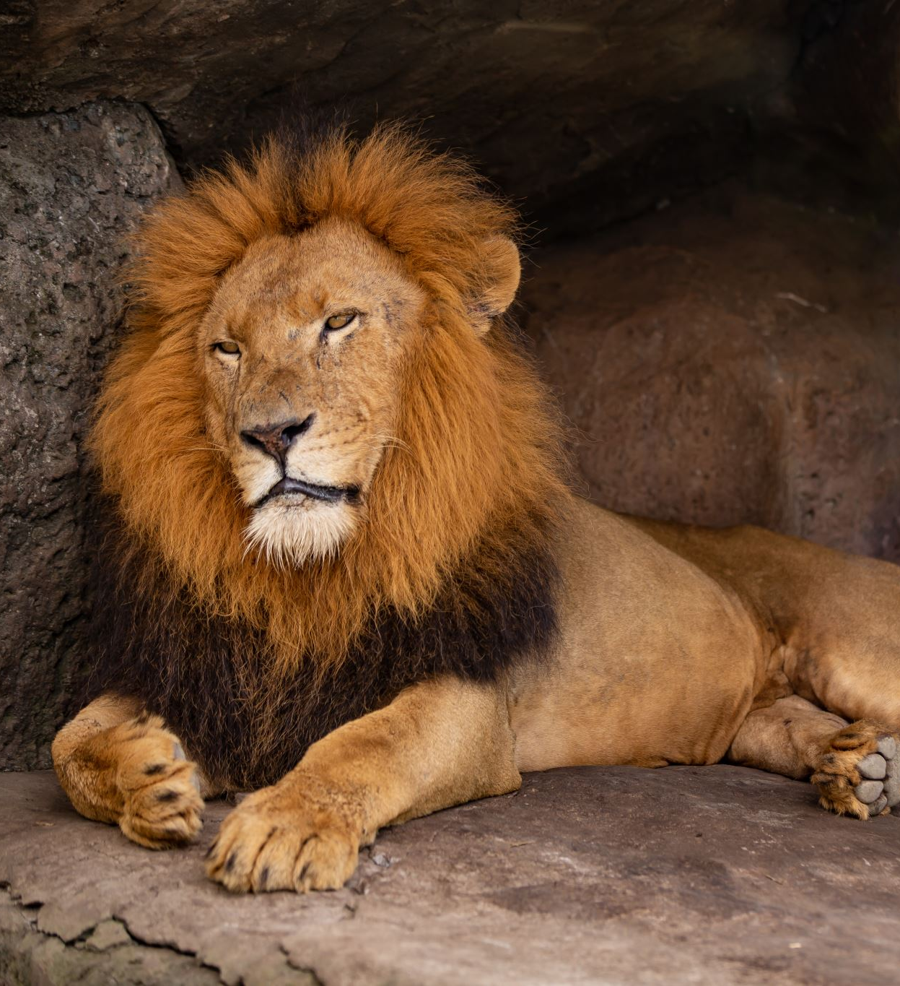
We`re going on a lion hunt!
We`re going to see a fluffy one!

Slide 3
What a hot day!
We`re not scared!

Slide 4
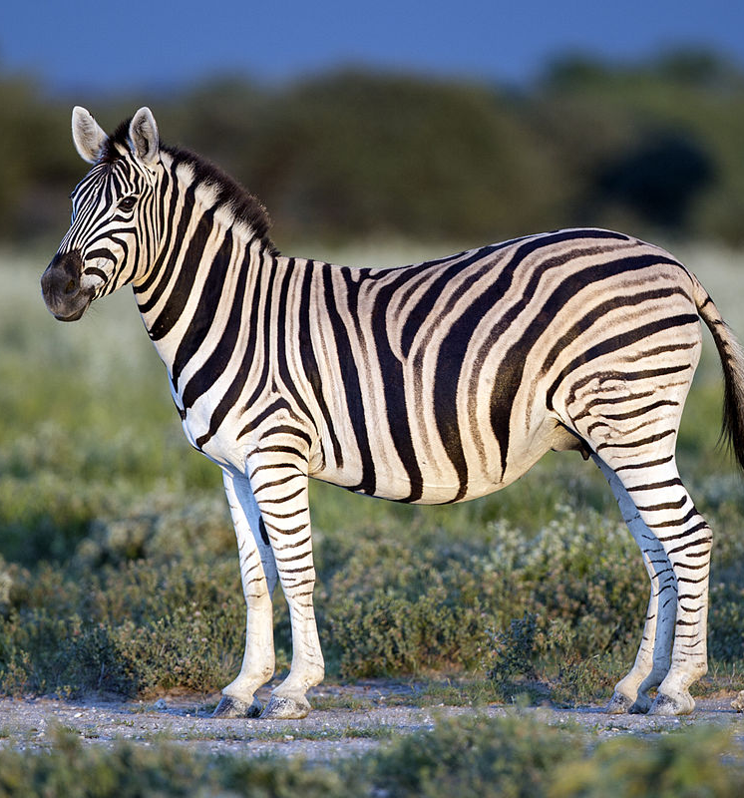
Oh no there is a herd of zebras coming.
This Photo by Unknown Author is licensed under CC BY-SA

Slide 5
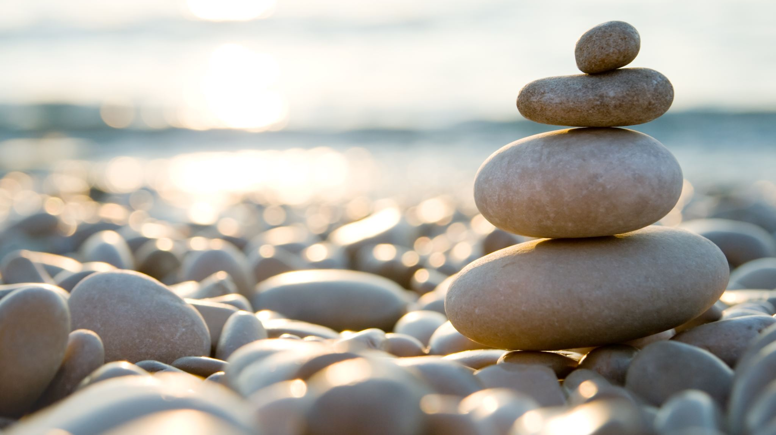
Let`s go hide in the rocks.
Phew phew phew!

Slide 6
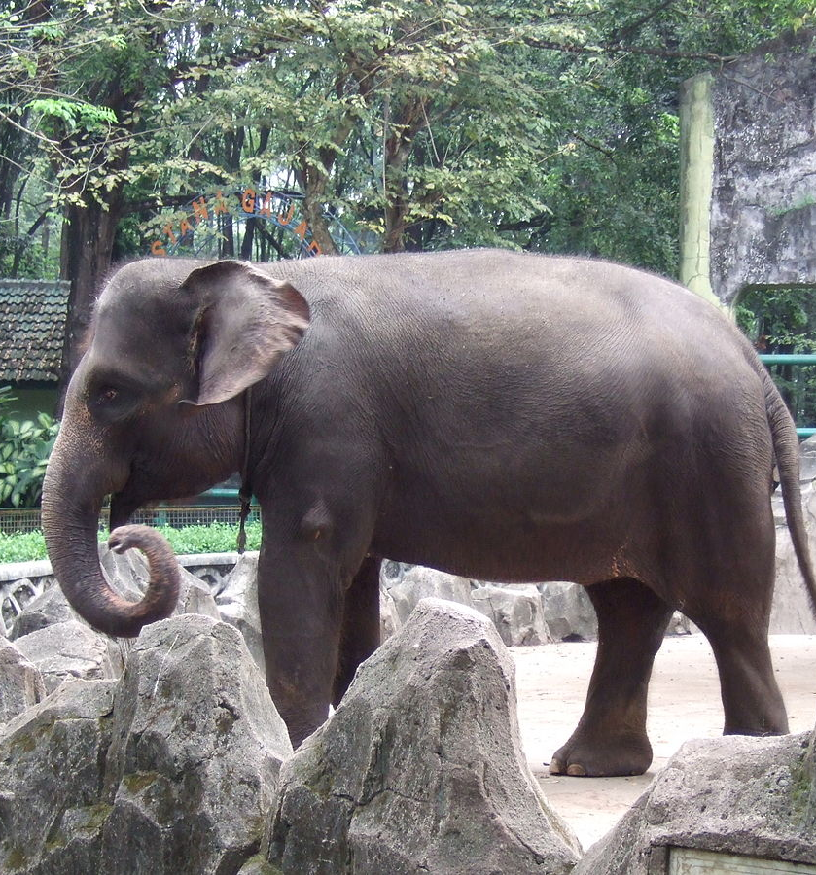
Look over there it’s a herd of elephants walking to the river.
Boom boom boom!
This Photo by Unknown Author is licensed under CC BY-SA

Slide 7
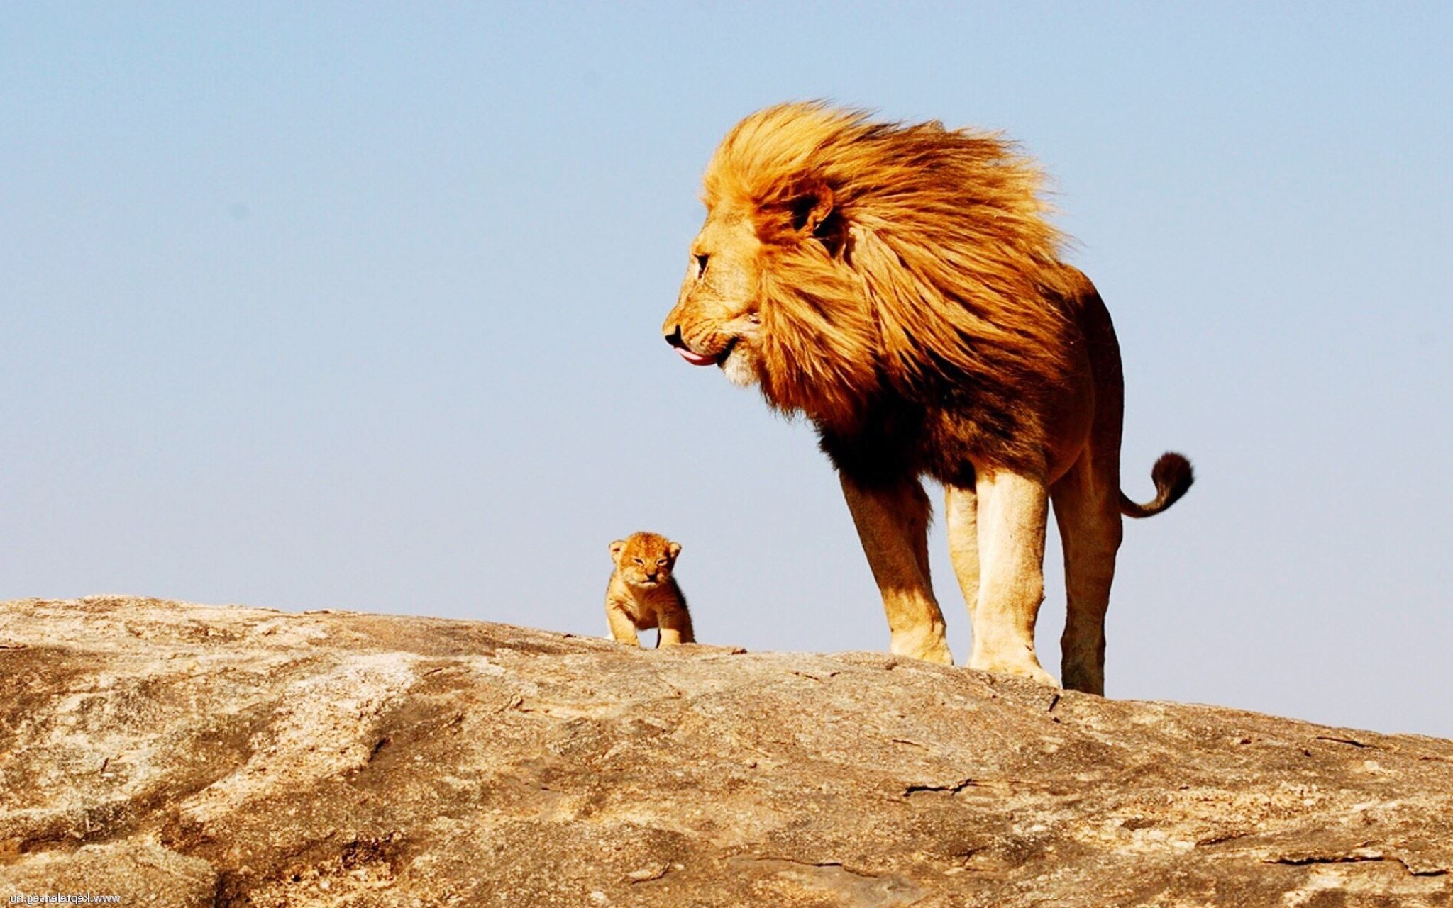
Wow! Look there is a pride of lions! With lion cubs! Awwwwwwwwwww

