Slide 1
Thurston Outdoor Centre
Monday 11th February – Friday 15th February 2019

Slide 2
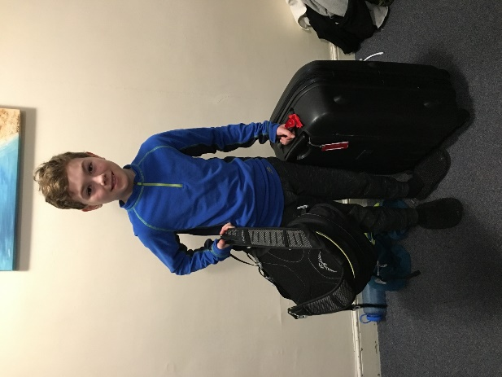
Organisation – What to pack???
2 pairs of thick hiking socks (not cotton) and sufficient normal daywear socks
1 pair of old trainers or plimsolls for water activities (they will get wet)
1 pair of indoor shoes or slippers
1 pair of outdoor shoes
At least 4 warm jumpers/fleece tops
4 T-shirts or polo shirts (or thermal vests in winter)
3 pairs of trousers/joggers (loose fitting – not jeans)
At least 1 pair of gloves or mitts
At least 1 woollen/fleece hat or balaclava
Nightwear
Several changes of underwear
Wash kit and 2 towels
Torch and spare batteries
Elastoplast plasters and personal medication (labelled with name)
Pen, pencil
Swimming costume
A bin liner for dirty clothes (end of course)

Slide 3
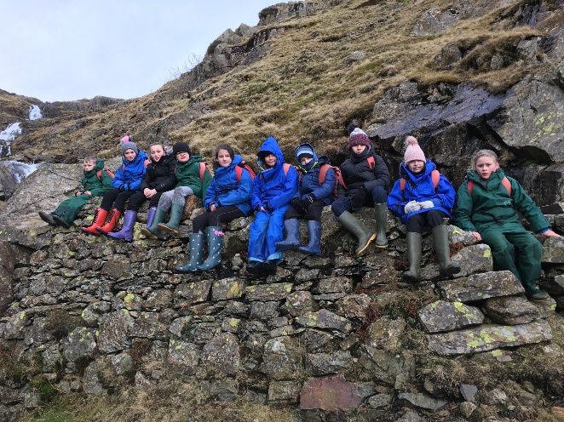
Rules about other things…..
All specialist equipment, including boots and waterproofs, is provided but if you have your own and would like to bring them please feel free.
Since storage space in the dormitories is limited, please bring only essential clothing.
Please do not bring aerosol products such as deodorant and hairspray.
Mobile phones, electronic games and devices are not allowed at Thurston or on the bus.
Optional Items
Cuddly toy
Wellingtons (very useful if you have them)
Camera (labelled) disposable ones are good
Book
CD’s for use in centre music system (put your name on them.)
A scarf to be used for a snowman!!! (weather permitting!)
Pack all of your things 1 in ONE bag to go in the boot of the coach, then have a small bag to take on the bus.

Slide 4
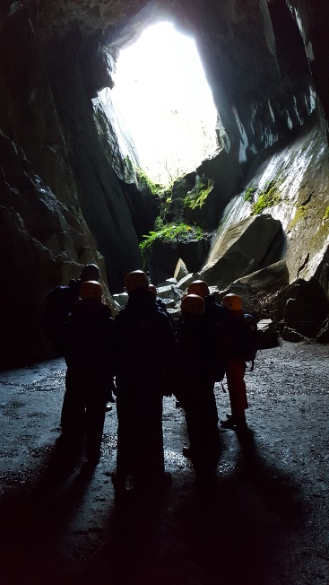
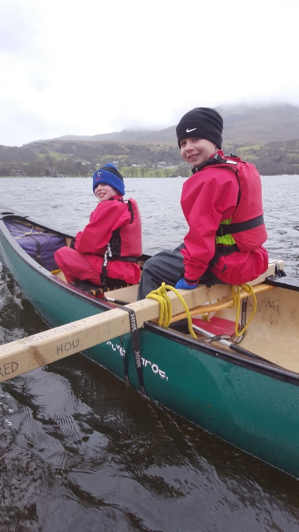
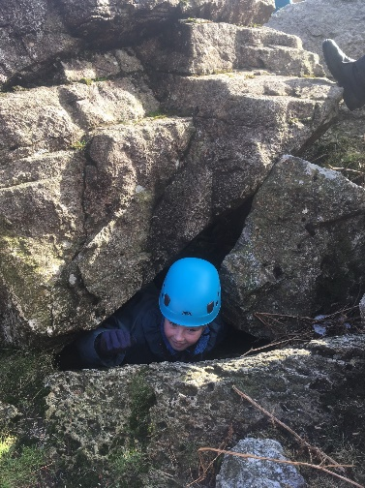
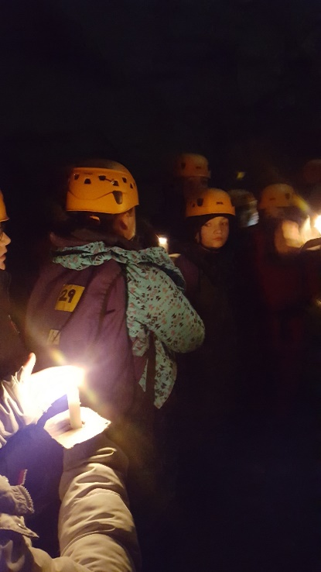
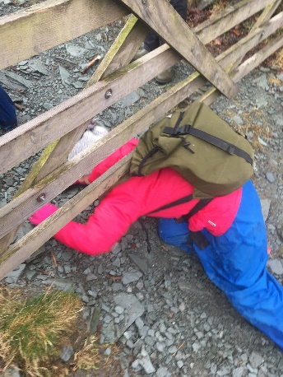
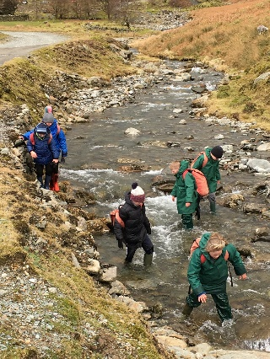
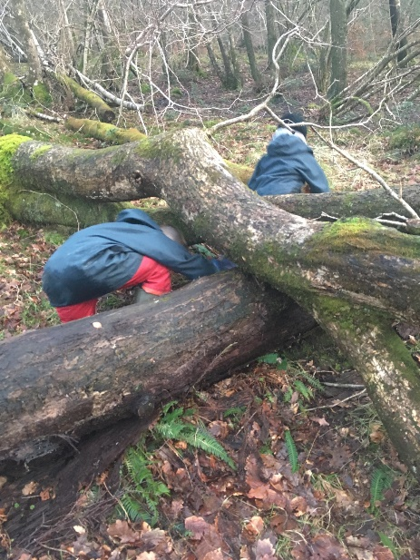
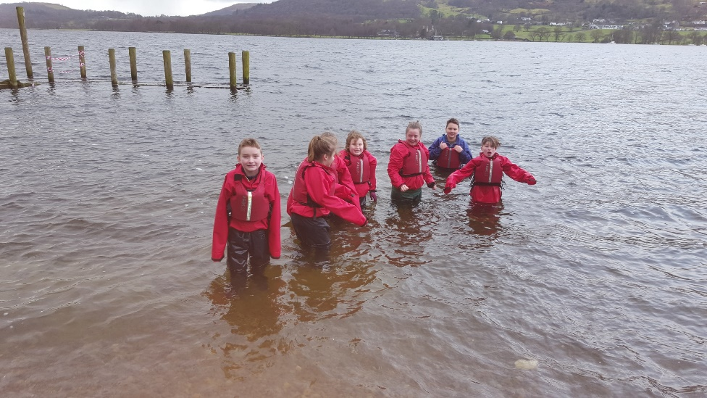
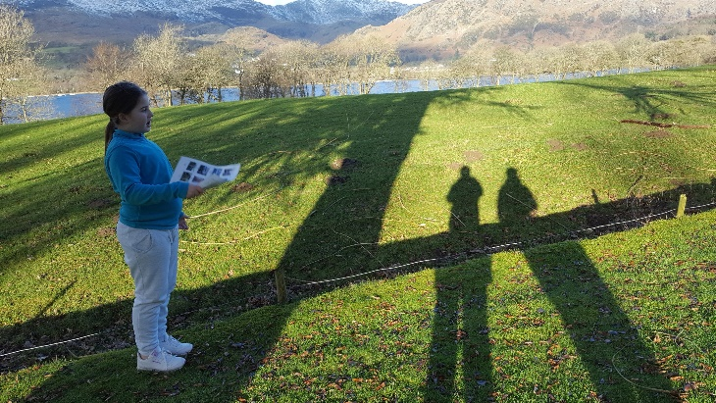
Activities

Slide 5
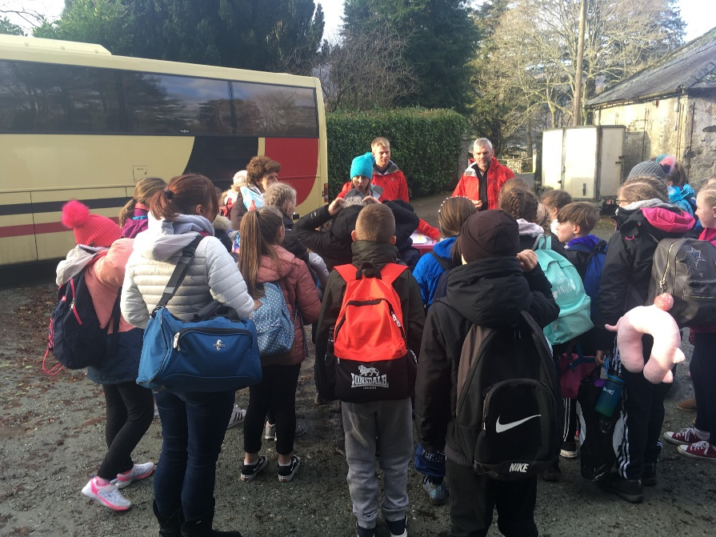
Bus arrangements
On the bus you will need:
A small bag to carry your personal belongings in
A packed lunch for the journey (A box or bag to be used for the rest of the week.)
A full water bottle (This will be used for the rest of the week.)
A book or magazine
Your choice of clothing to wear – school uniform is not required.
A warm coat.
Travel:
Arrive at school from 8:45AM and go straight to the hall.
Parents can stay.
Coach will leave at 9:30AM prompt.

Slide 6
Medication
Any medication your child needs must be mentioned on the ‘Registration/Consent form’ and needs to be in a labelled bag separate from the luggage.
Miss Edwards will be collecting ALL medication in on Monday morning.
Travel sickness tablets need to be given by parents on the Monday, but please supply enough for the way home!!
Any sanitary products need to be with the child, but please let Miss Edwards know.
Inhalers and asthma medication to be handed in, but will be returned to the children once we are on our way.

Slide 7
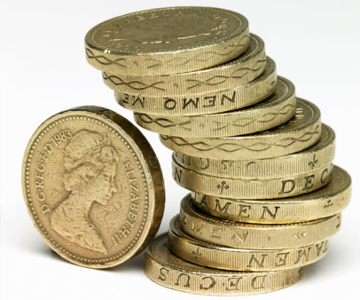
Money
Each child is allowed £10 MAXIMUM to spend on souvenirs.
Money needs to be handed into Mrs O’Brien BEFORE Friday 8th February in a purse or money bag with the child’s name on.
Please send coins to make it easier to spend.

Slide 8
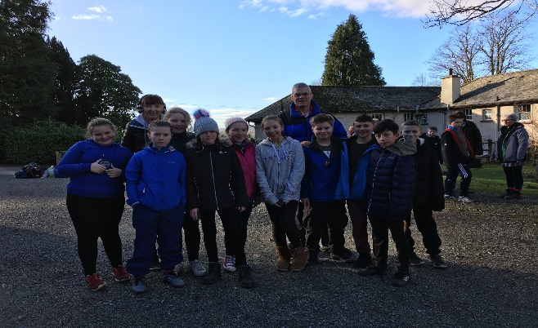
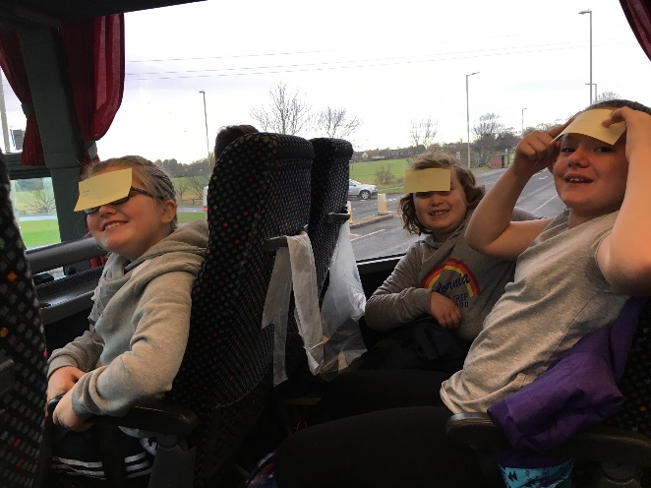
Friendships
The children have already been asked to choose two friends who you would like to be in a group with or in a room.
Rooms will not be allocated until we get to Thurston.
Girls will be separate from boys.
3 groups for activities

Slide 9
Contact
Parentmail – texts and emails
Website – blogs
Phonecalls if needed
No news is good
News!

Slide 10
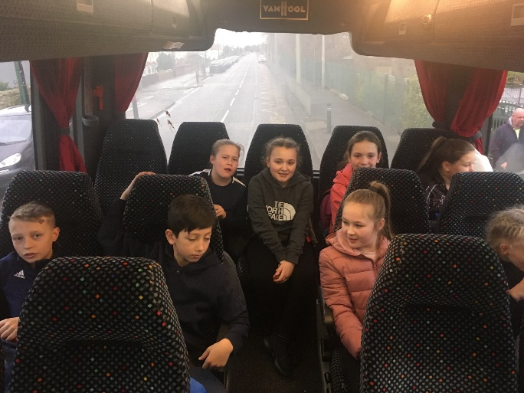
Leave Thurston at 11am
Messages and updates will be sent to parents.
Arrive at school 2:30pm APPROX
Sleep!!!

Slide 11
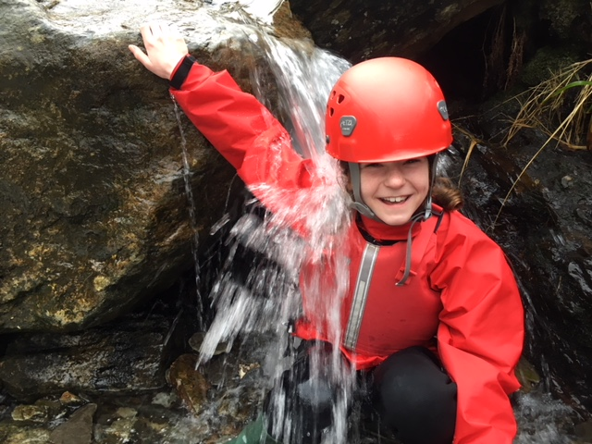
Before you leave tonight…
Ask any questions you wish
Any medical concerns or worries shared
Start to get excited
QUESTIONS

