Slide 1

Providing 30 Hours Free Quality Early Years Education
Marsden Primary EYFS

Slide 2
From September 2017 most working parents of 3 and 4 year old nursery children will be eligible for an extra 15 hours of free childcare a week, term time.
Added to their universal current entitlement of 15 hours, this means that some children will be entitled to 30 hours per week free early education, term time.

Slide 3
Eligibility for 30 hours free childcare
In a two parent family, both parents must work full or part-time.
In a one parent family the sole parent must work full or part-time.
Each parent must earn at on average £120.00 per week but less than £100,000 per year.
Eligible parents can also use Tax Free Childcare alongside the 30 hours free entitlement.

Slide 4
Am I eligible for the 30 hours?
You may be eligible if you are:
Employed or self- employed
If you are over 21 and earn at least £120 per week.
Different rates apply if you are under 21 years of age or an apprentice.
Earn less than £100,000 per year each- both parents.

Slide 5
Further eligibility
You may also be eligible if you have a partner and one of you gets any of the following benefits:
Carers Allowance
Employment and Support Allowance
Incapacity Benefit
Severe Disablement Benefit
Further information is available on
Childcare-support.tax,service.gov.uk

Slide 6
What can we provide at
Marsden Primary EYFS?
Existing 15 hour per week sessions-
Morning session- from 8.30-11.30 am
Afternoon session- from 12.15-3.15pm- children are required to bring a prepared packed lunch to school.

Slide 7
What we are offering for the free 30 hour entitlement?
Full –time teaching sessions of 6 hours daily
Morning session 8.30am-11.30am= 3 hours
Afternoon session 12.15 pm- 3.15 pm= 3hours
Totalling 6 hours of free early years education!
Wraparound lunchtime care 11.30-12.15pm
chargeable to parent at a cost of £3.00 per day/£15.00 per week, to be paid in advance. This is charged for the full entitlement.
Hot school lunches can be provided at a cost of £2.10 per day or parents can provide a packed lunch.
Parents that qualify for the 30 hours entitlement should also qualify for tax free childcare to help offset any extra costs- eg wraparound lunchtime care.

Slide 8
How do parents know if they are eligible for the free 30 hours early education?
The Government has set up a new process for parents to check their eligibility through an online process with HMRC.
This is the same system that parents use when signing up for tax-free childcare.
Eligible parents will get a 11 digit eligibility code which they will need to pass on to their childcare provider.
This will allow them to access the 30 hour entitlement.

Slide 9
What happens if I do not want 30 hours?
Parents can take up the free 15 hour entitlement at Marsden Primary.
Other childcare settings can provide the extra 15 hours of free childcare.
Only two providers can be used per day.

Slide 10


Provision at Marsden

Slide 11
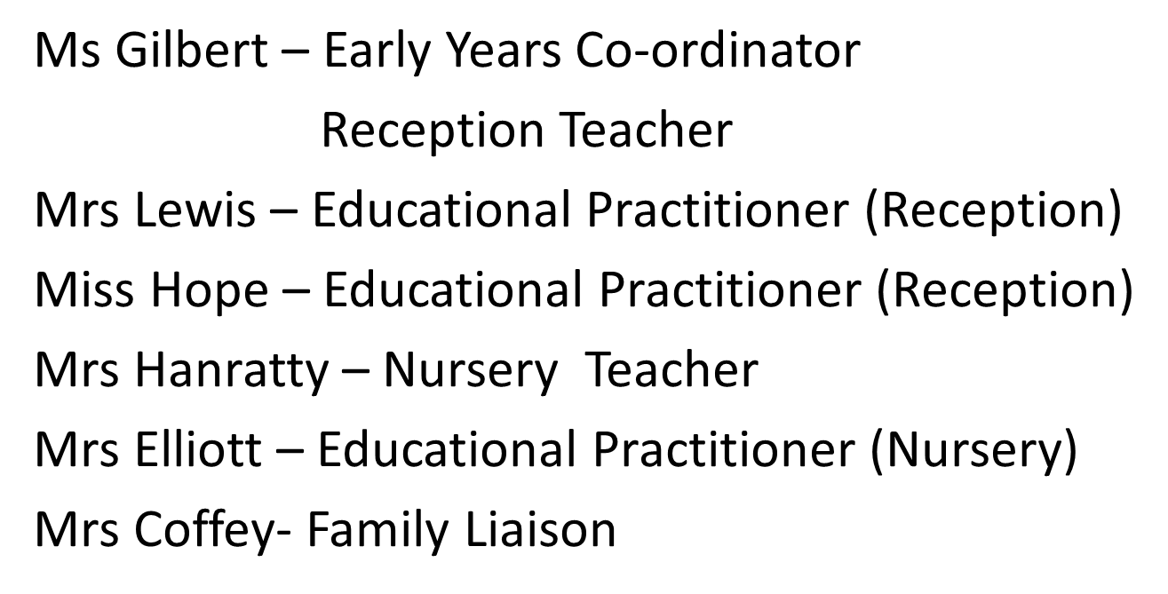
Our Team

Slide 12
Our Curriculum
The Early Years curriculum focuses on seven areas of learning.
Personal, Social and Emotional Development
Communication and Language
Physical Development
Literacy
Mathematics
Understanding of the World
Expressive Arts and Design

Slide 13
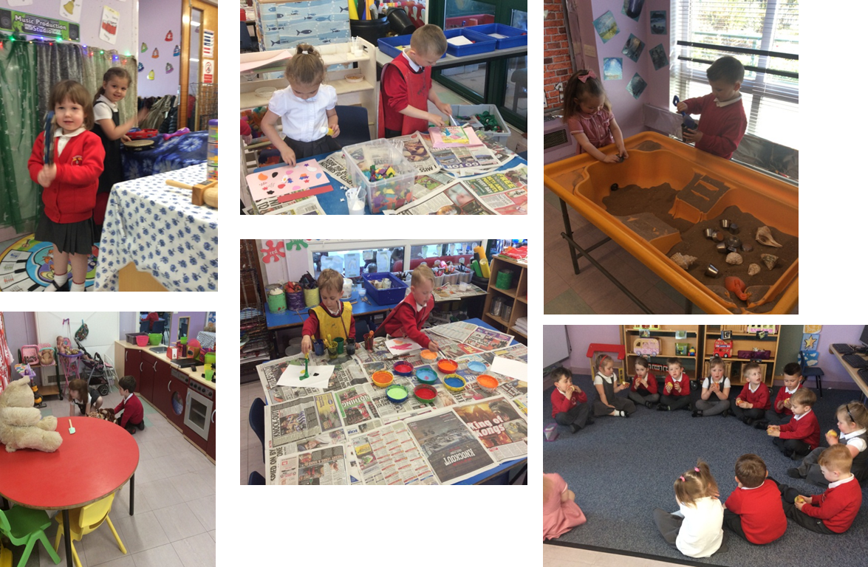
Our Environment

Slide 14
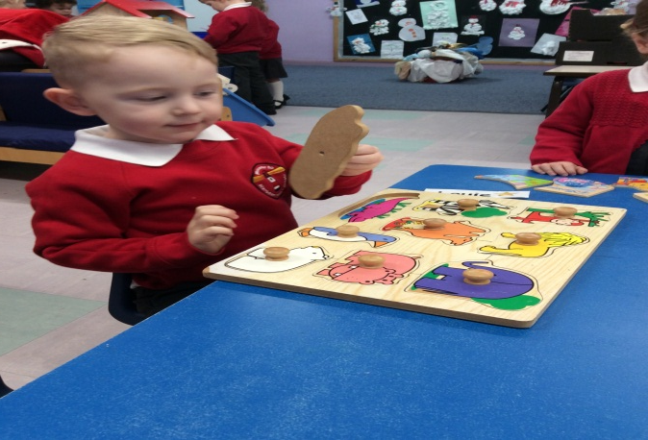
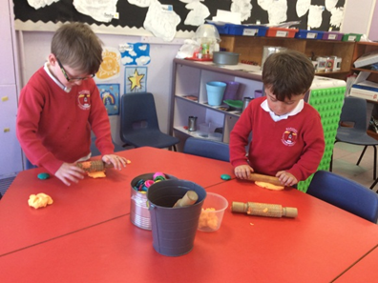
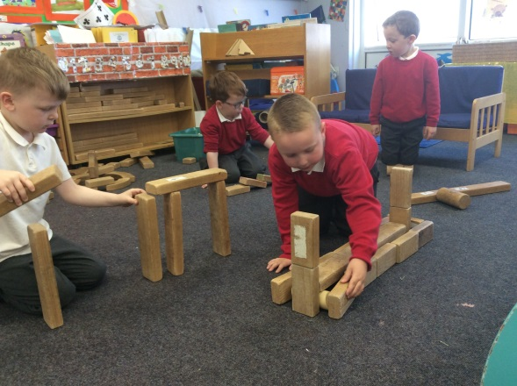
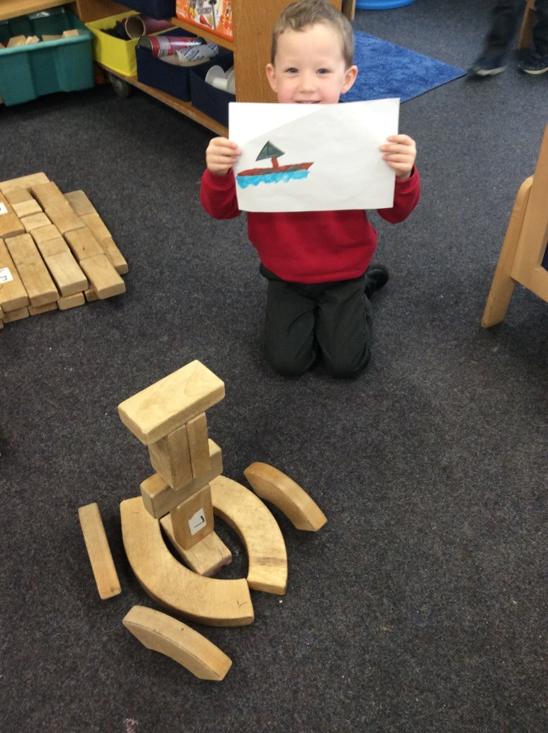
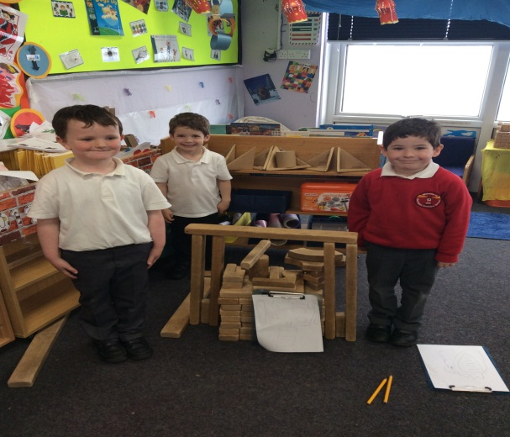
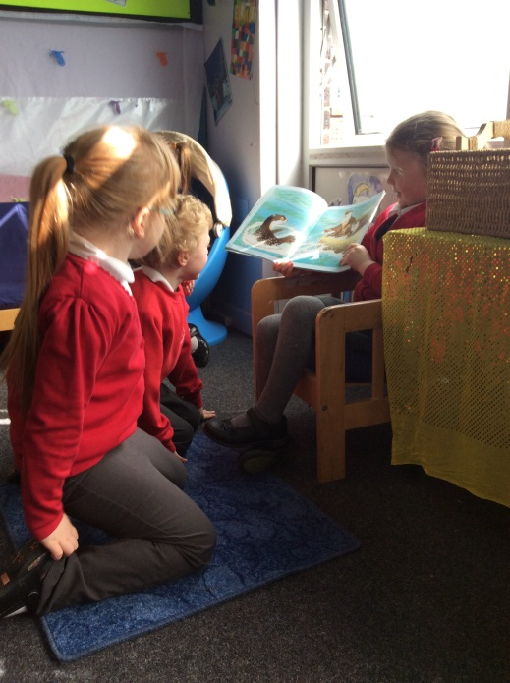
Our Environment

Slide 15
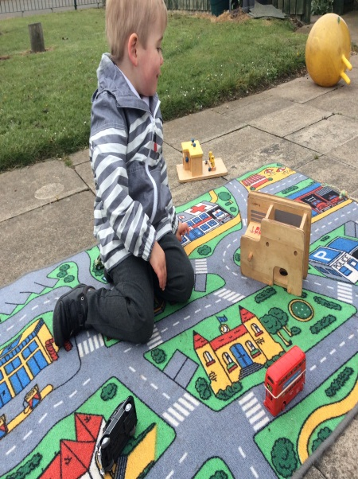
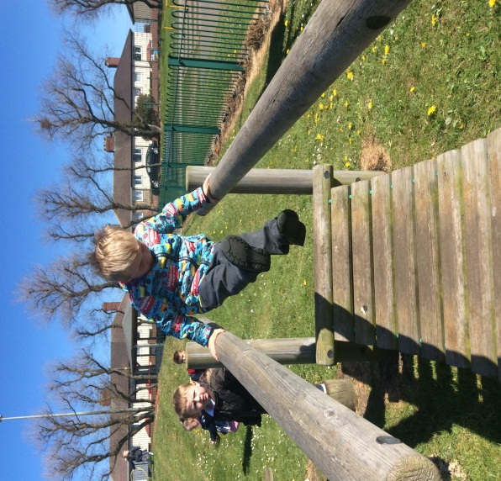
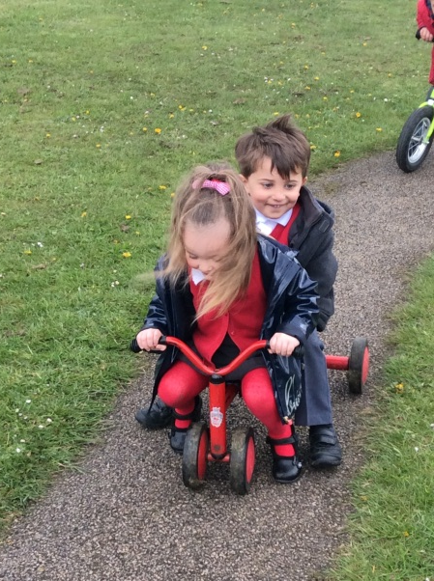
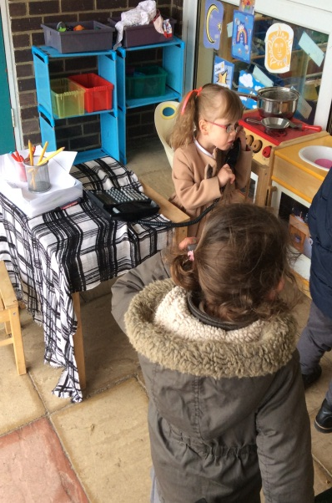
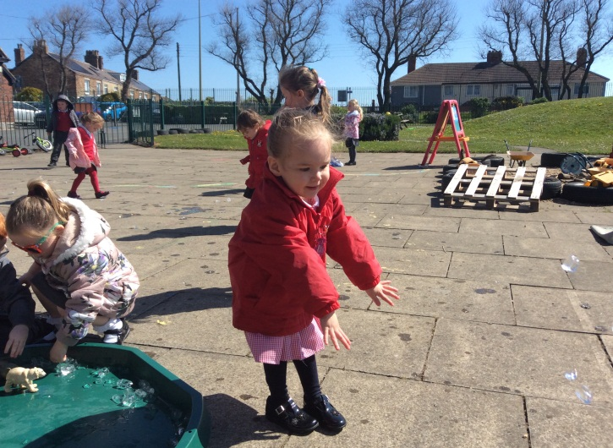
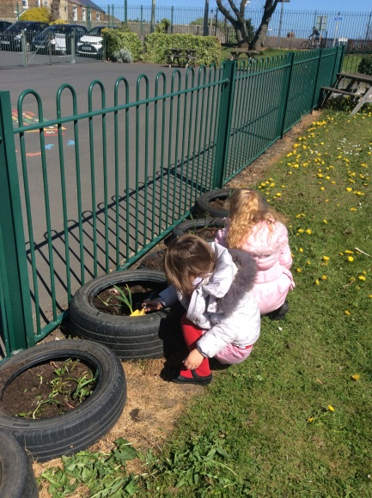
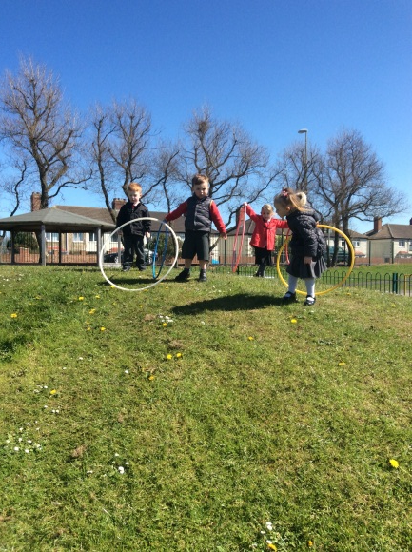
Our Environment

Slide 16
15 Hour Placement
AM Session
8:30-8:45-Characteristics of Learning
8:45-9:10-Rhyme Time/Register
9:10-10:00-Child Initiated Time
10:00-10:30-Phonics/Numbers and Patterns
10:30-10:45-Milk and Fruit
10:45-11:15-Challenge
11:15-11:30-Story Time
11:30-Home Time
PM Session
12:15-12:45-Lunch
12:45-1:00-Characteristics of Learning/Rhyme Time
1:00-1:30-Phonics/Numbers and Patterns
1:30-2:00-Challenge
2:00-2:45-Child Initiated Time
2:45-3:00-Milk and Fruit
3:00-3:15-Story Time
3:15-Home Time

Slide 17
30 hour placement
8:30-8:45-Skills of the Week
8:45-9:10-Rhyme Time/Register
9:10-10:00-Child Initiated Time
10:00-10:30-Phonics/Numbers and Patterns
10:30-10:45-Milk and Fruit
10:45-11:15-Challenge
11:15-11:30-Story Time
11:30-12:00-Lunch in the Hall
12:00-12:15- Indoor Activity
12:15-12:45-Outdoor- Physical Development
12:45-1:00-Skills of the Week/Rhyme Time
1:00-1:30-Personal Development Time
1:30-2:00-Personal Development Time
2:00-2:45-Child Initiated Time
2:45-3:00-Communication and Language Activity
3:00-3:15-Story Time
3:15-Home Time

Slide 18
What should parents do next?
Only HMRC can decide if a family is eligible so parents MUST apply for the additional hours through the free online childcare service.
Decide on your chosen settings and provision.
Express your interest today to secure your child's place for quality early years education at Marsden as places go quickly!

Slide 19
The Process of Application
Parents can check if they could be eligible for a range of government childcare offers, including the30 hours via
Childcare Choices at:
https://www.childcarechoices.gov.uk
or at the Childcare Calculator at:
https://www.gov.uk/childcare-calculator
Those who could be eligible for 30 hours and/or Tax Free Childcare will be directed to the digital childcare service to apply.

Slide 20


Slide 21
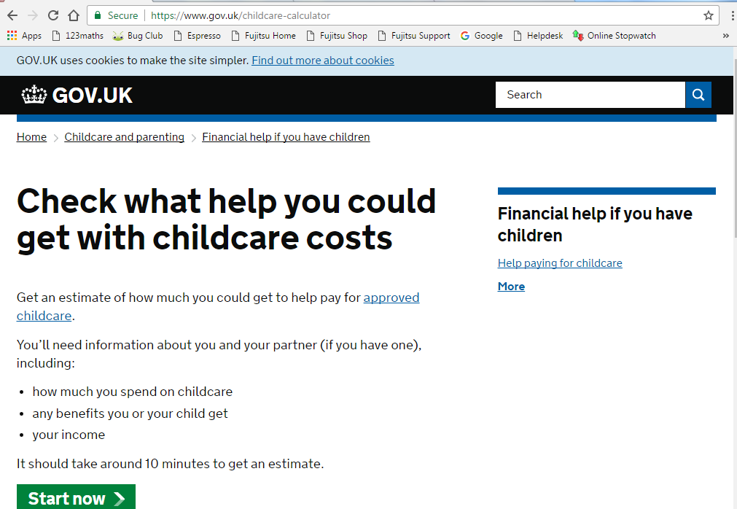

Slide 22
What will I need?
Parents can only apply for the extended entitlement and / or Tax Free Childcare through the digital childcare service.
As part of the application process, parents will be asked to enter personal details including their name, address and National Insurance number and the same details if they have a partner.
At the end of the application process, parents who are eligible will be given an 11 digit eligibility code for their child.

Slide 23
Securing a place.
It is this code along with the National Insurance number and the child’s date of birth which Marsden Primary require as your child’s extended care provider.
Once the code has been verified, a parent can then reserve a place for their child at Marsden.
Parents will be then prompted every three months by HMRC to reconfirm the details they entered on their application form are still accurate.
If circumstances remain the same the child will still be eligible for the free entitlement.

