Slide 1


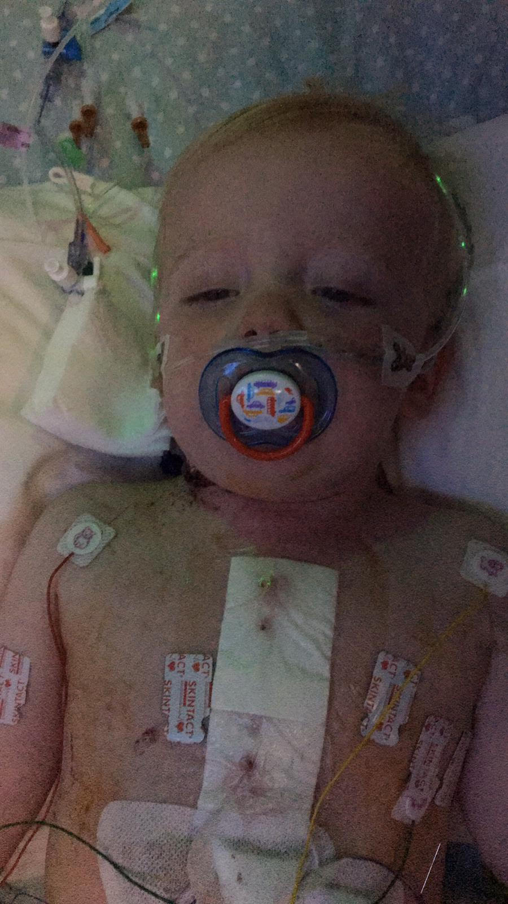
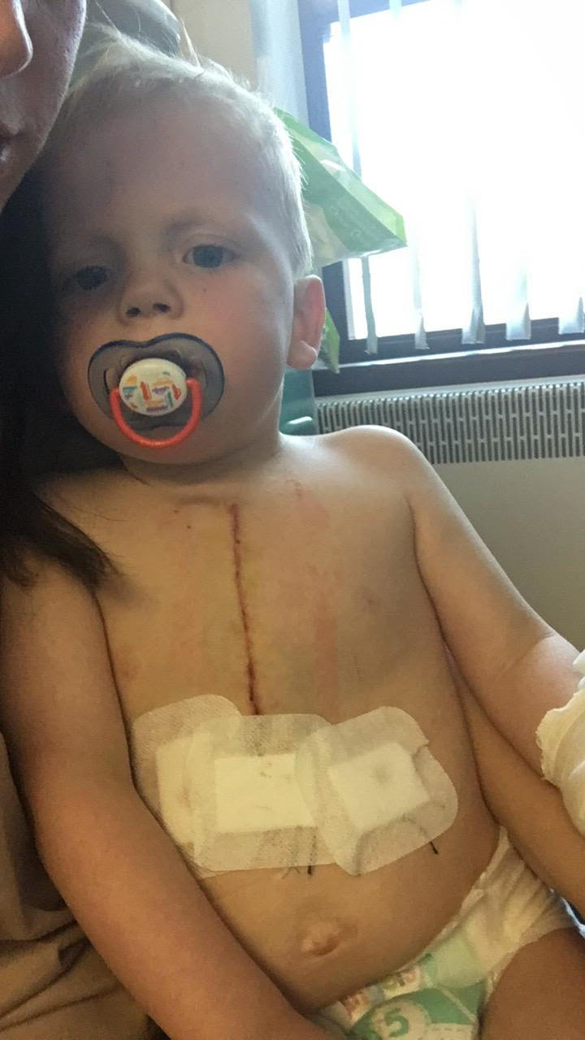
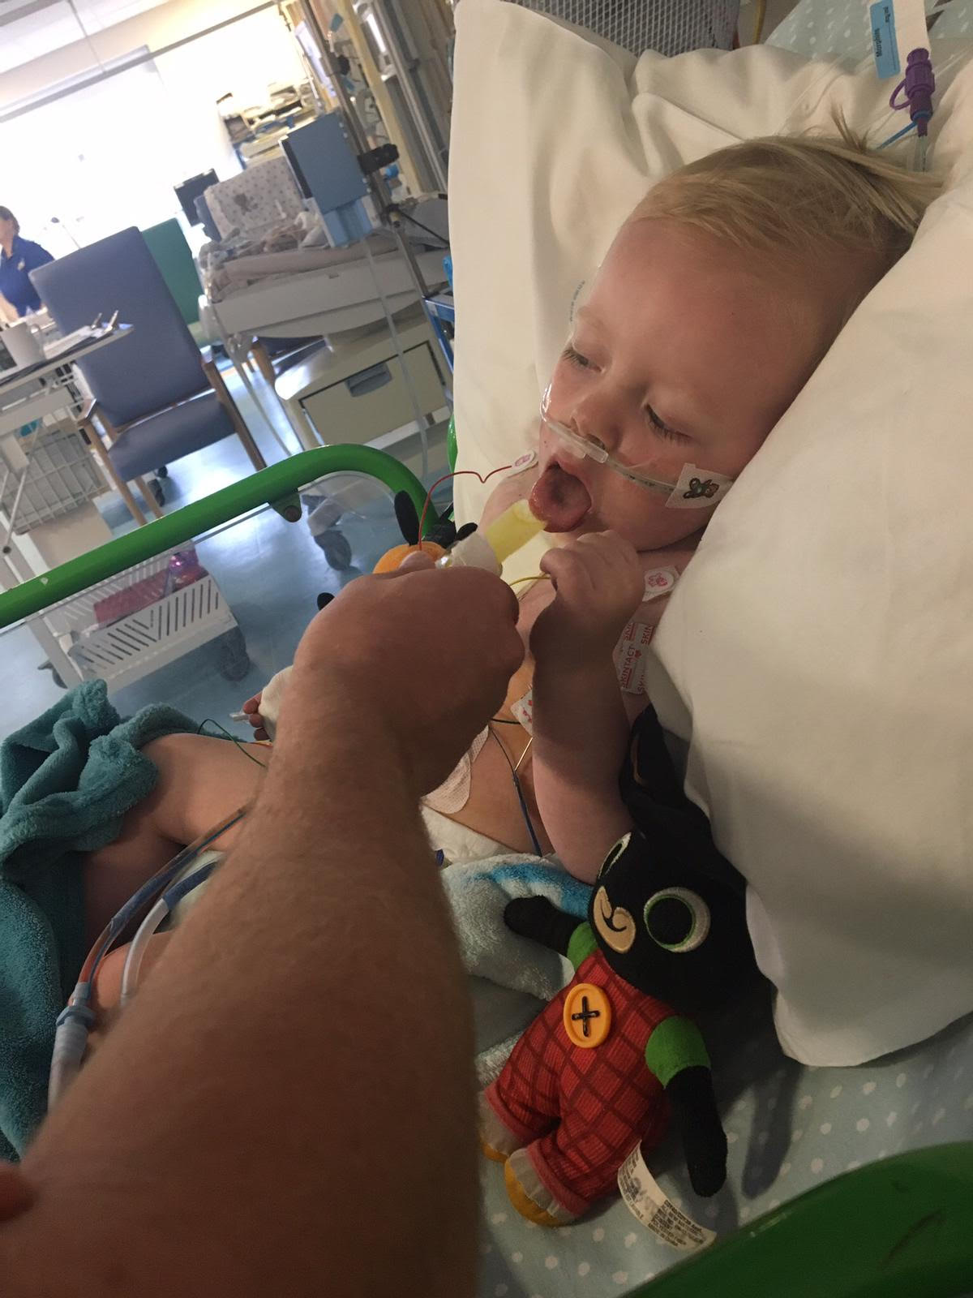
Heart link
Heart link is a charity that helps children that have got heart problems .
Heart link history
Heart link was formed in 1981 as a support group for parents and families who had a child suffering from heart defect. Families then, as now, wanted to meet and talk to others in a similar situation. The first meetings were well attended and supported by members of the hospital staff who recognized the need for such a group.
This is my cousin Freddie who has had three open heart surgeries and he is nearly five years old. He had his first open heart surgery at the age of seven weeks old. His second open heart surgery at the age of two years old. His third open heart surgery at the age of four years old. Heart link have supported Freddie and the family.

