Slide 1
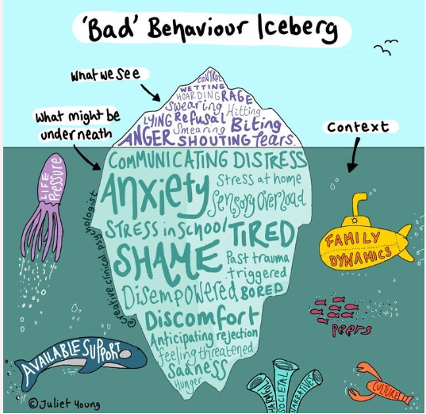
‘I will instruct you and teach you in the way you should go; I will counsel you with my loving eye on you’
Psalm 32:8
Notes:
TJ
What we sometimes see is a failure to behave correctly but actually is a failure to communicate effectively.
Select a couple of examples of what might be going on underneath the surface.
1

Slide 2
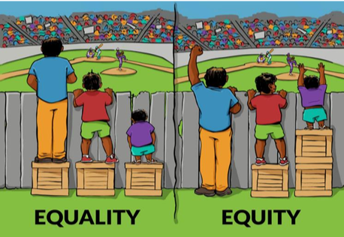
Notes:
TJ
Explain the two images above.
Equality is treating everybody the same.
Equality aims to promote fairness, but it can only work if everyone starts from the same place and needs the same help.
Equity is giving everyone what they need to achieve success.
At Edward Peake we advocate for each child to receive the resources, experiences, appropriate interventions and support in their learning to achieve their full potential.
2

Slide 3
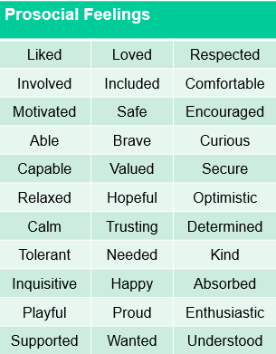
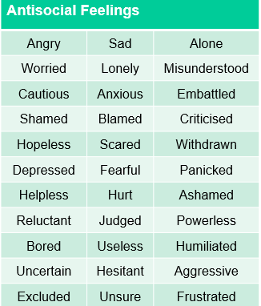
Notes:
HW
Anti-social feelings lead to anti social behaviours, this is often a list of things the child is unable or unwilling to do, which is why it becomes a deficit model.
We often capture what the child is doing but not why they are doing it.
Creating pro-social behaviour is the ambition. An inclusive behaviour policy should focus on how to create pro-social experiences and feelings to achieve pro-social behaviours. Without this focus the policy is expecting children to develop pro-social behaviour without being taught or shown how.
Pro-social experiences are ones designed to create pro-social feelings.
When we focus on what the child is doing well, we are able to build upon it (strengths-based model). With the journey towards pro-social behaviour, the direction of travel is more relevant than the destination.
Pro-social feelings are feelings that will generate behaviours that are useful for the child and those affected by the child.
Developing pro-social behaviour should be a key element of a behaviour curriculum.
3

Slide 4
‘I will instruct you and teach you in the way you should go; I will counsel you with my loving eye on you’
Psalm 32:8
Notes:
TJ
Read the information out and wait for the responses.
4

Slide 5
What is involved in a behaviour curriculum?
‘I will instruct you and teach you in the way you should go; I will counsel you with my loving eye on you’
Psalm 32:8
Notes:
TJ
Read the information out and wait for the responses.
5

Slide 6
Reward and positive reinforcement
Feedback and recognition
Comfort and forgiveness
Positive language
Restorative Practice
Relationships
Role modelling
Consistency (not equality)
Routines
Prioritising prosocial behaviour
Planning alternatives to antisocial behaviour
‘I will instruct you and teach you in the way you should go; I will counsel you with my loving eye on you’
Psalm 32:8
Notes:
TJ
Relationships (invest at the start – children should want to do something because of the quality of their relationship with you. The more you know about the child, the more therapeutic you can be)
• Role modelling (this is essential – for e.g. we have to show them how to ‘play nicely’ by playing with them)
• Consistency (not equality) • Routines (but with flexible thinking referring to individual circumstances and quick wins)
• Prioritising prosocial behaviour (really valued in every child – thanking them, proximal praise)
• Planning alternatives to antisocial behaviour
• Reward and positive reinforcement (should be given freely and unexpectedly, not as a form of bribery)
• Feedback and recognition (give feedback when something has not been asked for – don’t just celebrate the things that are expected (e.g. sticker for holding the door open – this should be the norm)
• Comfort and forgiveness (understanding and know that we will do it differently tomorrow)
• Ignoring (unsocial and low level behaviours, giving time for unsocial behaviour to stop – do not give attention to these behaviours)
• Positive language (tell children what you would like to see, not what you don’t e.g. ‘Walk thank you’ rather than ‘don’t run’)
• Restorative Practice (follow up the behaviour, it’s impact and consequences at the appropriate time, after regulation has taken place/provide strategies for further occurrences).Restorative approaches refer to a range of methods and strategies which can be used both to prevent relationship-damaging incidents from happening and to resolve them if they do happen.
6

Slide 7
‘I will instruct you and teach you in the way you should go; I will counsel you with my loving eye on you’
Psalm 32:8
Notes:
7

Slide 8
What are the differences between subconscious and conscious behaviour?
‘I will instruct you and teach you in the way you should go; I will counsel you with my loving eye on you’
Psalm 32:8
Notes:
TJ
Subconscious behaviour – unable to moderate or self-regulate
Behaviours that are present without any thought or planning
When the child is being overwhelmed by an emotional response we should identify and plan adaptations to protect the child from the experiences and feelings in order to support their self-regulation.
Conscious behaviour – unwilling to moderate or self-regulate
Behaviours that are the result of thought and planning
Conscious behaviour is evidenced to have been successful and effective at meeting the child’s needs regardless of any known detrimental impacts of adult responses.
How can I impact on the child’s beliefs or values?
What does the child need to learn?
How am I going to teach them?
8

Slide 9
Subconscious behaviour
unable to moderate or self-regulate
Conscious behaviour
unwilling to moderate
or self-regulate
‘I will instruct you and teach you in the way you should go; I will counsel you with my loving eye on you’
Psalm 32:8
Notes:
TJ
Subconscious is a result of the child being UNABLE to behave in a different way.
Their behaviour is a subconscious reaction to an experiences or feelings, the plan around subconscious behaviours or subconscious elements of a behaviour are to protect the child from things that will overwhelm them while we develop a plan to raise their awareness, engagement and coping strategies.
Conscious antisocial behaviour are behaviours with a strong perceived tangible gain.
Conscious behaviours tend to be self-interested and disengaged from the needs of others.
The child feels their behaviour is explainable or even justifiable.
They have insufficient motivation or insufficient deterrent to modify their behaviour to please other people.
When planning we look at where the perceived gain lies and work to ensure the gain is achievable with prosocial alternatives.
Protective consequences may be necessary where conscious behaviour will require a gradual change based on an evolving plan.
9

Slide 10
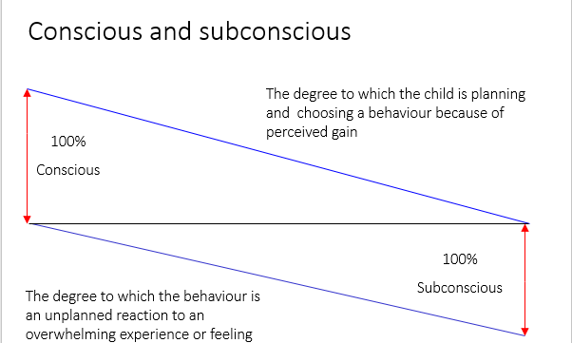
‘I will instruct you and teach you in the way you should go; I will counsel you with my loving eye on you’
Psalm 32:8
Notes:
TJ
Behaviour can be a mixture of both conscious and subconscious elements.
Predominantly conscious behaviours serve the individual well enough to encourage them to use the behaviour despite any known potential consequence or punishment associated with the behaviour.
Predominantly sub-conscious behaviour is a sign of a failure to cope with an overwhelming feeling. Such as being overwhelmed with frustration or overwhelmed with anxiety (arousal) or overwhelmed with depression.
We can also use this slide to challenge the concept of sanction/consequence.
If we punish conscious behaviours, we create conflict.
If we punish subconscious behaviours, we generate more of the negative feelings associated with injustice.
Bullying:
Who is bullied? What, when, where and how - a child is bullied may be very conscious decisions.
Why they bully may be deeply subconscious - their own vulnerability, insecurity, etc. that the child may not be engaged with.
We can manage the behaviour with a multidimensional plan. Manage the opportunity to bully whilst also working with their self-esteem.
10

Slide 11
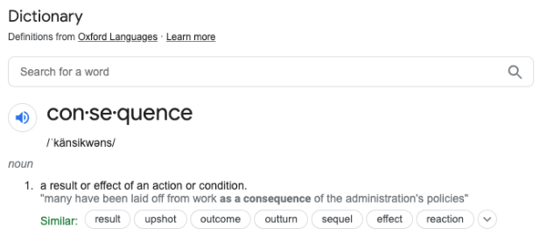
‘I will instruct you and teach you in the way you should go; I will counsel you with my loving eye on you’
Psalm 32:8
Notes:
TJ
11

Slide 12
What are the differences between protective and educational
consequences?
‘I will instruct you and teach you in the way you should go; I will counsel you with my loving eye on you’
Psalm 32:8
Notes:
TJ
Protective consequences are necessary measures to manage the risk of harm that results from dangerous behaviours.
Protective consequences limit freedoms where necessary for the prevention of harm.
When we use protective consequences we must have evidence of the educational consequences that are in place to progress the child to a point where we can return any freedoms limited by the use of protective consequences.
Educational consequences return freedoms.
12

Slide 13
Protective consequences
(removal of a freedom to manage harm)
Educational consequences
(the essential learning, rehearsing or teaching to enable behaviour change)
Notes:
TJ
Protective consequences are the immediate risk mitigation needed to reduce the risk of harm from the behaviour that has been displayed.
They should be specific to the behaviour and a logical removal of freedoms to protect all those within that dynamic
Protective consequences must remain in place until the educational consequence has taken place to make the reoccurrence of risk less likely
Educational consequences are the specific teaching following anti-social behaviour, designed to enable the young person when faced with the same situation to be equipped to react/respond differently
Education consequences are designed to inspire a young person to moderate, and self regulate their behaviour in order for freedoms to be returned
Freedoms removed through protective consequences should be returned slowly and monitored to enable the pupil to experience success and ensure the dynamic is not exposed to risk resulting from freedoms being fully returned without evidence of incremental success in the area where harm occurred previously.
This slow incremental increase incentivises the pupil to self regulate.
Consequence is outcome-related rather than time-related.

Slide 14
Olfactory (smell)
Tactile (touch)
Gustatory (taste)
Proprioceptive
(body position)
Auditory (sound)
Vestibular (movement)
Visual
(sight)
Interoceptive (internal)
Notes:
HW
Think of a pupil that fits into each category.
Olfactory and gustatory systems - responsible for tasting and smelling and assist in the identification of safe versus harmful items to consume.
Auditory system - responsible for receiving and processing sounds i.e. hearing and understanding what is heard.
Visual system - identifies sights, understands what the eyes see and prepares for a response. Good ocular motor control aids learning.
Tactile system – includes two types of touch receptors, protective and discriminative. Receives sensations of pressure, vibrations, movement, temperature and pain through the skin and provides us with the sense of touch.
Proprioceptive system – processes messages from muscles, joint capsules and tendons which provide information about where our body is in space and how it is moving (direction, speed and force) without using vision. It is proprioception that allows us to move our hands carefully without having to observe every movement.
Vestibular system – responsible for our balance and movement sense. It tells us where our body is in relation to gravity, where it is moving and how fast. The movement receptors are located in the inner ear and important for posture, muscle tone and bilateral integration (the ability to co-ordinate both sides of the body together).
Interoceptive system – detects responses that guide regulation (hunger, thirst, heart rate, elimination, need for air, itch). Sensation related to physiological needs and physical condition of the body.
14

Slide 15
Escape
Avoidance
Connection seeking
Tangible
Notes:
HW
Think of a pupil who is demonstrating these particular behaviours.
Escape
When experiencing anti-social feelings there is a conscious or subconscious desire to leave. The behaviour relieves the anti-social feelings.
Avoidance
When predicting the anti-social feelings will be experienced there is a conscious or subconscious desire to avoid the experience. The behaviour protects the individual from perceived anti-social feelings.
The phrase ‘attention-seeking’ is sometimes used in a moralising way. A more helpful phrase is ‘connection-needing’.
A useful analogy is to think of a child who is thirsty. They could be described as a water-needing child. A water-needing child will be a water-seeking child. And so, a connection-needing child will be a connection-seeking child.
Behaviour occurs as a way of gaining access to a person, location, item or activity.
When behaviour enables access to someone or something desirable then it is an incentive to repeat that behaviour.
Example a pupil behaving in a particular way to gain access to the HIVE.
15

Slide 16
Upper wave 1 behaviour support as part of the graduated response.
‘I will instruct you and teach you in the way you should go; I will counsel you with my loving eye on you’
Psalm 32:8
Notes:
HW
Formalising available information relevant to the behaviour
Early prognosis is used in a lot of professional situations such as a car mechanic, or GP triage etc
GPs will very rarely initially diagnose anything as they have no evidence, they will however look at the notes about the past, look at you and talk to you and based on what they know they will make a prognosis.
Sometimes it is more complex and we need to do more analysis.
Often the GP will use an early prognosis and suggested action as a first attempt to resolve an issue, only when this action is unsuccessful will they engage in more thorough analysis.
i.e. knee pain – muscular, take some anti-inflammatory –yes in 2 weeks it’s better, no it’s worse, phone back and then they say lets do some bloods and have an Xray/scan – further analysis.
Often with the right information, your professional experience will enable a prognosis and your experience will lead to a more effective plan of action.
16

Slide 17
Early prognosis is used to ensure…
We have not missed an opportunity to scaffold and maintain the current dynamic.
If we scaffold the dynamic, we will have a plan linked to analysis of function, experience, cultural expectation and diagnosis
We have engaged all relevant parties who can help us identify need.
‘I will instruct you and teach you in the way you should go; I will counsel you with my loving eye on you’
Psalm 32:8
Notes:
HW
17

Slide 18
Pupil Inclusion Plan (PIP)
Collecting information about the pupil to identify key concerns.
Collaborative approach.
The form will begin with the Form Tutor identifying the behaviour.
Year Leader will coordinate the form being completed as part of the Pastoral Support Plan.
The document will then be taken to the Inclusion Leads meeting for review, monitoring or escalation to a therapeutic plan.
‘I will instruct you and teach you in the way you should go; I will counsel you with my loving eye on you’
Psalm 32:8
Notes:
HW
Has the behaviour been described accurately?
Has the child, parent /carer, class teachers, SENDCO, other professionals etc. who all may all hold individual pieces of information that can help us to understand the behaviour and differentiate to meet the child's needs been consulted?
Have we ensured each person’s contribution is independent and unbiased by using a blank version of the form?
Has a named person drawn together all the information onto a single early prognosis document?
Has a named person used the information to form a hypothesis and action based on the above analysis?
Has the named person accessed a range of professional inputs where they are unable to form a hypothesis or plan suitable action?
18

Slide 19
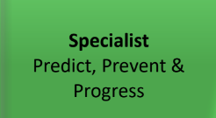
Wave 2 behaviour support as part of the graduated response.
‘I will instruct you and teach you in the way you should go; I will counsel you with my loving eye on you’
Psalm 32:8
Notes:
HW
19

Slide 20
Therapeutic Plan (TP)
Using information about a pupil to create a targeted approach and package of support.
Collaborative approach.
The plan will be completed by Inclusion leads and guidance taken from Year Leaders.
Once it is written into the therapeutic plan, the information becomes the agreed actions which must be carried out by all staff.
Guidance will be provided to staff to complete the TP
‘I will instruct you and teach you in the way you should go; I will counsel you with my loving eye on you’
Psalm 32:8
Notes:
HW
20

Slide 21
Pupil Inclusion Plan (PIP)
Pupil Passport
Therapeutic Plan (TP)
SEND PLAN
‘I will instruct you and teach you in the way you should go; I will counsel you with my loving eye on you’
Psalm 32:8
Notes:
HW
Has the behaviour been described accurately?
Has the child, parent /carer, class teachers, SENDCO, other professionals etc. who all may all hold individual pieces of information that can help us to understand the behaviour and differentiate to meet the child's needs been consulted?
Have we ensured each person’s contribution is independent and unbiased by using a blank version of the form?
Has a named person drawn together all the information onto a single early prognosis document?
Has a named person used the information to form a hypothesis and action based on the above analysis?
Has the named person accessed a range of professional inputs where they are unable to form a hypothesis or plan suitable action?
21

Slide 22
Restoratives
Edward Peake is committed to the restorative practice approach and philosophy.
It is a way of working that recognises the harm that has been caused, and it aims to repair relationships.
The repair takes place through restorative actions, such as repairing harm or damaged property, taking the time to develop an understanding of those who have been hurt and working together to identify new ways to interact.
‘I will instruct you and teach you in the way you should go; I will counsel you with my loving eye on you’
Psalm 32:8
Notes:
TJ
Section 9 from our behaviour policy
Page 13
Restorative approaches allow adults to model emotional literacy and develop the pupil’s empathy so that their drive to behave in a negative way is challenged not by sanctions, but by the impact the behaviour has on others in society. It is not about using fear to force a person to change behaviour or make amends but instead using structured conversation to make them accountable for what they choose to do.
22

Slide 23
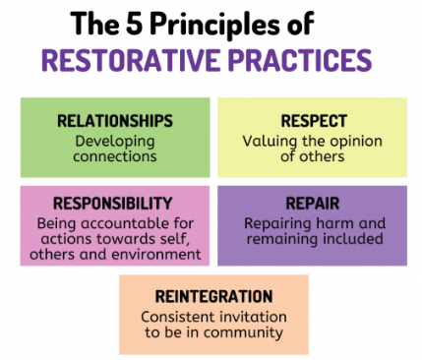
‘I will instruct you and teach you in the way you should go; I will counsel you with my loving eye on you’
Psalm 32:8
Notes:
TJ
Taken from the behaviour policy and previous training
23

