Slide 1
South East Midlands
The Labour Market
January 2024

Slide 2
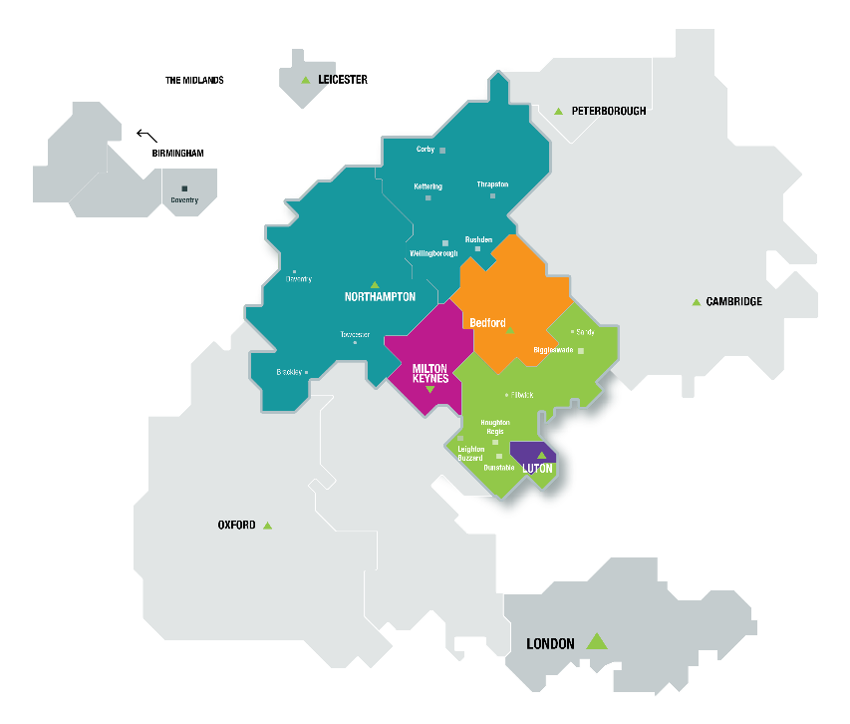
Introduction
South East Midlands comprises:
Bedfordshire
Luton
Milton Keynes
Northamptonshire
Our role is to help economic growth thrive across the South East Midlands by supporting job creation, a pipeline of talented people and skills development for the future prosperity of the local communities.

Slide 3
Job Vacancies Trends
Facts
Job vacancies are the highest since the start of 2017
North Northamptonshire highest since 2015
Source: Lightcast

Slide 4
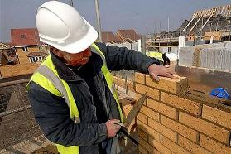
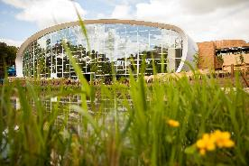
Top occupational groups in demand now
Source: Lightcast

Slide 5
“Employability Skills”
Basic Skills
Literacy
Numeracy
Spoken English
Basic digital
Attitudes & Behaviours
Detail orientated
Work ethic
Willingness to learn
Enthusiasm
Self-motivation
Independent working
Flexibility
Adaptability
Honesty
Reliability
Politeness
Humility
Empathy
Curiosity
Technical/Vocational Skills
Job specific
Operations
Customer service
Sales
Management
Specialist digital skills
Commercial acumen
Financial awareness
Working with hands
Driving
Core Transferable Skills
Communication
Organisation
Digital literacy
Planning
Problem solving
Creativity/Innovation
Leadership
Time management
Analytical
Teamwork/Collaboration
Resilience
Qualifications and Certification
Source: Local Skills Improvement Plan

Slide 6
Digital Skills
Increase in demand for digital literacy
Most requested computer programming languages
Other digital systems
Software | Vs 2020
Microsoft Excel | ++
Microsoft Office | ++
Microsoft Outlook | ++
Microsoft PowerPoint | =
Microsoft Azure | =
Microsoft Word | =
Power BI | ++
Rank | Software | Vs 2020
1 | SQL | +
2 | JavaScript | ++
3 | C# | +
4 | Java | +
5 | Python | +
Software | Vs 2020
SAP Applications (Business) | ++
Amazon Web Services (Business/Sales) | +
AutoCAD (Design) | +
All sectors show a demand for Microsoft Excel and Outlook
Source: Local Skills Improvement Plan

Slide 7
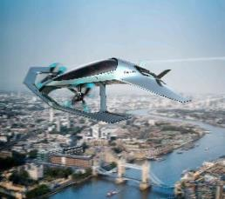
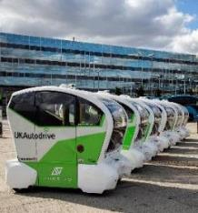
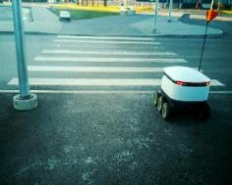
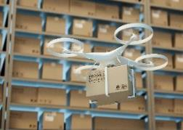
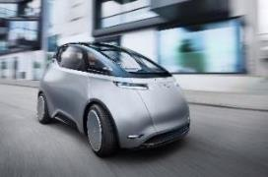
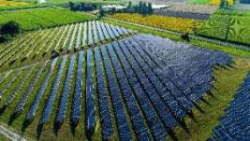
Future Opportunities
Intelligent Mobility
Aerospace/Space
Manufacturing
Modern Methods of Construction
Logistics
Artificial Intelligence
Internet of Things
5G
Data Science/Analytics
Technology/Automation
Environment
Labour Costs
Aging Population
Digital
Green Economy
Net Zero
Sustainability
Non-Carbon Fuelled Transport
Agri-tech
Creative
Health and Care

Slide 8
Future opportunities
New Jobs and Changes in Occupation Roles
Automation driven service industries
Digital
Engineering and technology
Education
Health
Care
Net Zero/Green Economy/Sustainability
Scientific research
Engineering and technology
Machine operators/technicians
Agriculture
Regulatory professionals
Population Serving
Health
Care
Education

Slide 9
Pathways – Routes to Work
Higher
Education
Vocational/
Higher Technical
Employment & Career
+19
A Level
Technical/ T Levels
Applied Learning
Work Study
Programme
+16
GCSE
Applied Learning
No ‘better’ or ‘worse’ pathway just the relevant route for a career
14-16

Slide 10
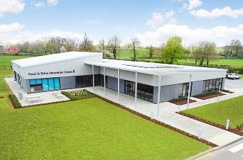
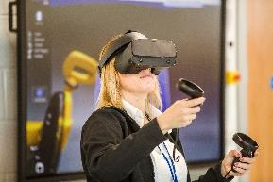
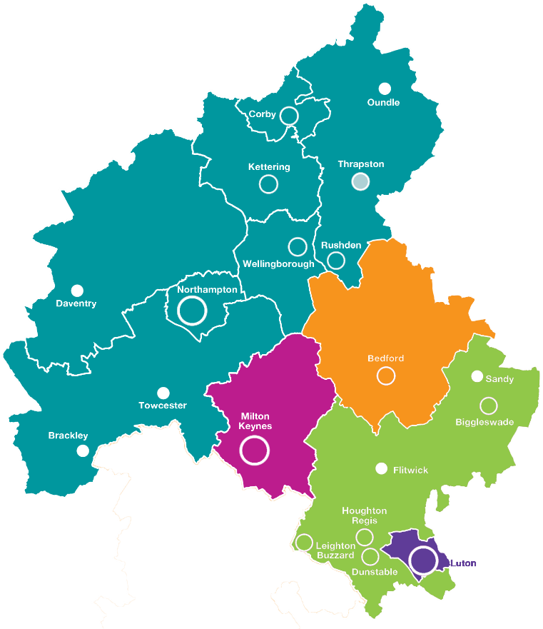
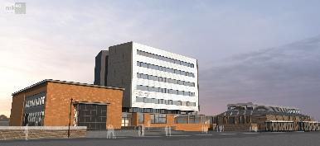
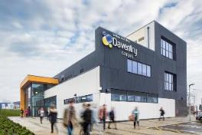
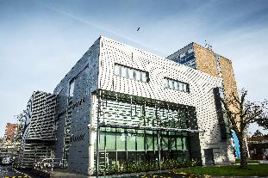
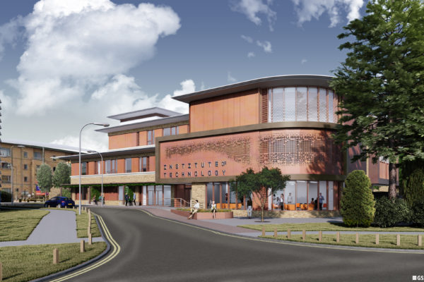
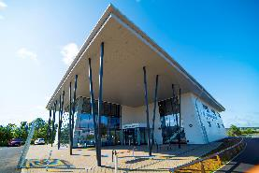
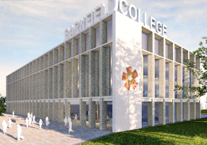
Pathways – Innovative Further Education
Moulton College
Northampton College
Tresham College
Northampton
College
Daventry
Campus
Bedford College
Milton Keynes
College
The South
Central
Institute of
Technology
Barnfield College
Central Bedfordshire College

Slide 11
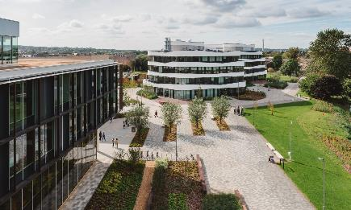
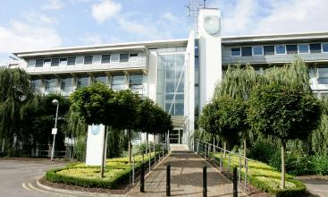
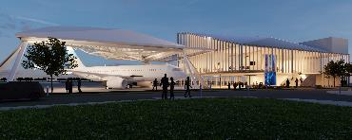
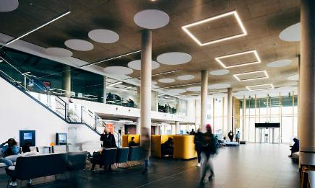
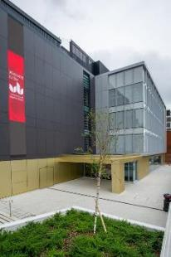
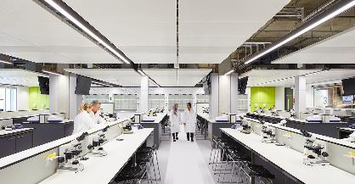
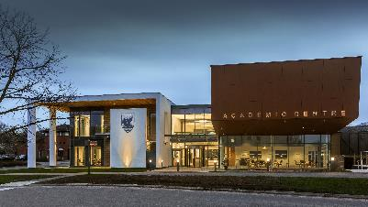
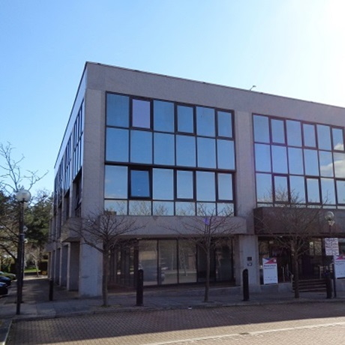
Pathways – Higher Education
University of Northampton
The Open
University
Cranfield
University
University of Bedfordshire
University of
Buckingham
Medical School
MK:U

Slide 12
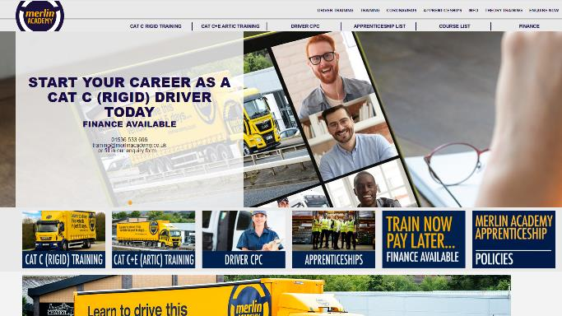
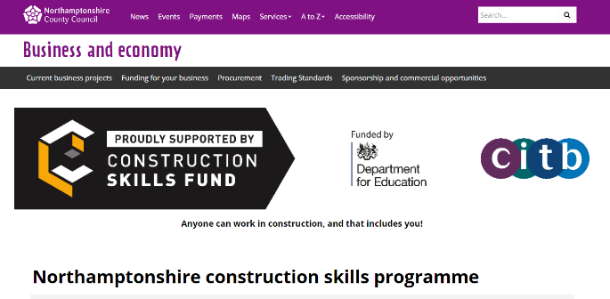
Pathways – Other
Independent training providers delivering training provision
Primarily for apprenticeships, traineeships, specialist training or targeted to help particular groups of people

Slide 13
Other Sources of Information
Explore your education and training choices at Skills for Careers – https://www.skillsforcareers.education.gov.uk/pages/young-people
Explore careers at:
National Careers Service - https://nationalcareers.service.gov.uk/explore-careers
Prospects – Information on jobs, work experience and pathways https://www.prospects.ac.uk/jobs-and-work-experience/job-sectors/
Youth Employment Careers and pathways into work https://www.youthemployment.org.uk/careers-hub/
icould – video and careers information - https://icould.com/explore/categories/job-types/#jobtype
South East Midlands Careers Hub - Careers Advice & Applications

Slide 14
Other Sources of Information
Explore occupational groups with need locally
Engineering - This is Engineering - An introduction to the sector and the opportunities it offers https://www.thisisengineering.org.uk/
Construction - GoConstruct, the construction industry guide to careers https://www.goconstruct.org/
Manufacturing - Makeuk, what is it like to work in UK manufacturing -https://www.makeuk.org/insights/blogs/what-is-it-like-to-work-in-uk-manufacturing
Creative Industries - Creative Industries Federation, discover creative careers https://discovercreative.careers/#/
Health - NHS Find Your Career https://www.healthcareers.nhs.uk/FindYourCareer, MK, Bedfordshire, Luton https://work-learn-live-blmk.co.uk/jobs/, Northamptonshire https://bestofbothworlds.uk.net/
Care - Think Care Careers, Skills for Care https://www.skillsforcare.org.uk/Careers-in-care/Think-Care-Careers.aspx, Logistics and Supply Chain - Transport & Logistics careers - https://generationlogistics.org/
Digital - Digital World - https://www.digitalworld.net/industries-and-jobs
Hospitality (Food and Accommodation) - https://nationalcareers.service.gov.uk/job-categories/hospitality-and-food

Slide 15
More information:
https://www.semlep.com/school-labour-market-information/

