Slide 1
Year 9 Options Process
Thursday 3rd March

Slide 2
Key dates and decisions
1. Tuesday 1st March – start of time in lessons exploring different Options
2. Wednesday 2nd March - Options assembly information and timeline
3. Thursday 3rd March – Parent information evening and release of the Options subject booklet
4. Thursday 10th March – Year 9 Parents Evening (chance to discuss Options choices with teachers and members of the Senior Leadership Team)
5. Friday 11th March – release of the ‘perfect Options’ survey. Helps to give us an idea of possible Option blocks. Deadline for completion is Wednesday 16th March
6. Monday 21st March onwards – release of Option blocks to make your choices (first and second choice from each Option block)
7. End of Spring term – confirmation of final Option choices for students

Slide 3
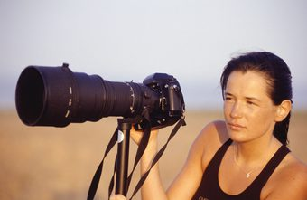

Slide 4
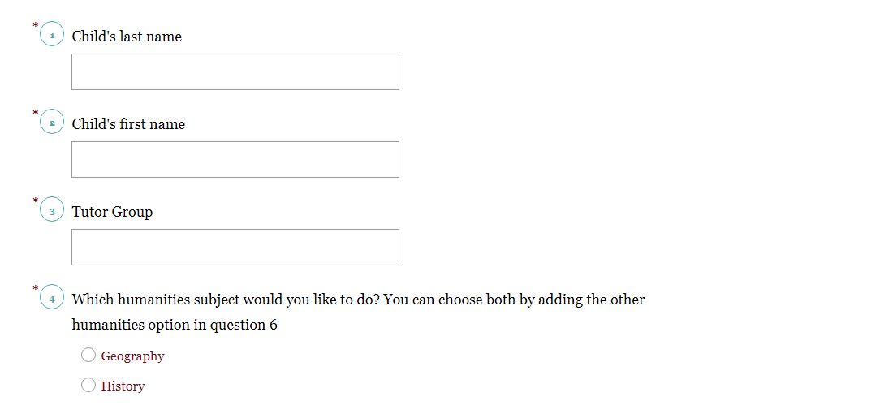
What decisions do you have to make?
When the survey is released you will have some important decisions to make. The first is whether your child decides to do Geography or History:

Slide 5
What decisions do you have to make?
Next, you will need to select if they are likely to be choosing Triple Science or not:
Triple Science is more challenging and requires a strong work ethic in order to succeed. Currently, around 30% of students nationally choose Triple Science. It is expected that we will have 2 sets of Triple Science for this year group in Year 10. If your child is in a higher set for Science at the moment then it is likely that this is a better option for them.

Slide 6
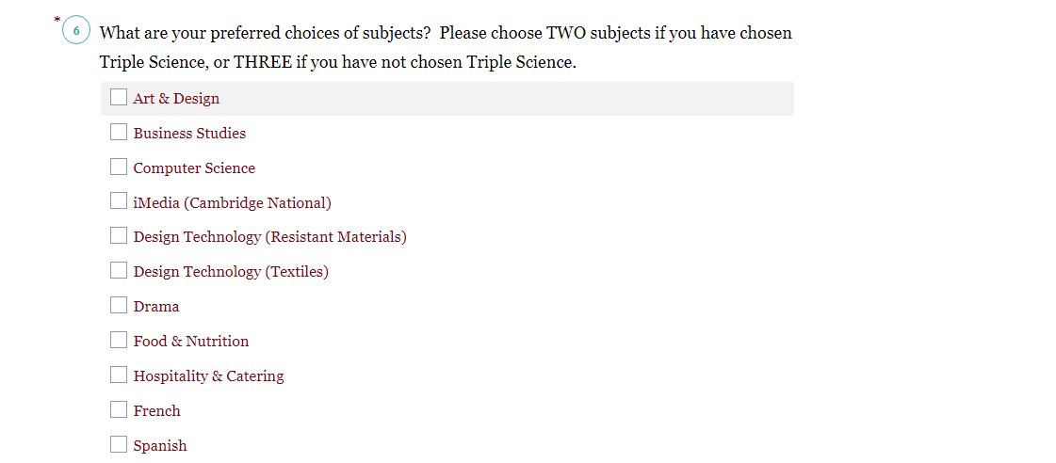
What decisions do you have to make?
The final choice that you have to make is for your 2 remaining Options (3 if you have chosen to do Combined Science). It is really important that you choose the correct number of remaining Options to ensure that their timetable is balanced. Below is a section of what the final part of the survey will look like.

Slide 7
Additional information about subjects
Modern Foreign Languages:
We are encouraging pupils to consider taking a Modern Foreign Language (French, Spanish or German) to complete their EBacc suite of subjects. Languages are regarded as ‘facilitating’ subjects in that they offer opportunities to develop skills that can be transferred both to other subjects and to further study. Languages can open doors in the future. Studying a language is a highly regarded skill for future employers.
Differences between ‘GCSE’ and ‘Level 2’ awards:
Although both qualifications carry the same weight, it is important to understand the differences between these types of qualifications.
‘Level 2’ awards tend to focus more on the practical element of the subject and can often require less theory. For example, Food and Nutrition has more weighting towards the knowledge of food preparation whereas Hospitality and Catering places more emphasis on the practical creation of food.
Similarly, GCSE PE places more emphasis on the theory behind scientific elements such as the muscular and skeletal system when compared to the Cambridge National Certificate in PE.
Important detail about Options choices
The following Options cannot be chosen together:
- Food and Nutrition with Hospitality and Catering
- Art with Photography
- GCSE PE with Cambridge National PE

Slide 8
Curriculum model – compulsory subjects
English Language – 1 GCSE
English Literature – 1 GCSE
Mathematics – 1 GCSE
Science Combined – 2 GCSEs (becomes 3 if you choose Triple Science as an Option)
History OR Geography – 1 GCSE (it is possible to do both if there is sufficient interest)
PE Core (no GCSE awarded)

Slide 9
Curriculum model – Options subjects
Art & Design
Astronomy (twilight invitation only)
Business Studies
Computer Science (twilight invitation only)
Creative iMedia
Design & Technology (Resistant Materials)
Design & Technology (Textiles)
Drama
Food Preparation & Nutrition
Geography
History
Hospitality & Catering
Modern Foreign Languages (French, German or Spanish)
Music (Level 2)
Music (GCSE) (twilight - invitation only)
Photography
Physical Education (GCSE)
Religious Studies
Sports Studies (Level 2)
Travel & Tourism

Slide 10
Example – these will not be the final Options blocks but gives an idea of how the process works
Humanities choice | Option 2 | Option 3 | Option 4
GEOGRAPHY | TRIPLE SCIENCE | ART | GEOGRAPHY
HISTORY | RE | MUSIC | HISTORY
 | HOSPITALITY AND CATERING | PE (CAMBRIDGE NATIONAL) | ART
 | IT | IT | PHOTOGRAPHY
 | FOOD AND NUTRITION | SPANISH | BUSINESS STUDIES
 | SPANISH | FRENCH | PE (GCSE)
 | BUSINESS STUDIES | TECHNOLOGY (RESISTANT MATERIALS) | DRAMA
 | TRAVEL AND TOURISM | TECHNOLOGY (TEXTILES) | GERMAN
 |  | RE

Slide 11
Further information
We have added in an additional hour per fortnight for each of our Options choices. This should allow for additional time and support to guide students through their courses.
Although it is not an assessed GCSE, we have a statutory requirement to offer PSHE within our curriculum. This is in addition our ‘PD days’ timetabled during the year.
The difference between Level 2 qualifications and GCSE qualifications is really important. Broadly speaking, Level 2 qualifications place more of an emphasis on coursework (sometimes referred to as NEA or non-examined assessments) whilst the GCSE courses have more emphasis on theory alongside the practical application of skills.

Slide 12
Next steps
Talk to your family members. They might have experience of the different qualifications and can offer guidance
Talk to subject staff (especially in subjects where your child might be starting a ‘new’ qualification such as Photography or Business Studies)
Do some research and think ahead to what your child might want to do after they leave Studley High School (both in terms of post-16 studies and future careers)
Think very carefully about the upcoming ‘preferred choices’ survey as this affects the grids. If uptake in a subject is too low to make it viable then we may not be able to offer it as an Options choice
Speak with senior staff (available both this evening and for future appointments if necessary)

