Slide 1
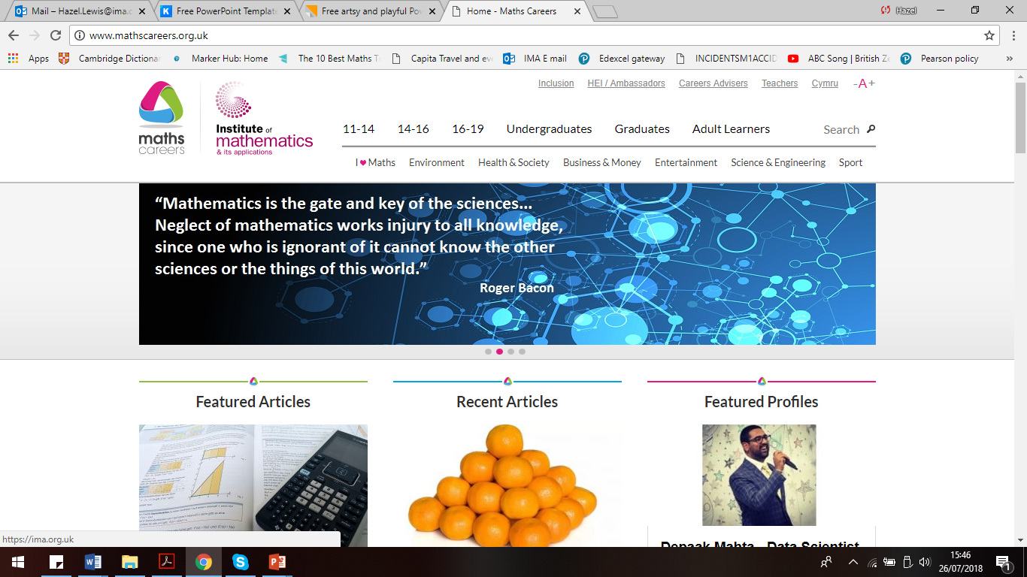
Creative Maths Poster Competition

Slide 2
“A mathematician, like a painter or poet, is a maker of patterns. If his patterns are more permanent than theirs, it is because they are made with ideas.”
G. H. Hardy, Mathematician

Slide 3
Possible Poster Ideas
Maths and art,
Maths and dance,
Maths and music,
Maths and drama or theatre,
Maths and film,
Maths and architecture,
Maths and textiles,
Maths and sculpture,
Maths and origami
You could also make a poster about something really specific such as the connection between one particular artist and maths. You can choose a topic which is not on the list – it could make your poster stand out more!

Slide 4
Instructions for your creative maths poster
1. Make it eye-catching and informative

Slide 5
Instructions for your creative maths poster
2. Make sure it is all your own work – no copy and pasting

Slide 6
Instructions for your creative maths poster
3. Choose one topic to focus on

Slide 7
Instructions for your creative maths poster
4. Show the connection with maths

Slide 8
Poster criteria:
Your poster should focus on the connection between maths and an aspect of the arts.
It sounds obvious, but your poster should be a poster – i.e. it doesn’t need to contain lots and lots of words, it needs to be visually eye catching and should give out a strong message.
You can draw your poster by hand; use a computer; or a mixture of both.
Your poster must be A4 size
Paper entries - Please mark your name, school year, and school clearly on the back of your entry. Please do not staple or glue items on to your work as posters are scanned for judging.
Online entries - Please ensure that the email address you provide is valid and that you choose the correct year group.

Slide 9
Poster criteria:
Judging
There will be three categories for judging:
Years 7 and 8 Years 9, 10 and 11 Years 12 and 13
The winning posters from students in each category will receive an Android tablet.
There will also be five ‘highly commended’ certificates awarded in each group.
Also great for you to include on CV/application forms!
All winning and highly commended posters will be on display on the Maths Careers website.
The closing date is Friday 11th January 2019
Winners will be announced here at the end of January 2019.
To enter complete the form on the link below:
http://www.mathscareers.org.uk/competition/creative-maths-poster-competition/

Slide 10
Possible Poster Ideas
Maths and art,
Maths and dance,
Maths and music,
Maths and drama or theatre,
Maths and film,
Maths and architecture,
Maths and textiles,
Maths and sculpture,
Maths and origami
You could also make a poster about something really specific such as the connection between one particular artist and maths. You can choose a topic which is not on the list – it could make your poster stand out more!

