Slide 1
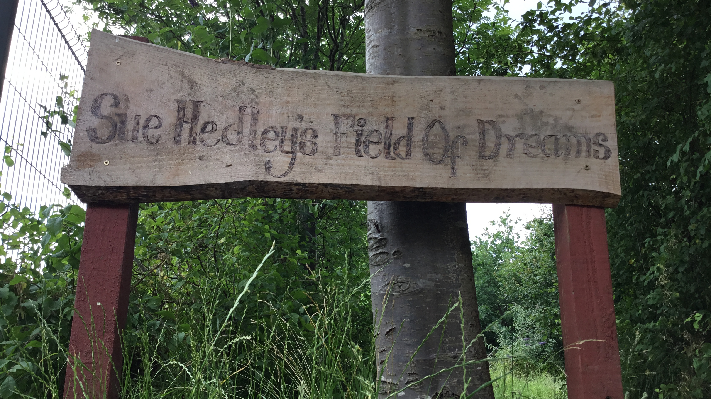
EYFS Forest School Curriculum

Slide 2
Children at The Sue Hedley Nursery School visit our very own Forest School once a week. What was once baron land has become a wonderful outdoor learning space which children continue to develop and grow learning and having hands on experiences throughout all seasons and weather. Our very own Sue Hedley whose vision enabled this to happen explains,
“The inspiration of our Forest ‘Field of Dreams’ was first developed from a whole school visit to Denmark to experience and observe children from a very young age (2-7 years old) exploring the awe and wonder of the natural and outside world in a safe but ‘free’ environment.
We believe the fundamental principles and values of the Forest School classroom children can be in a world of freedom where they can plan-do-review their experiences. Somewhere they can pursue their endless curiosity, endless energy, endless enthusiasm and their need to play. This feeds their natural ability to be explorers and discoverers, taking responsibility with endless fascination.
Forest School truly is a kingdom for children where they can have their field of dreams and who they want to be.”
Sue Hedley (2023)

Slide 3
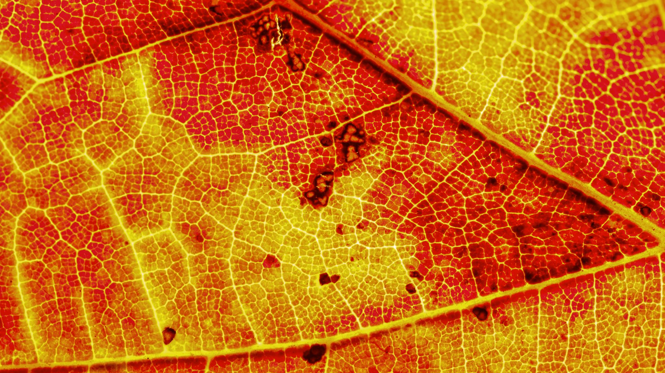
Forest School Autumn Term Two Year Old Curriculum
Vocabulary
Tree
Leaves
Apple
Wet
Cold
Frost
Ice
Birds
Mud
Activities
Health and Self-care
As Two Year Old’s we learn to help with getting ready for Forest School and begin to learn about the weather changes we may need extra clothing to keep warm.
Exploring Forest School
Exploring mud
Picking apples in the orchard
Exploring leaves
Feeding the birds
Exploring ice and frost
Autumn Walk
Outcomes: Children will explore their outside natural world through hands on active experiences. Children will observe autumnal and winter seasonal changes and their effects.

Slide 4
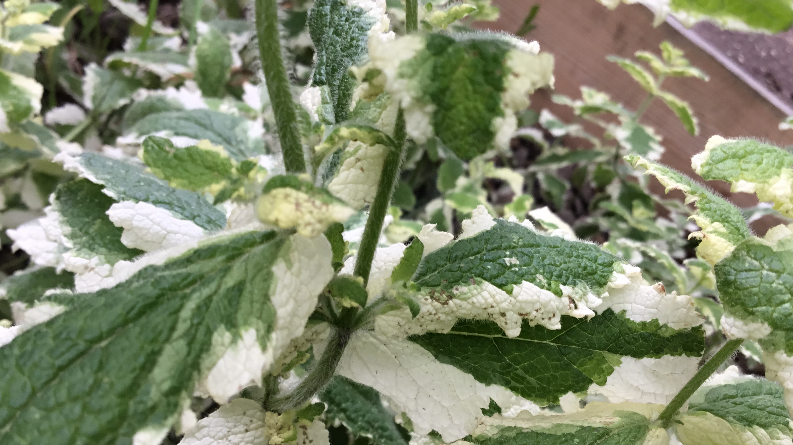
Forest School Spring Term Two Year Old Curriculum
Activities
Introducing the fire pit and fire safety
Exploring bird's nests
Making potions in the mud kitchen
Introducing the allotment
Exploring potatoes
Potato planting
Vocabulary
Sun
Buds
Daffodils
Nettles
Sticks
Leaves
Grow
Worms
Dig
Health and Self-care
Learn about carrying sticks safely.
Supported and encouraged to take safe risks, (slippy, jumping etc.)
Nettle and thorn awareness.
Outcomes:
Children will observe and notice the changes in their environment as the seasons change. Children will be introduced to the allotment and begin to learn how things grow. Children will be supported in carrying out safe risks and elements of safety.

Slide 5
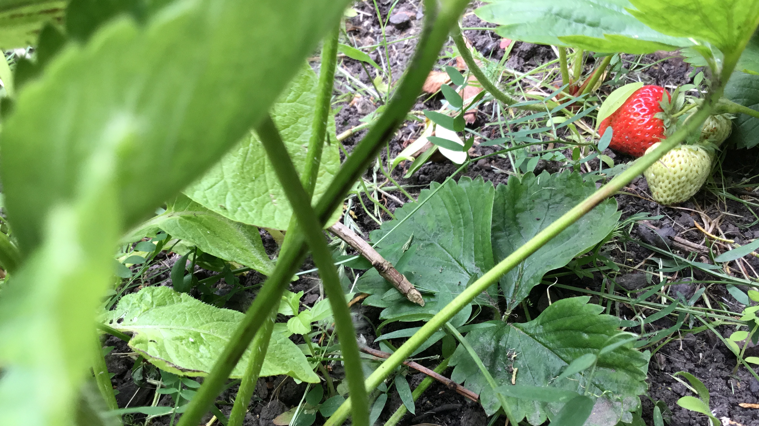
Forest School Summer Term Two Year Old Curriculum
Activities
Willow peeling
Watering
Potato picking/sorting
Exploring herbs in the allotment
Strawberry picking
Bug hunts
Feeding the birds
Exploring charcoal
Outcomes
We will observe changes from spring to summer and the growth that occurs in our Forest School.
We will use our knowledge of safety through our daily activities of Forest School, using the Fire Pit and watching out for red flags knowing that it could mean danger.
Be able to start making decisions about appropriate risk taking.
We will see our results from growing our own vegetables.
Vocabulary
Willow
Hot
Water
Feed
Jump
Safe
Fire/fire pit
Smoke
Swivel
Red flag/danger

Slide 6
Forest School
Autumn Term Nursery Curriculum
Vocabulary
Wet
Rain
Slippy
Ice
Frozen
Freeze
Crispy
Red flags
Names of leaves
Names of trees.
Worms
Insects
Birds
Outcomes
We will experience our outdoor natural world in all weathers learning to help keep ourselves warm and active.
We will develop our gross and fine motor skills developing appropriate risk taking.
We will be aware and learn about the changes in our environment from Autumn to Winter.
Activities
Exploring Apples in the orchard
Bird feeding
Habitats (Hedgehogs)
Introducing Compost
Exploring ice
Exploring pumpkins
Autumn walk
Painting with mud
Leaf printing
Making bird feeders

Slide 7
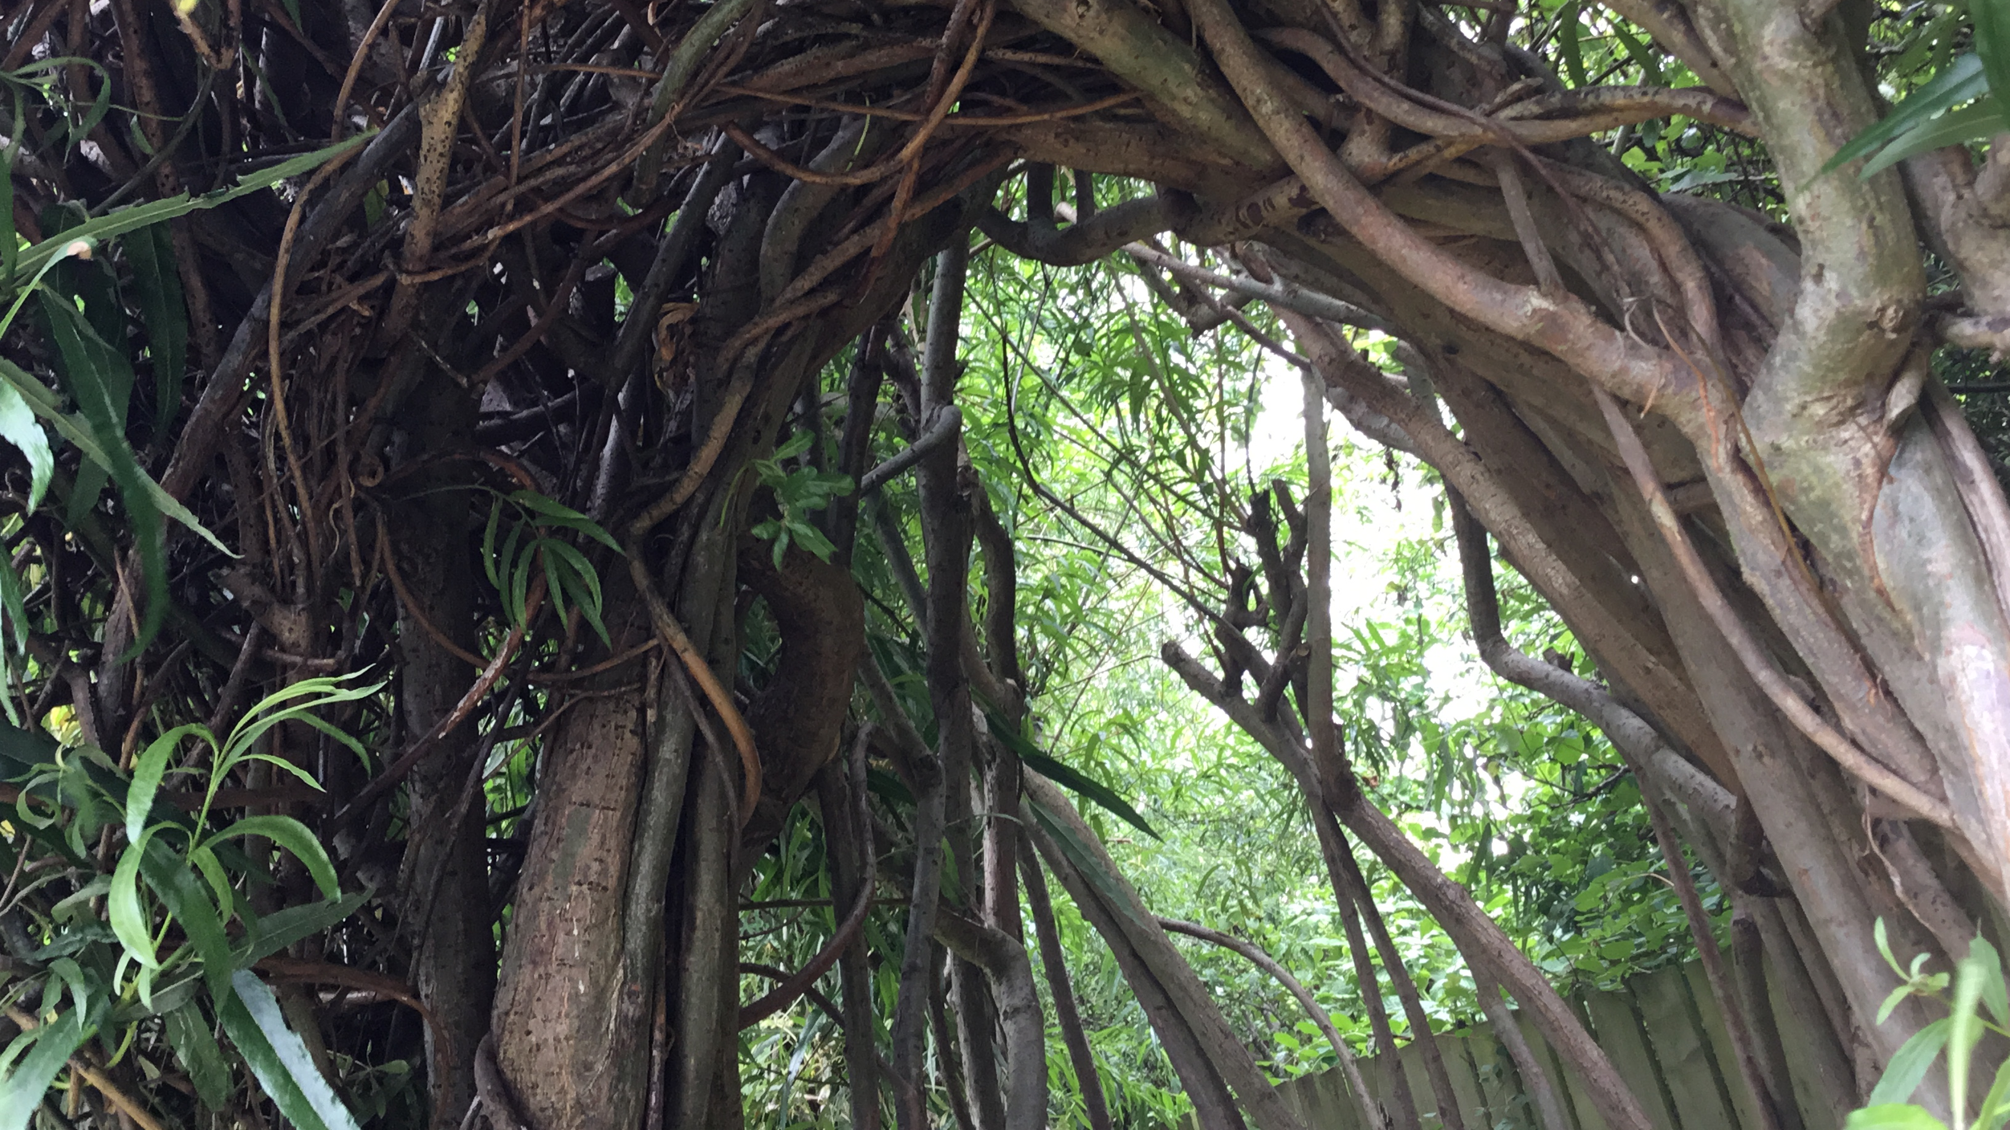
Forest School
Spring Term Nursery Curriculum
Vocabulary
Spring
Planting
Growing
Buds
Flowers
Climb
Jump
Potatoes
Chitting
Butterfly
Caterpillar
Frog spawn
Cycle
Fire pit
Smoke
Fire
Activities
Planting potatoes.
Working in the allotment.
Watering.
Exploring catkins and birds nests.
Visiting the fire pit.
Exploring Rhubarb and tasting herbs.
Looking at the lifecycles of frogs and butterflies.
Outcomes
We will look at and learn about the changes from winter to spring.
We will learn about the life cycles of frogs and butterflies.
We will learn about being safe around the fire pit.
We will identify herb names, flowers and plants
We will explore, discover and initiate our own learning taking manageable risks.
We will continue to develop and build on our fine and gross motor skills
We will learn about vegetables and food we grow and where we find in in the community and other countries.

Slide 8
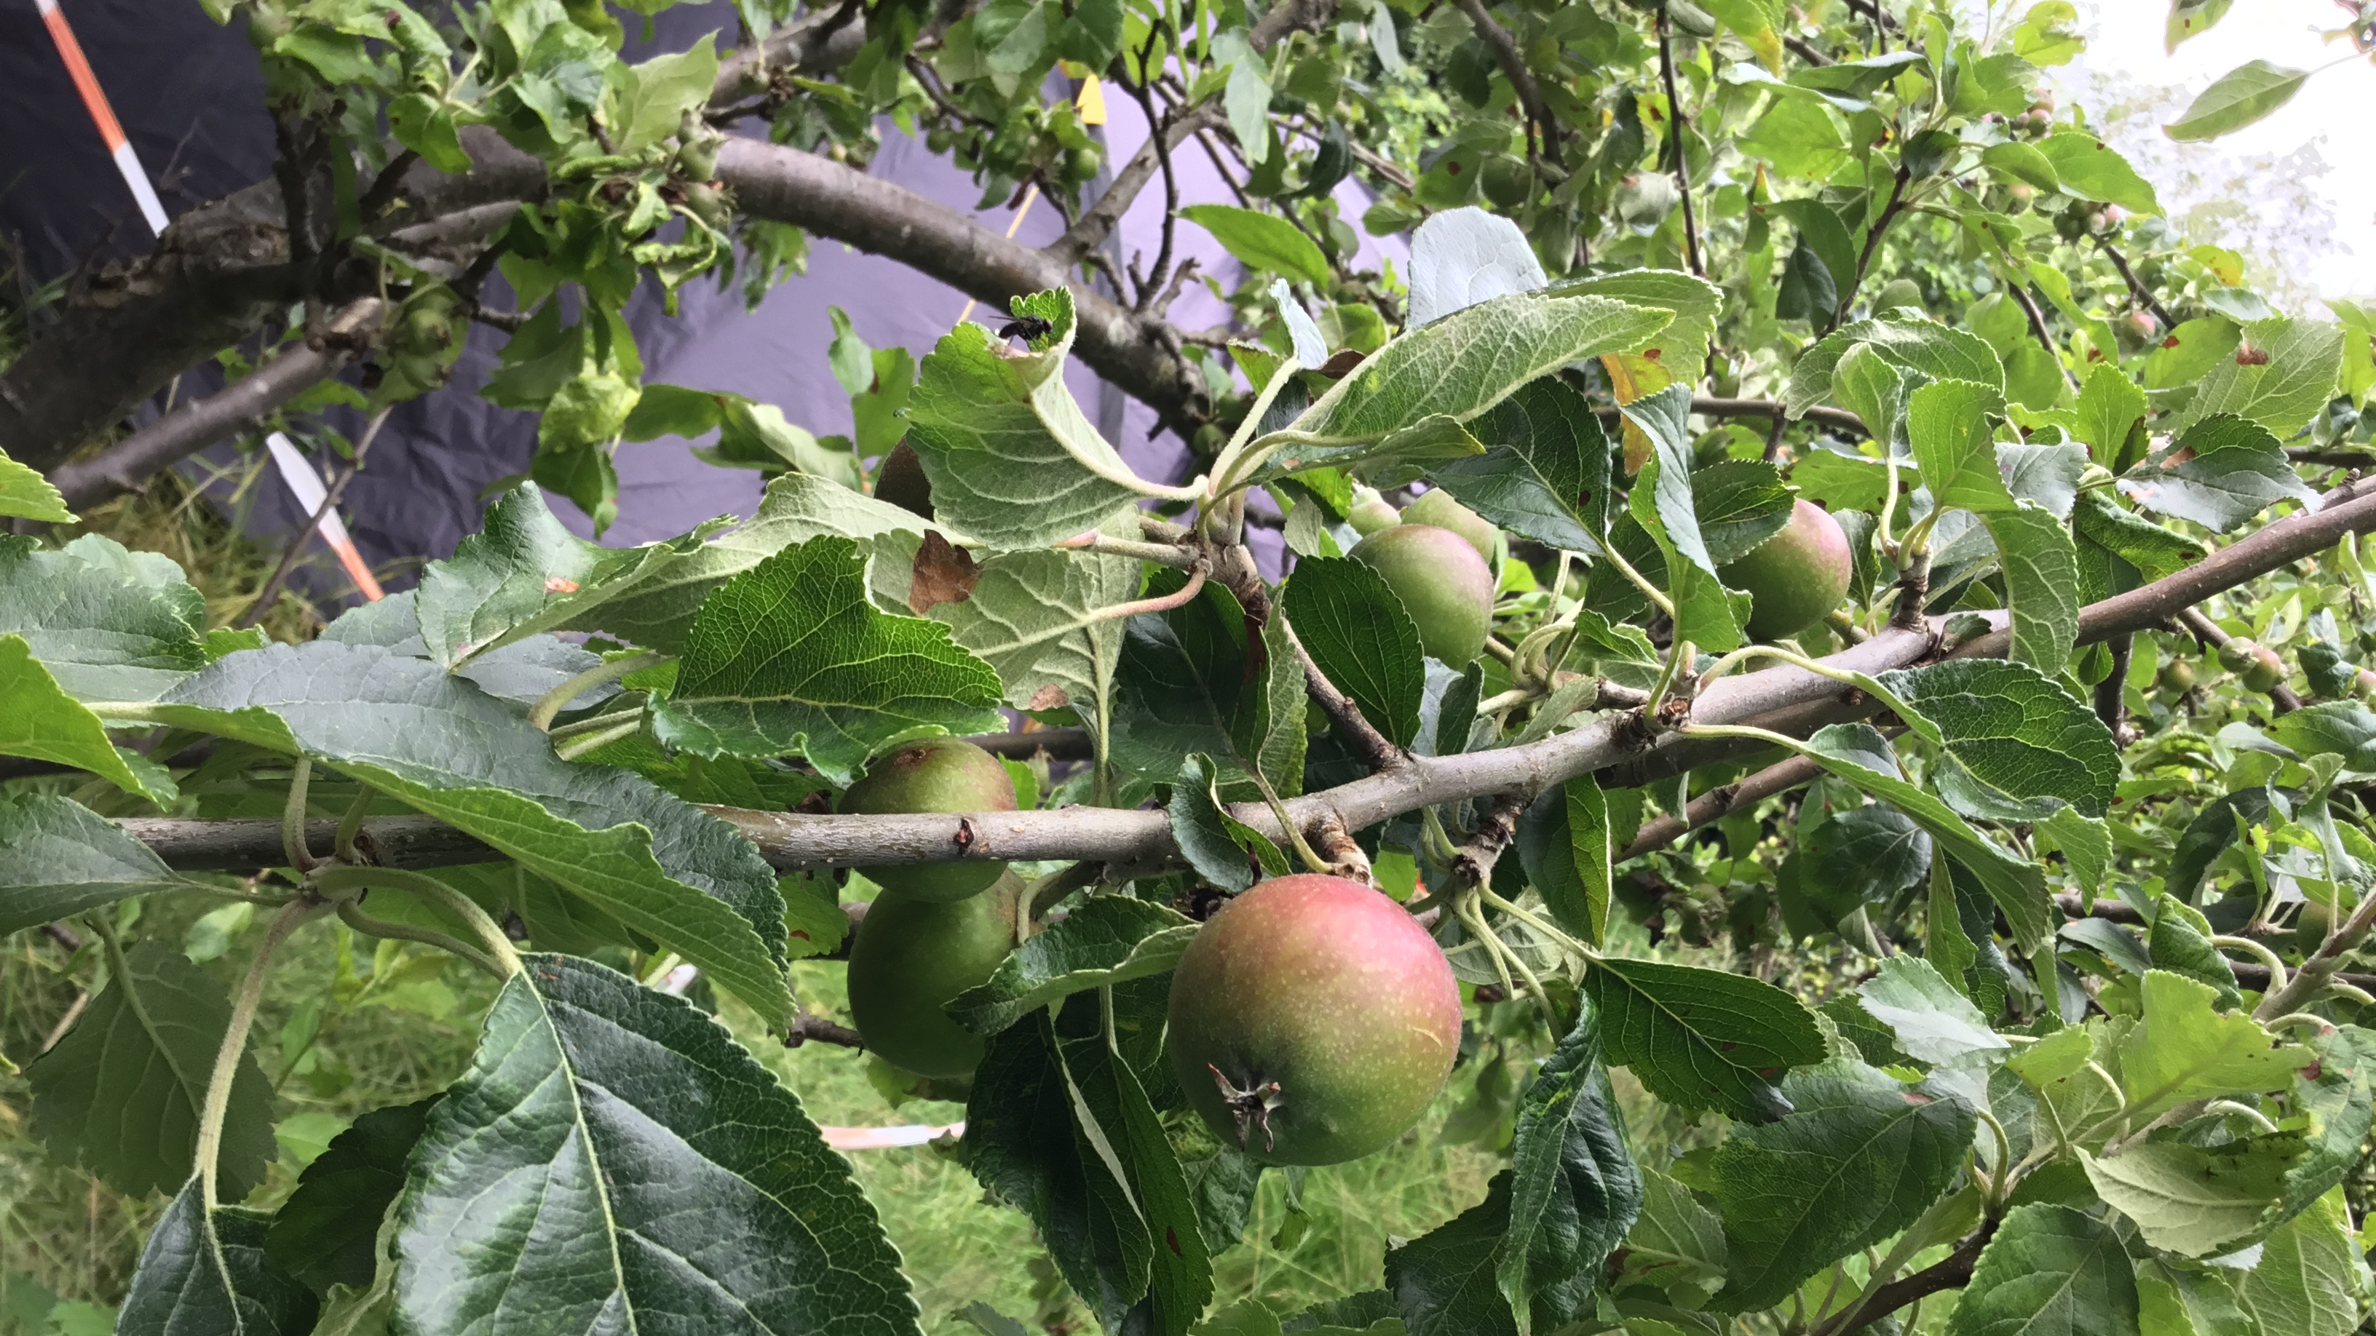
Forest School-Summer Term Nursery Curriculum
Vocabulary
Melt
Hot
Willow
Peeling
Nettles
Thorns
Sting
Bees
Wasps
Suncream
Fruit names
Vegetable names
Herb names
Spark
Flint
Insect names
Elderflower
Activities
Picking potatoes
Potato party
Making mint tea
Making elderflower cordial
Peeling willow
Creating with willow
Watering in the allotment
Water activities in mud kitchen
Life cycle of a ladybird (larvae-ladybirds and they live on the willow).
Bug hunt
Transporting bark
Trimming the willow tunnels
Den building
Outcomes and health and self-care
We will observe spring and summer changes.
Using natural resources, we will use our imaginations making imaginary and real-world representations.
We will talk about and express our thought processes through problem solving techniques, collaborating with others and independently.
We will use investigative techniques to test our ideas.
We will manage our own risks appropriately.

Slide 9
Forest School- Autumn Term Reception Curriculum
Vocabulary
Decay
Deciduous
Fungi
Oak Tree
Sycamore Tree
Maple Tree
Shoot
Nocturnal
Hibernation
Harvest
Conkers
Acorns
Squirrel
Crispy
Cold
Activities
Den Building
Making habitats
Hibernation
Autumn walk
Bird Feeders
Autumn Collage identifying leaves
Apple hunting in the Orchard
Pumpkin exploring ( exploring what animals can eat them)
Composting
Exploring with ice and frost (melting/freezing)
Painting/drawing with mud
Outcomes and health and self-care
We will learn in more depth about changes from autumn to winter.
We will explore what animals hibernate and experience creating habitats, understanding and respecting natural and outdoor animal habitats.
We will understand tree names and identify the leaves from the correct trees.
We will develop our fine and gross motor skills moving in different ways with understanding of risk such as slippy surfaces etc.
We will learn about nocturnal animals.
We will care for our environment and understand composting contributing our own compost.

Slide 10
Forest School- Spring Term Reception Curriculum
Vocabulary
Winter
Spring
Life Cycle
Planting
Sowing
Chitting
Male and Female Catkins
Changes
Frogs
Frog spawn
Bark
Fire Pit
Flint
Temperature
Thorns
Nettles
Activities
Bark rubbings
Exploring Catkins and looking at male/female
Fire pit
Bird Feeding
Cooking with herbs
Working and looking after the allotment
Chitting potatoes
Watering in the allotment
Insect and beetle identification
Cooking with Rhubarb
Identifying thorns
Outcomes and Health and self-care
We will learn about and notice the changes from winter to spring and be able to discuss this.
We will discuss animal changes from winter – spring.
We will look after the allotment understanding it needs to be cared for and watering plants is important.
We will cook with ingredients grown from our allotment.
We will respect the natural world around us.
We will understand the safety around thorns and nettles.
We will continue to develop our gross and fine motor skills.

Slide 11
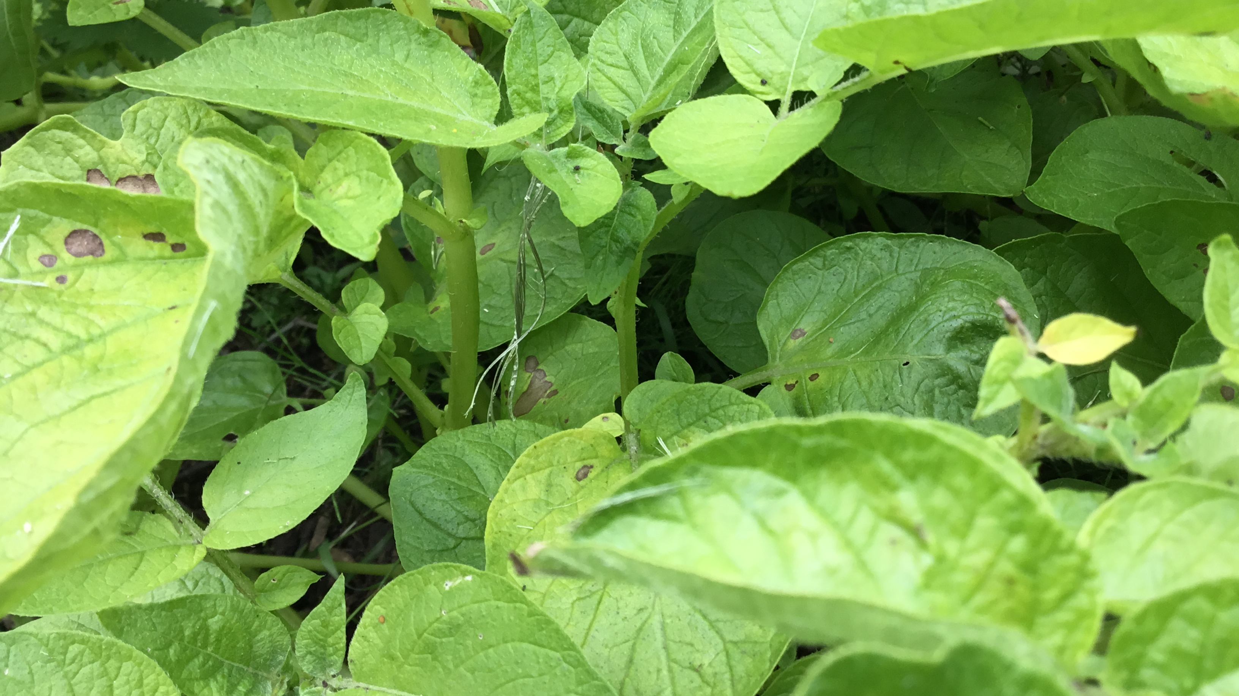
Forest School Summer Term Reception Curriculum
Activities
Potato picking
Potato Party
Building dens for shade
Working with willow
Making Elderflower Cordial
Trying fruits, we have grown such as strawberries etc.
Climbing trees
Composting
Fire pit
Art with mud, bark and leaves
Mud kitchen party
Cooking in the Fire pit with Marina.
Vocabulary
Spring
Summer
Heat
Safety
Growth
Hydrate
Cook
Ingredients
Compost
Sprout
Sun safety
Shade
Height
Fruit
Vegetables
Herbs
Climbing
Elderflower
Outcomes and Health and self-care
We will learn and discuss the changes from spring to summer.
We will understand using vegetables, herbs and fruits to make food and be willing to taste something new.
We will develop our large motor skills climbing various outdoor structures such as trees, rocks and hills showing safety and problem solving.
We will understand the importance of keeping safe in the sun and how shade and being hydrated helps us.
We will use a wide variety of natural materials to construct and model for a purpose.

Slide 12
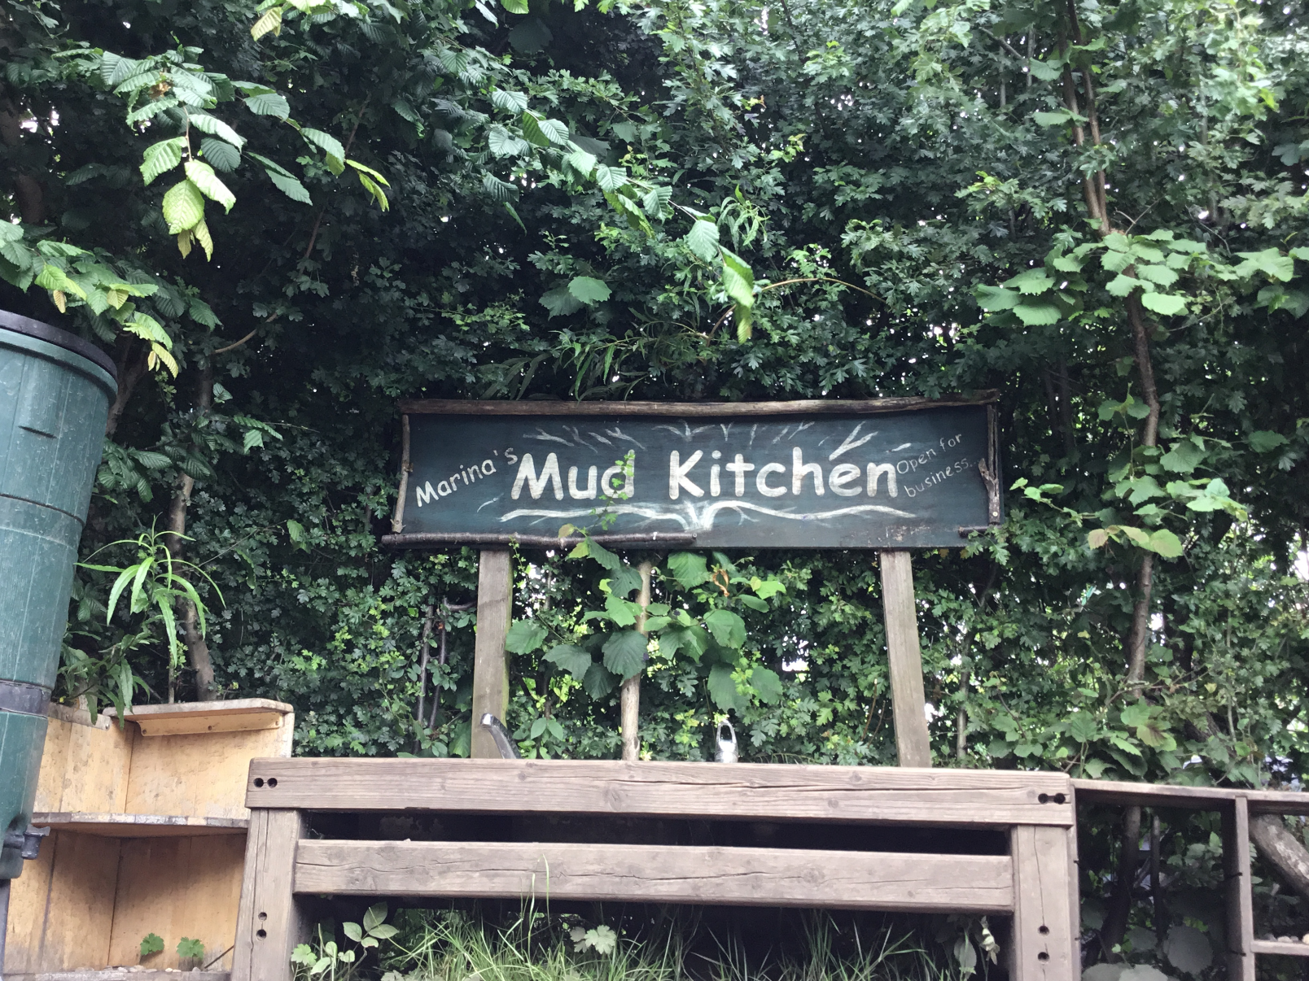
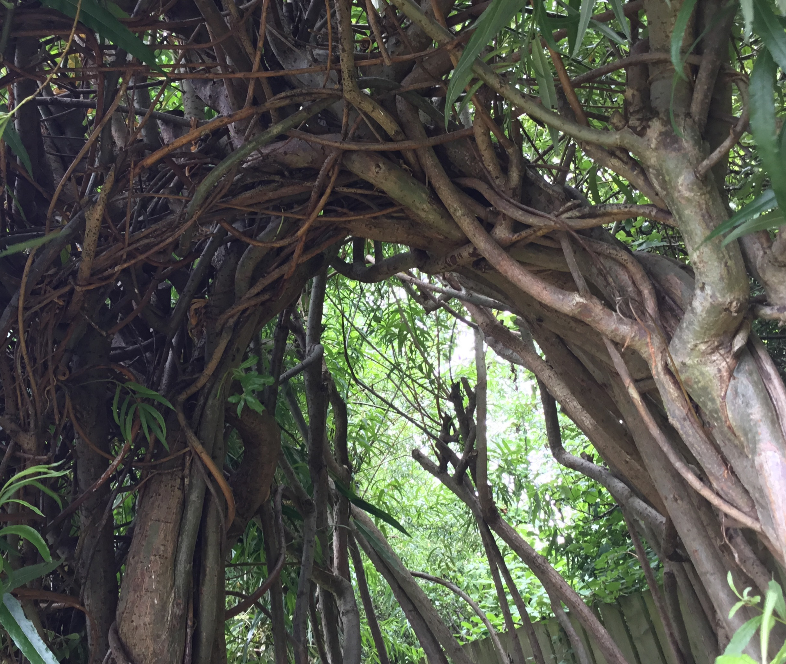
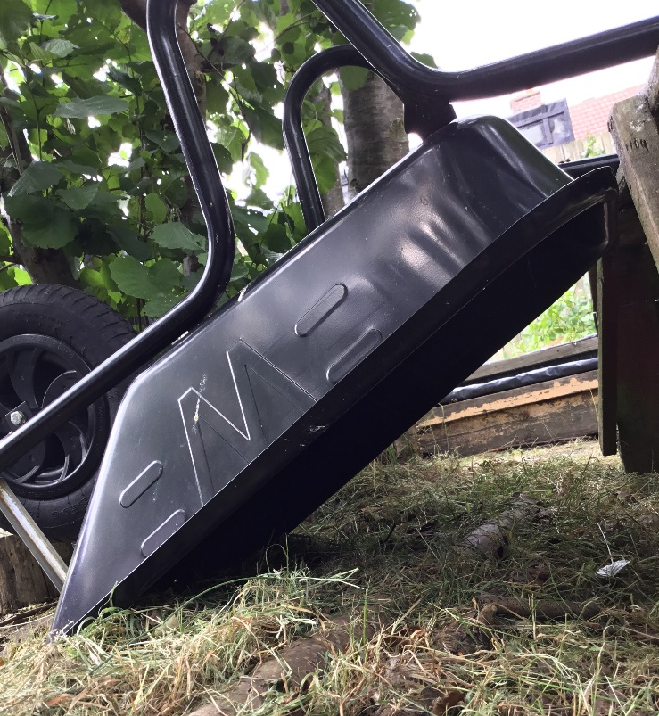
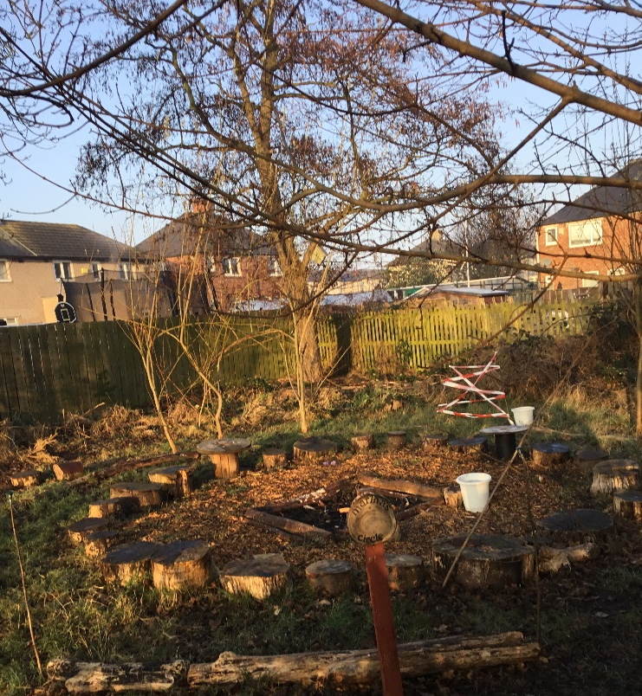
The Sue Hedley Nursery School Forest School

