Slide 1


Welcome!
dunnstreetprimary.co.uk

Slide 2

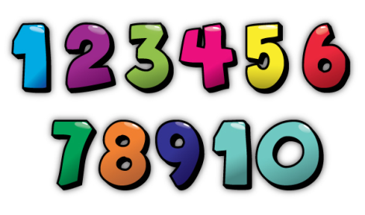
Maths Café – Why?
To build on successful EY and KS1 sessions
To share the National Expectations in mathematics for Year 5 and Year 6
To show you some activities that will help your child to reach End of Year Expectations
To answer any questions you have about maths
dunnstreetprimary.co.uk

Slide 3

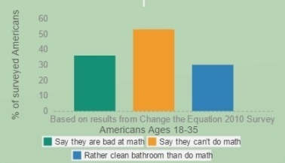
The L’Oreal advert that caused a stir…
“Age is just a number and maths was never my thing.”
National Numeracy chief executive Mike Ellicock said: "Throwaway remarks about being 'no good at maths' are so easy to make and so damaging in the way they normalise negative attitudes.”
“You’ll never have to use this!”
“You never know when this may be useful!”
“Maths is hard!”
“Maths is challenging!”
“You’re like me: not a maths person!”
“Keep practising and be resilient!”
“I hate maths!”
“I like that I have to work at maths!”
“I am bad at maths!”
“I am good at some maths!”

Slide 4
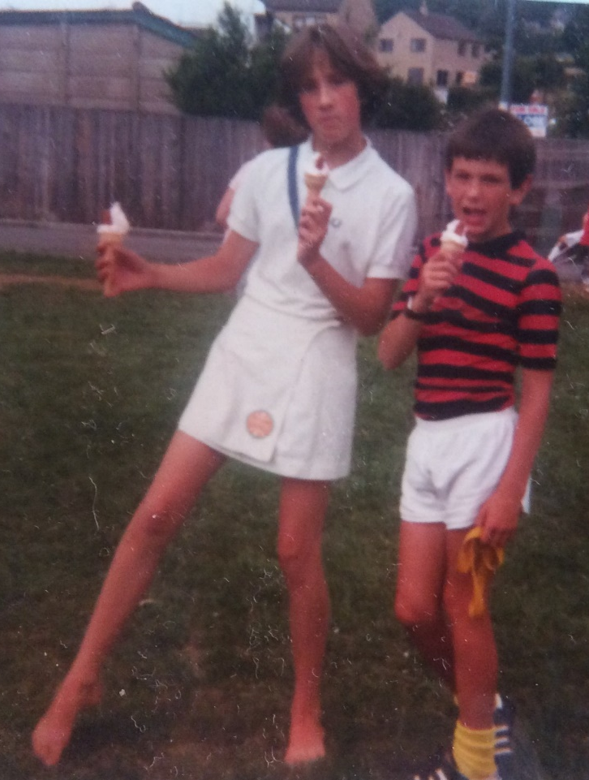
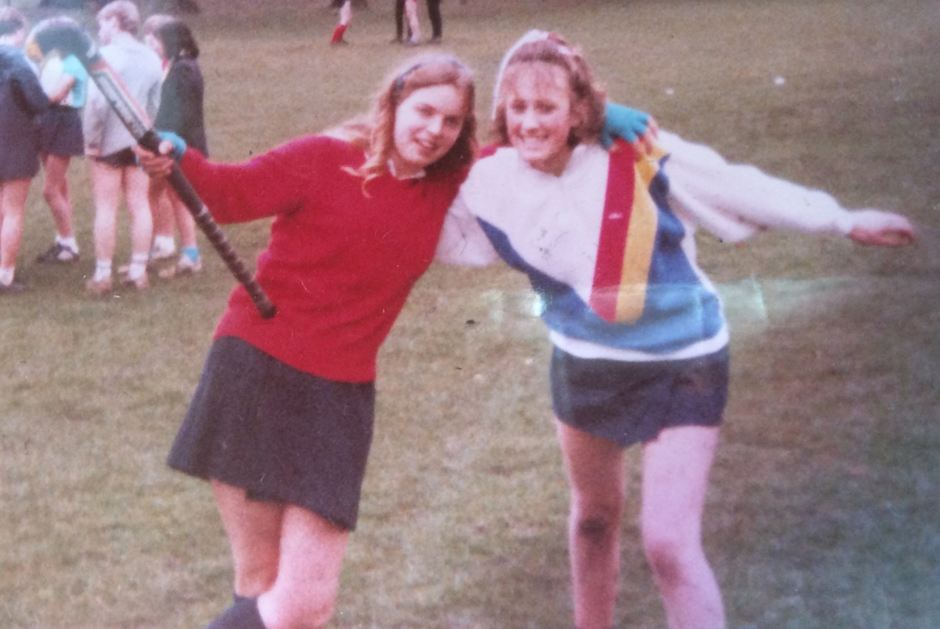
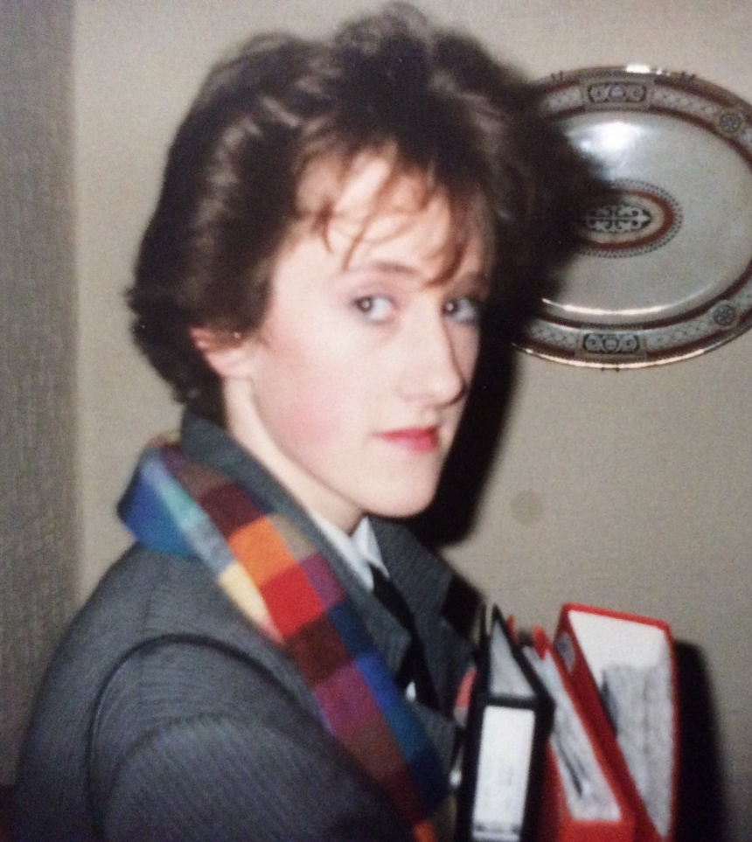
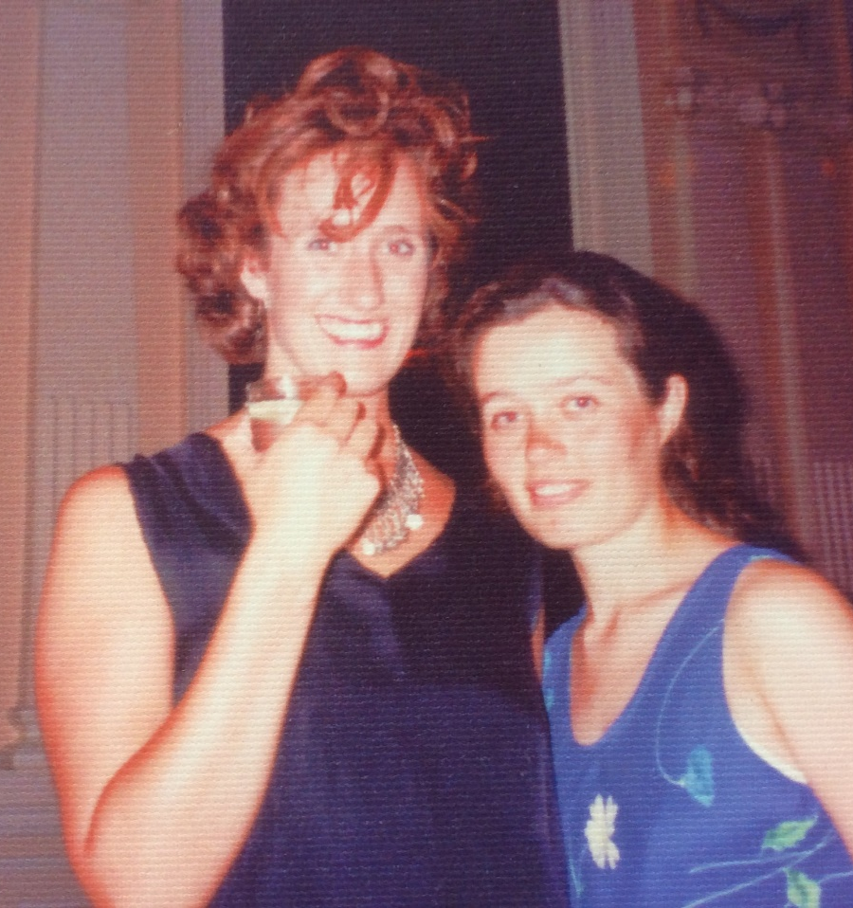
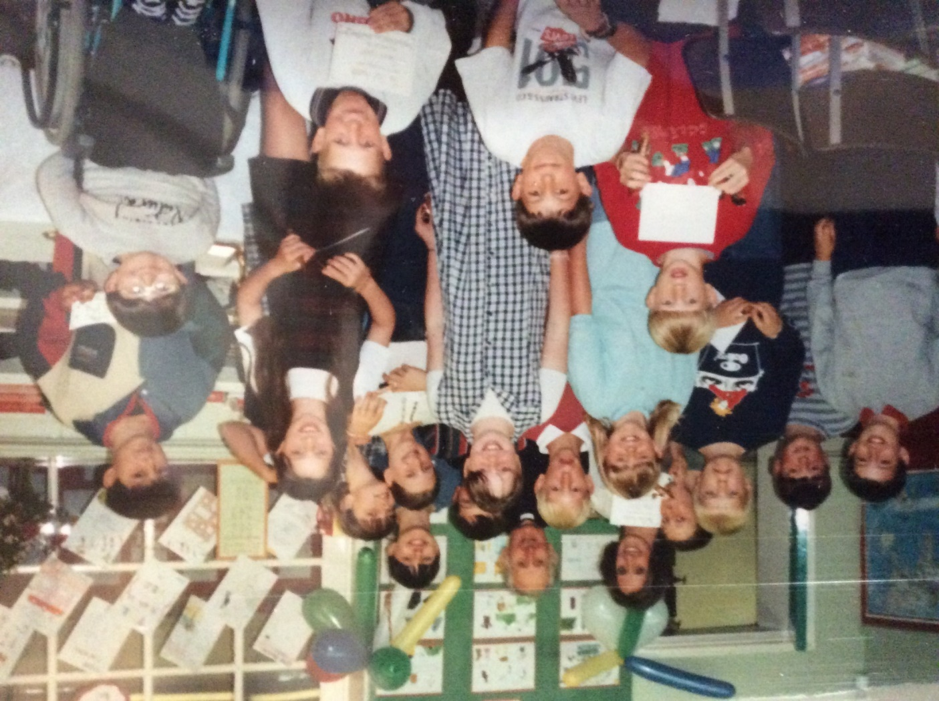
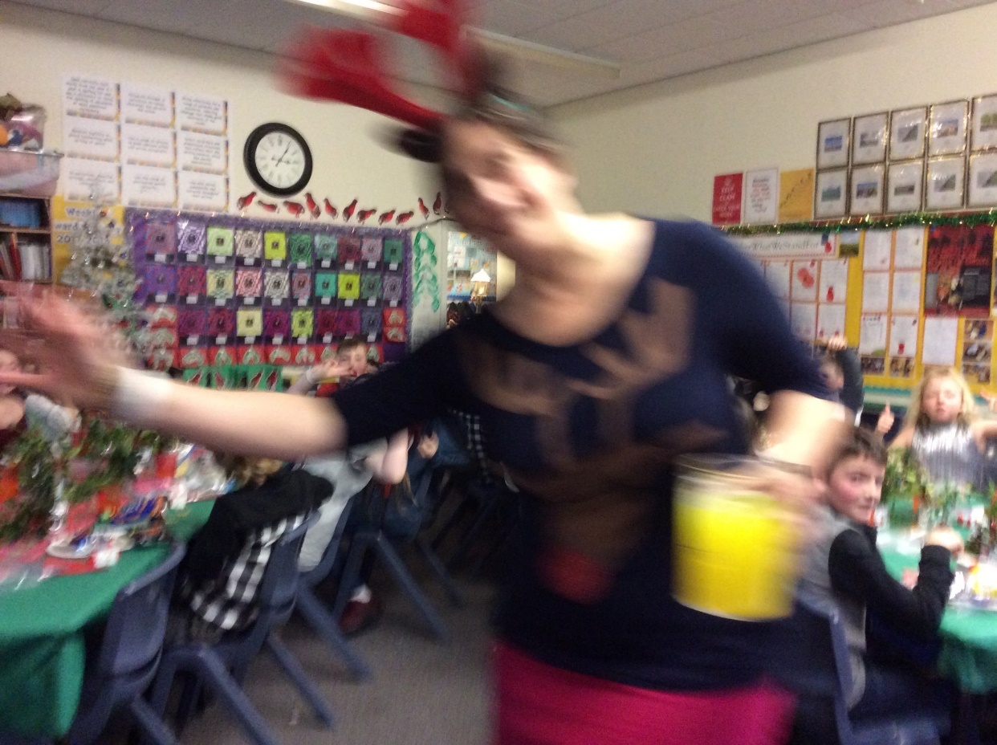
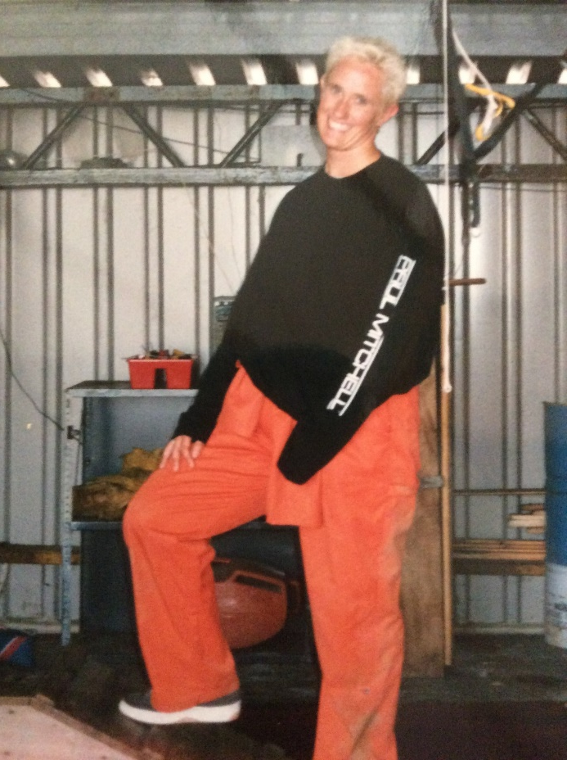
Relationships with Mathematics…
How would you describe your relationship with Mathematics? Has it changed? Is it a healthy relationship?

Slide 5


Aims of the curriculum
During maths lessons we aim to develop fluency, reasoning and problem solving.
Fluency – making connections, an understanding of what they are doing, why they are doing it and knowing when it is appropriate to use different methods.
Reasoning – fundamental to knowing and doing maths. It enables children to make use of their mathematical skills. It’s the glue that helps maths make sense.
Problem Solving – this is central to the mathematical development of all learners. It is at the heart of maths teaching, not an optional extra. It is a complex process that involves a competency of fluency and reasoning.

Slide 6
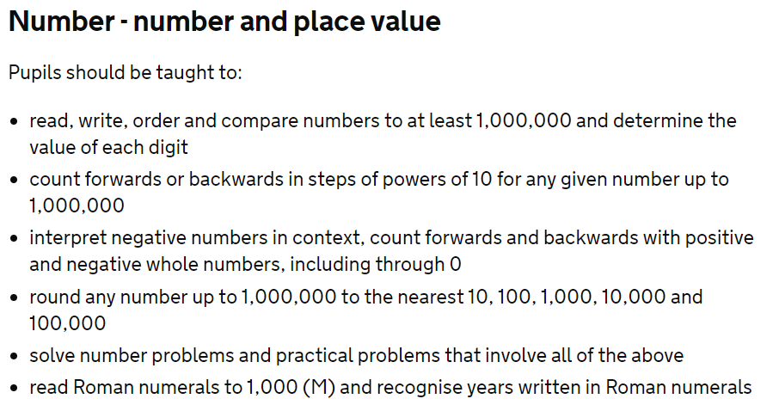
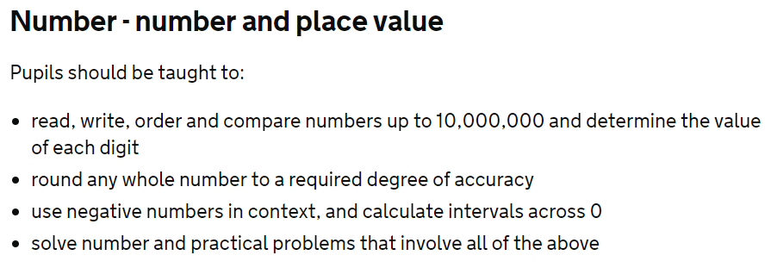
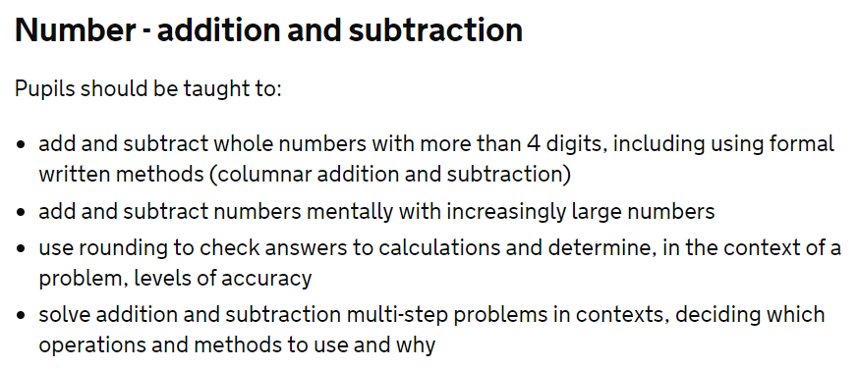
National Expectations
Year 5 Year 6

Slide 7
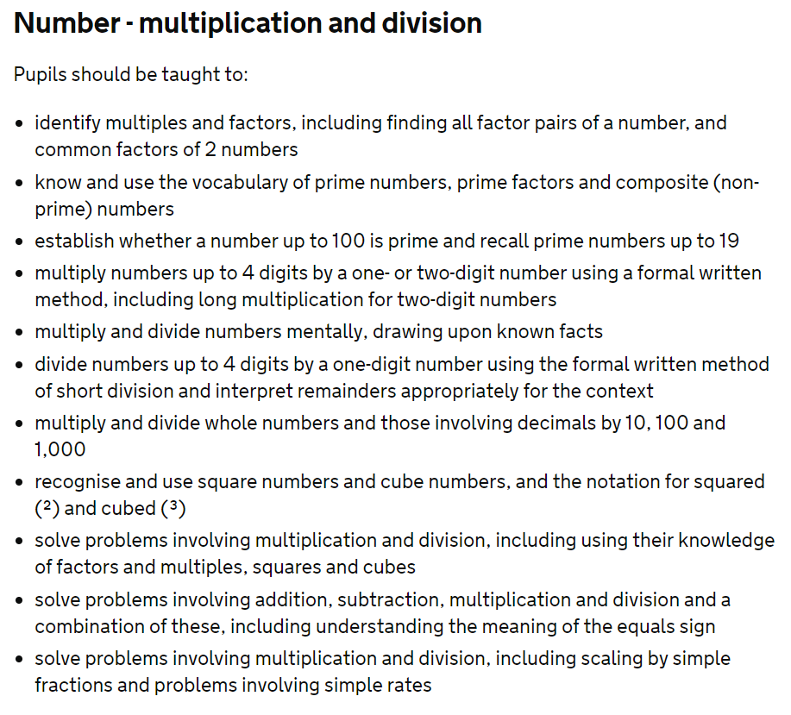
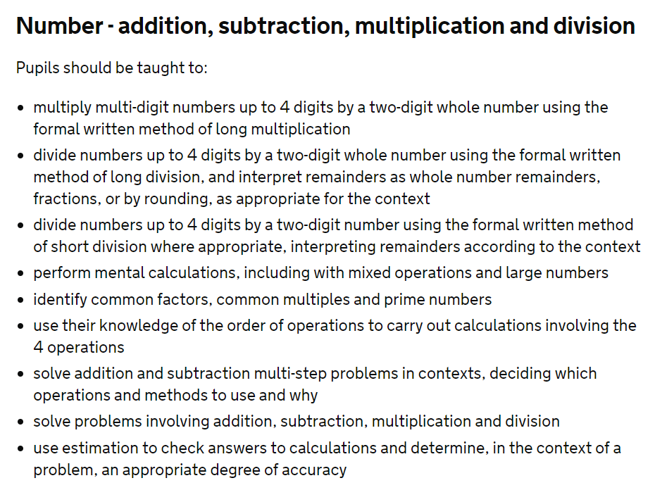
National Expectations
Year 5 Year 6

Slide 8
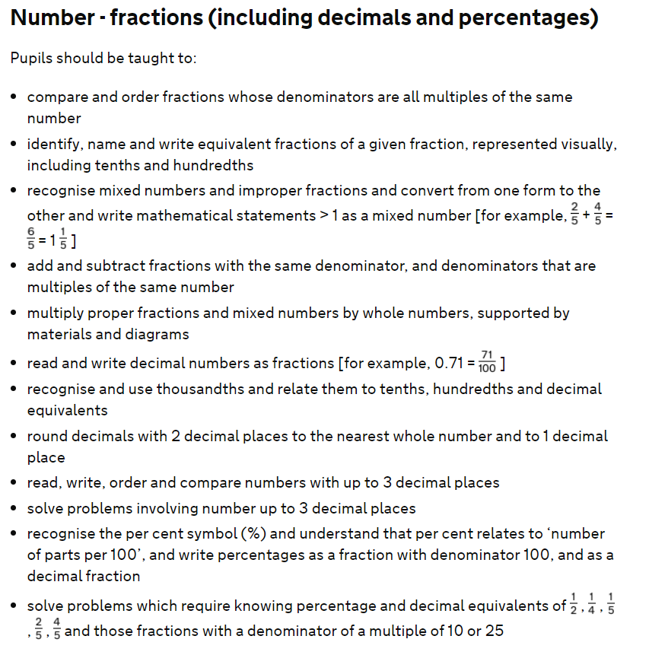
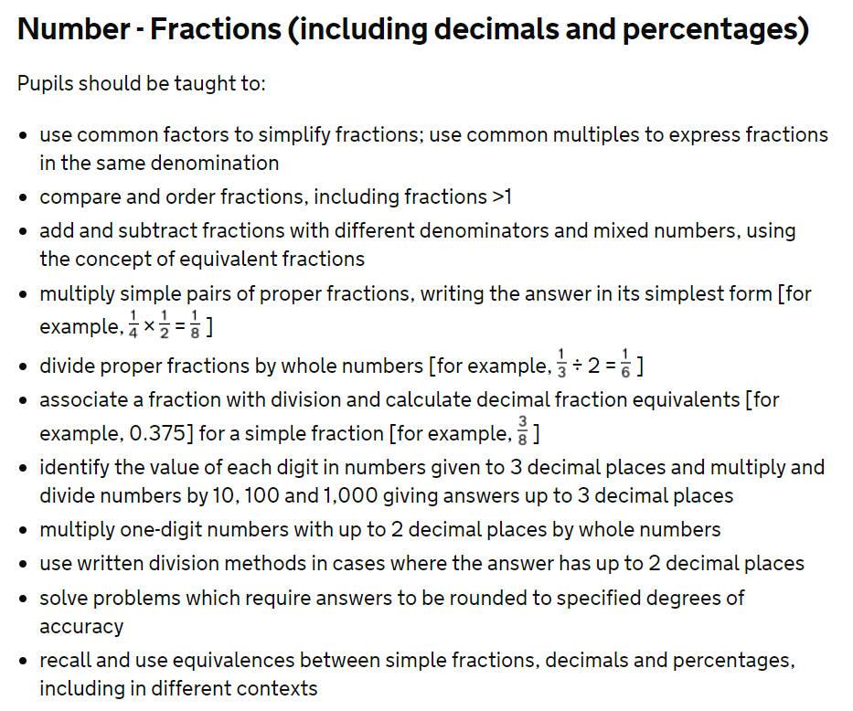
National Expectations
Year 5 Year 6

Slide 9
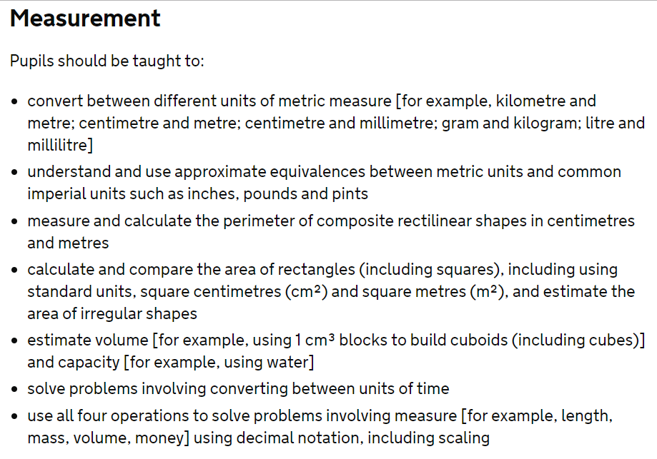
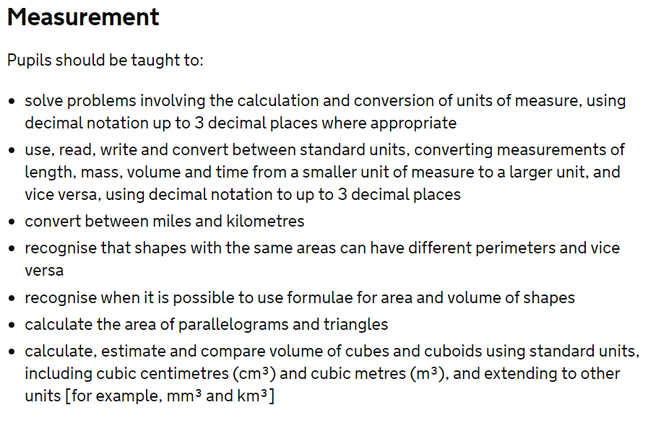
National Expectations
Year 5 Year 6

Slide 10
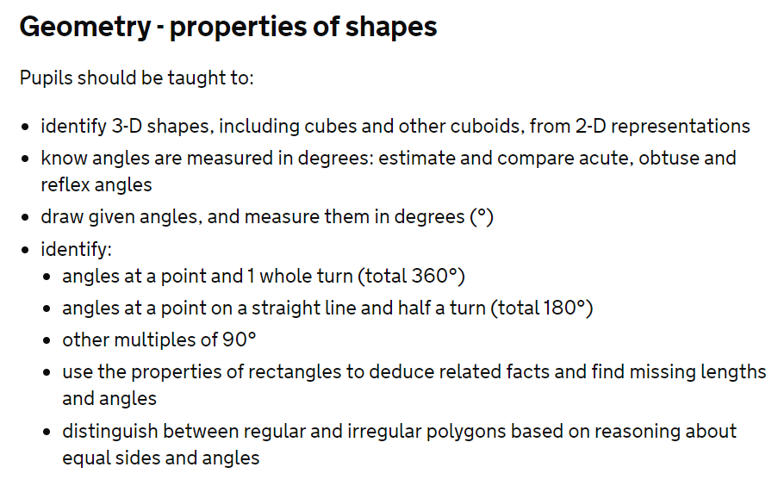
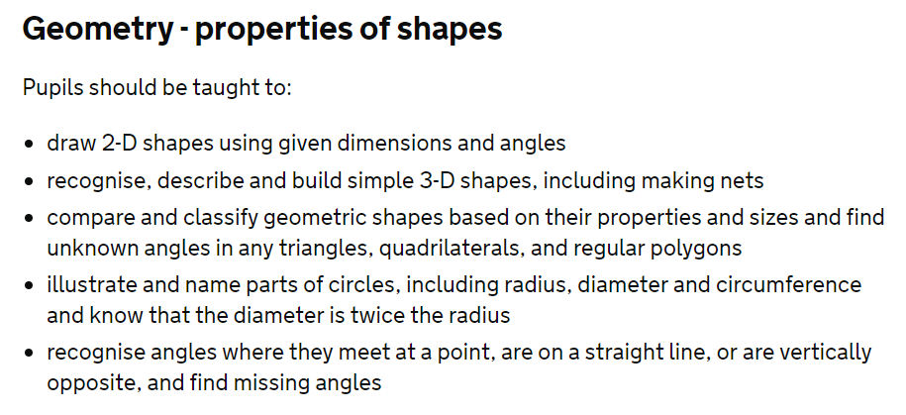
National Expectations
Year 5 Year 6

Slide 11
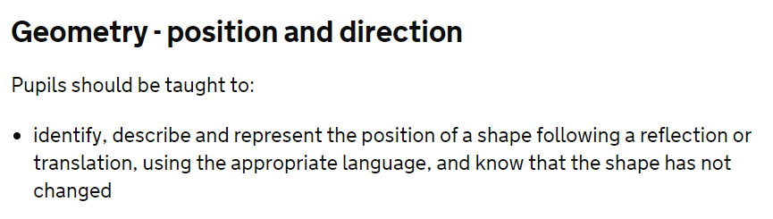
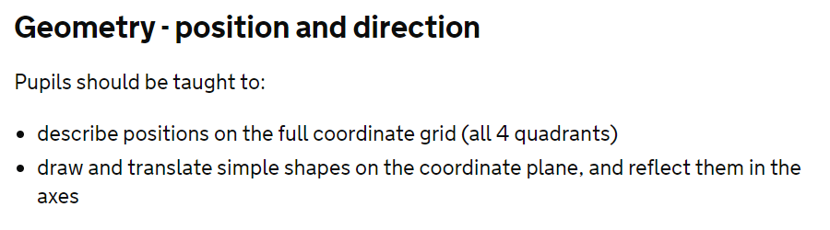
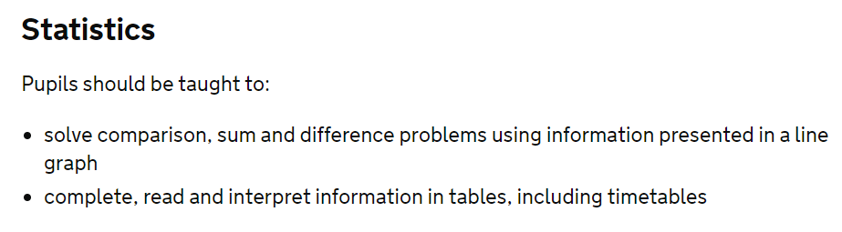
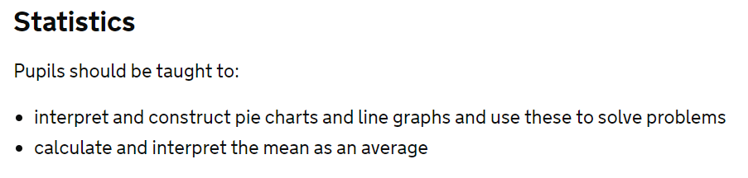
National Expectations
Year 5 Year 6

Slide 12
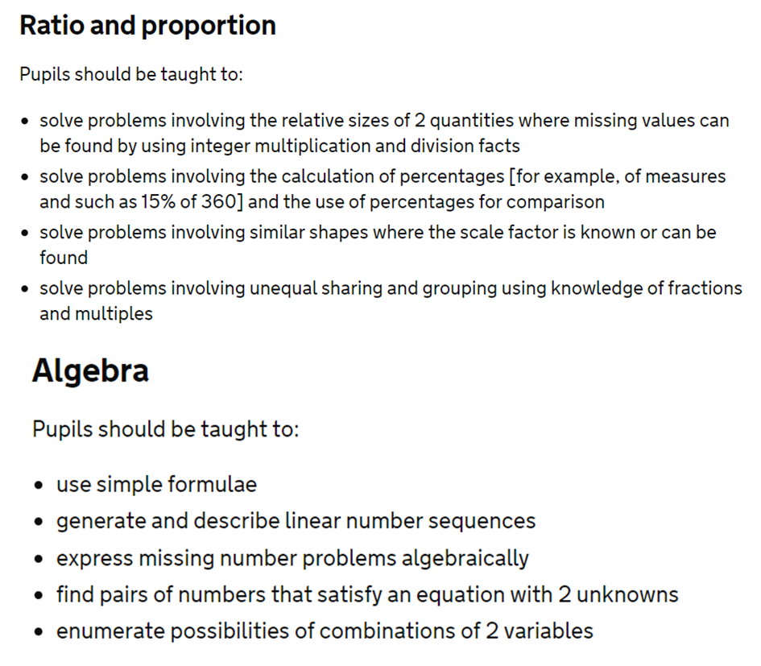
National Expectations
Year 5 Year 6

Slide 13
How are our children assessed?
The children in Key Stage 2 are assessed against the End of Year Expectations, throughout the year, as either:
beginning
developing
secure (at mastery level)
or
working at depth (mastery with greater depth).
They are assessed on a daily basis, through questioning, marking and feedback. We use the WhiteRose scheme of work and tasks based on fluency, reasoning and problem solving. We also use Big Maths.
Pupils are assessed termly using Testbase materials and Year 6 complete compulsory Standard Assessment Tests (SATs) at the end of the academic year.

Slide 14
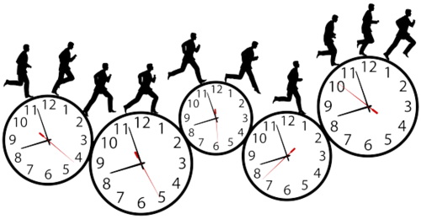
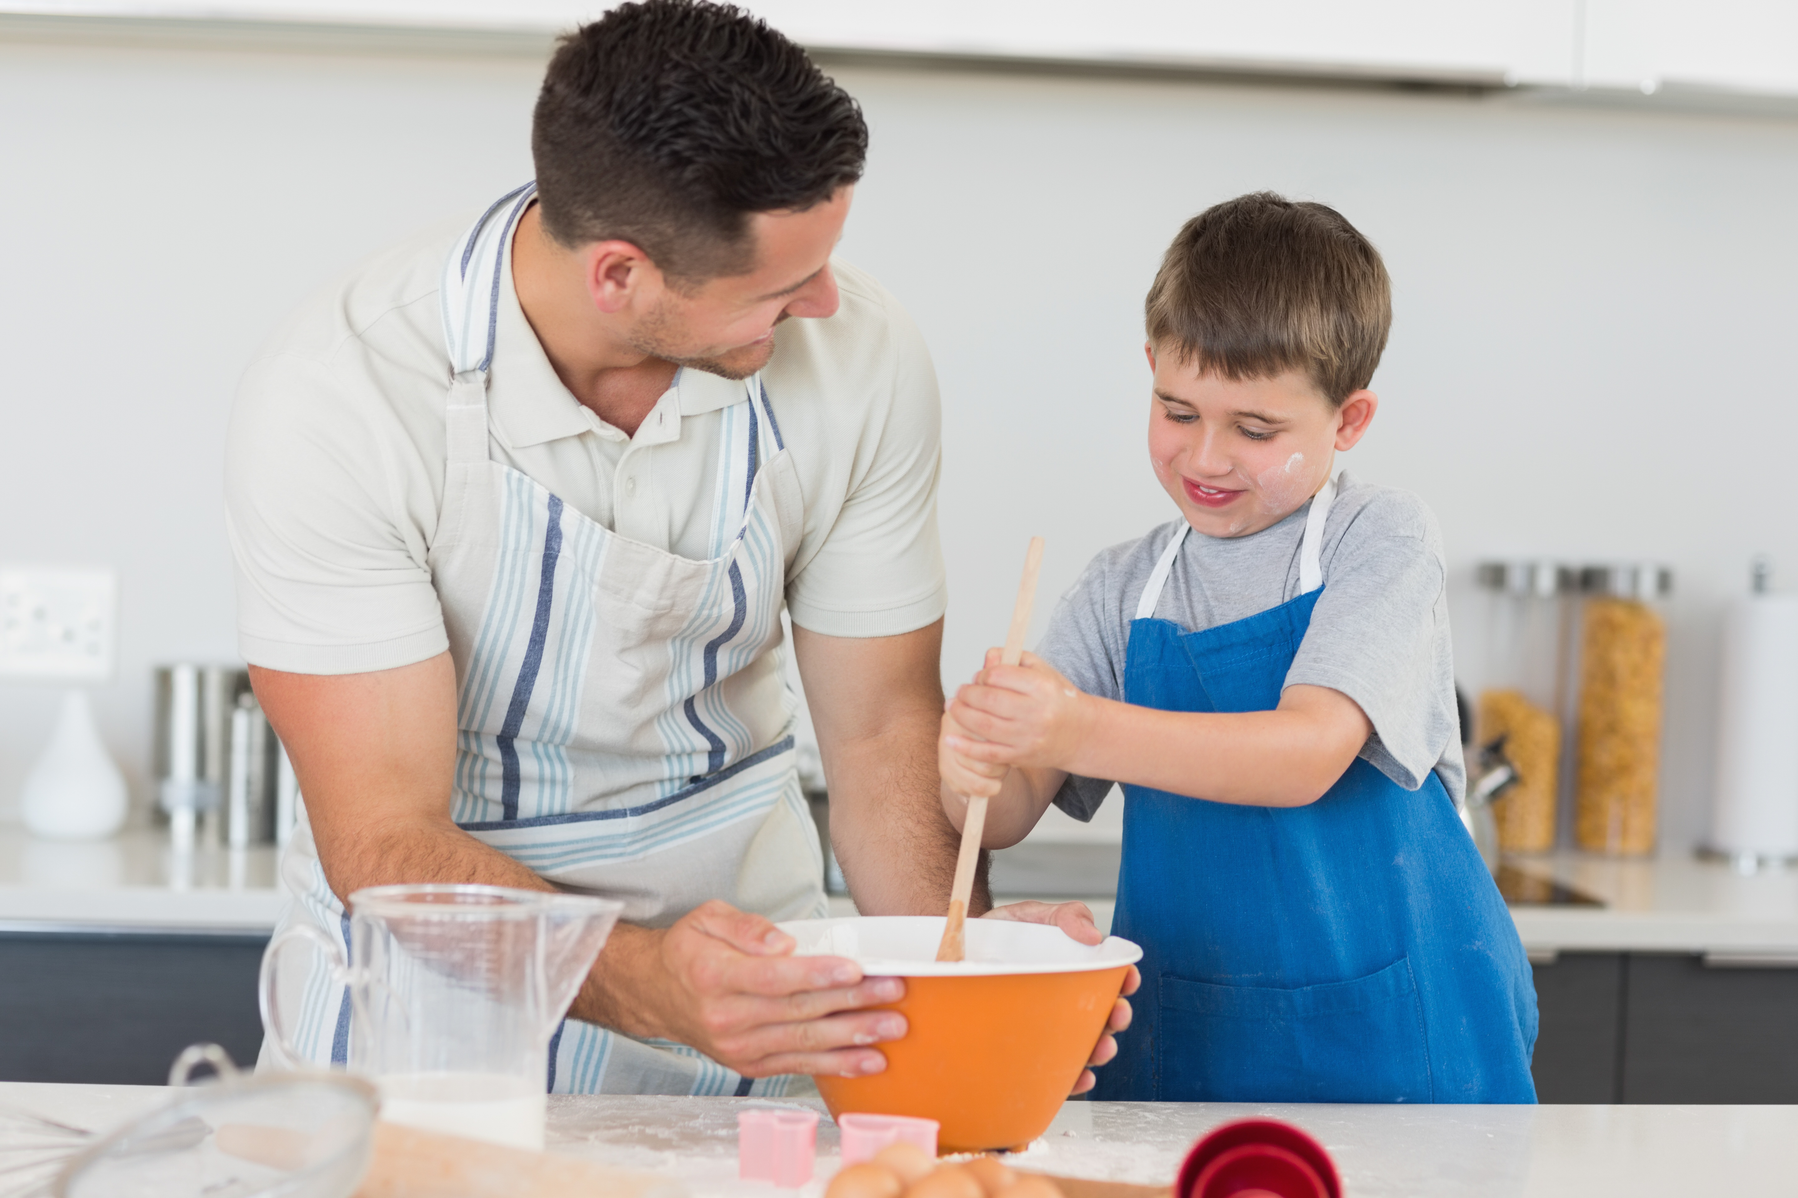
How can you help?
Make sure homework is completed and revisited. It is linked to the objectives covered in class so this reinforcement is crucial.
Share the learning process: do not be afraid of finding out together:
http://www.dasp.org.uk/DASPMaths/mathsvideo.html
Cook and/or bake together – measuring, timing, proportion… If this is a recipe for 4 people, how can we bake for 6?
Make something – e.g. a book shelf: calculate lengths, weights, amounts of materials required.
Talk about time, e.g. How long is it until lunch time? The journey takes 2½ hours, when will we arrive? We need to be there at 2.00 pm, when do we need to leave home? What is that in 24 hour clock? Read timetables and TV listings.

Slide 15

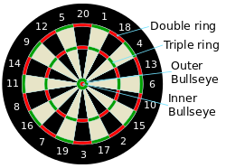
How can you help?
Handle amounts of money when shopping: work out total costs, work out change & check receipts. Work out prices of sale items e.g. 20% off.
Work out distances and directions from maps.
Discuss and compare house prices from newspaper house sales pages.
Work out how much petrol will be used on a journey, work out average speed for a journey.
Work out the cost of an ideal holiday using websites and/or brochures.
Play games which involve calculations and strategies: bridge, twenty-one, Scrabble, darts, bowling, snooker, rugby, draughts & chess.
Embrace the WWW and Google!

Slide 16


How can you help?
“The answer is 10 (or any number), what’s the question?”
Possible responses:
8 plus 2
1 million divided by one hundred thousand
5 x 2
25 - 15
2.5 times 4
the number before 11
9999 subtract 9989
the square root of 100
This is a brilliant activity because: there's no failure; it stimulates thinking about and stretching knowledge of numbers and mathematical relationships; it's good fun.

Slide 17

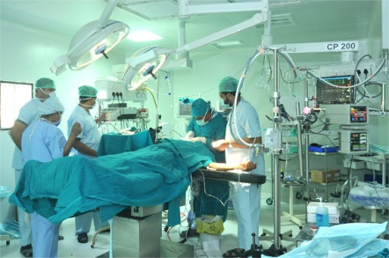

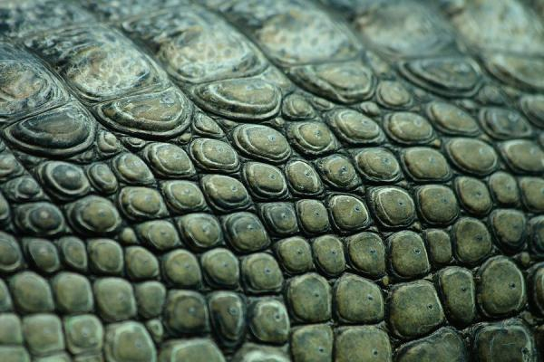
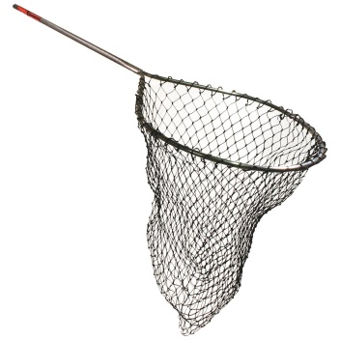

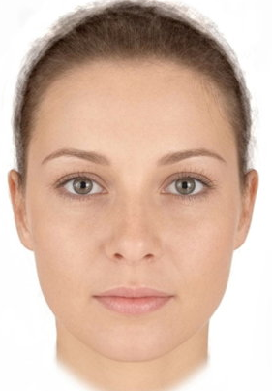
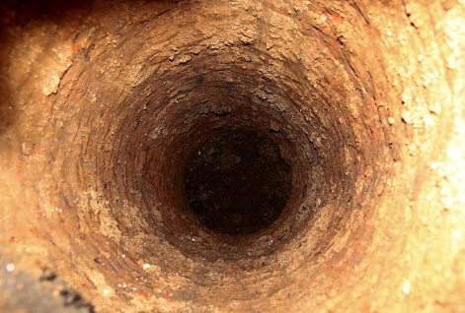

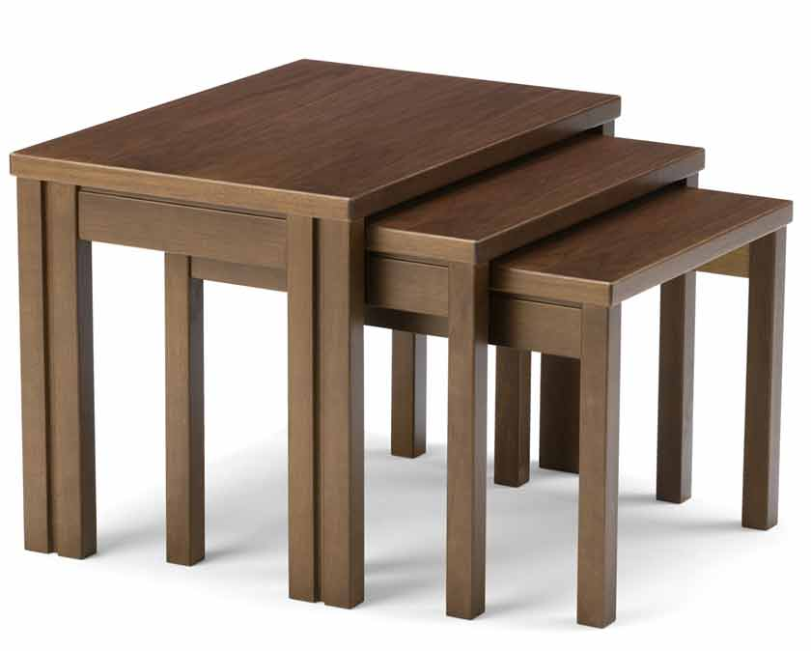
Mathematical Vocabulary
There are a lot of mathematical words that can just completely confuse the children!
6.
5.
1.
2.
3.
4.
net
digits
operation
key
scales
7.
face
8.
pair
9.
whole
the difference
10.
tables

Slide 18
Mathematical vocabulary
It is so important to take the time to explain mathematical vocabulary to avoid misconceptions.
Use every opportunity to use maths vocab so the children hear it regularly.

Slide 19


Useful websites
https://mathsframe.co.uk/en/resources/category/22/most-popular
https://www.topmarks.co.uk/maths-games/7-11-years/problem-solving
http://everydaymath.uchicago.edu/parents/ (Y5 approx. 4th Grade Y6 approx. 5th Grade)
http://www.crickweb.co.uk/ks2numeracy.html
http://primarygamesarena.com/Years/Year-5 http://primarygamesarena.com/Years/Year-6
https://uk.ixl.com/math/year-5
https://uk.ixl.com/math/year-6
https://claritymaths.uk/games/
http://www.math-exercises-for-kids.com/mathematics-10.htm
http://www.mathsphere.co.uk/resources/MathSphereFreeResourcesBoardgames.htm
https://nrich.maths.org/primary-upper
http://www.transum.org/Software/Fun_Maths/

Slide 20




Activity time
Explore a range of activities using fluency, reasoning and problem solving:
Fluency: DS Lites – Calculations x20 & Time Lapse
Fluency: Number Search – Find 20 (Y5) & 24 (Y6)
Reasoning: Matchstick Challenge; Board Games – 31 & Thirty Up
Reasoning & Problem Solving: Presents, Three Digits, Maze, Flash Harry & Age Old Problems
Y5
Y6

Slide 21
Thank-you!
dunnstreetprimary.co.uk

