Slide 1
Year 10 Parent/Carer Information Evening
Parents in Partnership
PiP
5.30pm Thursday 25th February 2016

Slide 2
Year 10 – where are we currently at?
First set of mock results completed prior to half-term, you have just been provided with the results for your child. There will be another set of mock results in June 2016, as they start their year 11 timetable.
Following the mocks they’ve just done the decision has been made that a group of students will take their Religious Education GCSE at the end of this academic year. Well done!
There will also be a group of students taking their Biology GCSE which is great news too!

Slide 4
Points to improve …
Completion of home-learning. Staff need to be better at setting and monitoring home-learning. Students must be working at home to consolidate the work studied in school, this will ensure the best possible outcomes in the final exams.
Students and parents need to be aware of both targets and progress (the information that you received tonight) This will be shared with you on a termly basis.
Clearer guidance for students on how to improve grades – steps in learning
Guidance for parents and carers on how to support their children’s learning.
Support for students in creating a timeline (not a revision plan) to manage their time.

Slide 5
Home Learning
Year 10 - Learning Journals
This specially created workbook has been designed for pupils to write their home learning in one place and will be a valuable revision resource in preparation for their exams.
Pupils are expected to spend approximately 45 minutes per week, per subject summarising their learning from their recent lessons. This is approximately 1 hour 30 minutes each night.
Additional home learning - teachers may set additional home learning tasks where necessary such as developing performance skills in Dance, Music and Drama etc.

Slide 6
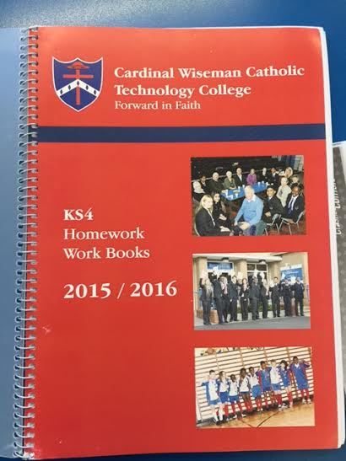
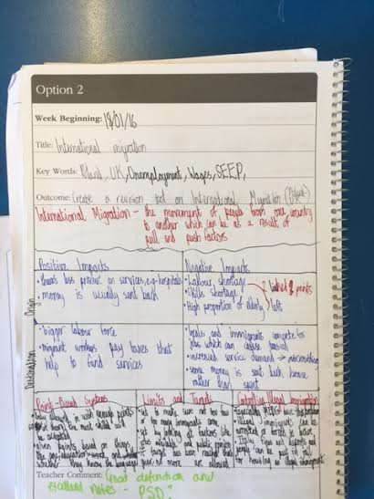
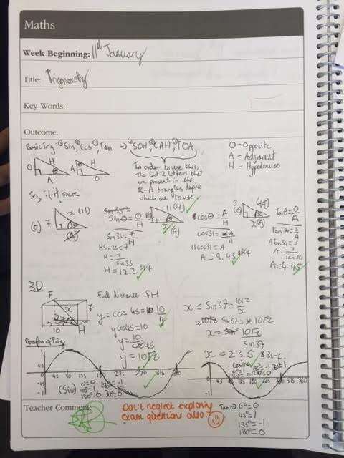
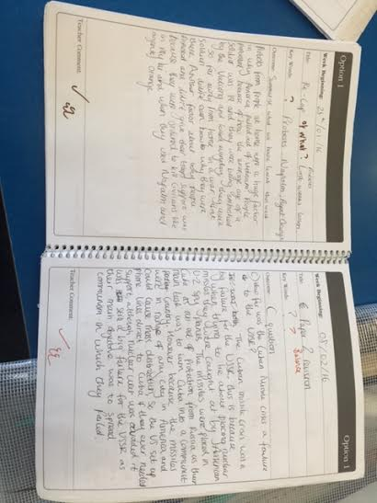

Slide 8
Mrs Meersand
Head Of Year 10 & 11
My role - high expectations – attendance, behaviour and work ethic.
Academic and pastoral support
Careers - aspirations

Slide 9
What is to come?
Careers Fair
Application to Sixth form/College/Apprenticeships
Personal statement writing
1 to 1 mentoring
Sixth form/college presentation assemblies
A Level taster sessions
College trips to try courses
Revision techniques
Examination technique building
Revision sessions after school

Slide 10
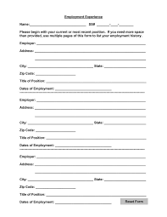
On the horizon…
Year 10 aspirations parent information evening – summer term
Work experience opportunities

Slide 11
How can you help?
Having shared expectations/setting goals
Home revision support
Sixth Form/College Open Evenings (October/November)
Home/school communication
Positivity and encouragement!
We thank you for your ongoing support.

Slide 12
English language & literature
English language paper 1 – 19th and 20th century fiction text analysis and then imaginative writing (narrative or descriptive)
English language paper 2 – 19th and 20th century non-fiction text analysis and comparison and then transactional writing
English literature paper 1 – Romeo and Juliet and Jekyll and Hyde
English literature paper 2 – An Inspector Calls and poetry
All year 11 students take 4 examinations. There is no coursework. Grade based on final exams.
Literature - No copies of the texts in the examinations. - Students will get an extract for the Romeo and Juliet question
- Students must discuss context
- One of the poems studied will be printed on the exam paper but the poem they compare it to will not
Language
New linear structure – progressively harder
50% reading and 50% writing
Analyse language, structure and form within unseen texts

Slide 13
How can you support your child?
Rea read the exam novels and discuss the characters and themes. Develop a clear understanding. With no texts in the examination it is vital they know the text inside out
Completion their weekly homework and journal activities
Catching up on missed work is vital
Re-read the poems and discuss. Use key notes cards.
Encourage active research into the context of the texts being studied. A better understanding of themes and events will be gained.
Completion of practice answers and exam papers.
Read widely. The more they read, the better at writing they will become. They should read anything and everything.
Use online revision sites such as BBC Bitesize to help them revise
Watching film or theatre adaptations can be useful in cementing understanding.

Slide 14
Mathematics 100% Exam Students take three Exams:-
Paper 1 – Non-Calculator
1 hour and 30 minutes
Paper 2 – Calculator
1 hour and 30 minutes
Paper 3 – Calculator
1 hour and 30 minutes

Slide 15
How can you support your child?
Ensure your child completes their weekly learning journal entry.
Ensure your child is regularly using online resources to consolidate and extend their learning such as:
www.mathswatchvle.com which the school subscribes to.
www.corbettmaths.com
Ensure your child is utilising opportunities for extra-Mathematics during KS4 lunchtime.
Support your child with completing practice exam papers, using the mark scheme so as to better understand where marks are available.
Promote a positive attitude towards Maths by believing in and encouraging your child in their ability.

Slide 16
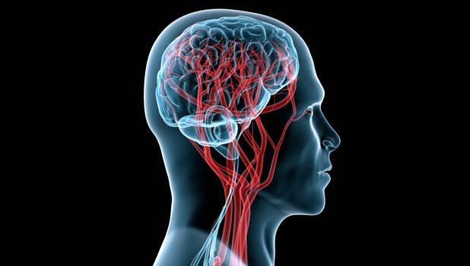
Science
There are currently 2 routes in science;
3 separate Science GCSE’s [Biology, Chemistry and Physics] | Core and Additional GCSE [2 GCSE’s]
Each GCSE is 25% coursework [3 pieces] | Each GCSE is 25% coursework [2 pieces]
9 x 60 min exams for 9 separate units | 6 x 60 minute exams for 6 separate units
Your child will know which route they are on from their teacher. Some pupils may have the option to sit one GCSE early during the summer.
Notes:
Excellent results
Still lots to do
Weighting of exams – not enough to just know it
How to help – build on great start, homework revision, practice papers

Slide 17
How can you support your child?
Please check your child is completely their weekly revision homework in the home learning journal.
Pupil should have already bought the relevant revision guides [£2.75 each] to help with their revision.
Use the following web address to print off practice papers and mark schemes for your child to complete at home. http://www.aqa.org.uk/exams-administration/exams-guidance/find-past-papers-and-mark-schemes
Ensure your child attends extra revision when offered by the department.
Use the following sites for interactive and online revision ;
https://www.youtube.com/user/myGCSEscience
http://www.bbc.co.uk/schools/gcsebitesize/science/aqa/
Download the CGP AQA Science revision app so your child can test themselves through games and quizzes.

Slide 18
Two Units
RE
Unit 3- Catholic Christianity
3.1- Believing in God
3.2- Matters of Life and Death
3.3-Marriage and family
3.4- Community Cohesion
Unit 8- Religion and Society (Christianity and Islam)
8.1 Rights and Responsibilities
8.2 Environmental and Medical issues
8.3 Peace and Conflict
8.4 Crime and Punishment

Slide 19
Good News!
Unit 3
3.1
3.2
One a, b, c and d question on each of these topics in mock.
3.3
3.4

Slide 20
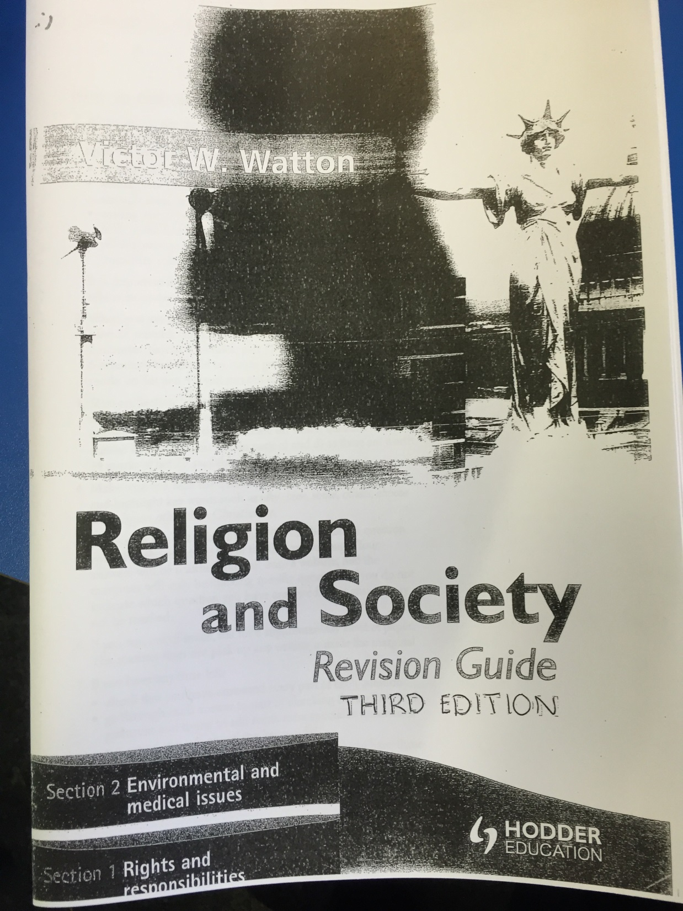
Unit 8
8.1
8.2
One a, b, c and d question on each of these topics in mock.

Slide 21
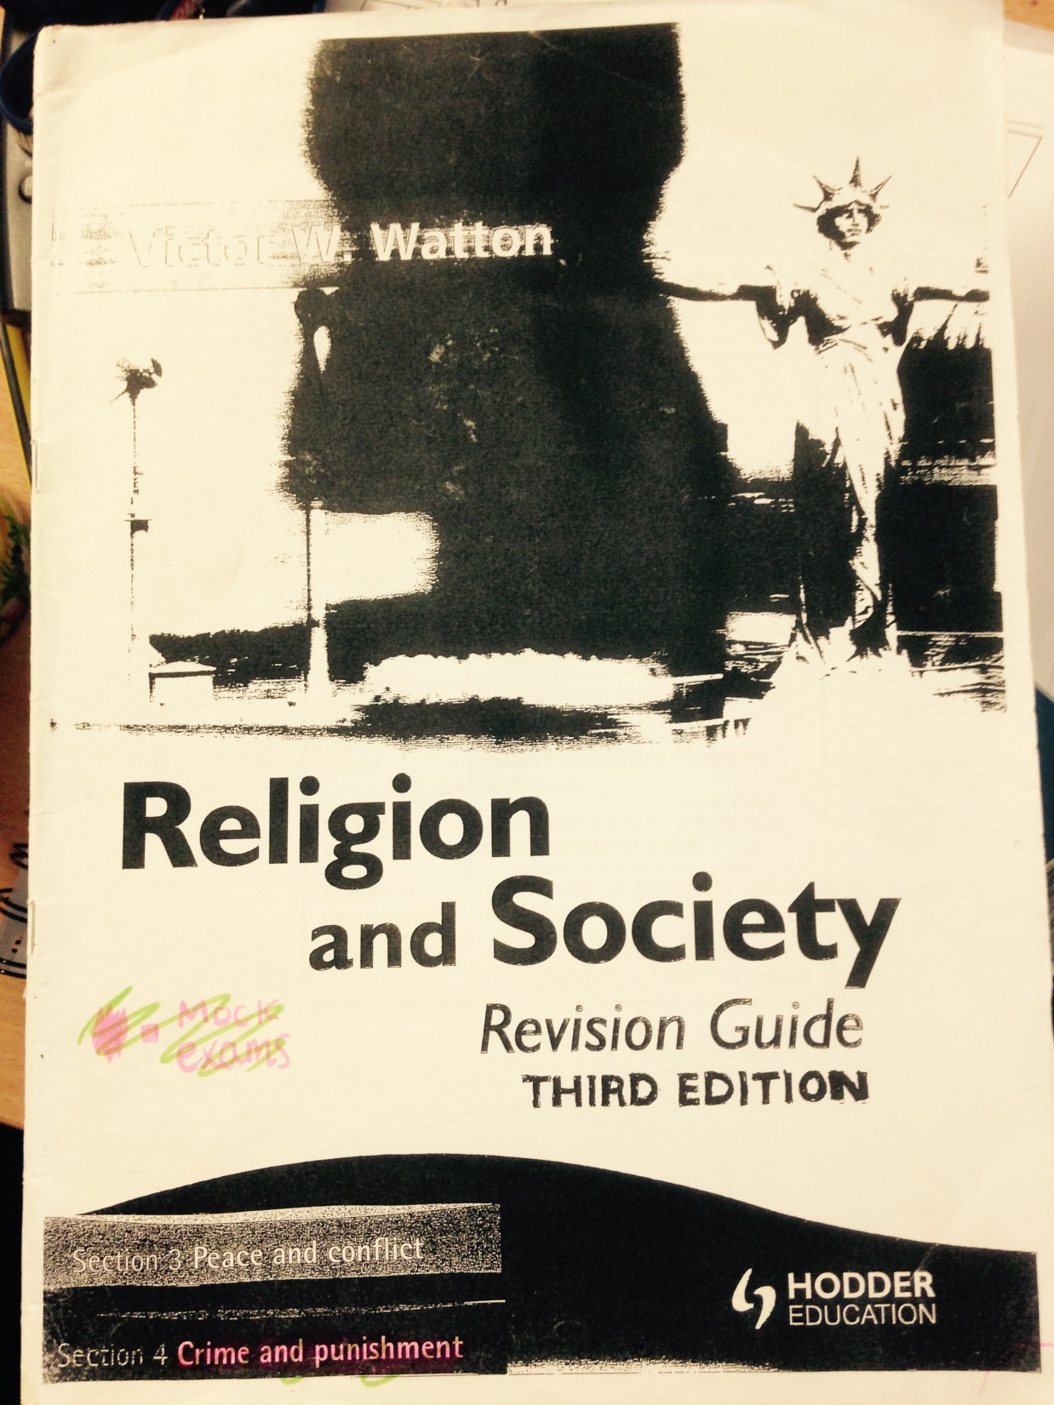
Unit 8
8.3
8.4
One a, b, c and d question on each of these topics in mock.

Slide 22
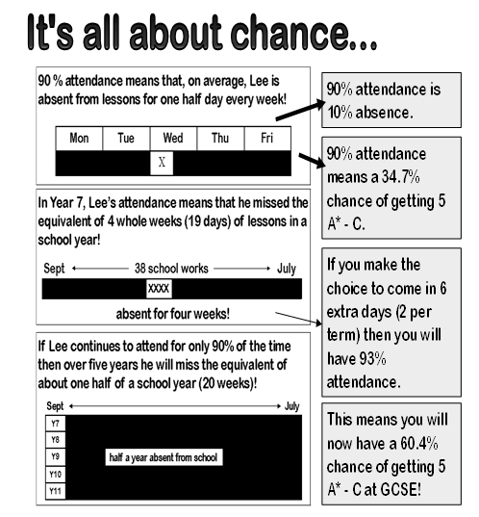

Slide 23
How Can Parents/Carers Help Their Child?

Slide 24
How Can Parents/Carers Help Their Child?
Provide a quiet space to work/concentrate.
Be interested in their education
Having shared expectations/setting goals
Home revision timetable
Communication with school
Encourage your child and be positive!
We thank you for your ongoing support.

