Slide 1
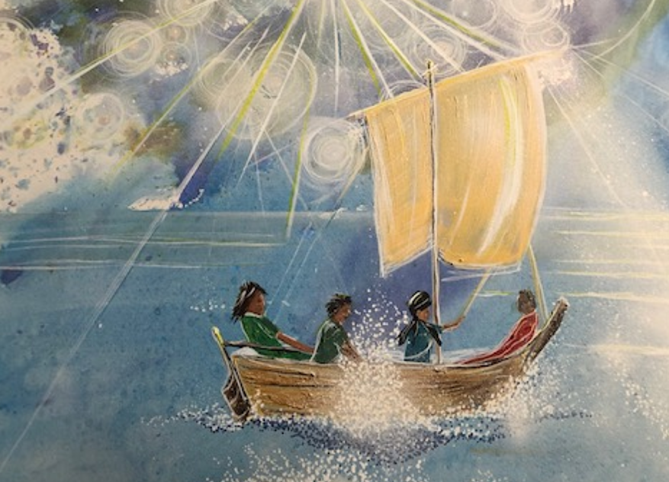

Picture Reflections
Dementia
Staying afloat in the boat

Slide 2
Becoming a dementia friendly school
This worship is designed to be used alongside a dementia awareness event or as part of the introduction to becoming a dementia friendly school.
Please feel free to adapt it as you see fit.

Slide 3

Starter question
Have you ever been in a boat?
What was the boat like?
Where did you go?
Was it stormy or calm?

Slide 4
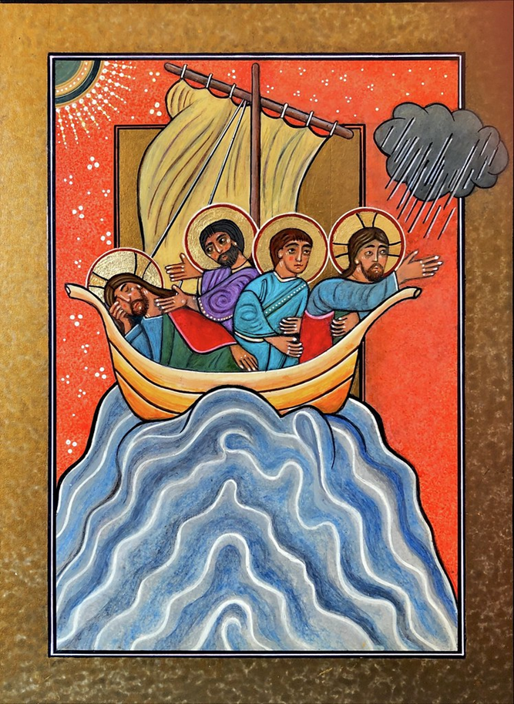

What do you see in the picture?
Can you make a prediction about what we are going to talk about today?

Slide 5
Bible account – Jesus calms the storm
As evening came, Jesus said to his disciples, “Let’s cross to the other side of the lake.” So they took Jesus in the boat and started out, leaving the crowds behind (although other boats followed). But soon a fierce storm came up. High waves were breaking into the boat, and it began to fill with water.
Jesus was sleeping at the back of the boat with his head on a cushion. The disciples woke him up, shouting, “Teacher, don’t you care that we’re going to drown?”

Slide 6
Bible account – Jesus calms the storm
When Jesus woke up, he rebuked the wind and said to the waves, “Silence! Be still!” Suddenly the wind stopped, and there was a great calm. Then he asked them, “Why are you afraid? Do you still have no faith?”
The disciples were absolutely terrified. “Who is this man?” they asked each other. “Even the wind and waves obey him!”

Slide 7

Reflection Time – Storms in our lives…
Imagine if you had been in the boat how would you have felt as the storm became really strong? Remember that some of the disciples were fishermen and so the storm must have been really bad if they had been really scared.
Christians believe that this miracle shows that God is there for us through every storm of life.
What storms might we face?

Slide 8
Reflection Time – Storms in our lives…
For some people in our community one ‘storm’ of life that they might have to weather is when they discover that they are having to live with dementia or someone they love is living with it.
We will be thinking today about what we can be doing to help people to stay afloat if this storm hits their life.

Slide 9
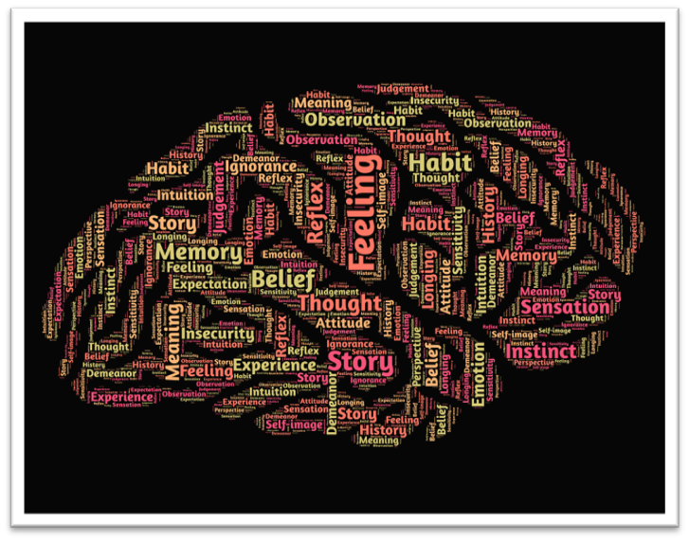
What is dementia?
Dementia is usually associated with getting old BUT not everyone who is old will get dementia and not everyone who gets dementia is old.

Slide 10
What is dementia?
Dementia is a condition or illness that affects the way the person’s brain is working. The brain controls everything that we do and so dementia can cause changes in the way the person thinks, their memory, the way they see things and the way they talk. (Dementia UK)
Planning and organising can be affected. That’s the sort of sequencing that we use when we make a cup of tea or when we get dressed in the morning.
And language is another symptom. So a person may find that they can’t remember certain words.
Perception of objects can change too. So a rug in the middle of the floor – now it may look like a hole, or may be even like water.
And also mood and behaviour can be affected.

Slide 11
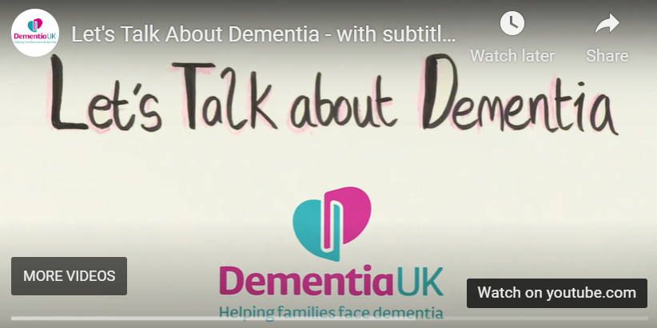
What is dementia? https://www.dementiauk.org/get-support/resources/children/
This is a really helpful video clip created by dementia UK to explain dementia to young people.
https://www.youtube.com/watch?v=lJdLf7gQWJs

Slide 12
Becoming a dementia friendly school
We want:
• ALL IN OUR SCHOOL COMMUNITY (pupils, staff, and families) to be aware of dementia and to understand how to stay in step as patterns change through advancing dementia.
• ALL IN OUR SCHOOL COMMUNITY (pupils, staff, and families) affected by dementia to be welcomed, understood, respected and supported.

Slide 13
Becoming a dementia friendly school
We will be doing this by deciding on three actions that we will work on together:
(NOTE you will need to edit the list to suit your own thoughts)
Learning more about dementia
Working alongside people with dementia in our community
Working with our church to help our community become a more dementia-friendly community
Making our school building more dementia-friendly
Remembering people who are living with dementia in our prayers

Slide 14
If you would like to, join in with this Prayer or sit and think quietly about all we have Talked about today
Dear God,
Thank you for the encouragement of today’s Bible story.
Bless all our schools as places of learning and welcome,
places of compassion and safety,
places of connection and love for all.
Bless us to share small acts of kindness,
so that love for all may be made known
in our community.
AMEN

Slide 15

think…
What can you be doing as an individual to start our work to becoming a dementia friendly school?
Some ideas may include:
You could research for yourself around dementia.
If you know someone who is living with dementia then make them a card to let them know you are thinking about them.
If you are concerned about someone you know who is living with dementia, speak to a member of staff who can listen to you and stand by you.

