Slide 1
Picture Reflections
Equality and Respect

Slide 2
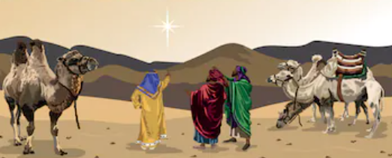

Slide 3


What do you see in the picture?
Can you make a prediction about what we are going to talk about today?
What questions do you have about this picture?
Come up with three questions.

Slide 4
Who should we value most?

Slide 5
Who should we value most?

Slide 6
How do you feel about this story?
What is your one key emotional response word?

Slide 8
Challenge question
Why is it important for us to see beyond the outward and into the heart of a person?
What is dangerous or unfair about judging others from the outside?
What is dangerous or unfair about judging ourselves from the outside?

Slide 9
reflection
It can be easy to judge others by how they look or the clothes that they wear. If we are going to be honest we all do it sometimes. But this can sometimes mean that we misjudge people and it can even lead us to be prejudice against a person and not treating people equally.
There is a saying: ‘Don’t judge a book by its cover.’
If we learn to get to know people rather than judging them from the outside we might all get along much better.

Slide 10

British Values
Respect
We respect others
We know that we are all special
We understand the consequences of our actions
We treat everybody equally
This Photo by Unknown Author is licensed under CC BY-SA

