Slide 1
Picture Reflections
Equality and Respect

Slide 2
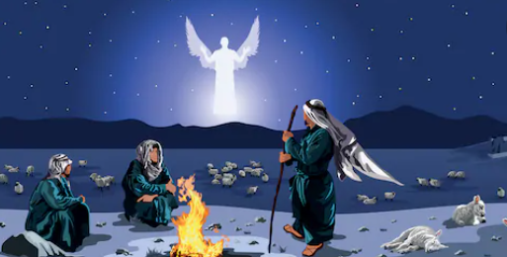

Slide 3


What do you see in the picture?
Can you make a prediction about what we are going to talk about today?
What questions do you have about this picture?
Come up with three questions

Slide 4
A birth is announced
While Joseph and Mary were in Bethlehem, the time came for her to have the baby. She gave birth to her first son. There were no rooms left in the inn. So she wrapped the baby with cloths and laid him in a box where animals are fed.
That night, some shepherds were in the fields nearby watching their sheep. An angel of the Lord stood before them. The glory of the Lord was shining around them, and suddenly they became very frightened. The angel said to them, “Don’t be afraid, because I am bringing you some good news. It will be a joy to all the people. Today your Saviour was born in David’s town. He is Christ, the Lord. This is how you will know him: You will find a baby wrapped in cloths and lying in a feeding box.”
Then a very large group of angels from heaven joined the first angel. All the angels were praising God, saying:
“Give glory to God in heaven,
and on earth let there be peace to the people who please God.”

Slide 5
A birth is announced
Then the angels left the shepherds and went back to heaven. The shepherds said to each other, “Let us go to Bethlehem and see this thing that has happened. We will see this thing the Lord told us about.”
So the shepherds went quickly and found Mary and Joseph. And the shepherds saw the baby lying in a feeding box. Then they told what the angels had said about this child. Everyone was amazed when they heard what the shepherds said to them. Mary hid these things in her heart; she continued to think about them. Then the shepherds went back to their sheep, praising God and thanking him for everything that they had seen and heard. It was just as the angel had told them.
When the baby was eight days old, he was circumcised, and he was named Jesus. This name had been given by the angel before the baby began to grow inside Mary.

Slide 6
How do you feel about this story?
What is your one key emotional response word?

Slide 7
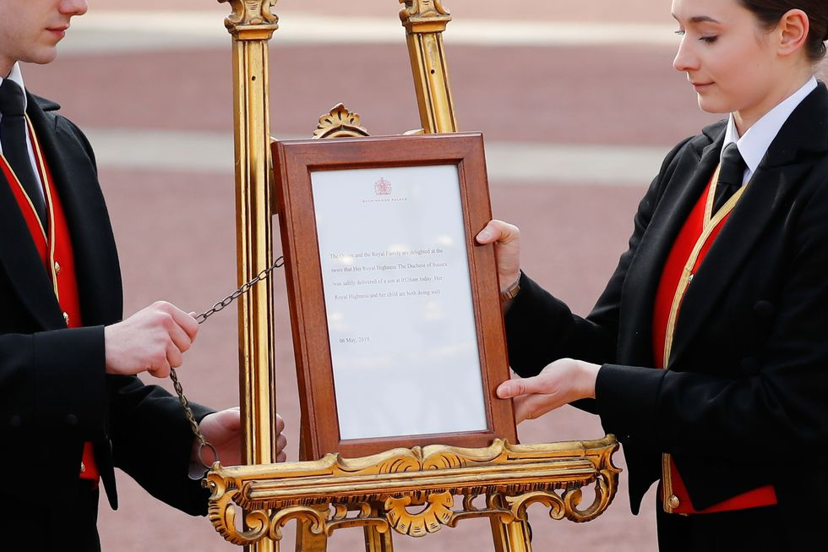
Announcing a Royal birth
A royal birth is announced outside the palace
A royal birth is announced on the hills outside Bethlehem

Slide 8
Why Do you think the shepherds were the first to hear the news about Jesus’ birth?
Though being a shepherd was the most ancient job for the Israelites, it was not one that many people really wanted to do. Being a shepherd was a dirty job, and according to the Bible, at that time, sheep farmers were generally seen as having low or little value by other people. The shepherds were quietly getting on with their own business when suddenly an angel appeared to them. It is not surprising that they were afraid!
This is only the second time in the whole Bible that a group of angels rather than one angel had appeared to people, so this proved that they had a very important message to give to them. We don't know the names of the angels or how many there were of them, but in the Bible it says that there are millions of angels - so it would have been an amazing experience!
Having seen the new baby, the Bible says "...they spread the word concerning what had been told them about this child, and all who heard it were amazed at what the shepherds said to them.“

Slide 9

Challenge question
Why do you think God chose to tell the shepherds before anyone else about Jesus’ birth?
What does this tell you about how God sees all people?

Slide 10
reflection
The shepherds in Luke’s Christmas story don’t make it warm and cuddly. In fact they make it an extraordinary event. When a royal baby is born in the UK, there is a great fuss made. There is an announcement posted outside Buckingham Palace, the newspapers run headlines and reporters gather outside the hospital to get the first photograph. Jesus’ birth was completely the opposite. When God came to earth as a baby we see the world turned upside down. In Luke’s account of the first Christmas the poor, the marginalized, the people without any power or privilege, like the shepherds, are told first about this amazing birth. What is more amazing is that they are told via a host of angels – God’s heavenly messengers are sent to tell these unsuspecting shepherds to most amazing news of all times.
This account of the first Christmas shows how much God values and respects all people. In God’s kingdom there is equality for all.
Who are the downtrodden and forgotten in our society?
What do we learn from this story about how we should treat them?

Slide 11

British Values
Respect
We respect others
We know that we are all special
We understand the consequences of our actions
We treat everybody equally
This Photo by Unknown Author is licensed under CC BY-SA

