Slide 1
Picture Reflections
Mary, Joseph and God incarnate

Slide 2
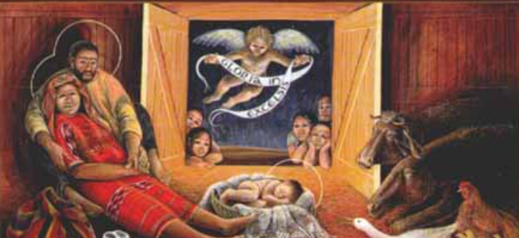

Slide 3
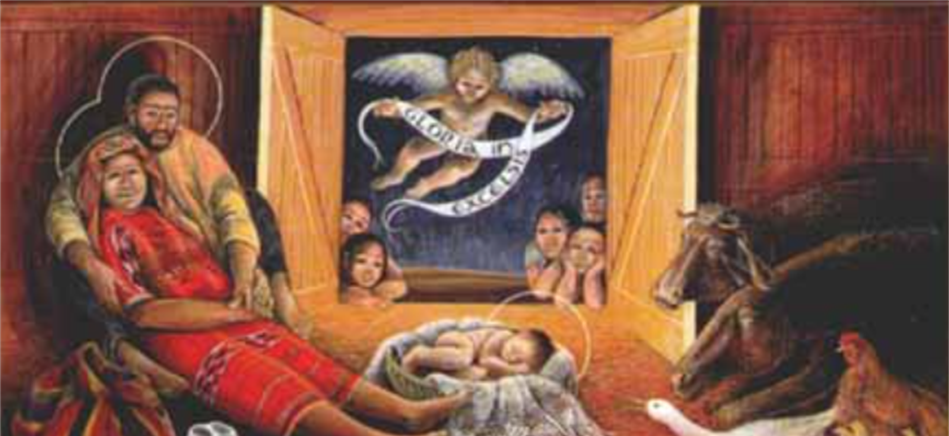

What do you see in the picture?
Can you make a prediction about what we are going to talk about today?
What questions do you have about this picture?
Come up with three questions.

Slide 4
God has no favourites - Equality in the Christmas story
The Birth of Jesus (Luke Chapter 2)
At that time, Augustus Caesar sent an order to all people in the countries that were under Roman rule. The order said that they must list their names in a register. This was the first registration taken while Quirinius was governor of Syria. And everyone went to their own towns to be registered.
So Joseph left Nazareth, a town in Galilee. He went to the town of Bethlehem in Judea. This town was known as the town of David. Joseph went there because he was from the family of David. Joseph registered with Mary because she was engaged to marry him. (Mary was now pregnant.) While Joseph and Mary were in Bethlehem, the time came for her to have the baby. She gave birth to her first son. There were no rooms left in the inn. So she wrapped the baby with cloths and laid him in a box where animals are fed.

Slide 5
How do you feel about this story?
What is your one key emotional response word?

Slide 6
God has no favourites - Equality in the Christmas story
According to the Bible, after Jesus was born, he was wrapped in strips of cloth and placed in a manger. A manger is a feeding trough from which donkeys, horses, and other animals eat. While we usually think the manger was made of wood, the only examples we have left in the Holy Land from ancient times are actually large stones that have been carved out on top to hold straw.
The gospel writer Luke mentions the manger three times in just a few verses as he tells the story of Jesus’ birth. This is unusual and should lead us to ask why. Why does Luke feel it important to tell us about Jesus’ first bed? And why does he mention it three times?
One reason for Christians is that the manger points to Jesus’ humble birth. Christians believe that it points to an amazing truth: that on his first night on this earth, the Son of God, slept in a trough where the animals fed. What a picture of God’s desire to show that he has no favourites. God does not judge a person by wealth or status, He does not have favourites but treats all people equally. This is why Jesus was born on earth in the poorest of situations, giving up all the glory and beauty of heaven.

Slide 7
Challenge question
The Christmas accounts shows that God doesn’t show favourites and treats all people equally.
Why do you think it is important for us to treat all people equally?
How does it make us feel if we are treated unfairly?

Slide 8
reflection
Many of us long to know that we are loved and that we are seen as equal to others. We do not want to be treated unfairly or be seen as different – we want to be respected for who we are. Sadly, however, we can sometimes treat others unfairly and without respect because of where they live, what they look like or where they come from. Christians believe that the Christmas story shows that God doesn’t behave like that and nor should we.

Slide 9

British Values
Respect
We respect others
We know that we are all special
We understand the consequences of our actions
We treat everybody equally
This Photo by Unknown Author is licensed under CC BY-SA

